Slide 1

Shapes Within
A Compostional Idea

Slide 2
Shapes Within
The shape of the image consists of more than the outer frame but also the forms that fill the picture space.
The human face is the reason why Portrait Photography is rewarding because of the structure of the face.
But other topics need more work.

Slide 3
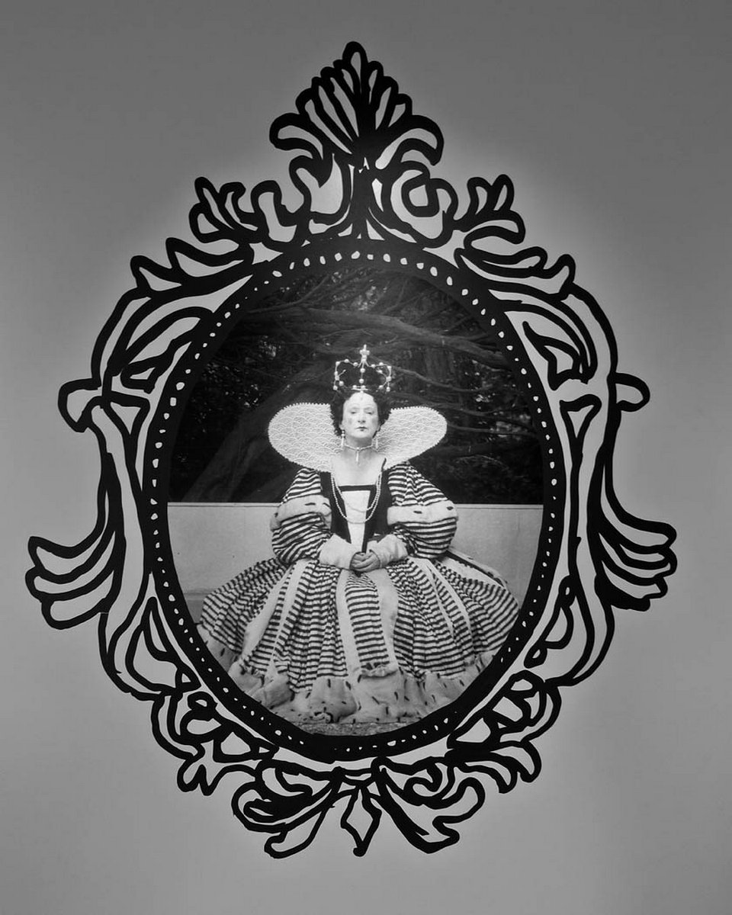
Shapes Within
Here is an example of a frame within and a human face as well.

Slide 4
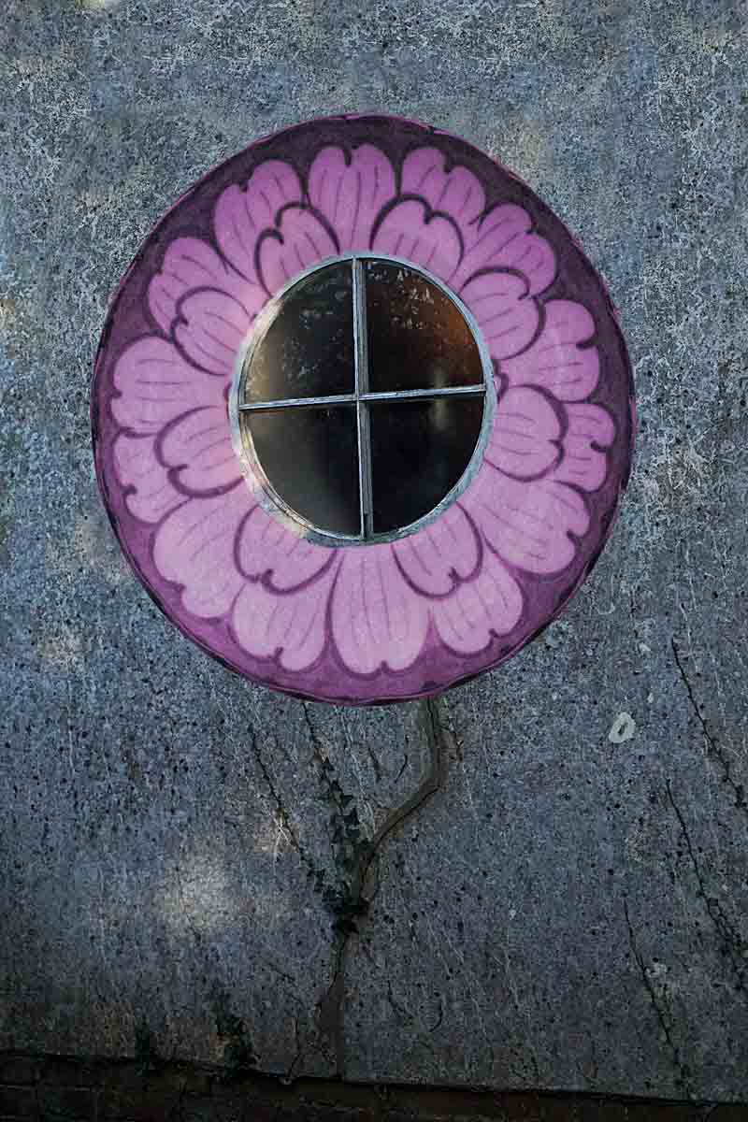
Shapes Within
Here is another idea.
An oval frame with a fancy border and the added bonus of a branched crack that looks like a stem.

Slide 5
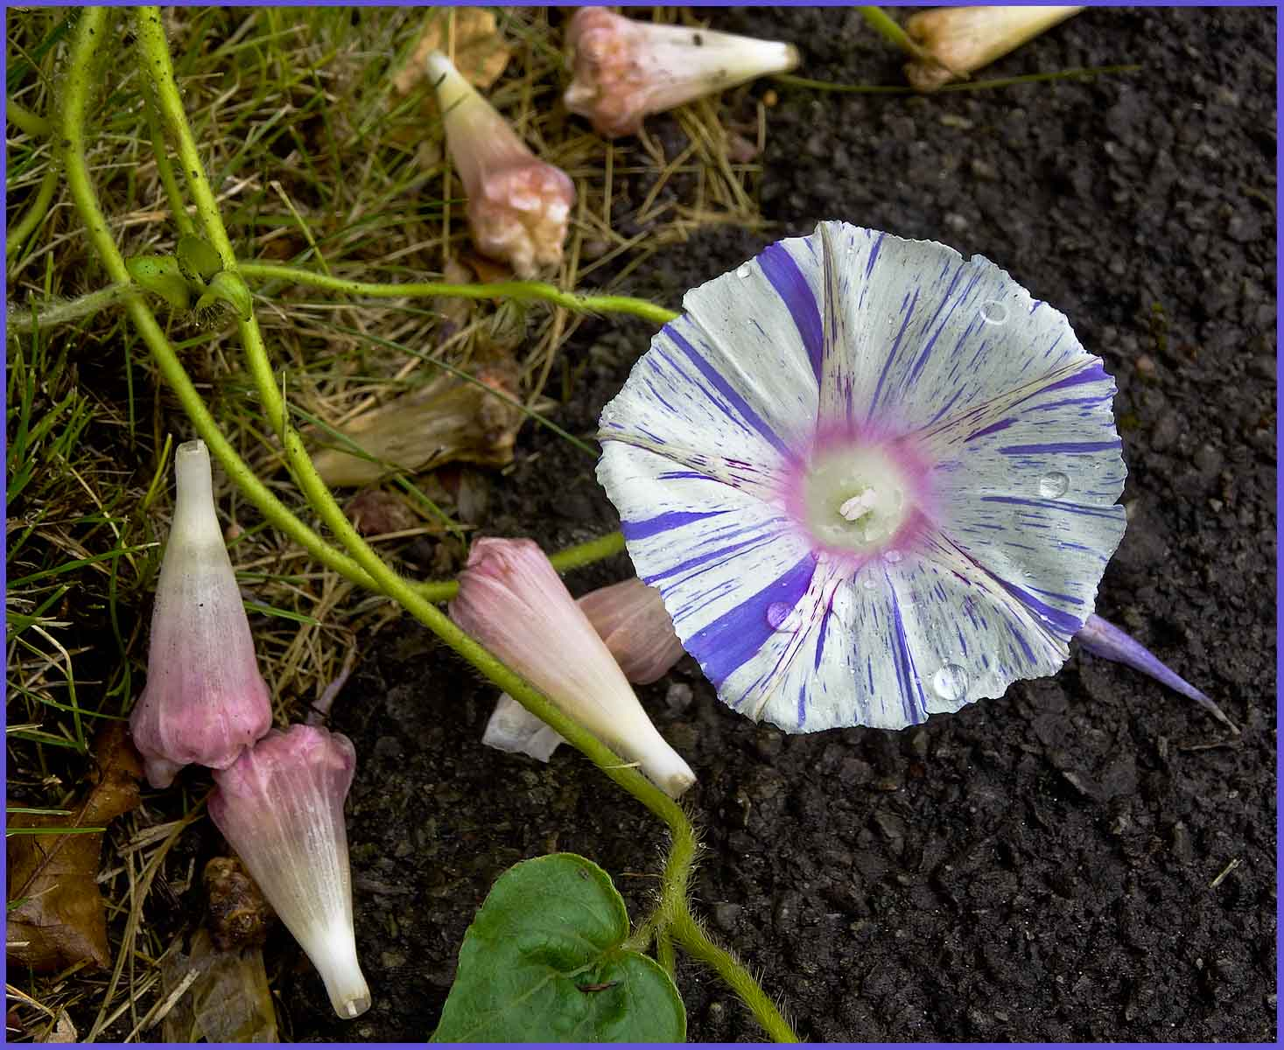
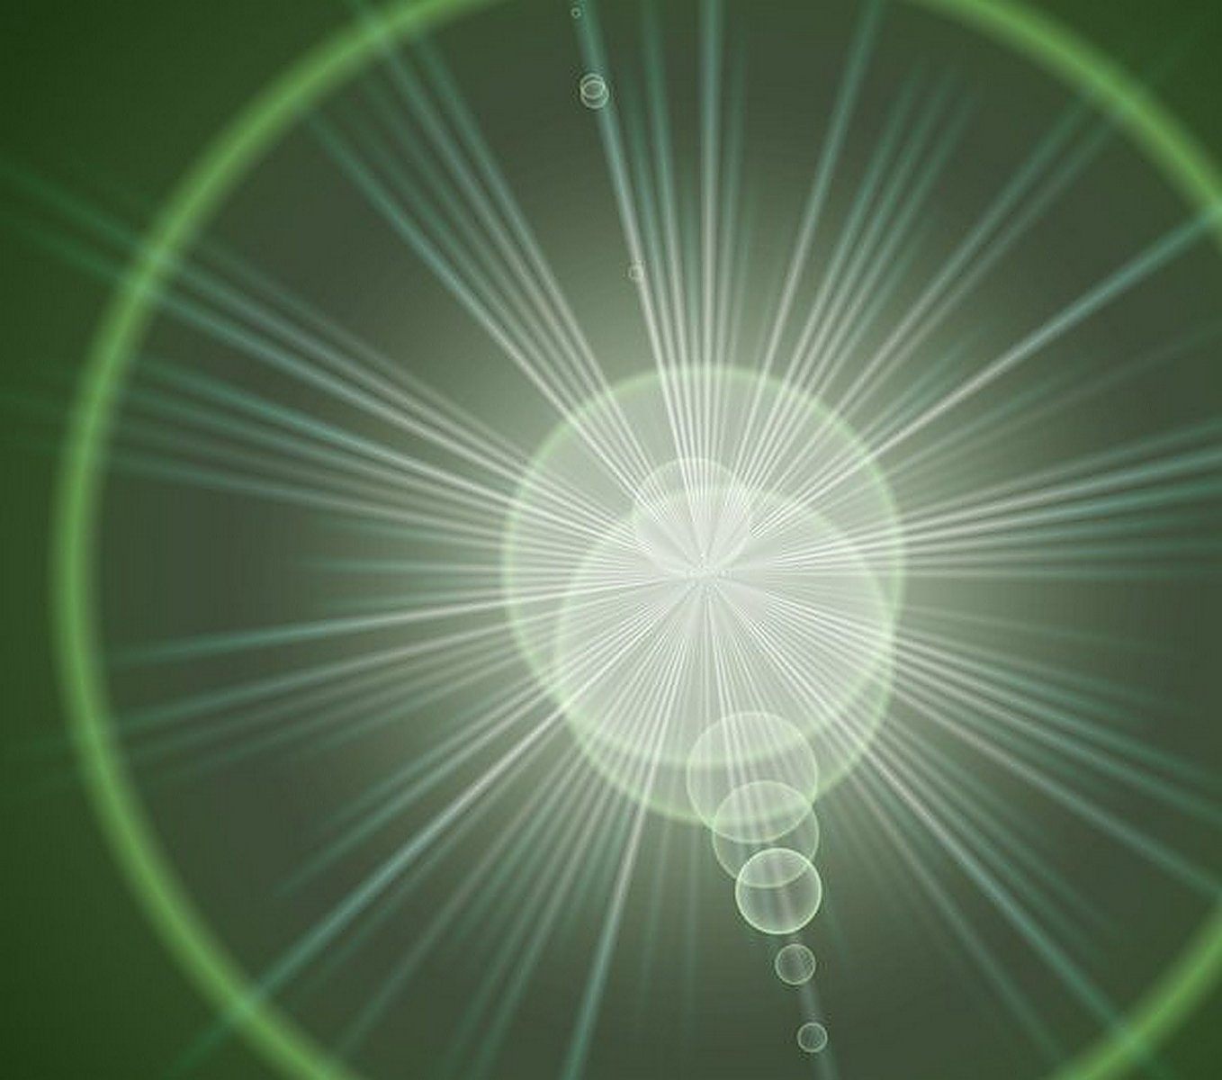
Shapes Within
The Round Theme continues

Slide 6
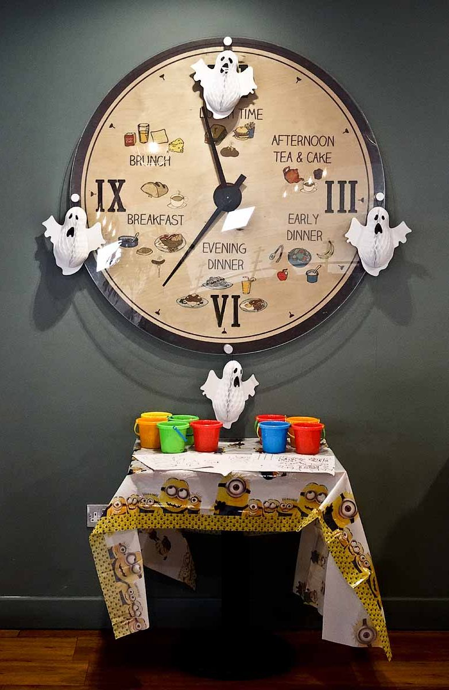
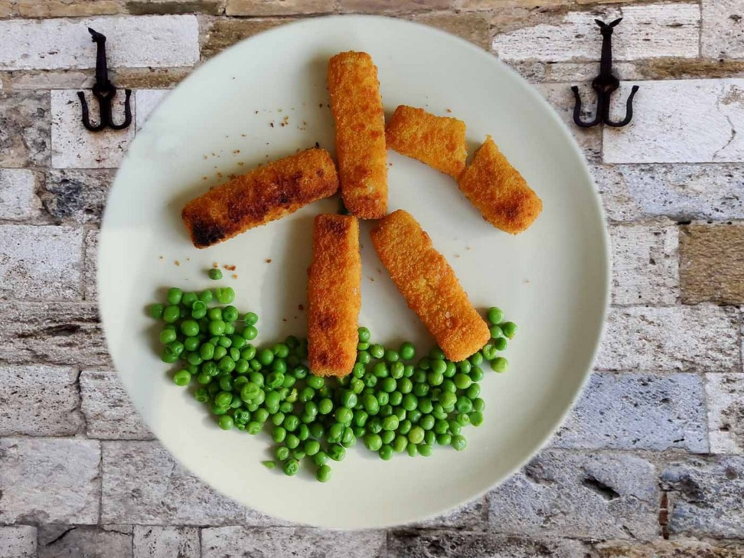
Shapes Within
The Circular Theme carries on

Slide 7
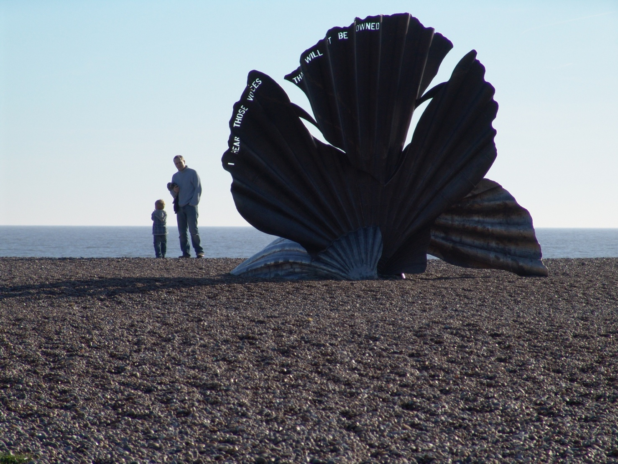
Shapes Within
The circular theme sort of continues here with this famous bronze sculpture on the beach at Aldeburgh, Suffolk

Slide 8
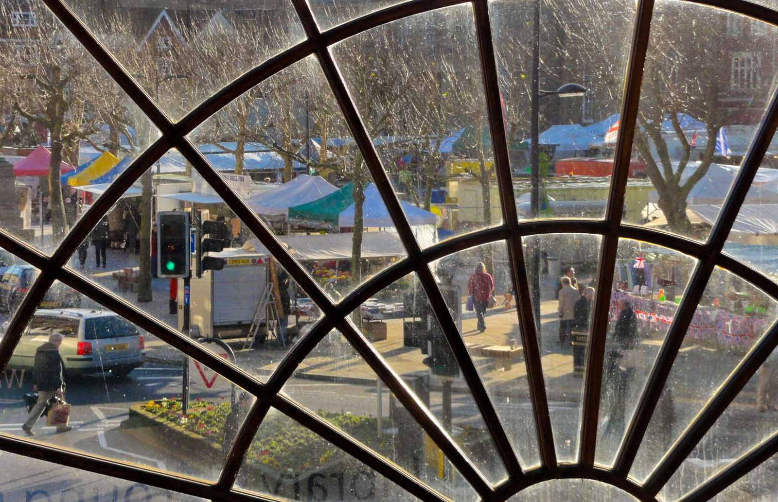
Shapes Within
Here the panes have shapes within such as
the tree or the woman or the traffic light

Slide 9
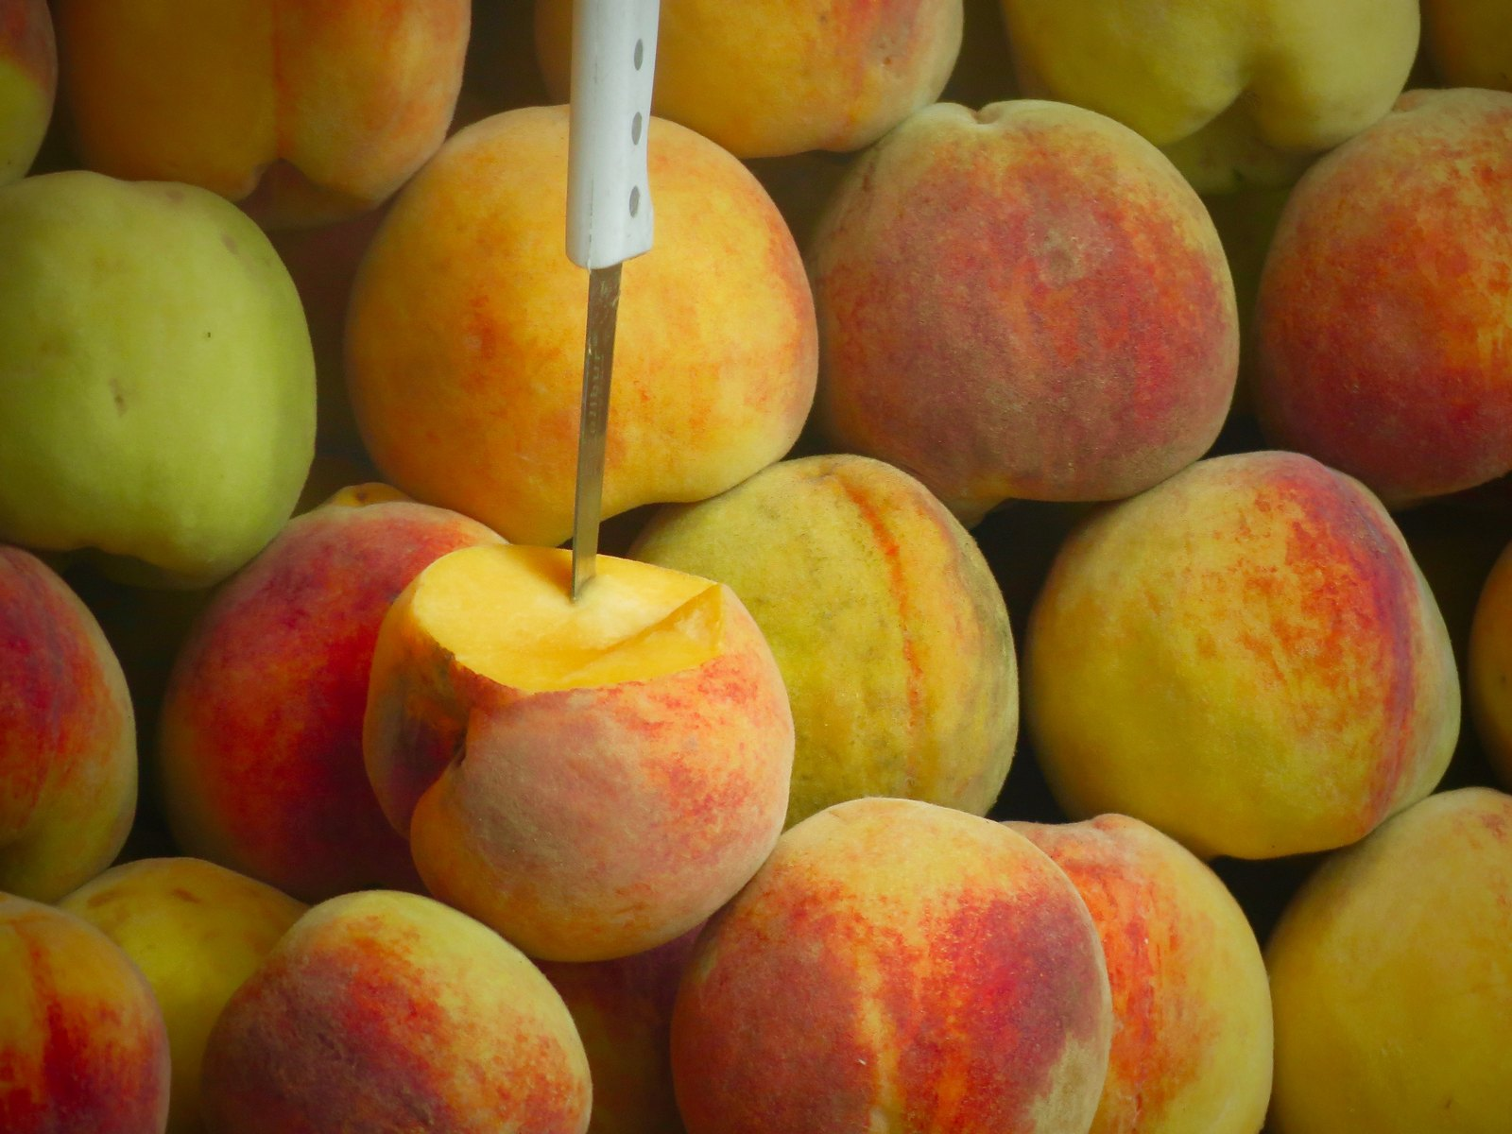
Shapes Within
Perhaps multiple round shapes as in
this peach of a photograph is worthy of a try

Slide 10
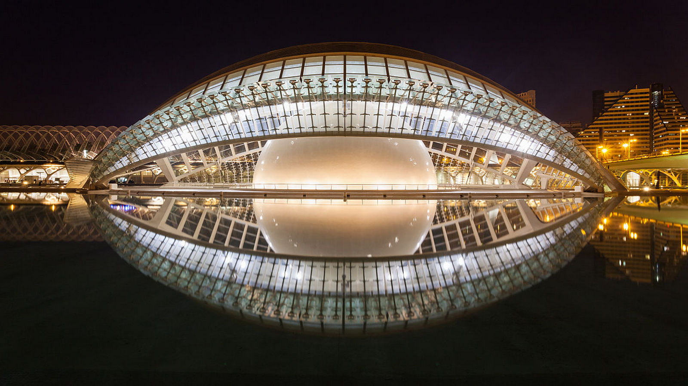
Shapes Within
But why stick to a rounded shape?

Slide 11
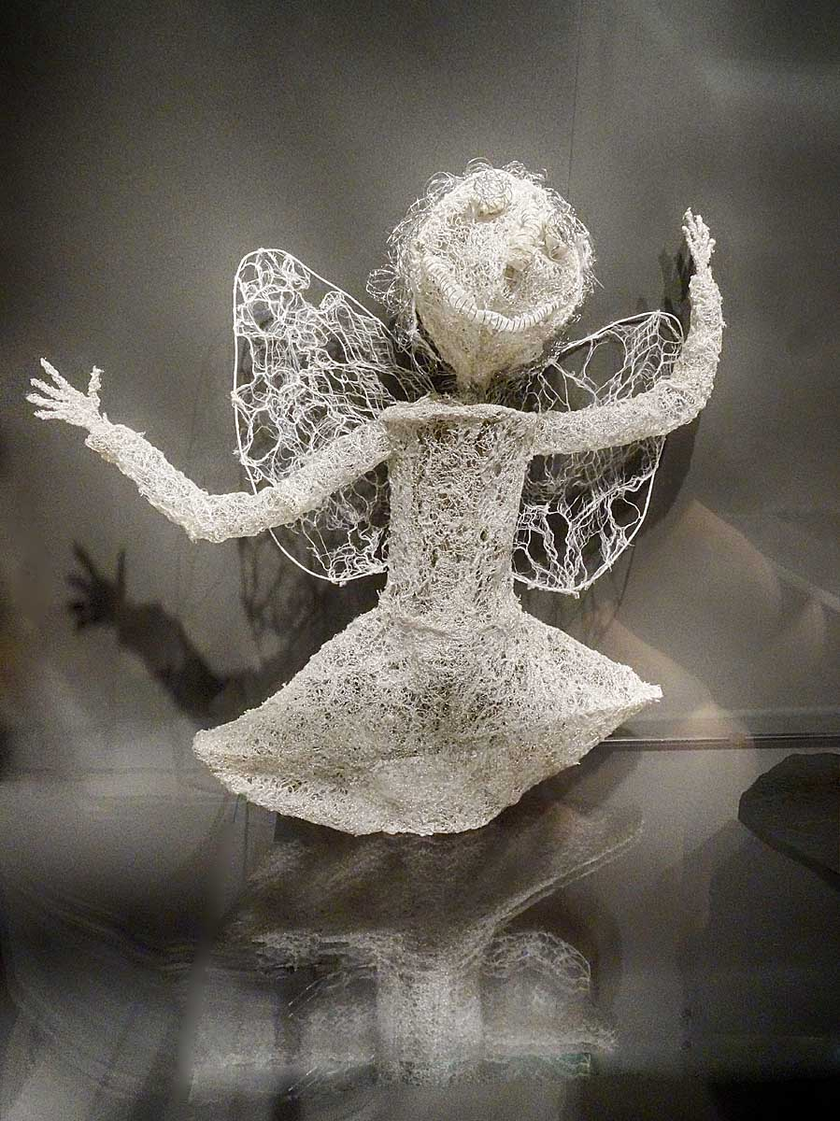
Shapes Within
Here we have another round part in the form of a face

Slide 12
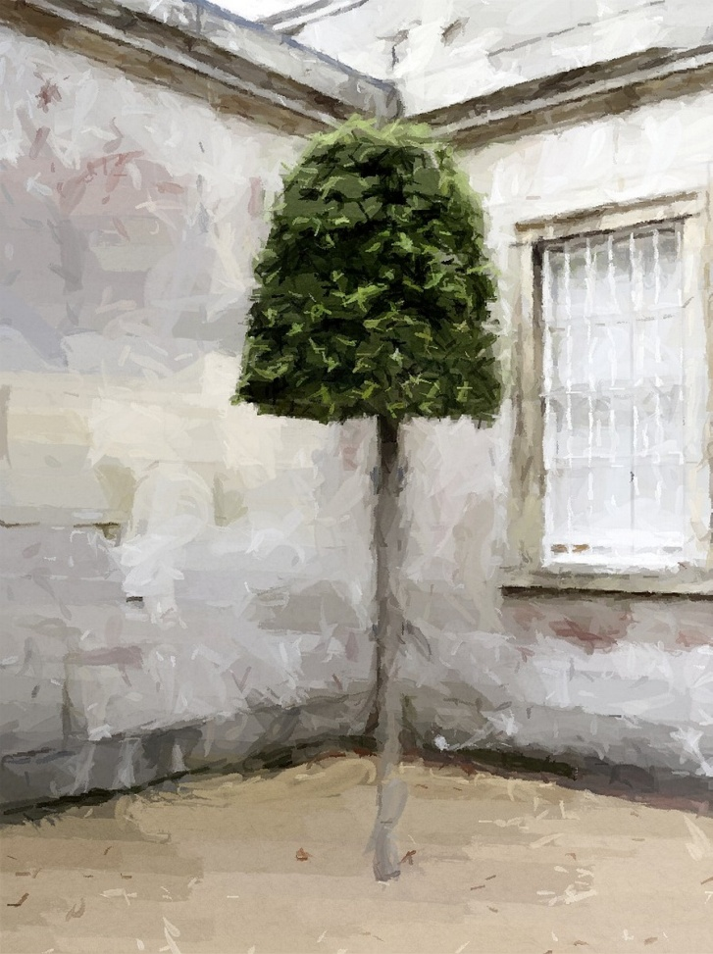
Shapes Within
This tree shape is again rounded and bang in the centre

Slide 13
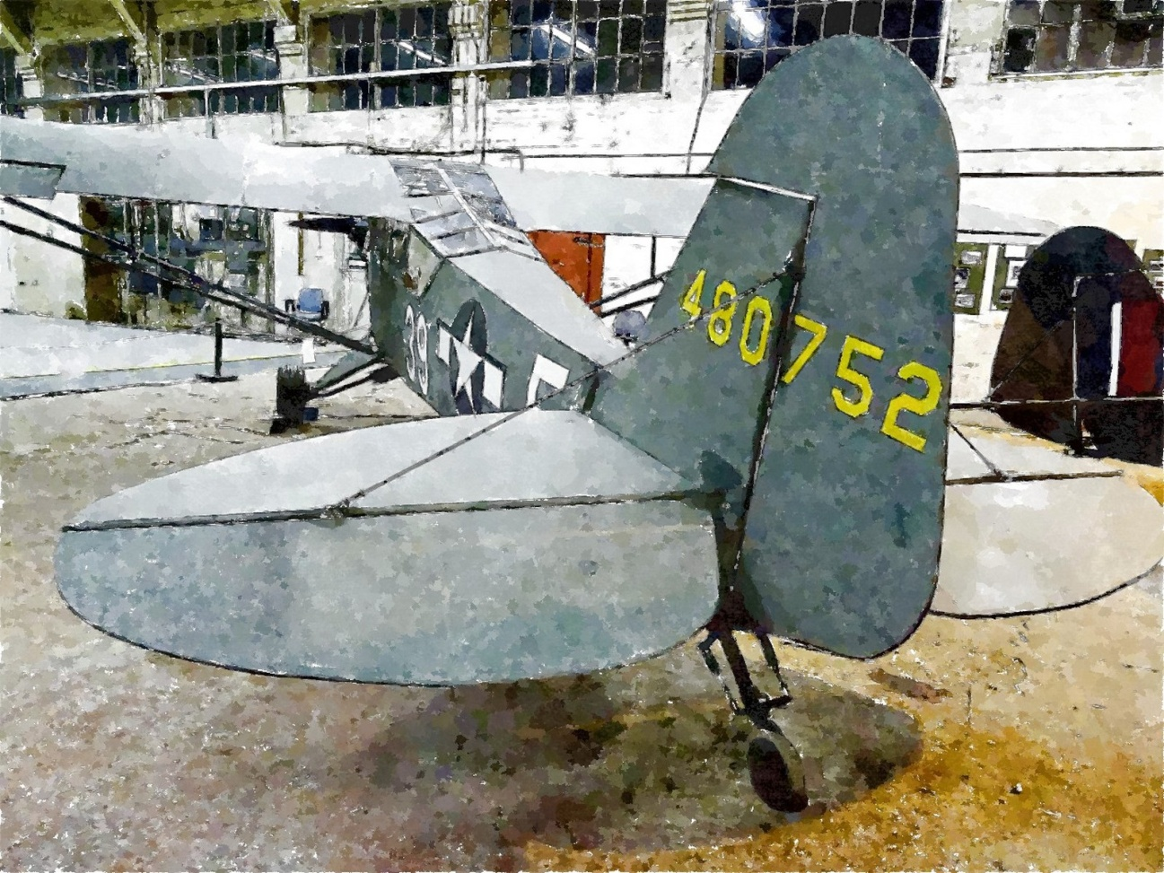
Shapes Within
The aircraft has the interest of the rounded form tail fin

Slide 14
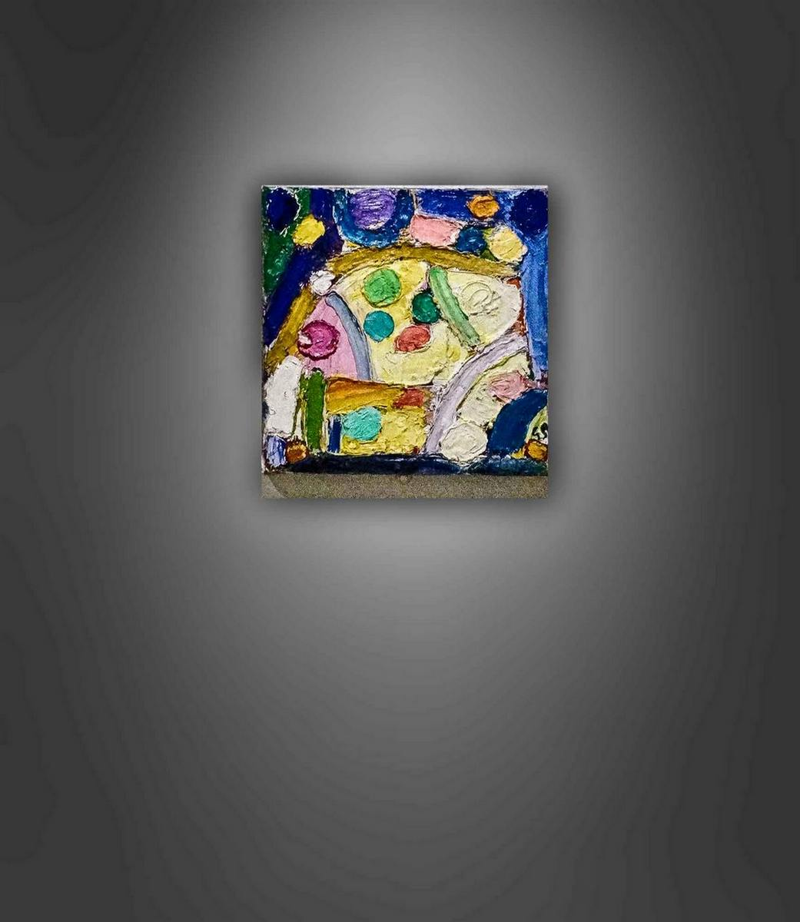
Shapes Within
There is no reason why a square shape is not used as this painting in the spot light shows

Slide 15
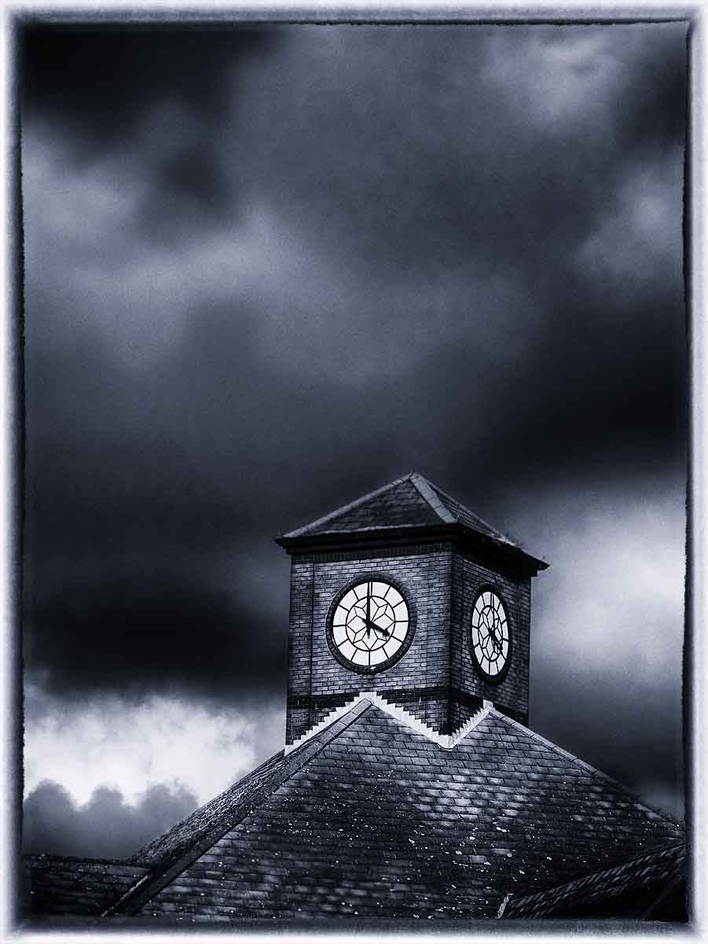
Shapes Within
Another square shape within. The Tesco clock.

Slide 16
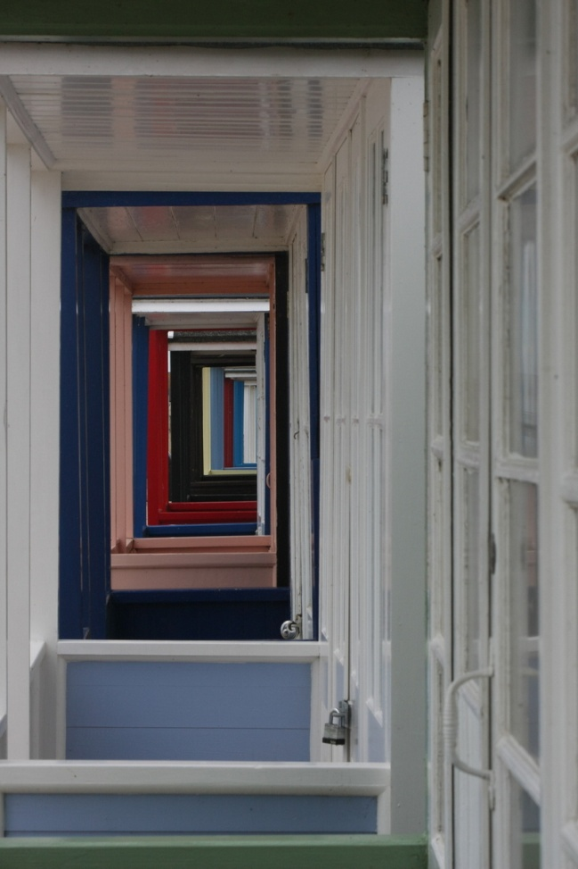
Shapes Within
Or looking down a series of rectangles.

Slide 17
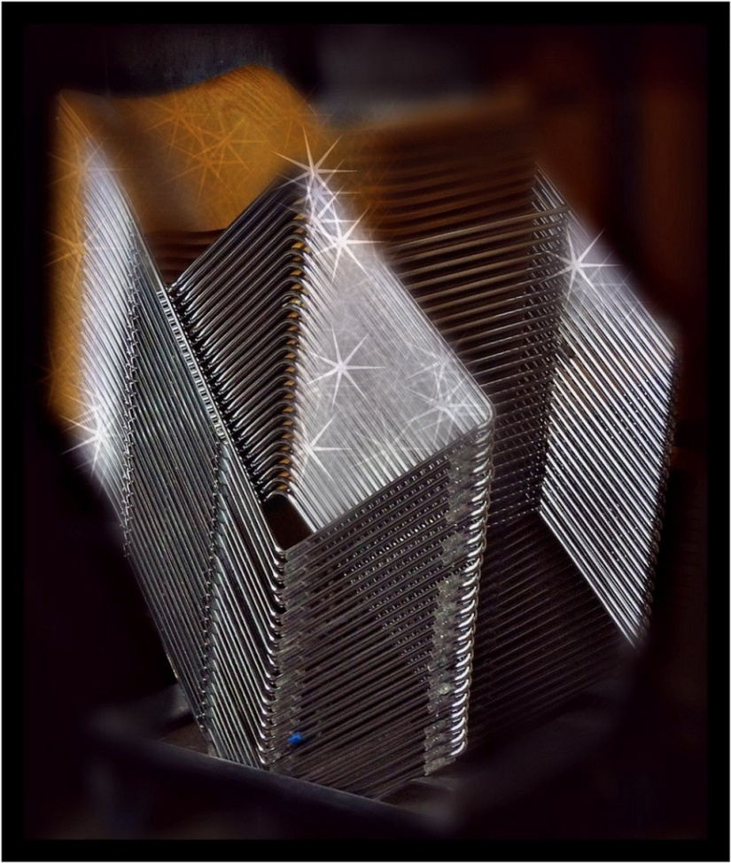
Shapes Within
Or even a set of shiny chairs glinting

Slide 18
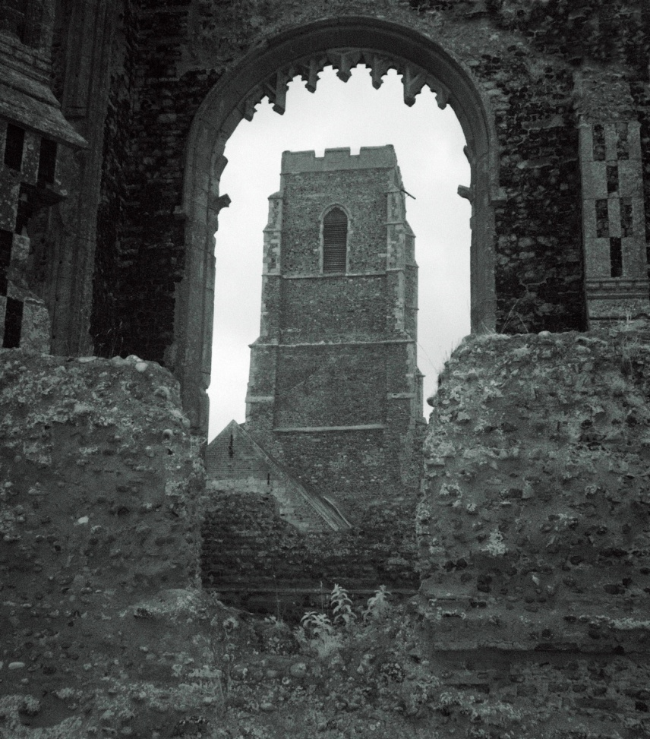
Shapes Within
This is a real life example of a shape within.
This church is built within an older church

Slide 19
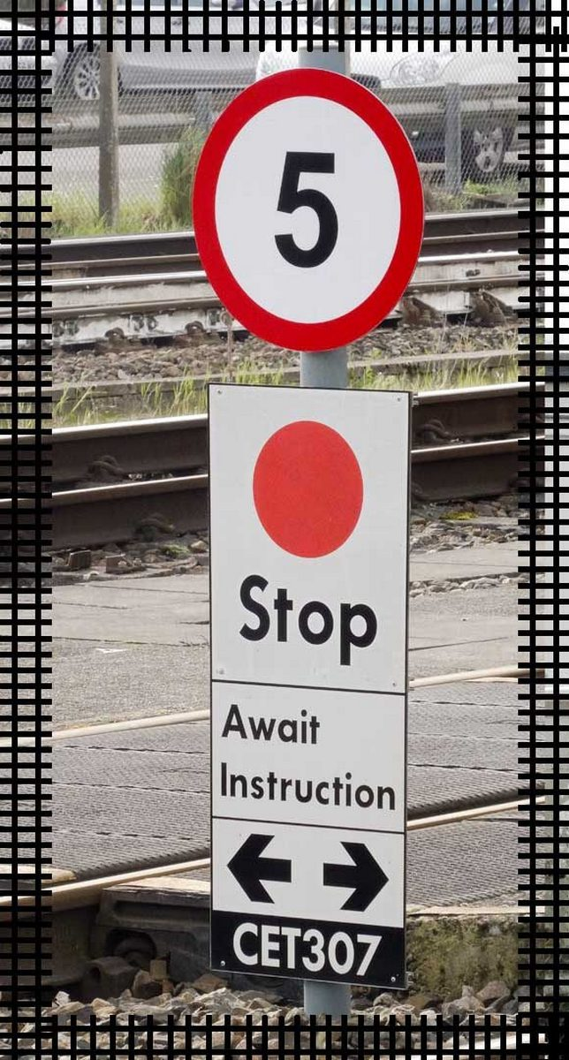
Shapes Within
This is a mixture of round and rectangular
Plus a rail track border

Slide 20
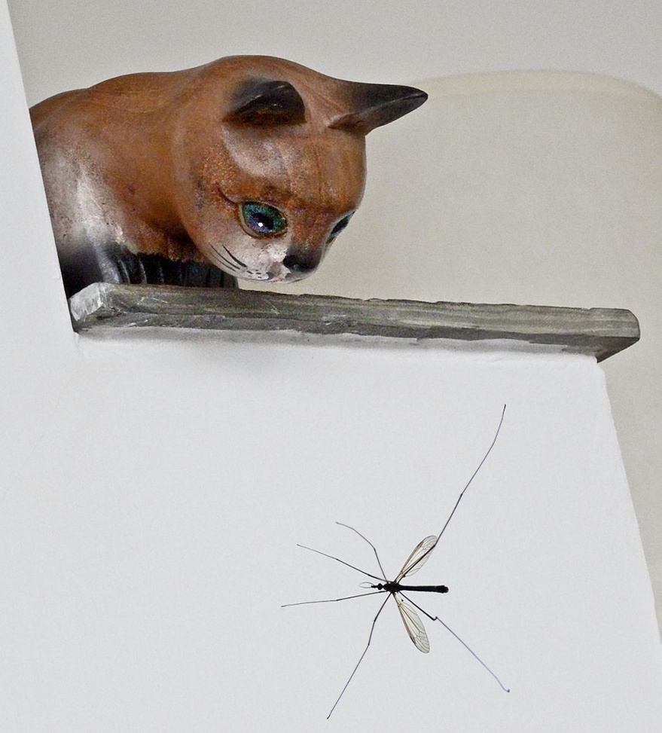
Shapes Within
The daddy long legs shape has all the attention

Slide 21
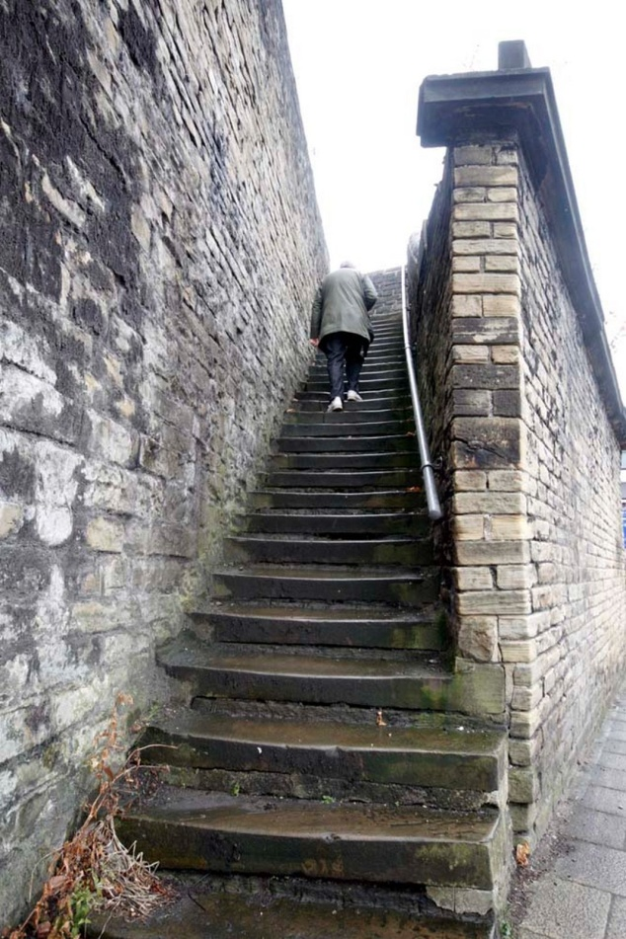
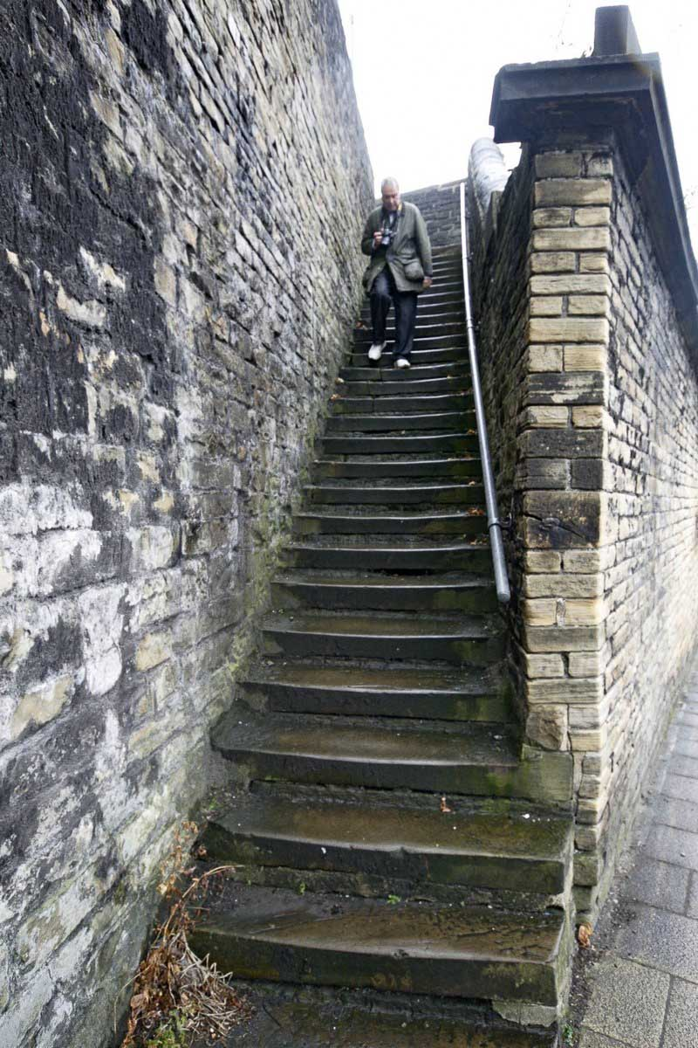
Shapes Within
Up he goes- Quiller in Halifax
And Down again

Slide 22
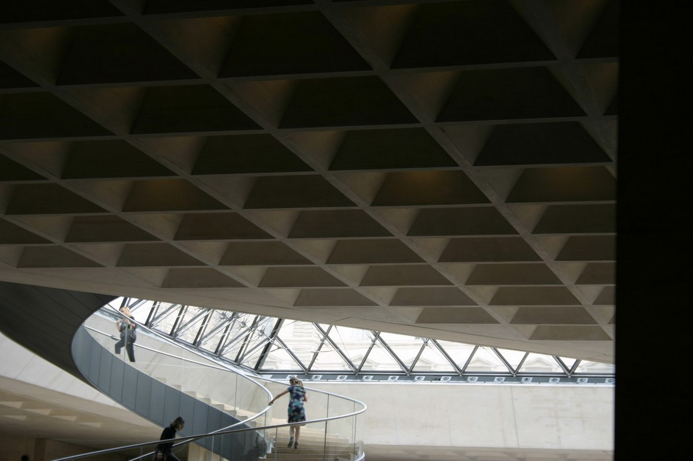
Shapes Within
The curving rails and the light area show us the people

Slide 23
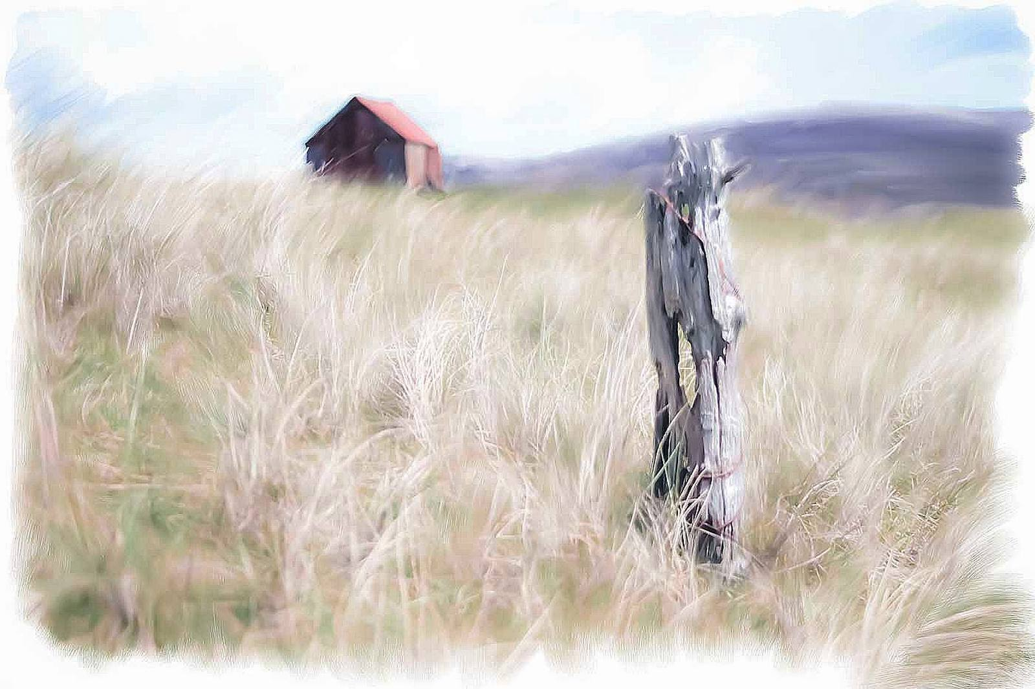
Shapes Within
The old post grabs our gaze. The hut adds to the shot.

Slide 24
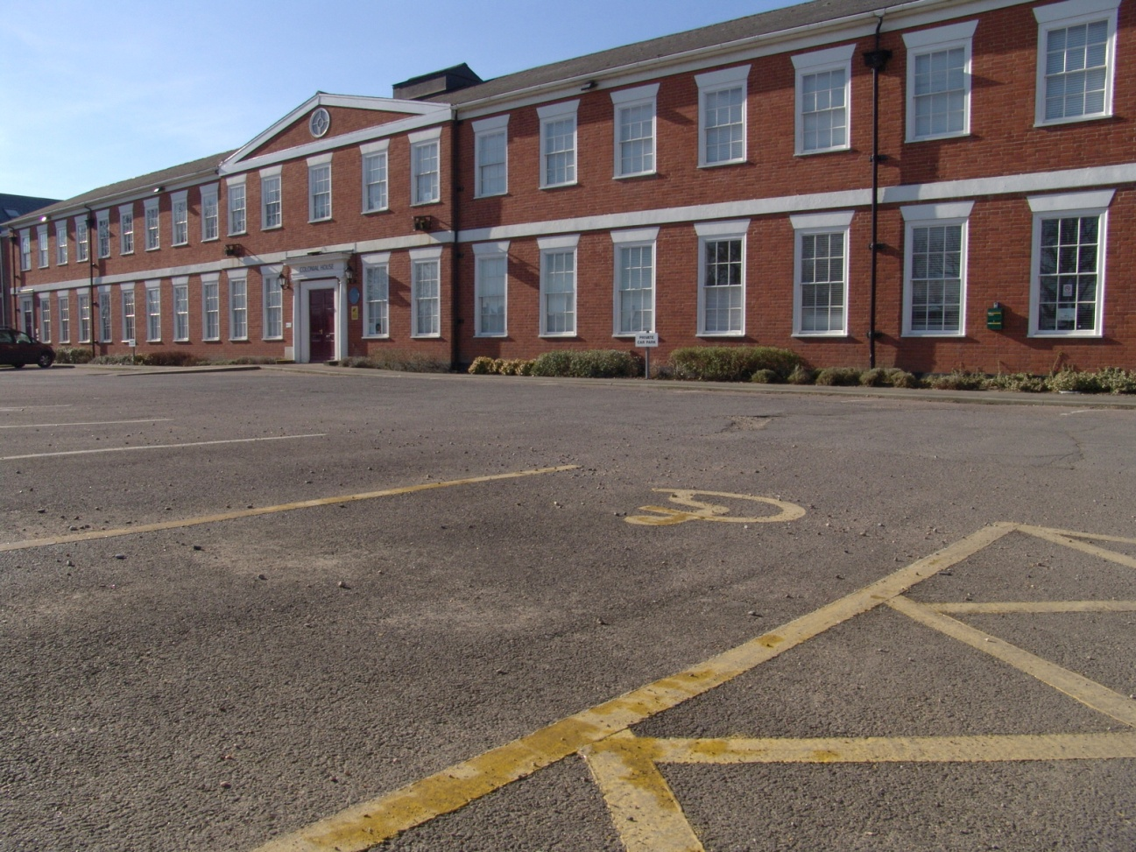
Shapes Within
The symbol is a shape within here

Slide 25
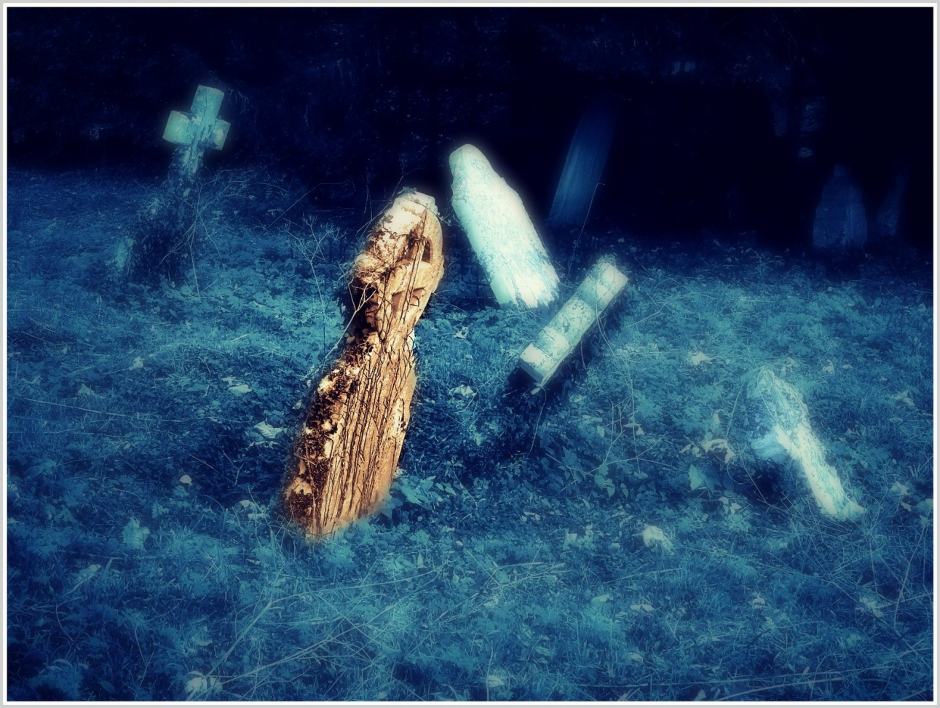
Shapes Within
The near gravestone is the shape that we see first

Slide 26

Shapes Within
Red within really does work to get your attention

Slide 27
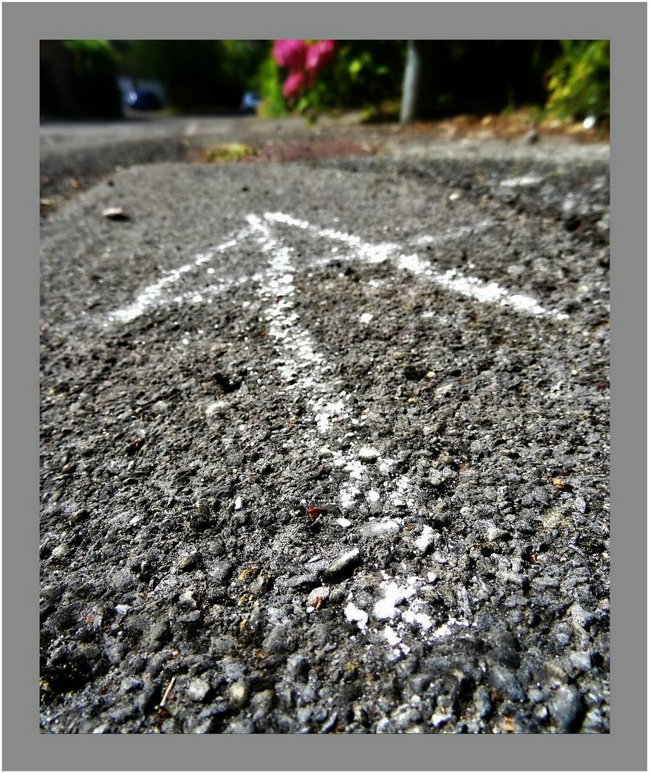
Shapes Within
The chalk marks leads us in. To what?

Slide 28
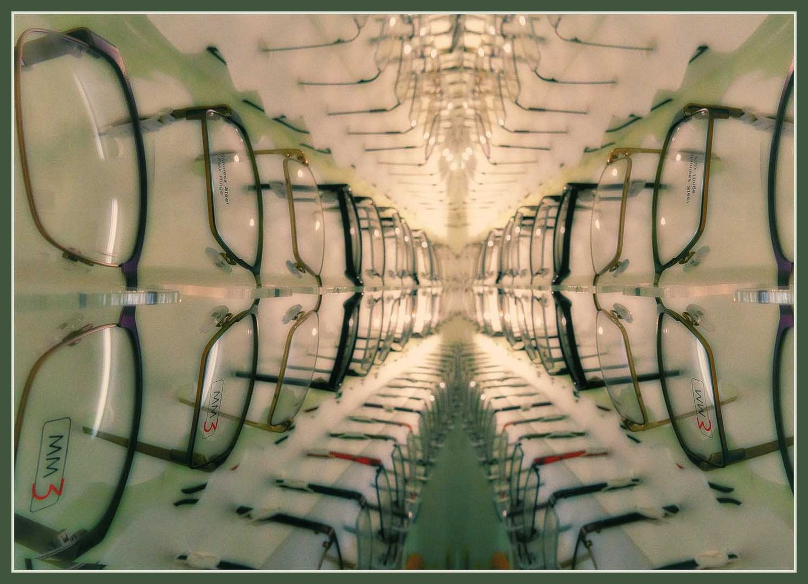
Shapes Within
The shapes of the specs takes us deep within

Slide 29
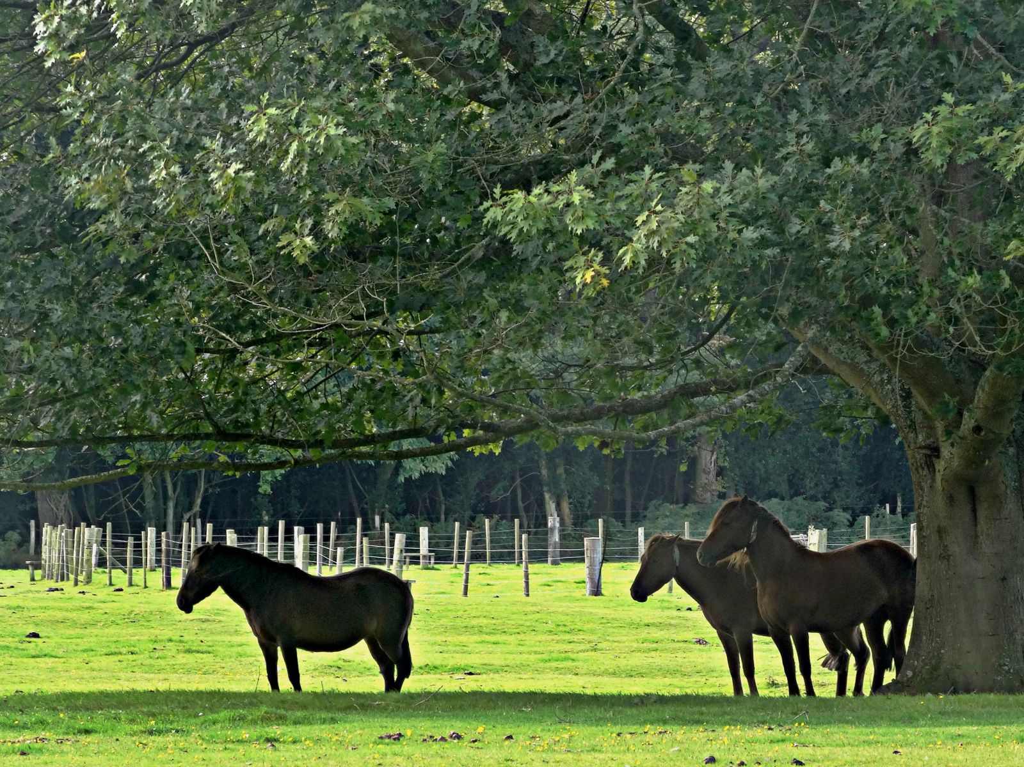
Shapes Within
The silhouettes of the ponies is the interest here

Slide 30
Shapes Within
A practical aid to composition is to hold up a small frame to assess the shape within your next image.
An old slide frame is perfect for this.
Also try looking with half closed eyes to blur the scene and reduce the detail but showing the shapes within.

Slide 31
Shapes Within
Why not vignette your image when post processing the photograph to draw in the eye?
Maybe you could add a special border of your own to do this.

Slide 32
Shapes Within
The End

Slide 33

Shapes Within
By Peter Read

