Slide 1
New Objectivity
Photography
Revolution 1920 to 1930

Slide 2
New Objectivity
Camera Work was a photo periodical from 1903 to 1917 . There were 50 issues.
It was produced by Alfred Steiglitz.
He was a prominent photographer and there were many examples of his work in the magazine.
Paul Strand lived from 1890 to 1976 in the USA.
New Objectivity Photography
Paul Strand made a deliberate break with traditional subject matter. His new work appeared in Camera Work in 1917.
He noticed the aesthetic appeal of the ordinary such as a White Fence.
He wrote ‘that unlike other arts which are anti-photographic the camera is objective. This is the very essence of photography.
The Photographer has to clearly see the limitations and potential qualities of the medium.’

Slide 3
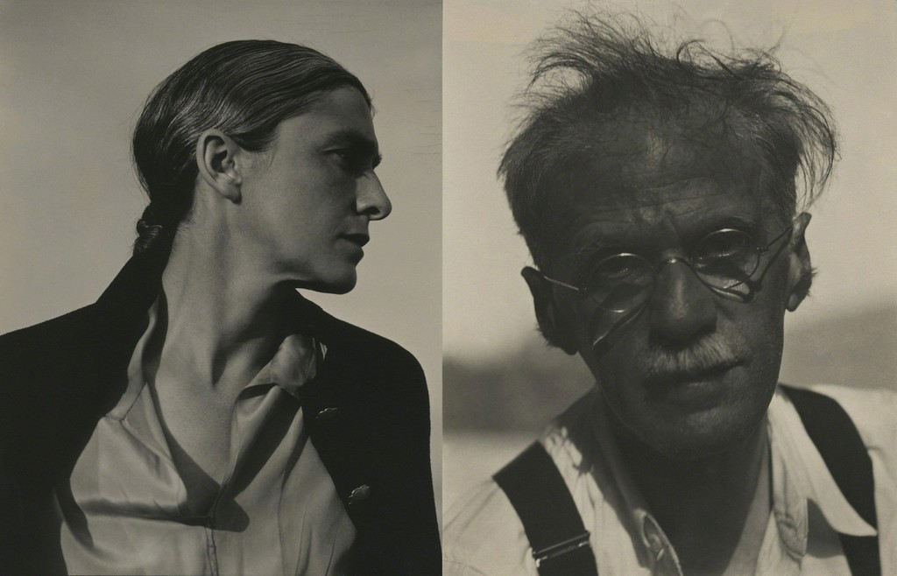
New Objectivity
Paul Strand
Rebecca [Paul’s wife]
And
Alfred Steiglitz

Slide 4
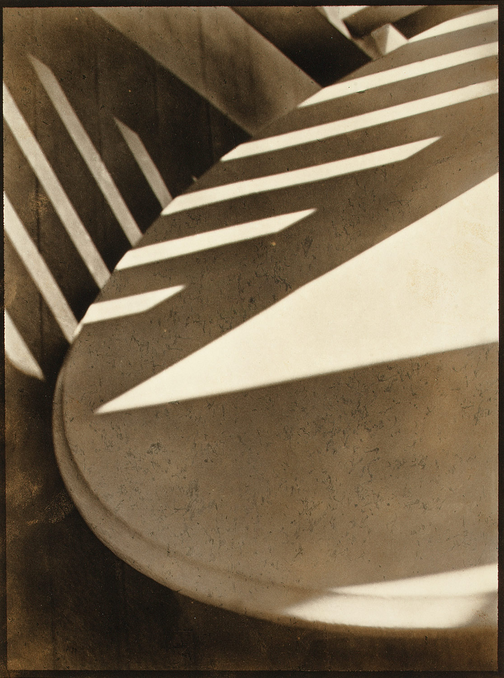
New Objectivity
Paul Strand
Abstraction Porch Shadow 1916

Slide 5
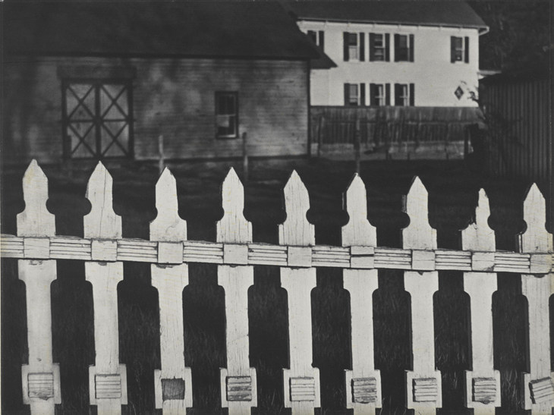
New Objectivity
Paul Strand
White Fence, Port Kent New York
1916

Slide 6
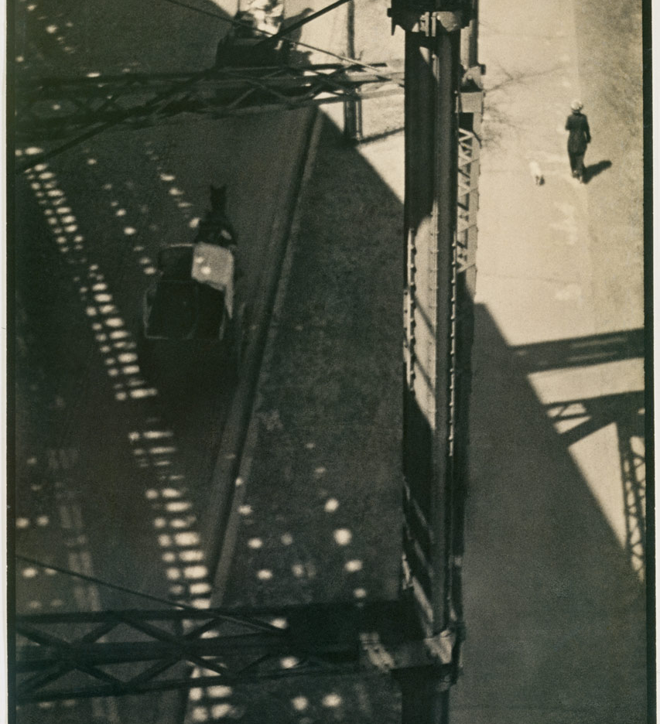
New Objectivity
Paul Strand
From the El

Slide 7

New Objectivity
Paul Strand
New York 1917

Slide 8
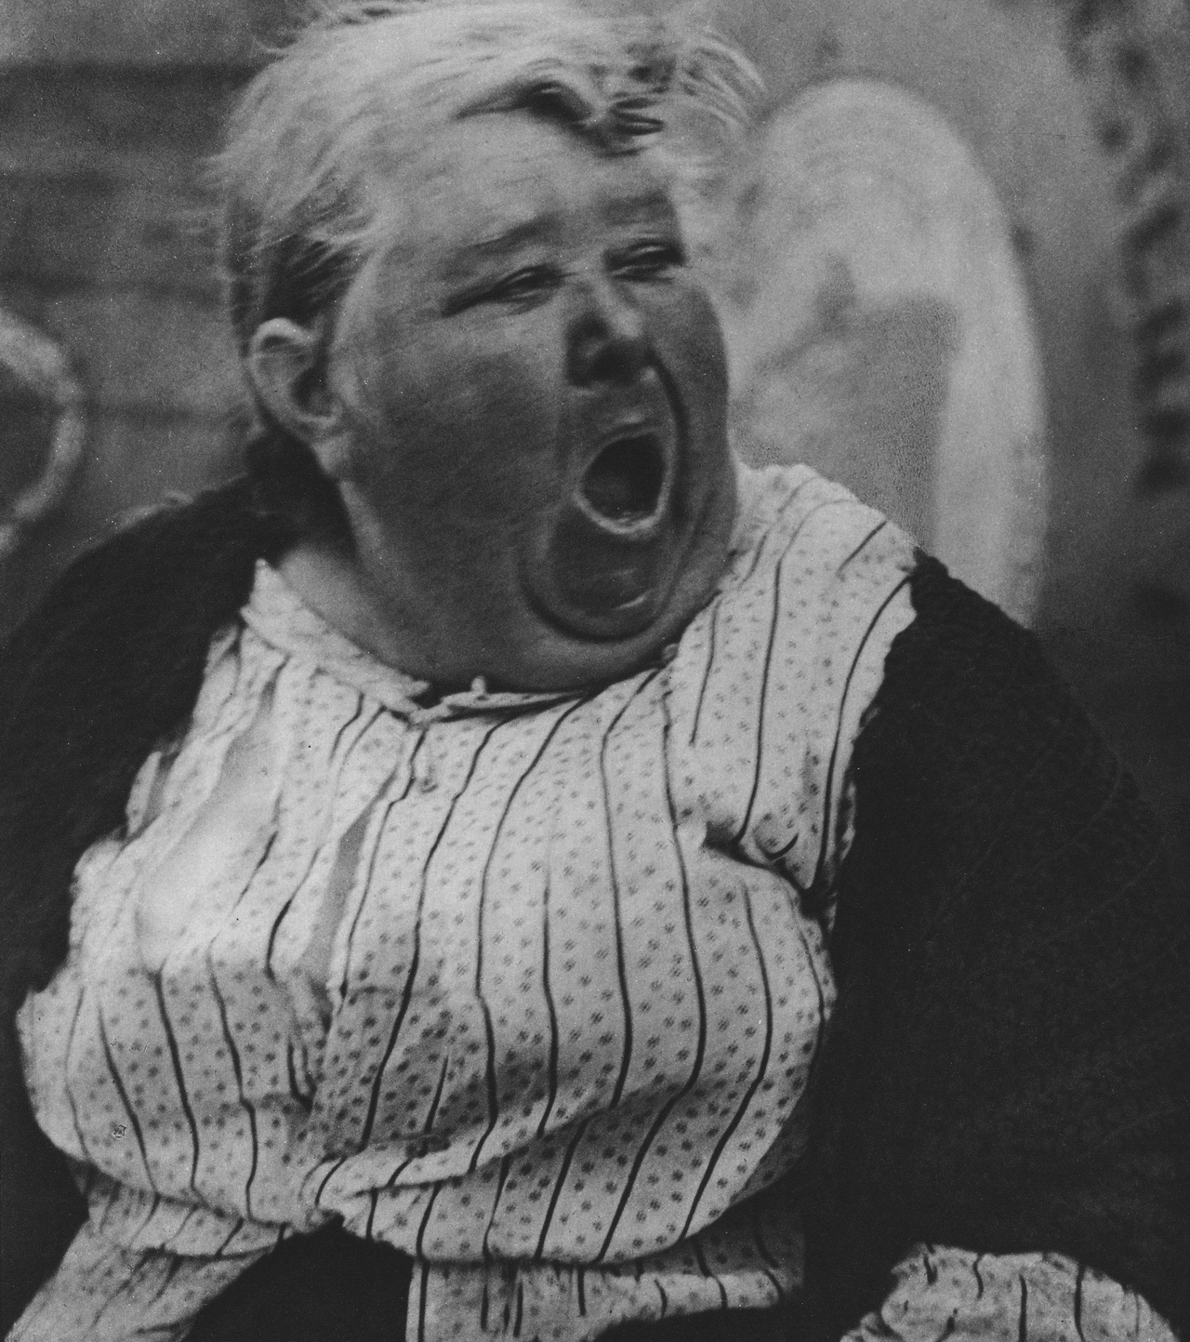
New Objectivity
Paul Strand
Yawning Woman

Slide 9
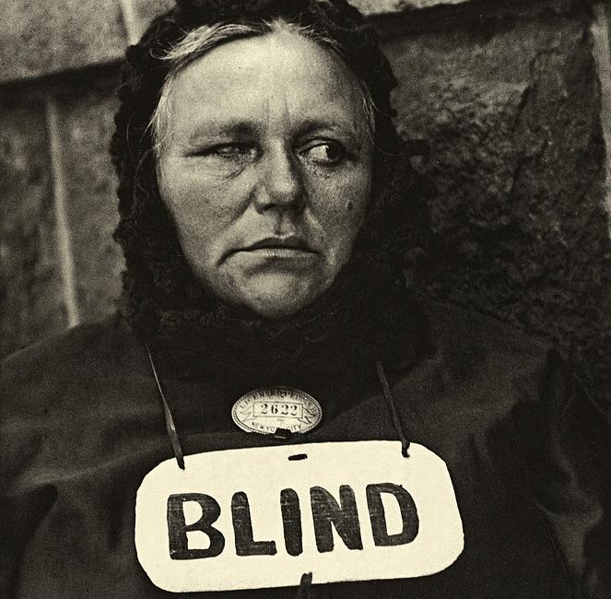
New Objectivity
Paul Strand
Blind Woman
New York 1917

Slide 10
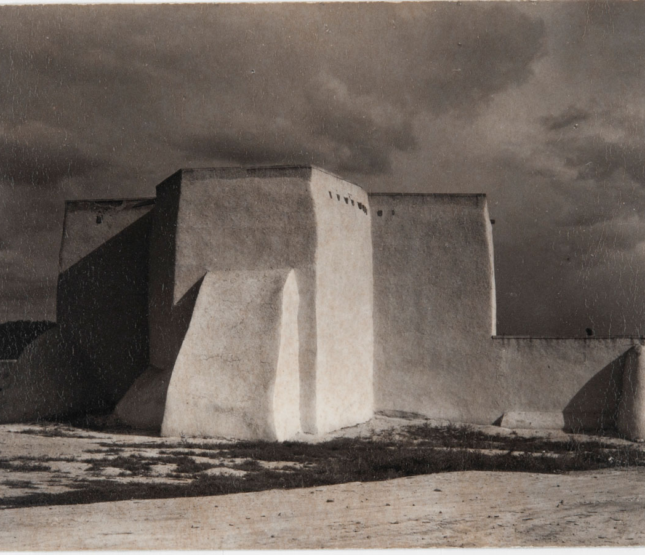
New Objectivity
Paul Strand
Taos, New Mexico, Ranchos Church
1931

Slide 11
New Objectivity
“New Objectivity” is a term used to describe a sharply focused, documentary approach to photography which emerged in 1920s Europe. In the decade prior, the soft look of pictorialism was the dominant aesthetic practiced by art photographers seeking to emulate the expressive qualities of painting. German artists Albert Renger-Patzsch, August Sander, Karl Blossfeldt, and their counterparts in Europe and the United States moved in the opposite direction and embraced the camera’s mechanical ability to capture the real world in a clear, apparently objective manner.

Slide 12
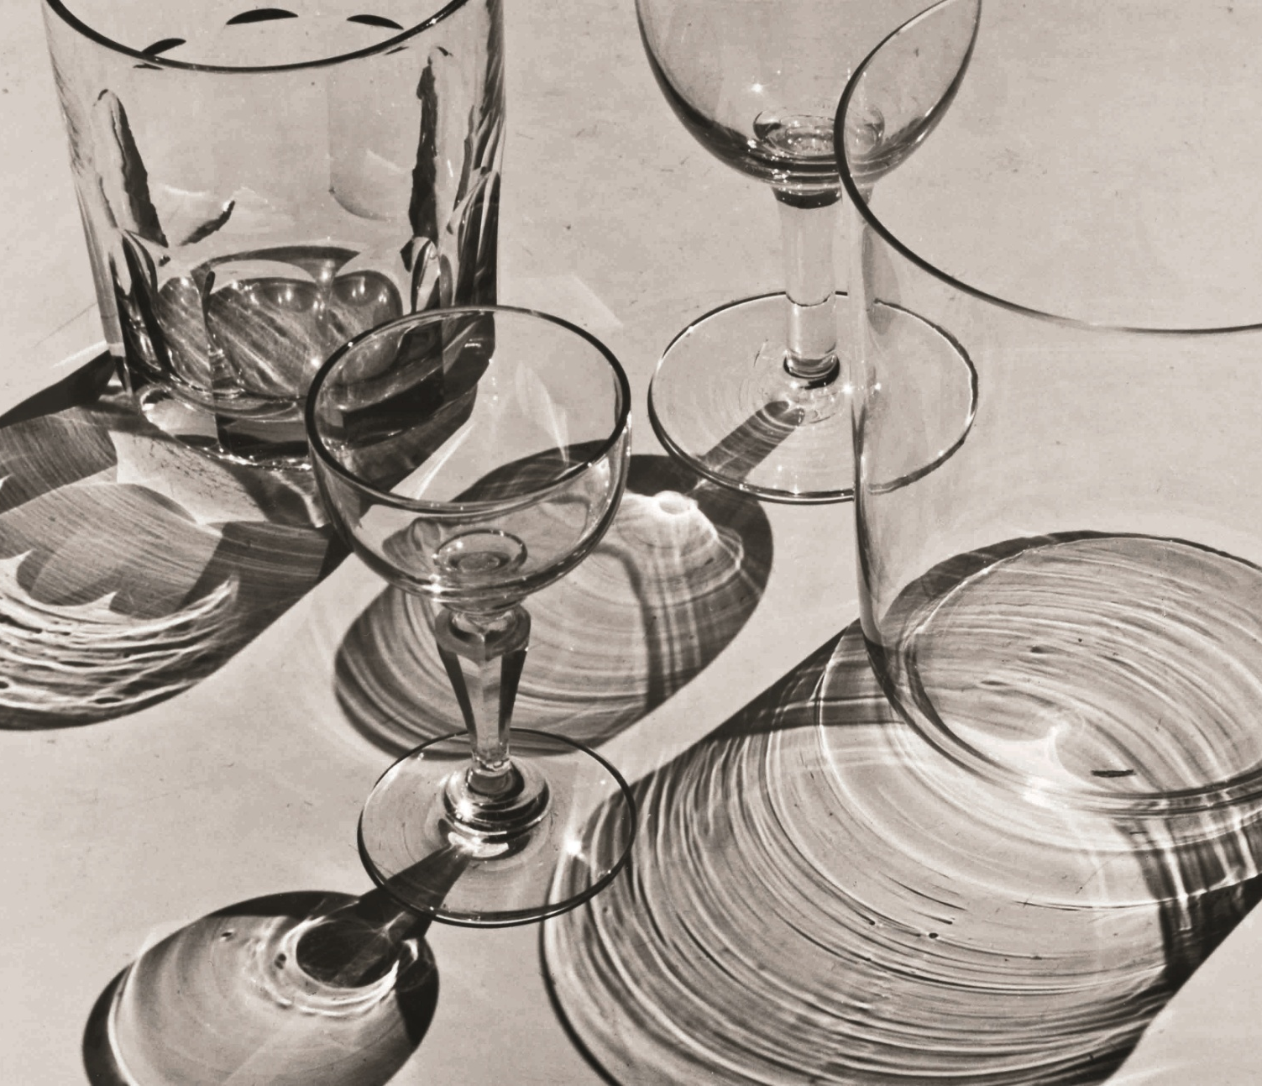
New Objectivity
Albert Renger-Patzsch
Glasses
1928

Slide 13
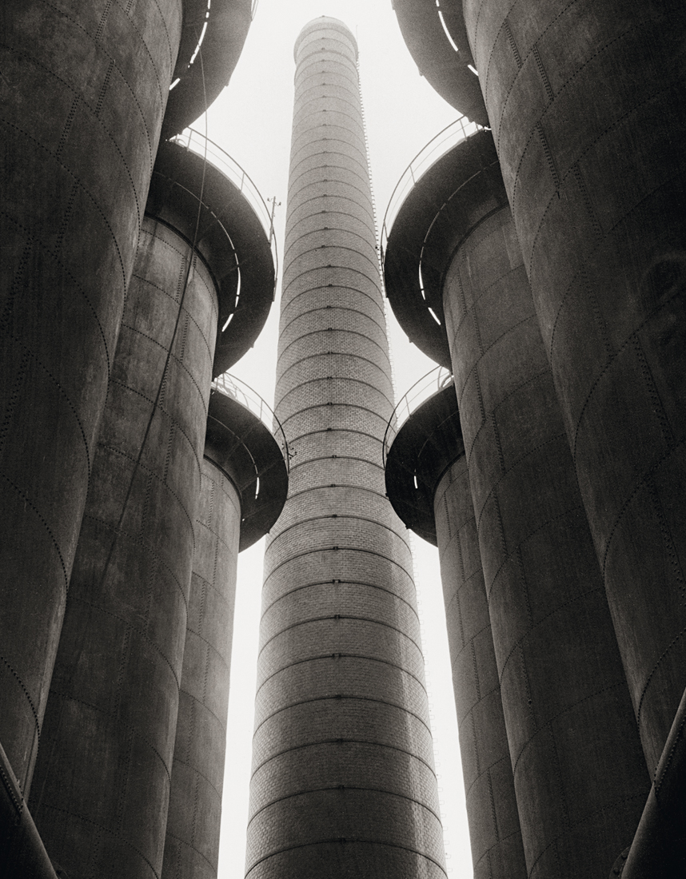
New Objectivity
Albert Renger-Patzsch
Blast Furnaces
1928

Slide 14
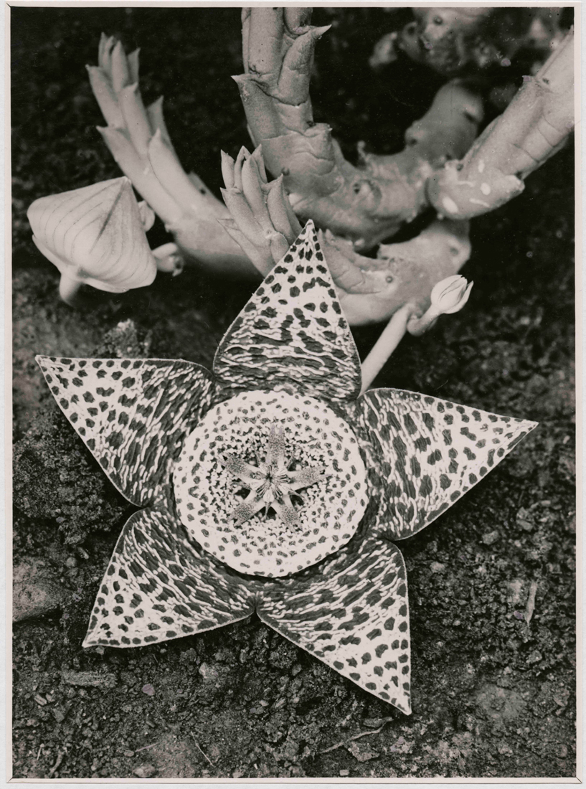
New Objectivity
Albert Renger-Patzsch
Stapelia variegata, Asclepiadaceae. 1923

Slide 15

New Objectivity
Albert Renger-Patzsch
Open Book
1930

Slide 16
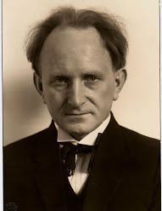
New Objectivity
August Sander
German
A Jew
1876 – 1964
Sander's first book Face of our Time (German: Antlitz der Zeit) was published in 1929. Sander has been described as "the most important German portrait photographer of the early twentieth century."

Slide 17
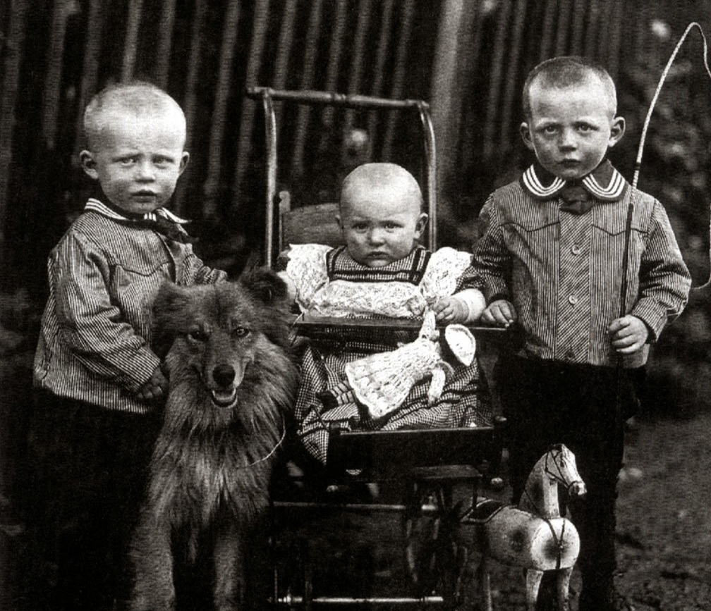
New Objectivity
August Sander
German
A Jew
1876 – 1964
Sander's first book Face of our Time (German: Antlitz der Zeit) was published in 1929. Sander has been described as "the most important German portrait photographer of the early twentieth century."

Slide 18
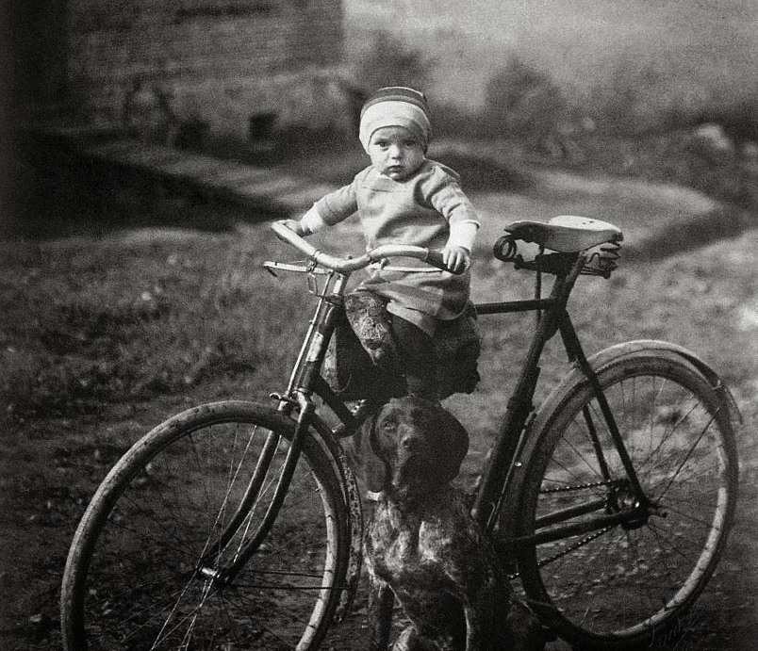
New Objectivity
August Sander
German
A Jew
1876 – 1964
Sander's first book Face of our Time (German: Antlitz der Zeit) was published in 1929. Sander has been described as "the most important German portrait photographer of the early twentieth century."

Slide 19
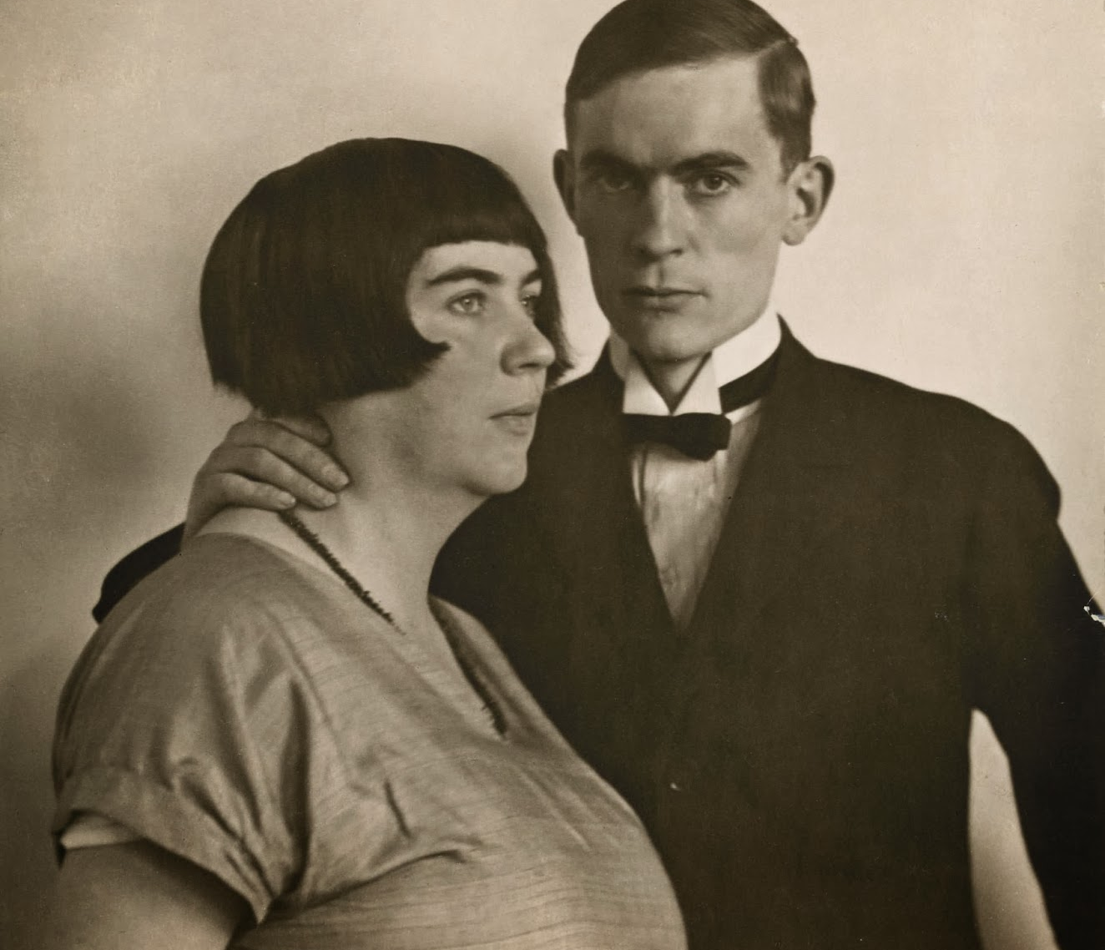
New Objectivity
August Sander
German
A Jew
1876 – 1964
Sander's first book Face of our Time (German: Antlitz der Zeit) was published in 1929. Sander has been described as "the most important German portrait photographer of the early twentieth century."

Slide 20
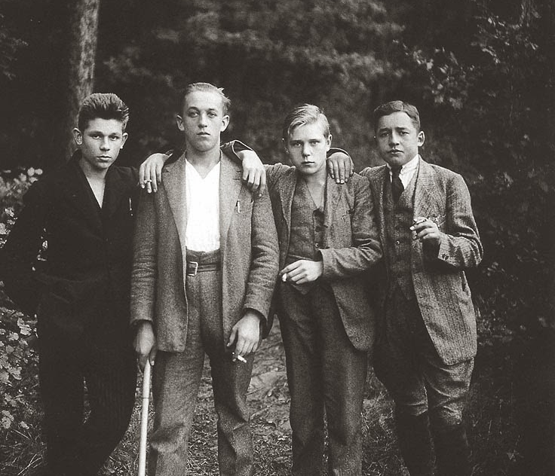
New Objectivity
August Sander
German
A Jew
1876 – 1964
Sander's first book Face of our Time (German: Antlitz der Zeit) was published in 1929. Sander has been described as "the most important German portrait photographer of the early twentieth century."

Slide 21
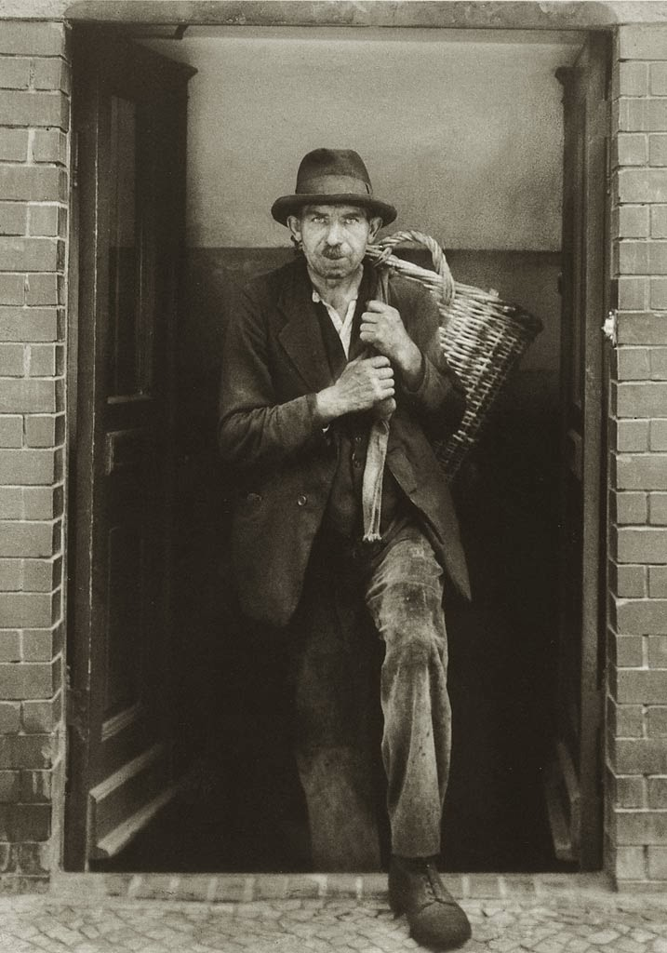
New Objectivity
August Sander
German
A Jew
1876 – 1964
Sander's first book Face of our Time (German: Antlitz der Zeit) was published in 1929. Sander has been described as "the most important German portrait photographer of the early twentieth century."

Slide 22
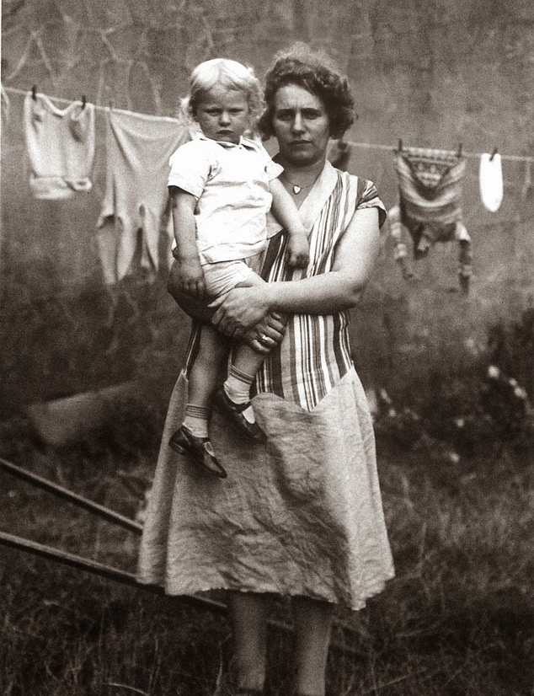
New Objectivity
August Sander
German
A Jew
1876 – 1964
Sander's first book Face of our Time (German: Antlitz der Zeit) was published in 1929. Sander has been described as "the most important German portrait photographer of the early twentieth century."

Slide 23
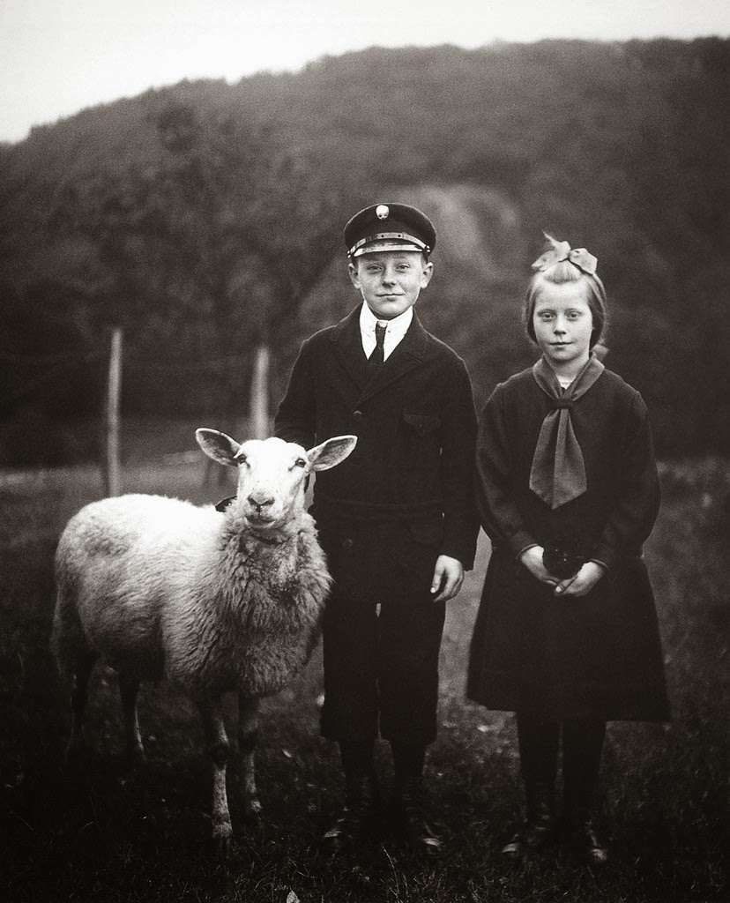
New Objectivity
August Sander
German
A Jew
1876 – 1964
Sander's first book Face of our Time (German: Antlitz der Zeit) was published in 1929. Sander has been described as "the most important German portrait photographer of the early twentieth century."

Slide 24
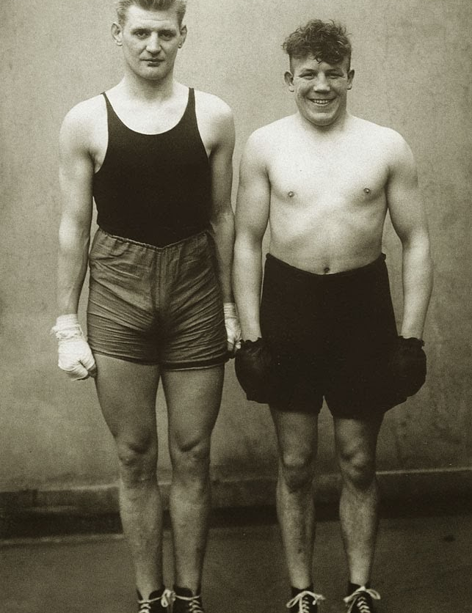
New Objectivity
August Sander
German
A Jew
1876 – 1964
Sander's first book Face of our Time (German: Antlitz der Zeit) was published in 1929. Sander has been described as "the most important German portrait photographer of the early twentieth century."

Slide 25
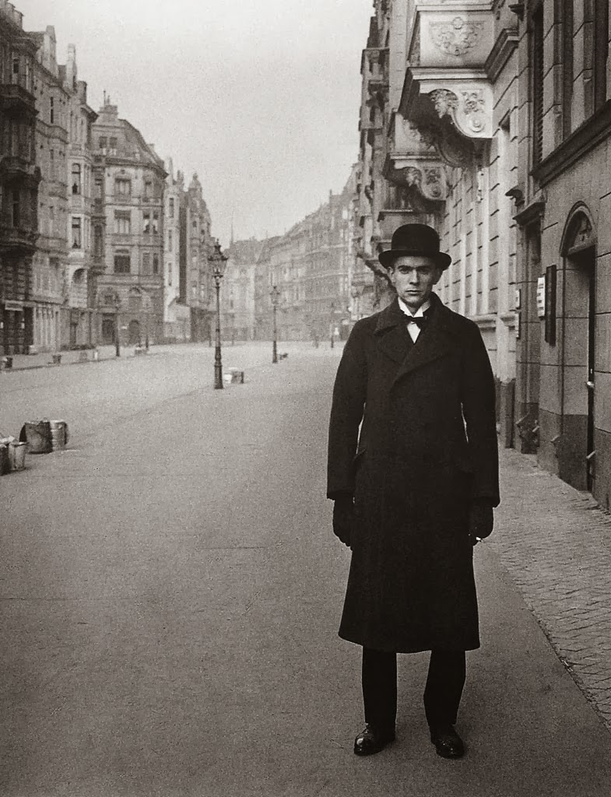
New Objectivity
August Sander
German
A Jew
1876 – 1964
Sander's first book Face of our Time (German: Antlitz der Zeit) was published in 1929. Sander has been described as "the most important German portrait photographer of the early twentieth century."

Slide 26
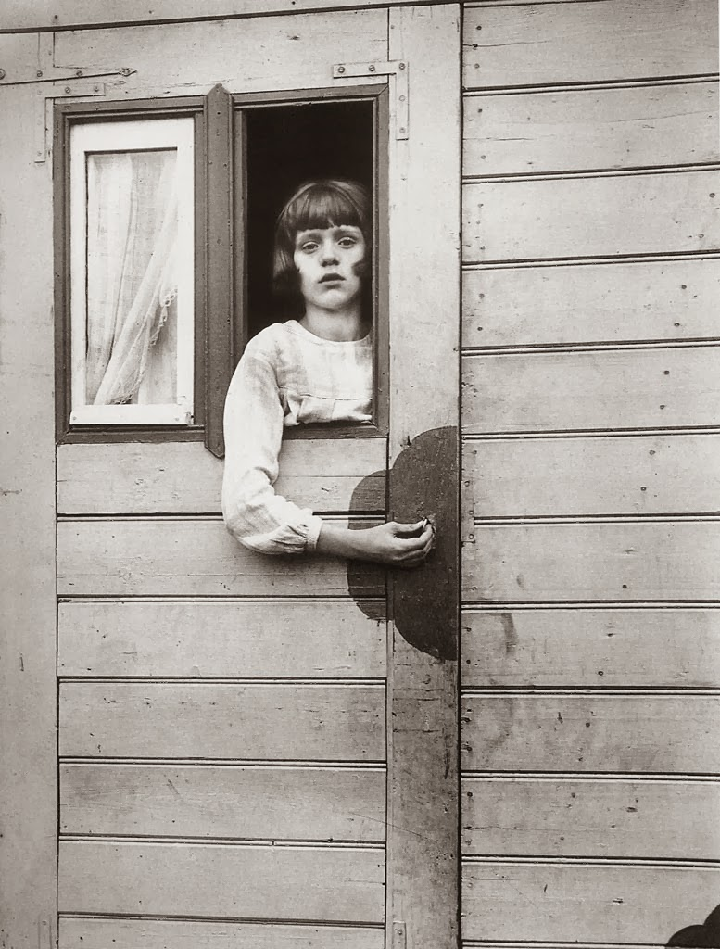
New Objectivity
August Sander
German
A Jew
1876 – 1964
Sander's first book Face of our Time (German: Antlitz der Zeit) was published in 1929. Sander has been described as "the most important German portrait photographer of the early twentieth century."

Slide 27
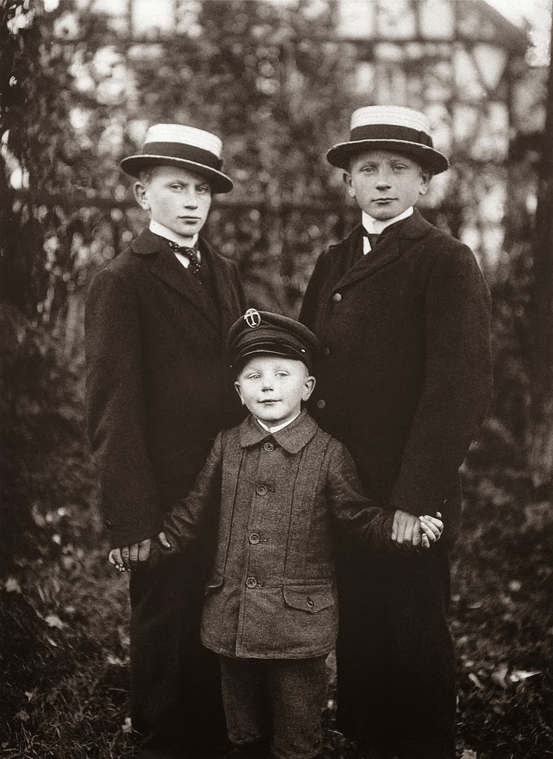
New Objectivity
August Sander
German
A Jew
1876 – 1964
Sander's first book Face of our Time (German: Antlitz der Zeit) was published in 1929. Sander has been described as "the most important German portrait photographer of the early twentieth century."

Slide 28
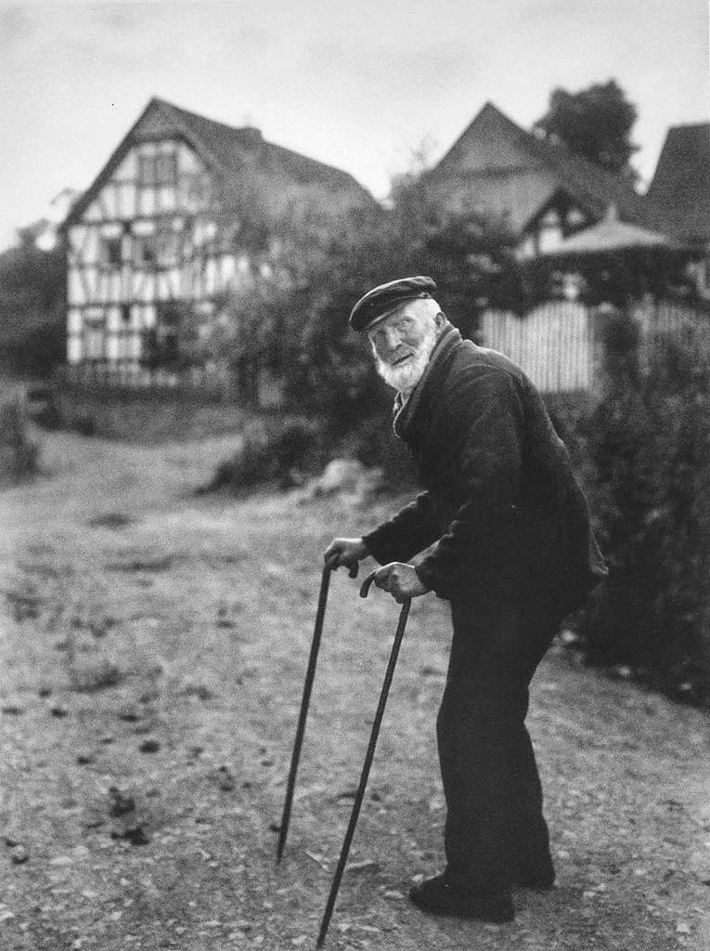
New Objectivity
August Sander
German
A Jew
1876 – 1964
Sander's first book Face of our Time (German: Antlitz der Zeit) was published in 1929. Sander has been described as "the most important German portrait photographer of the early twentieth century."

Slide 29
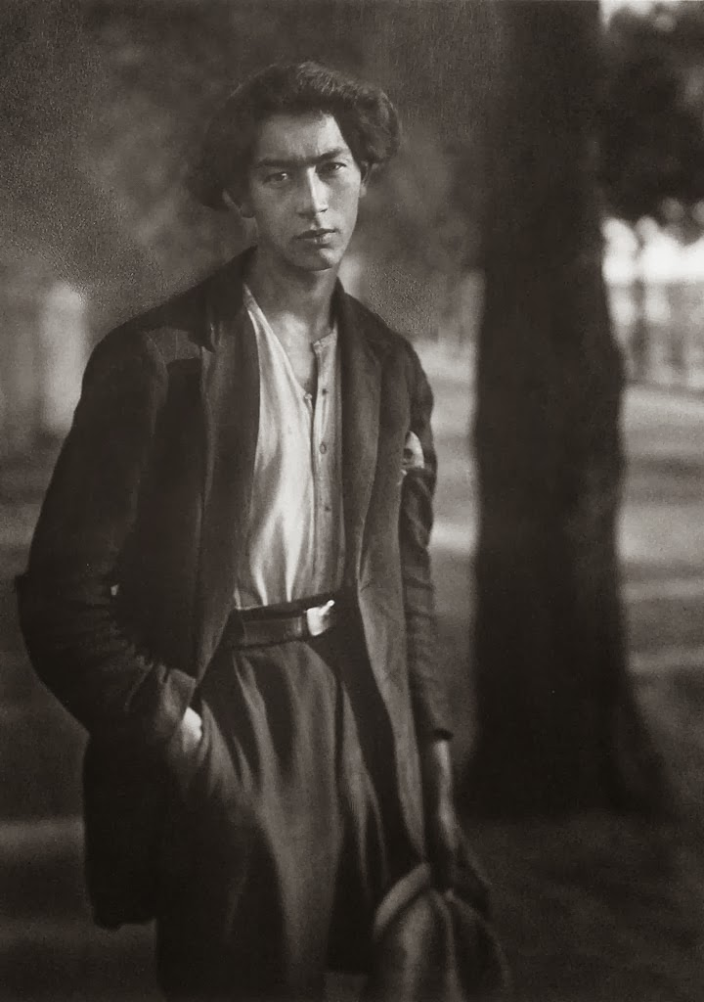
New Objectivity
August Sander
German
A Jew
1876 – 1964
Sander's first book Face of our Time (German: Antlitz der Zeit) was published in 1929. Sander has been described as "the most important German portrait photographer of the early twentieth century."

Slide 30
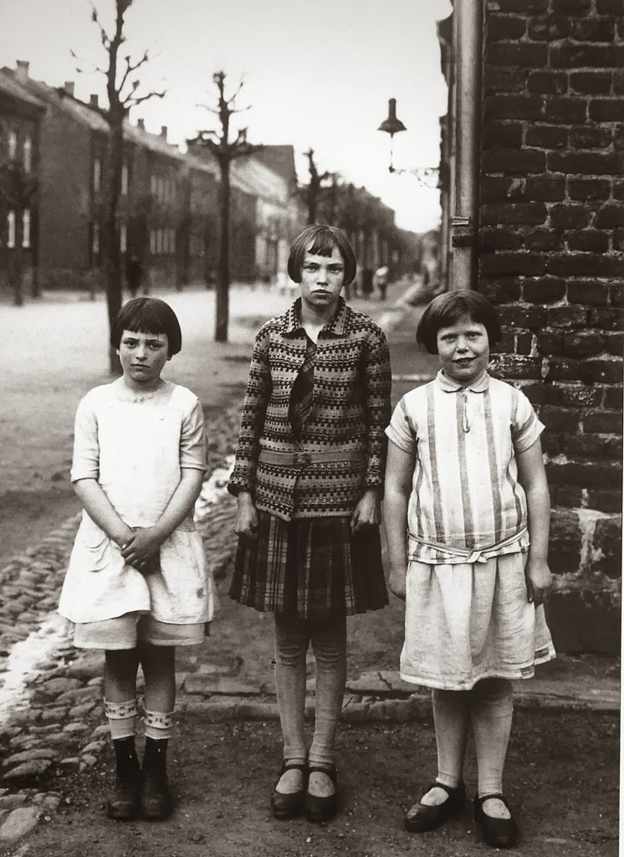
New Objectivity
August Sander
German
A Jew
1876 – 1964
Sander's first book Face of our Time (German: Antlitz der Zeit) was published in 1929. Sander has been described as "the most important German portrait photographer of the early twentieth century."

Slide 31
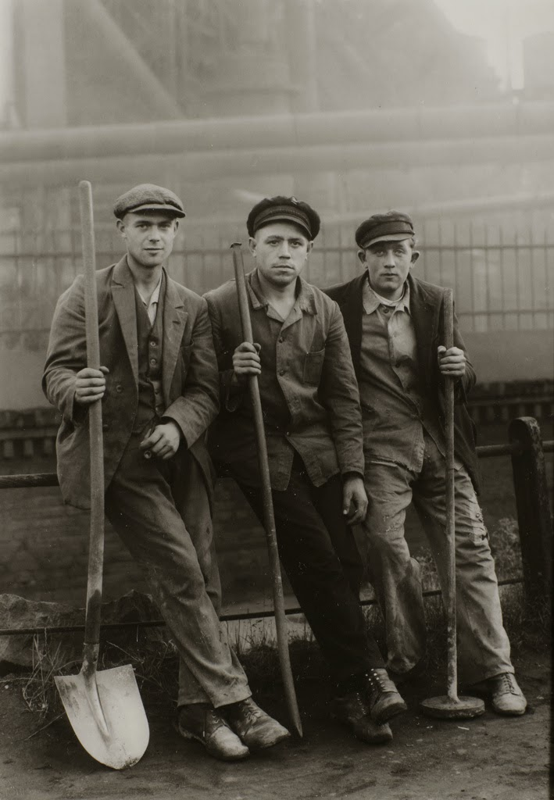
New Objectivity
August Sander
German
A Jew
1876 – 1964
Sander's first book Face of our Time (German: Antlitz der Zeit) was published in 1929. Sander has been described as "the most important German portrait photographer of the early twentieth century."

Slide 32
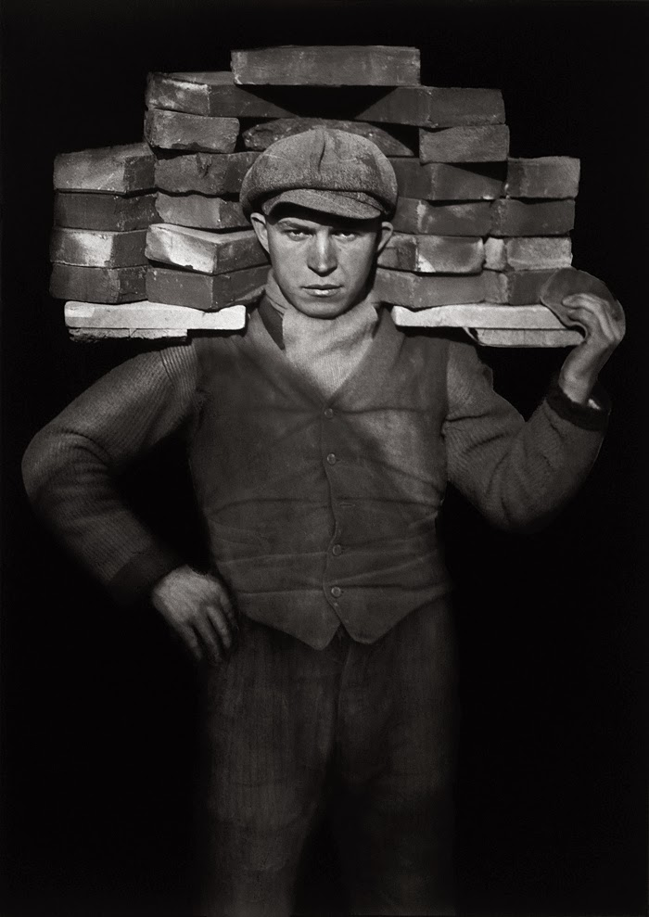
New Objectivity
August Sander
German
A Jew
1876 – 1964
Sander's first book Face of our Time (German: Antlitz der Zeit) was published in 1929. Sander has been described as "the most important German portrait photographer of the early twentieth century."

Slide 33
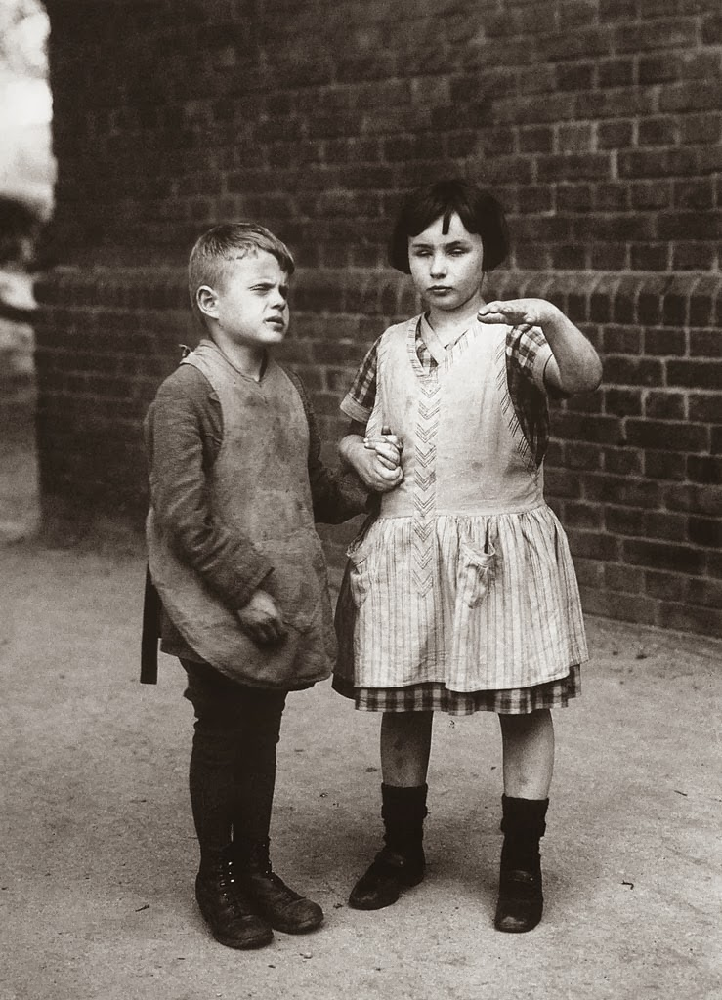
New Objectivity
August Sander
German
A Jew
1876 – 1964
Sander's first book Face of our Time (German: Antlitz der Zeit) was published in 1929. Sander has been described as "the most important German portrait photographer of the early twentieth century."

Slide 34
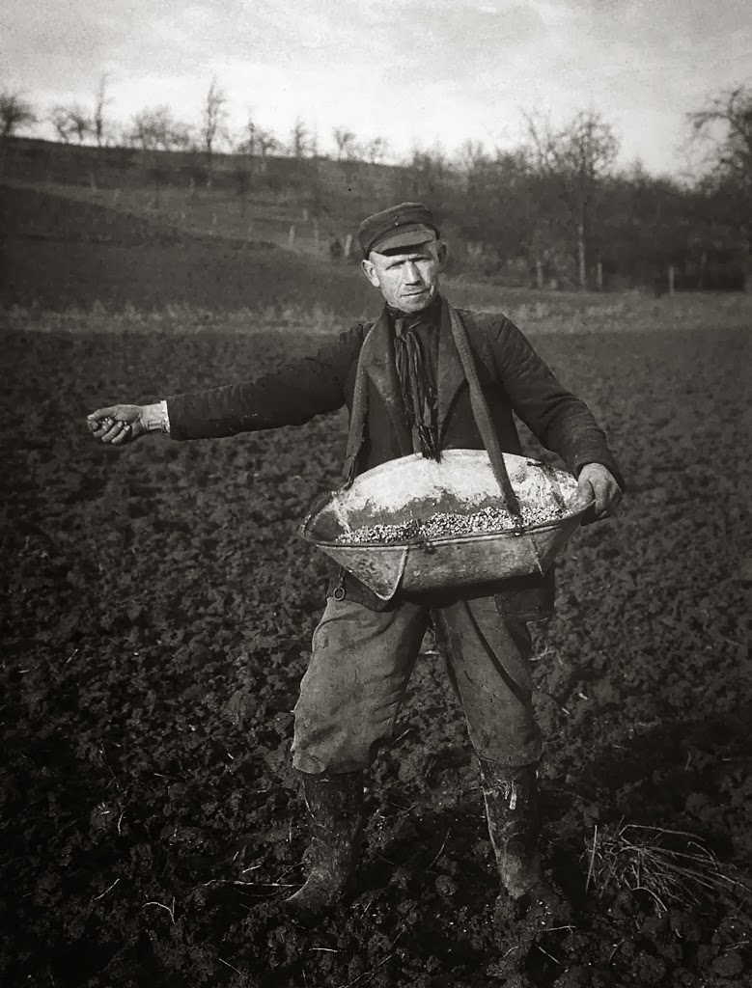
New Objectivity
August Sander
German
A Jew
1876 – 1964
Sander's first book Face of our Time (German: Antlitz der Zeit) was published in 1929. Sander has been described as "the most important German portrait photographer of the early twentieth century."

Slide 35
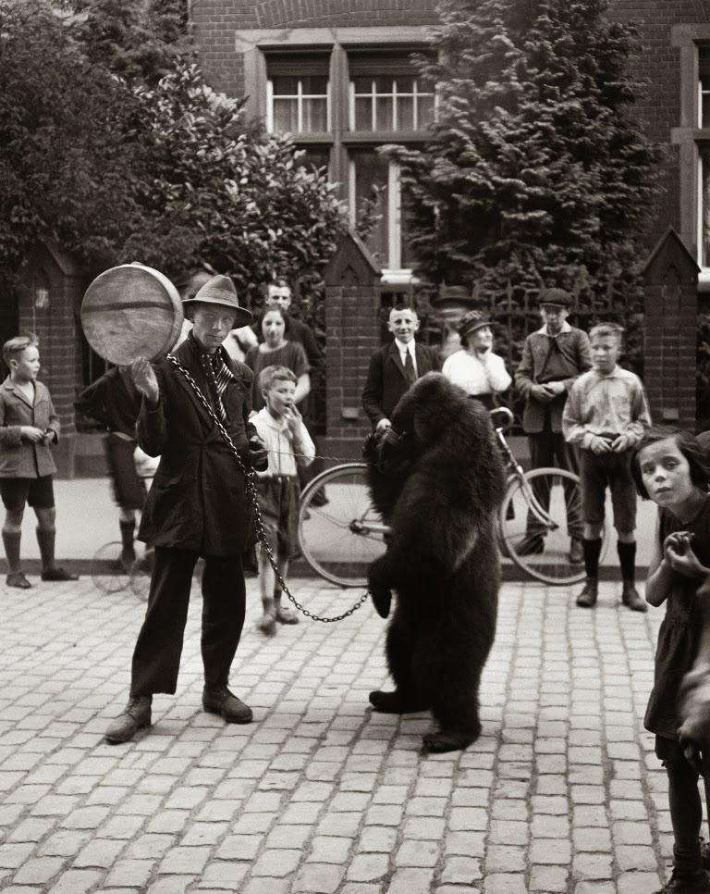
New Objectivity
August Sander
German
A Jew
1876 – 1964
Sander's first book Face of our Time (German: Antlitz der Zeit) was published in 1929. Sander has been described as "the most important German portrait photographer of the early twentieth century."

Slide 36
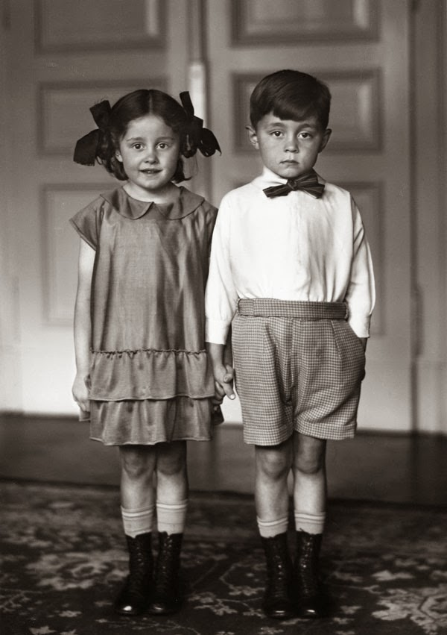
New Objectivity
August Sander
German
A Jew
1876 – 1964
Sander's first book Face of our Time (German: Antlitz der Zeit) was published in 1929. Sander has been described as "the most important German portrait photographer of the early twentieth century."

Slide 37
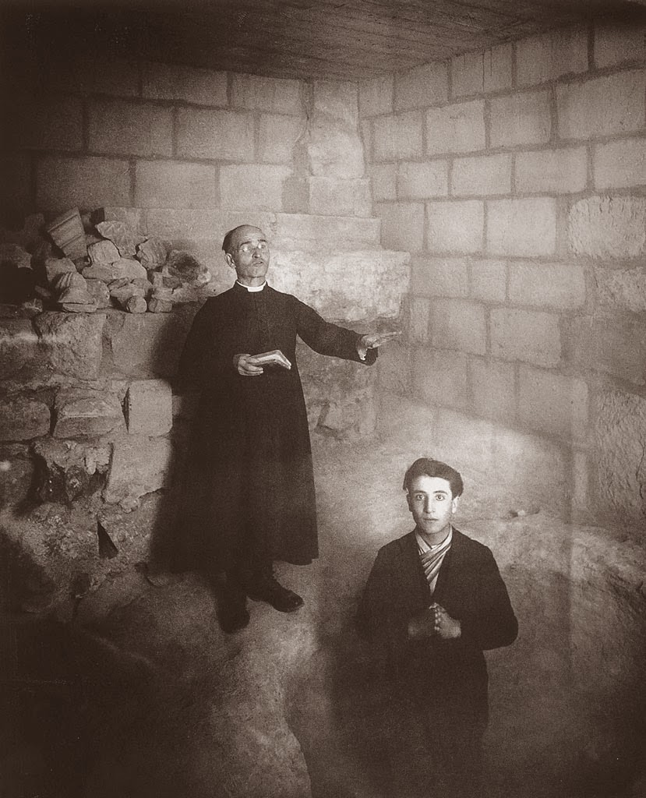
New Objectivity
August Sander
German
A Jew
1876 – 1964
Sander's first book Face of our Time (German: Antlitz der Zeit) was published in 1929. Sander has been described as "the most important German portrait photographer of the early twentieth century."

Slide 38
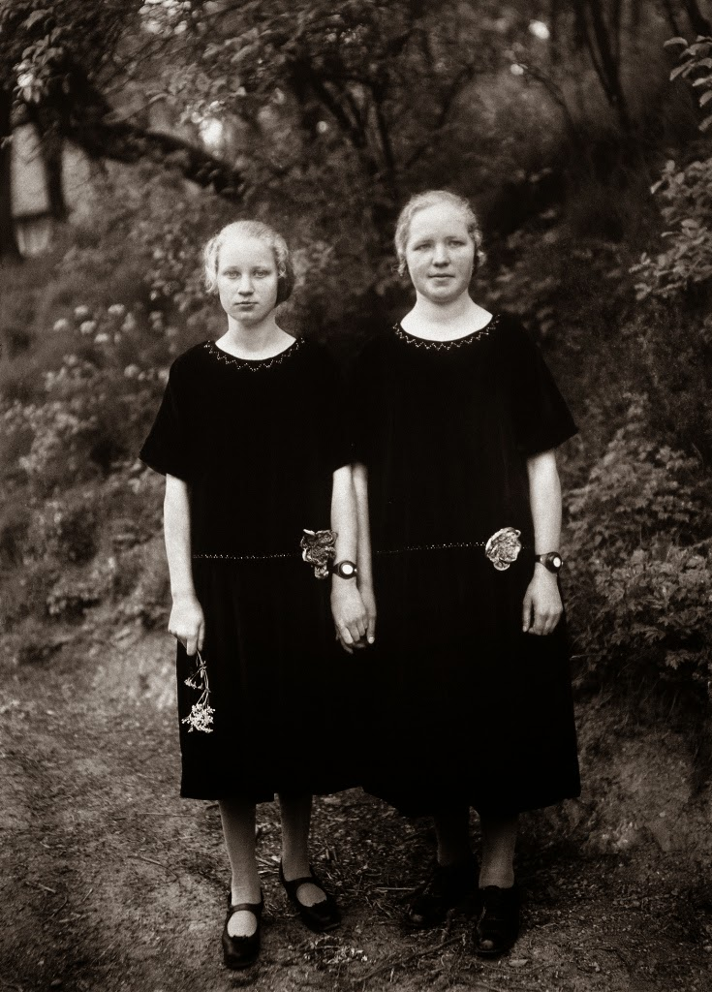
New Objectivity
August Sander
German
A Jew
1876 – 1964
Sander's first book Face of our Time (German: Antlitz der Zeit) was published in 1929. Sander has been described as "the most important German portrait photographer of the early twentieth century."

Slide 39
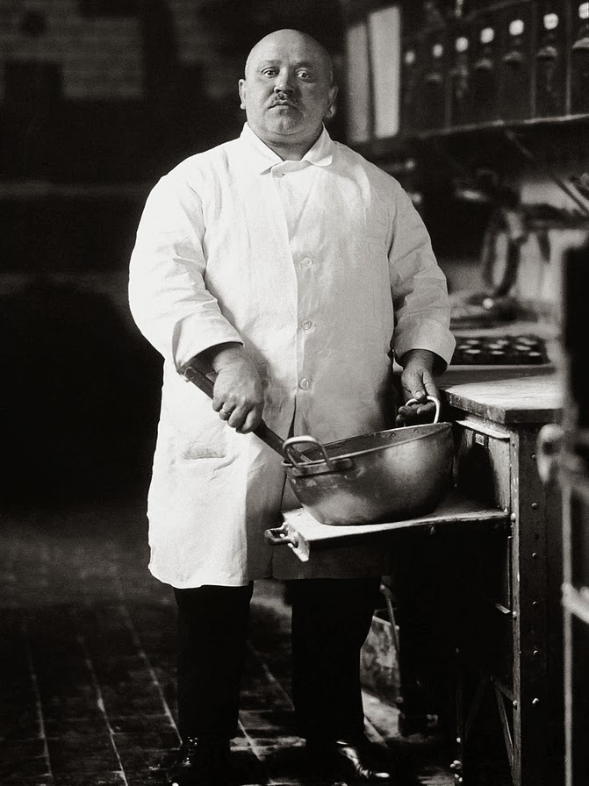
New Objectivity
August Sander
German
A Jew
1876 – 1964
Sander's first book Face of our Time (German: Antlitz der Zeit) was published in 1929. Sander has been described as "the most important German portrait photographer of the early twentieth century."

Slide 40
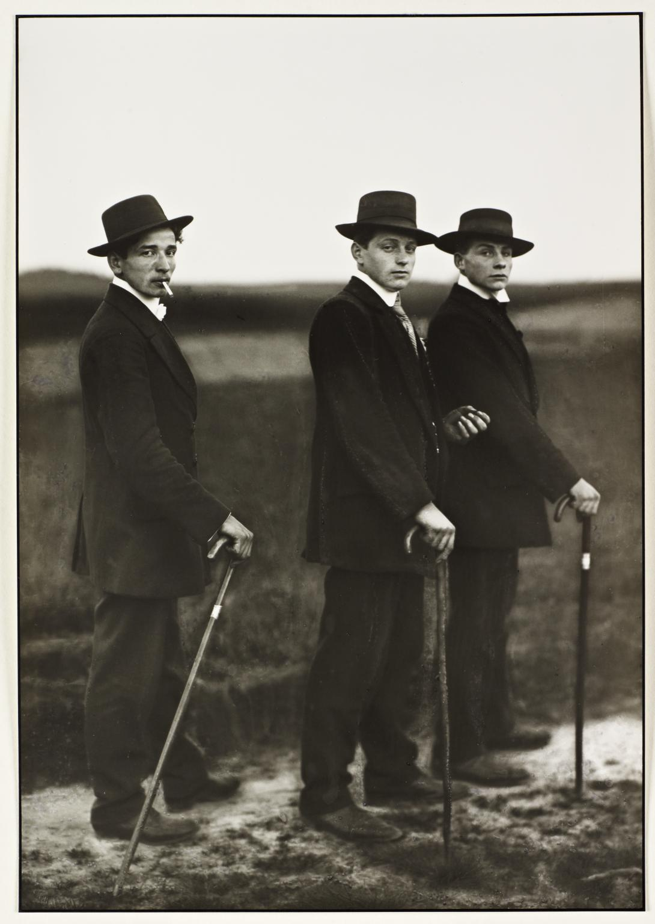
New Objectivity
August Sander
German
A Jew
1876 – 1964
Sander's first book Face of our Time (German: Antlitz der Zeit) was published in 1929. Sander has been described as "the most important German portrait photographer of the early twentieth century."

Slide 41
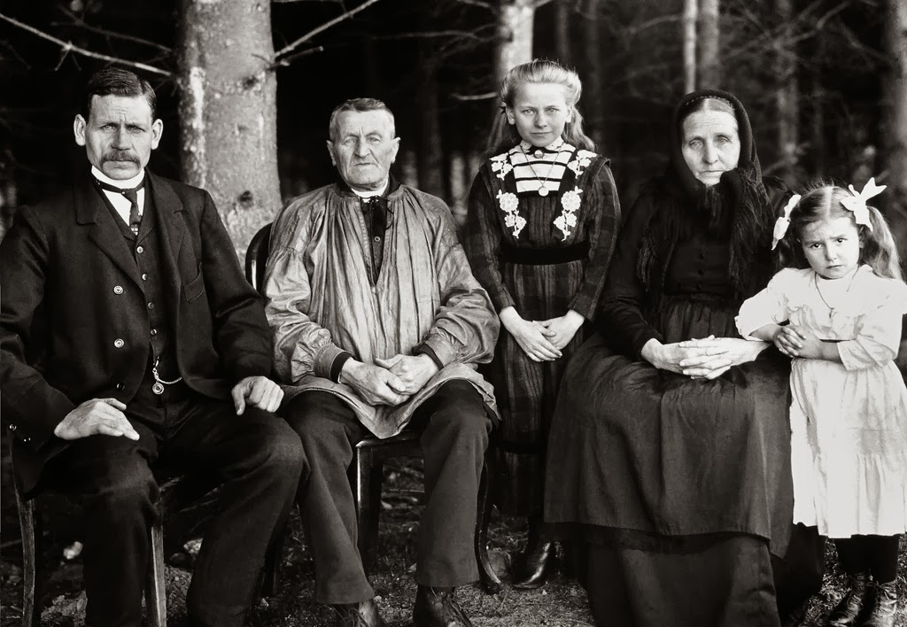
New Objectivity
August Sander
German
A Jew
1876 – 1964
Sander's first book Face of our Time (German: Antlitz der Zeit) was published in 1929. Sander has been described as "the most important German portrait photographer of the early twentieth century."

Slide 42
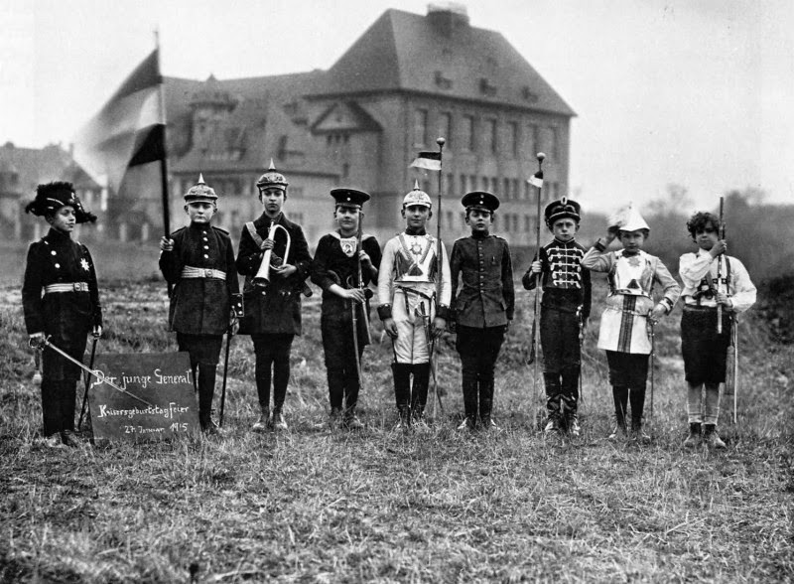
New Objectivity
August Sander
German
A Jew
1876 – 1964
Sander's first book Face of our Time (German: Antlitz der Zeit) was published in 1929. Sander has been described as "the most important German portrait photographer of the early twentieth century."

Slide 43
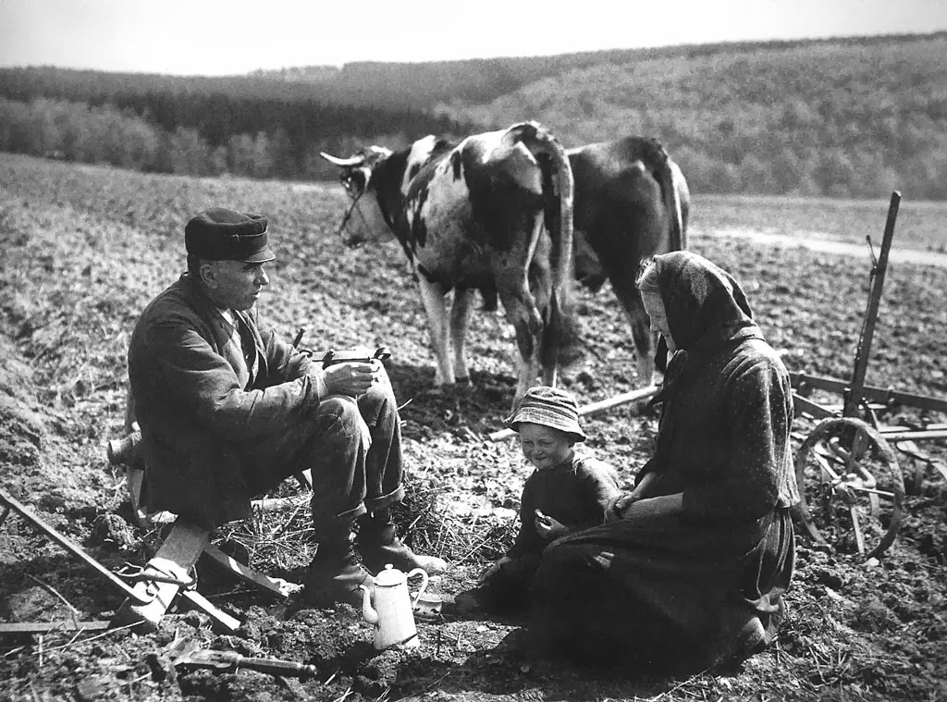
New Objectivity
August Sander
German
A Jew
1876 – 1964
Sander's first book Face of our Time (German: Antlitz der Zeit) was published in 1929. Sander has been described as "the most important German portrait photographer of the early twentieth century."

Slide 44
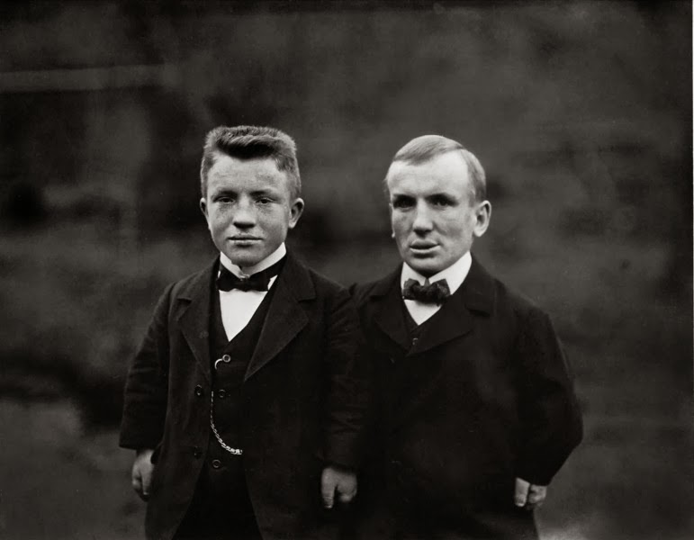
New Objectivity
August Sander
German
A Jew
1876 – 1964
Sander's first book Face of our Time (German: Antlitz der Zeit) was published in 1929. Sander has been described as "the most important German portrait photographer of the early twentieth century."

Slide 45
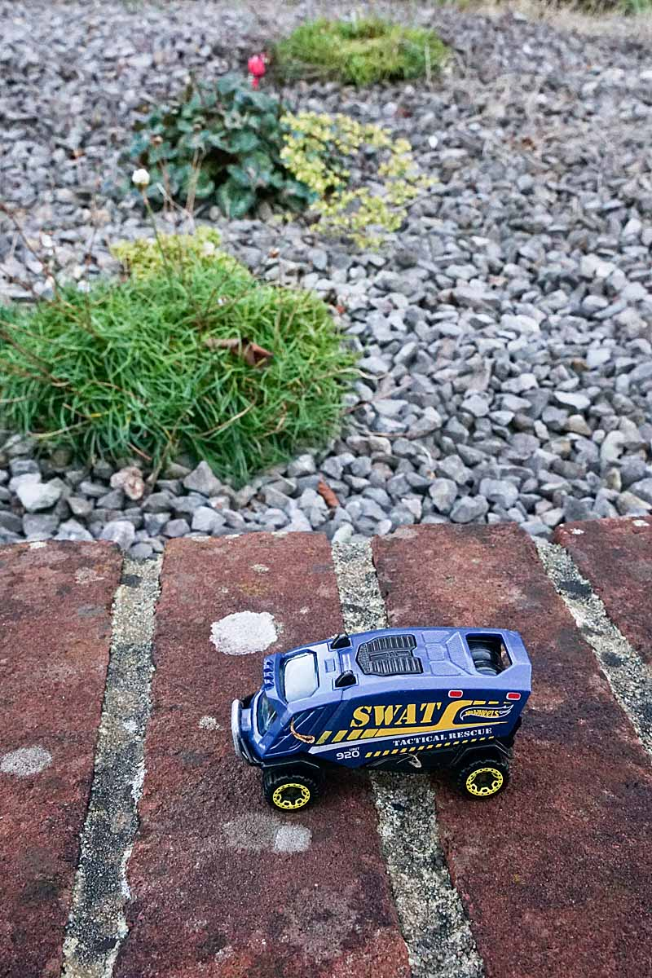
New Objectivity
Other Photographers

Slide 46

New Objectivity
Hein Gorny
Pins

Slide 47
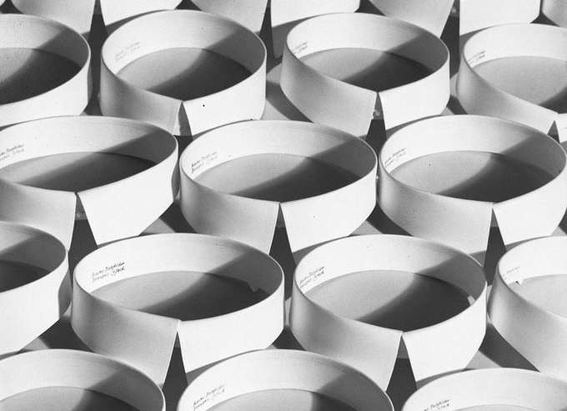
New Objectivity
Hein Gorny
Collars

Slide 48
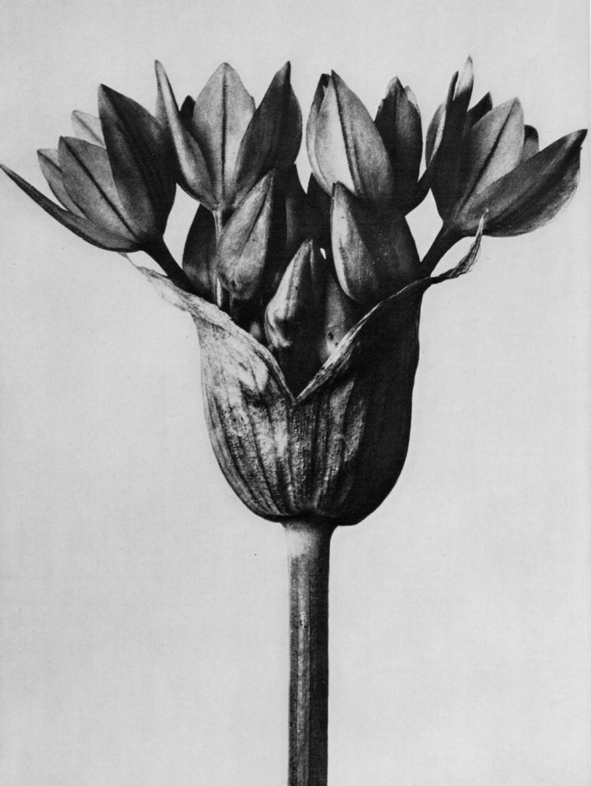
New Objectivity
Blossfeldt
Art forms in nature 1928

Slide 49
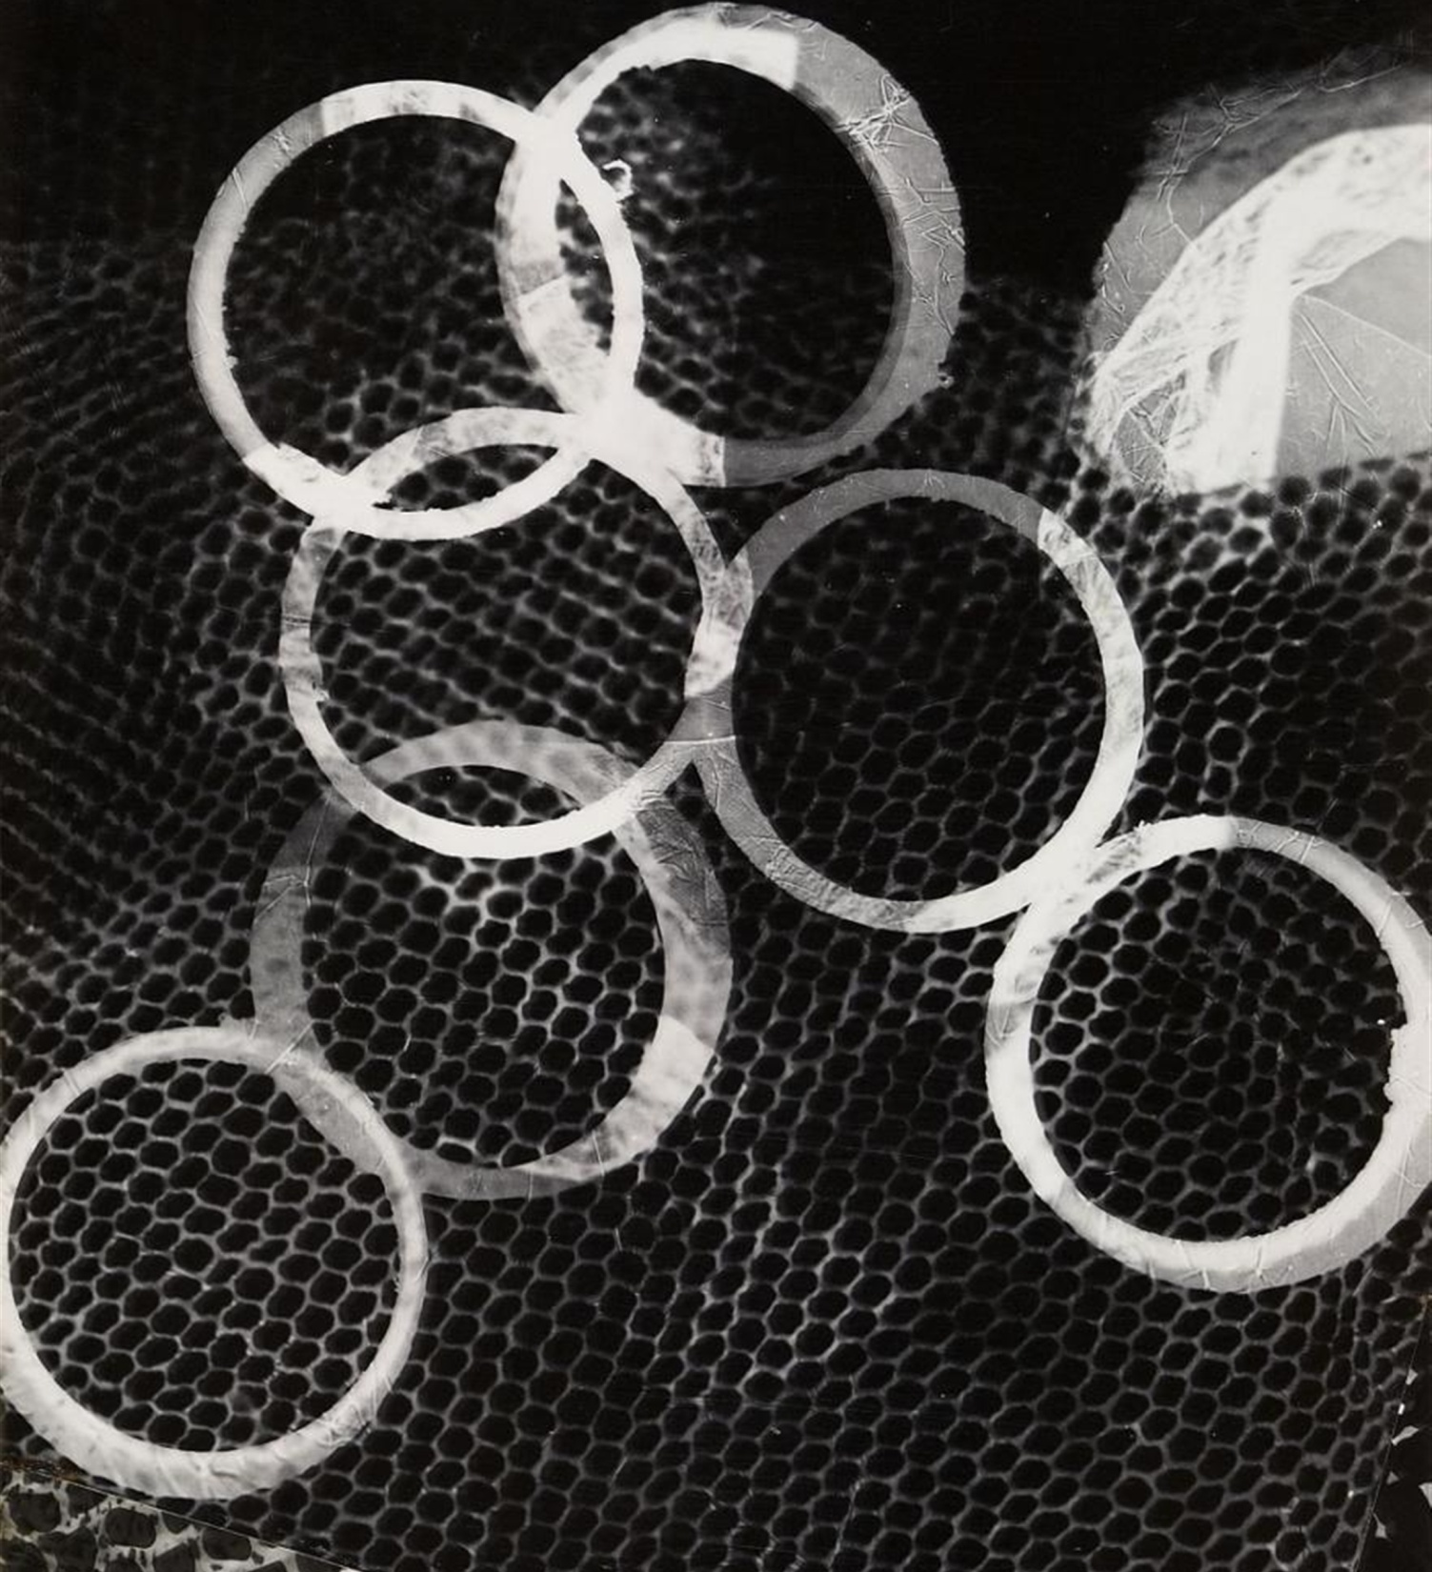
New Objectivity
Christian Schad
SCHADOGRAPH-No-16

Slide 50
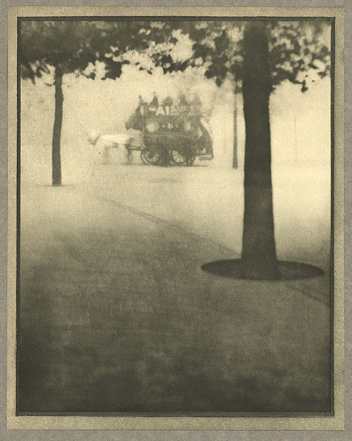
New Objectivity
Alvin Langdon Coburn
His images were ;
Like this before 1915
Hyde Park Corner
1910

Slide 51
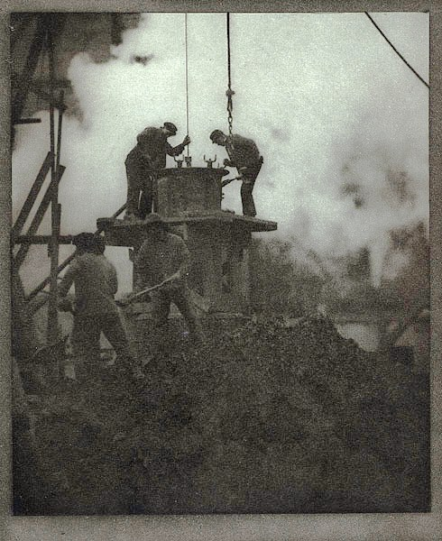
New Objectivity
Alvin Langdon Coburn
His images were ;
Like this before 1915
The Tunnel Builders
1913

Slide 52
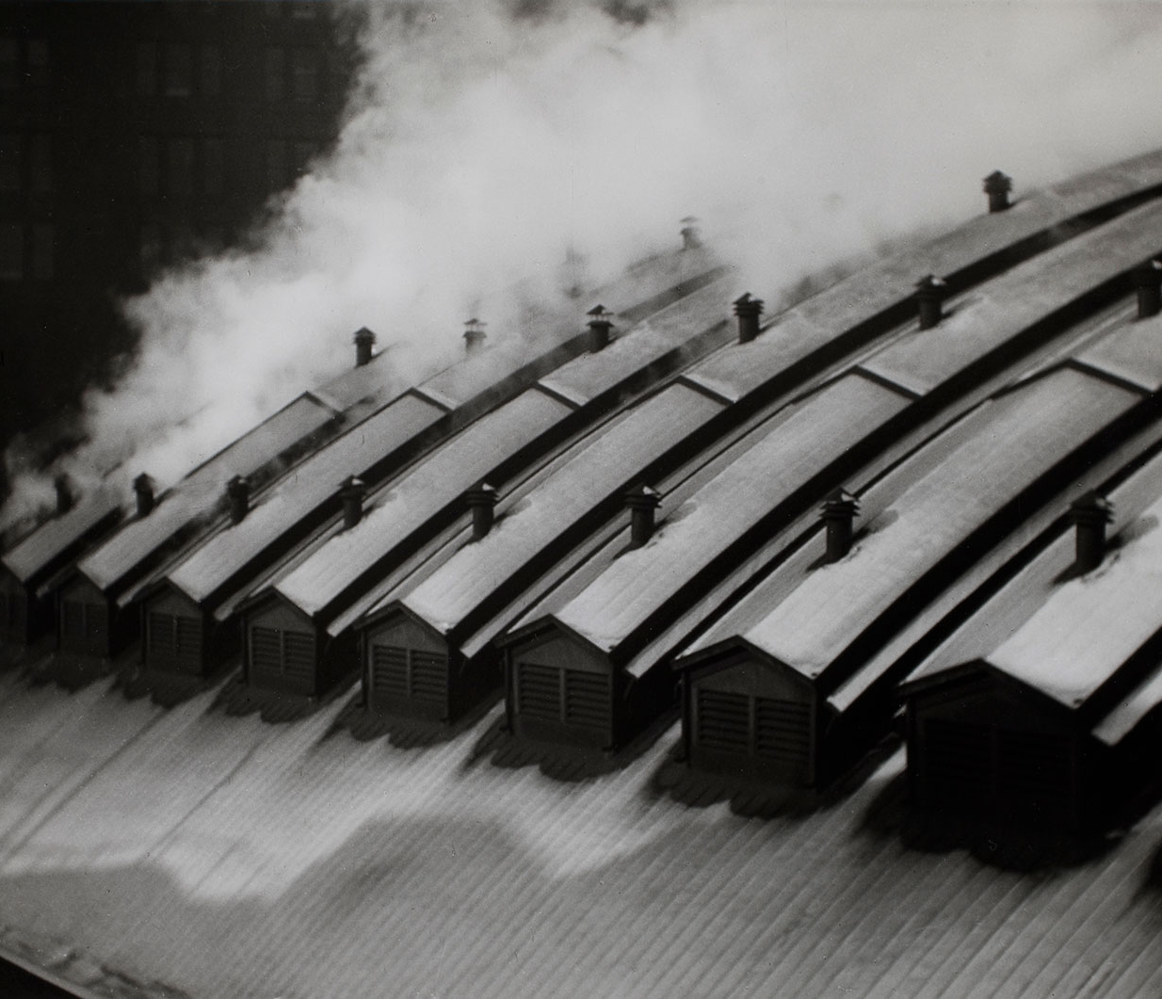
New Objectivity
Alvin Langdon Coburn
Pittsburgh Station Roofs 1910
This is an exception

Slide 53
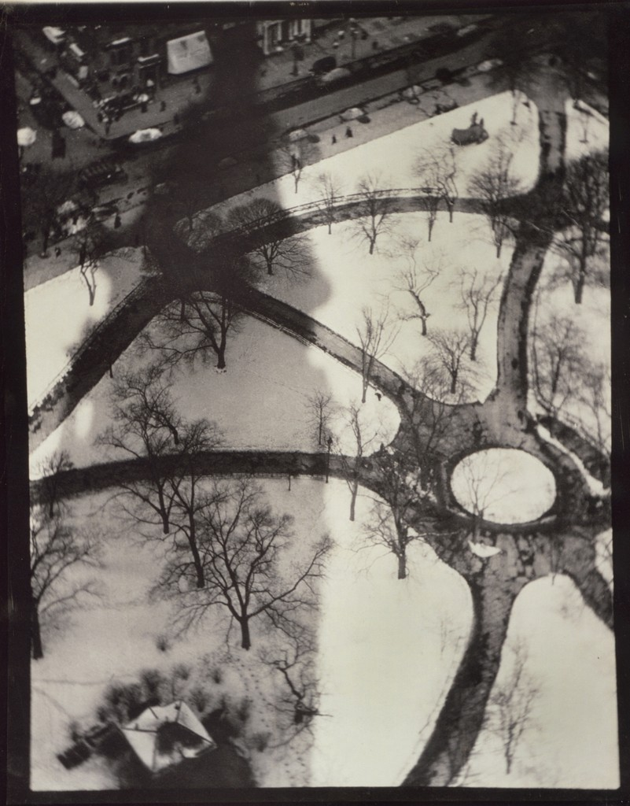
New Objectivity
Alvin Langdon Coburn
The Octopus 1
1912

Slide 54
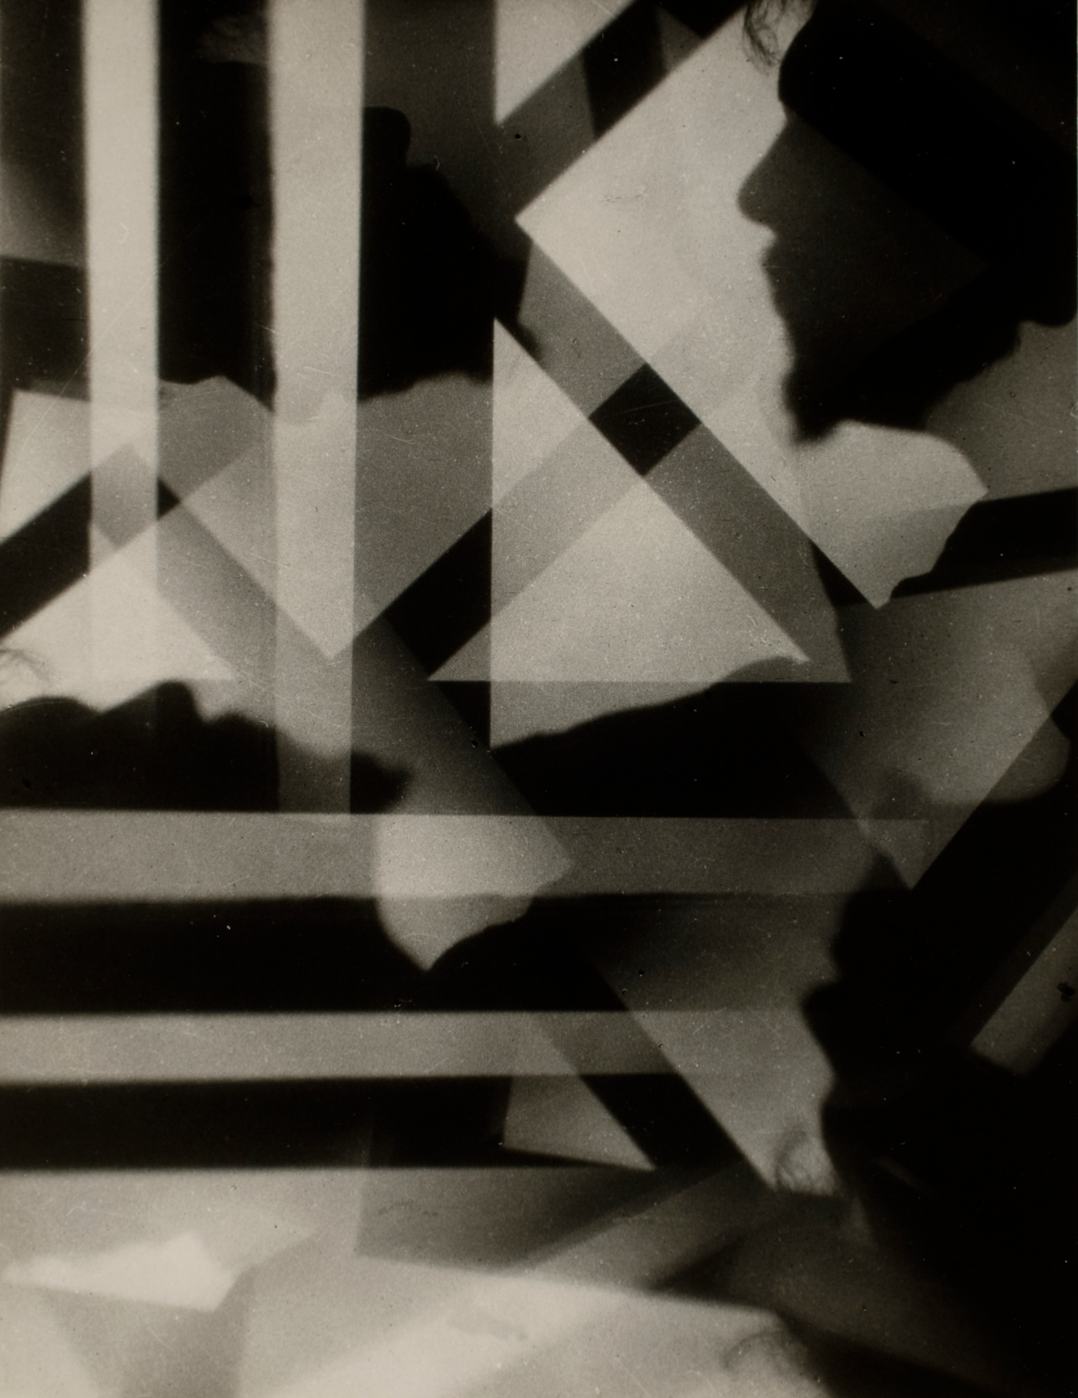
New Objectivity
Alvin Langdon Coburn
Vortograph of Ezra Pound 1917

Slide 55
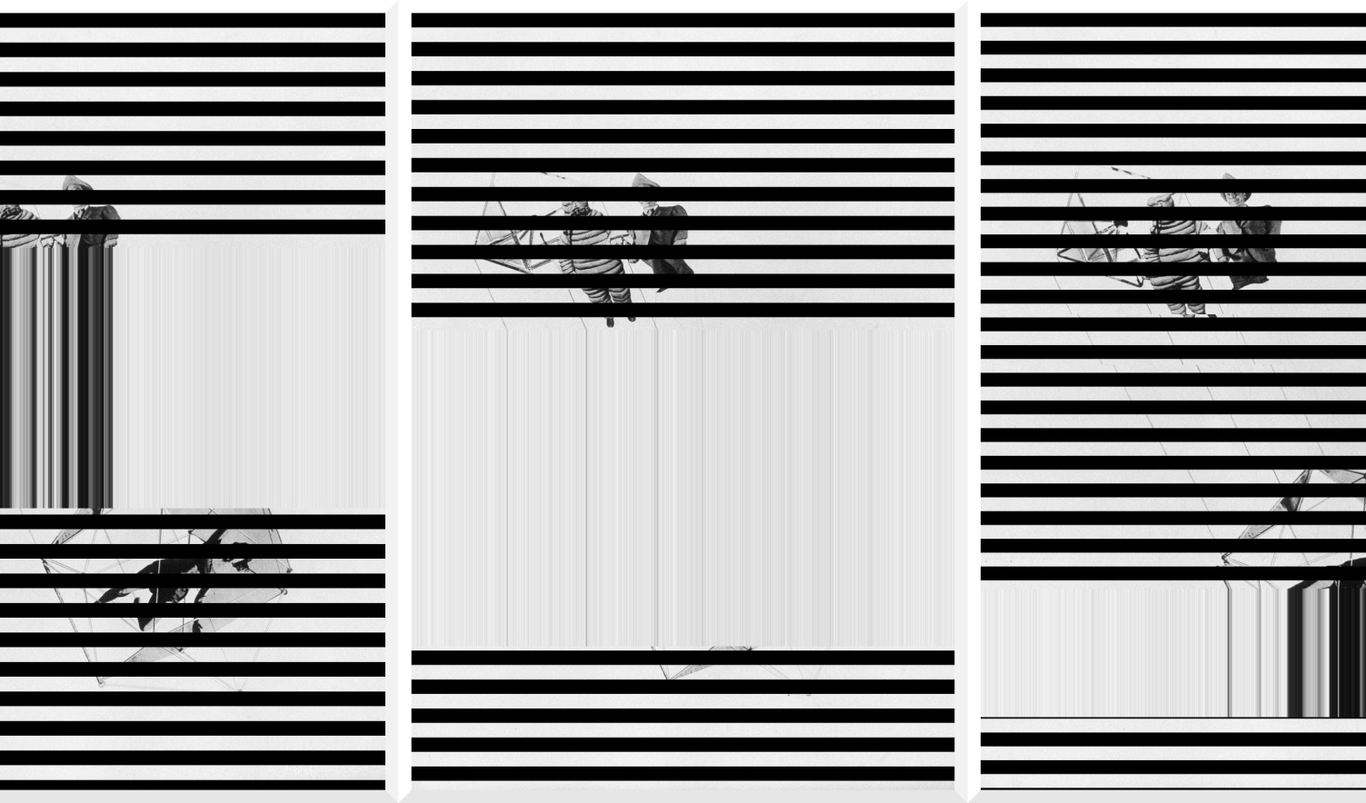
New Objectivity
Lázló Moholy Nagy
Untitled
1927
Dada scan manipulation photographique à partir

Slide 56
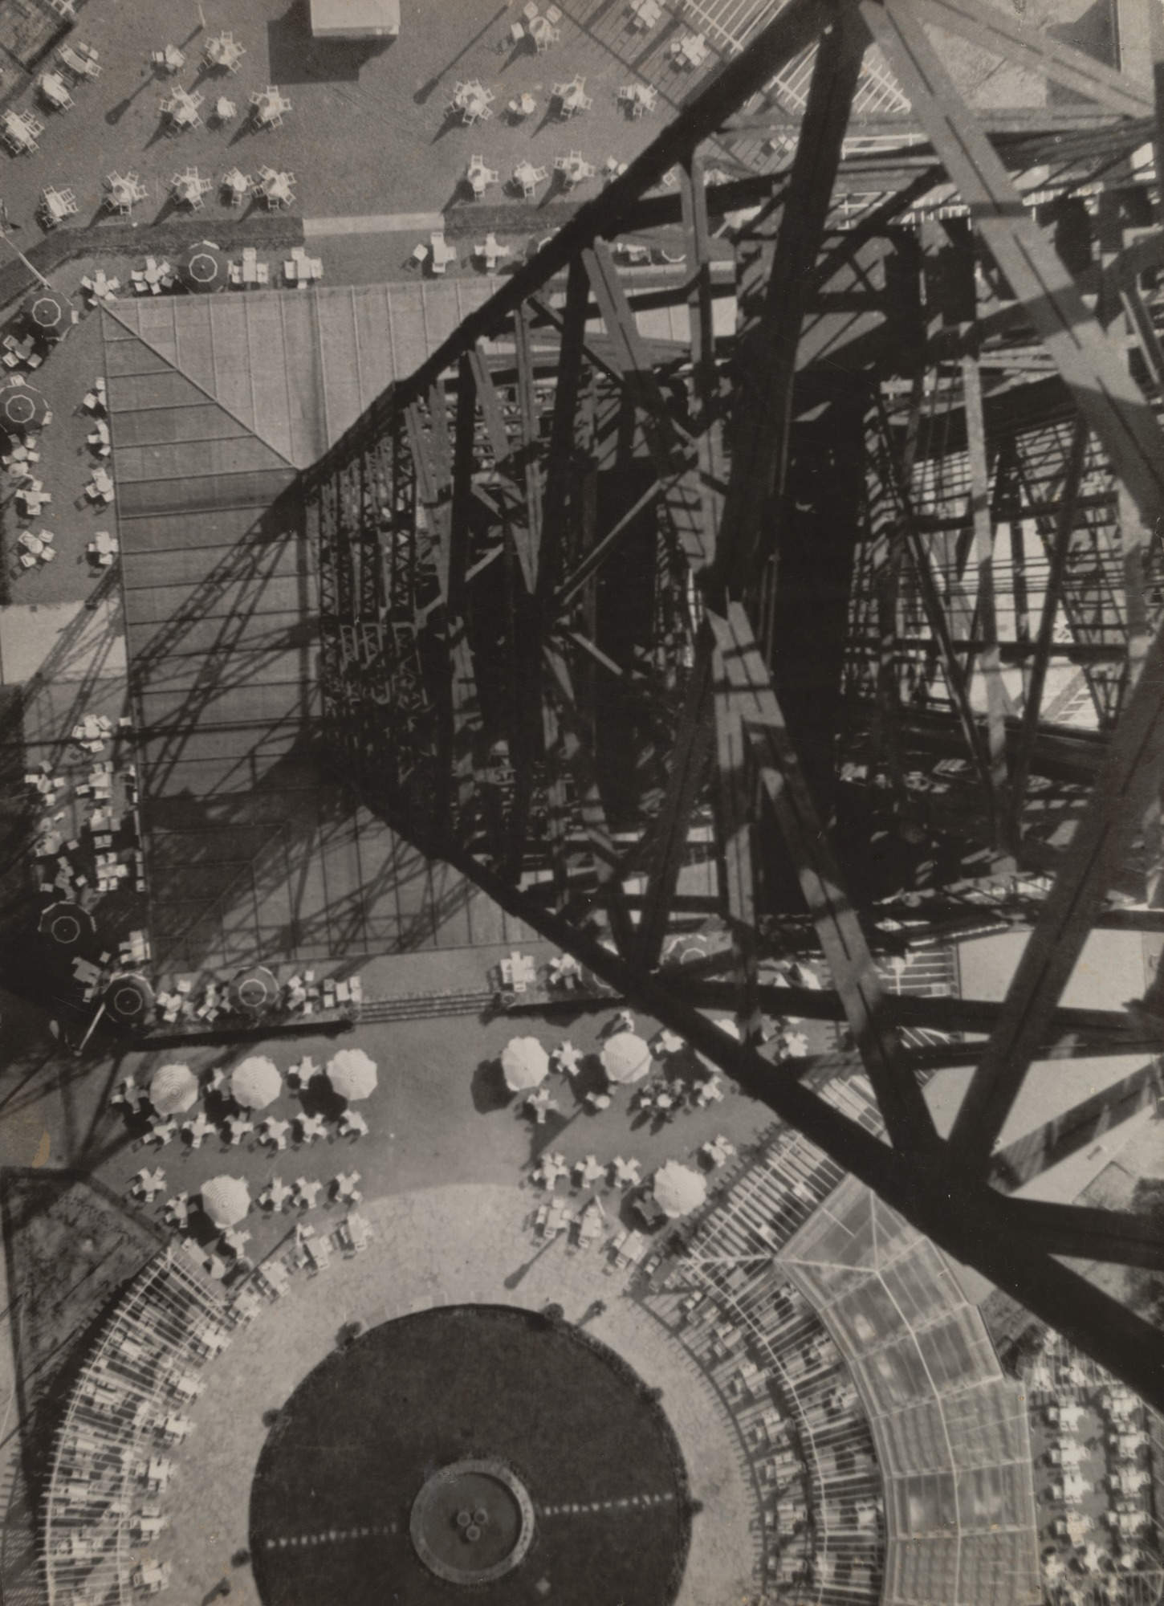
New Objectivity
Lázló Moholy Nagy
Berlin, Radio Tower
1928

Slide 57

New Objectivity
Jacob Riis
Bandits‘ Roost

Slide 58
New Objectivity
Man Ray (born Emmanuel Radnitzky; August 27, 1890 – November 18, 1976) was an American visual artist who spent most of his career in France. He was a significant contributor to the Dada and Surrealist movements, although his ties to each were informal.

Slide 59

New Objectivity
Man Ray

Slide 60

New Objectivity
Man Ray
Kiki de Montparnasse {Alice Prin}

Slide 61

New Objectivity
Man Ray
Glass Tears
1933

Slide 62

New Objectivity
Man Ray
SLEEPING WOMAN
Solarised Print
This is a partially reversed print made by momentary exposure to light during development.
Very tricky to get right.

Slide 63
New Objectivity
Summing up.
In 1915 Strand began working in straight photography. This was photography that used minimal manipulation. It was more direct.

Slide 64
New Objectivity
Summing up.
In 1923 Paul Strand said
“When you cease to be a student you might as well be dead as far as the significance of your work is concerned. And I say to you, before you give your time, and you will have to give much to photography, find out in yourselves how much it means to you.”

Slide 65
New Objectivity
Summing up.
The lesson here is to never stop being a student. Keep the fire for personal growth fed with learning. There is no endgame. Strand said the field of photography is one that will never be fully explored. ‘The field is limitless, inexhaustible’

Slide 66
New Objectivity
Summing up.
To grow as photographers, we must continue to be students. Continue to learn. Learn new techniques. New approaches. Study the work of other photographers, past and present.

Slide 67
New Objectivity
                The End

