Slide 1
José Ortiz-Echagüe
Spanish Photographer
1886-1980

Slide 2
José Ortiz-Echagüe
A Spanish entrepreneur, industrial and military engineer, pilot and photographer, founder of Construcciones Aeronáuticas SA (CASA) and Honorary lifetime President of SEAT.
He discovered the art of photography at the age of 12. In 1903, he made a photo in La Rioja during the sermon in a village church.
Here is a selection of his prolific work. Lots of Castles and People.

Slide 3
José Ortiz-Echagüe
Ortiz-Echagüe believed strongly on the one hand that Spain must modernize itself in accordance with the spirit of the times but on the other hand was well aware that a broad modernization could lead to disappearance of traditional clothing, a change in the villages and even a transformation of the landscape.
He wanted at least to capture with his camera and hold this cultural heritage, before the change occurred.

Slide 4
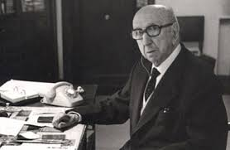
José Ortiz-Echagüe

Slide 5
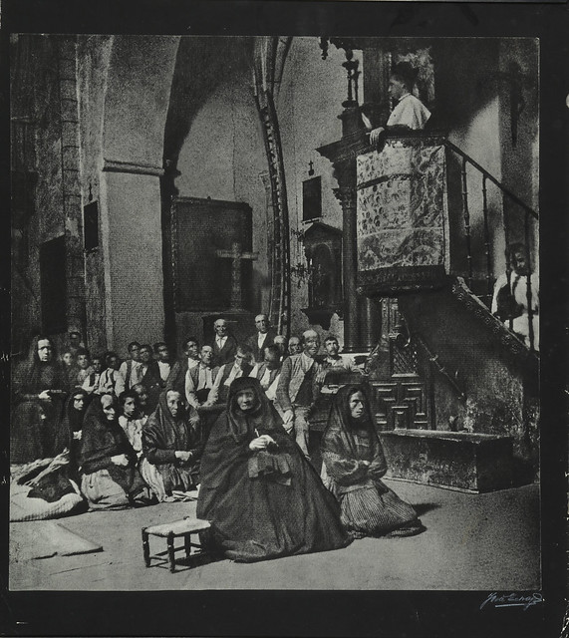
José Ortiz-Echagüe
1903
Sermon in a village church.

Slide 6
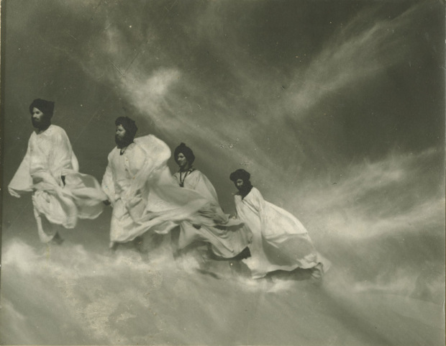
José Ortiz-Echagüe
Siroco en el Sahara
1965

Slide 7
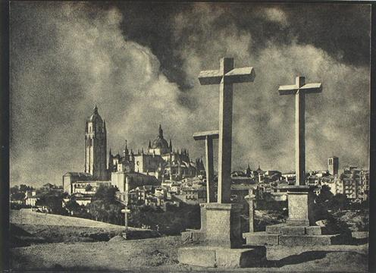
José Ortiz-Echagüe
Crosses

Slide 8
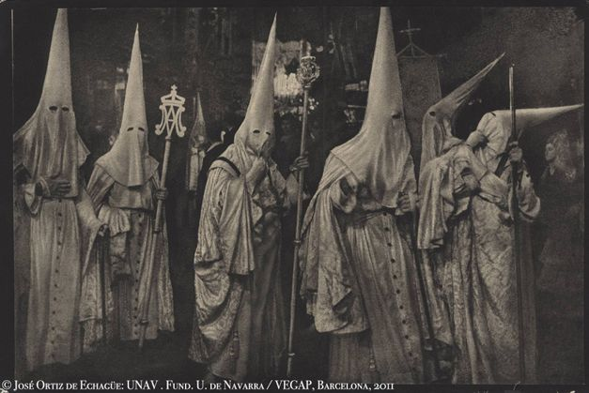
José Ortiz-Echagüe
Not the
Ku-Kux-Klan

Slide 9
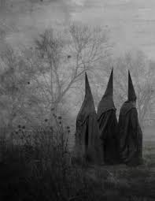
José Ortiz-Echagüe
Penitents

Slide 10
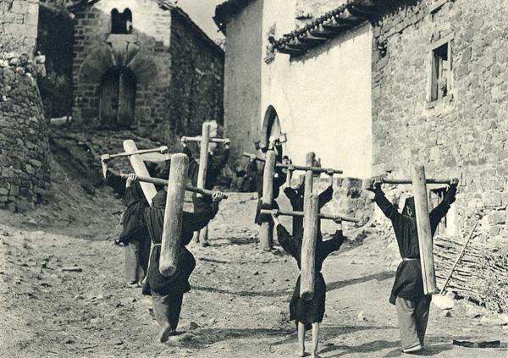
José Ortiz-Echagüe
Penitents carrying Crosses

Slide 11
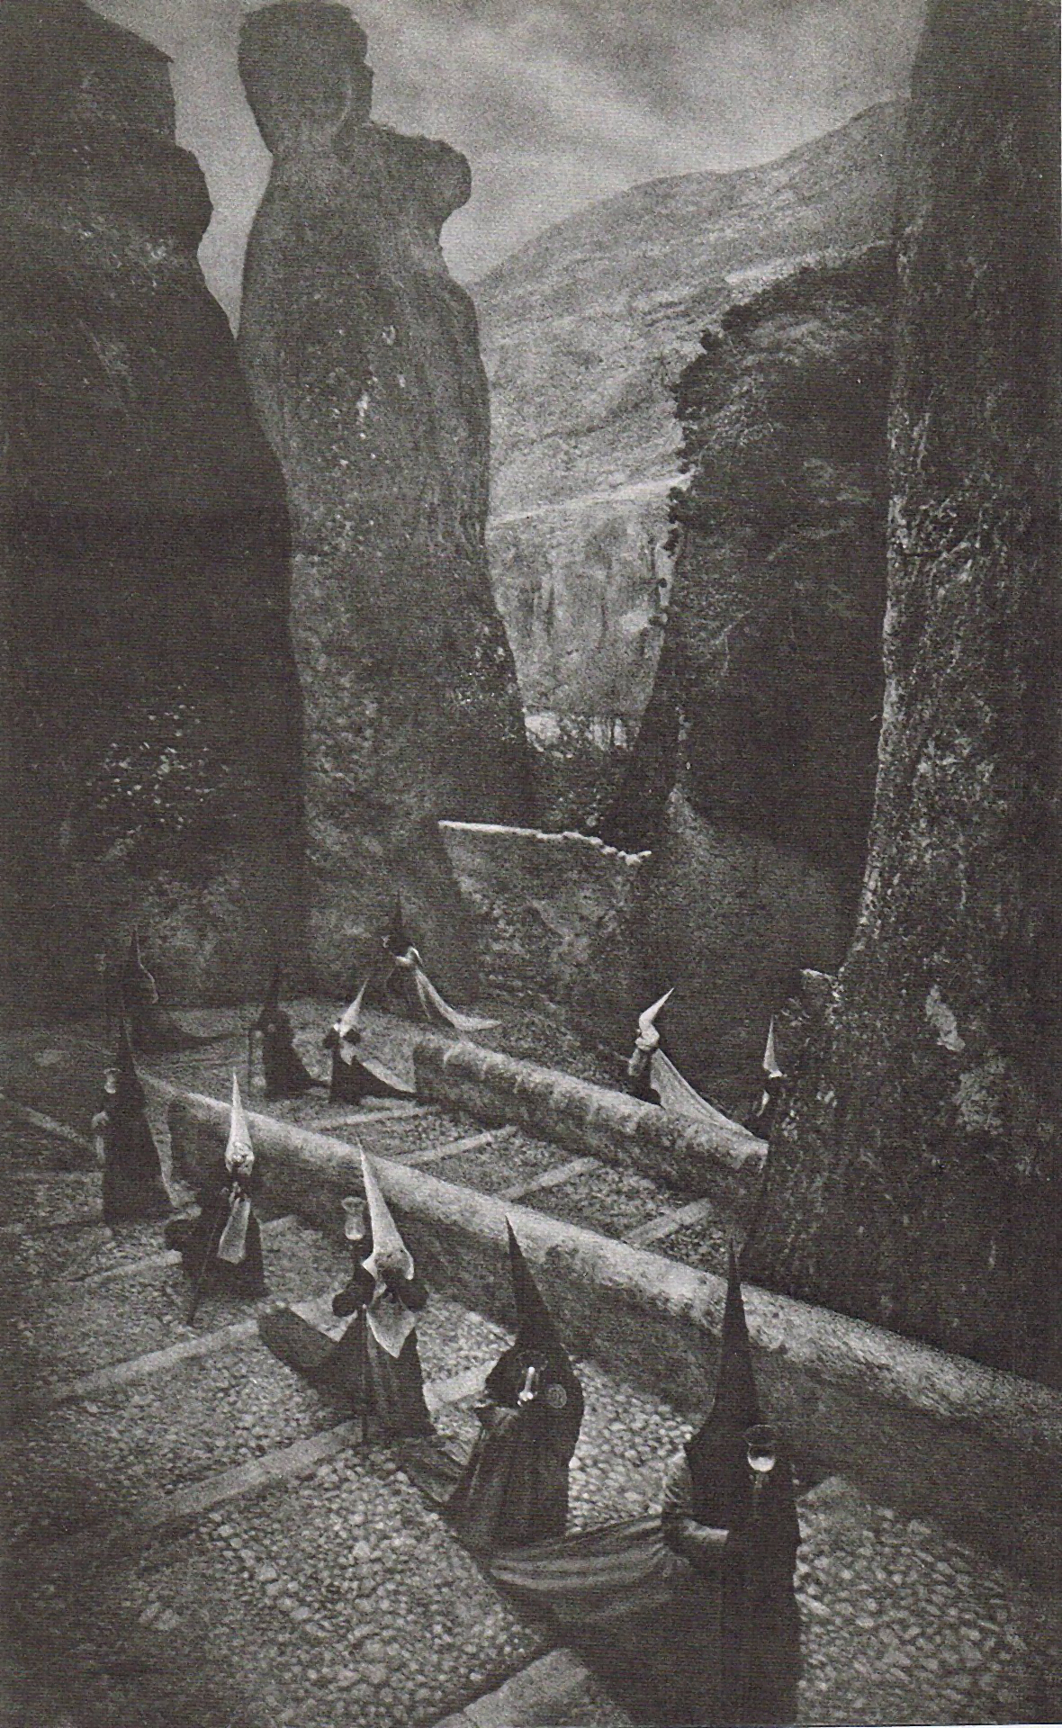
José Ortiz-Echagüe
Penitents in Cuenca,
1940

Slide 12
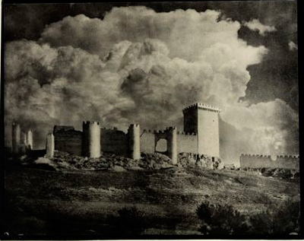
José Ortiz-Echagüe
Spanish Castle

Slide 13
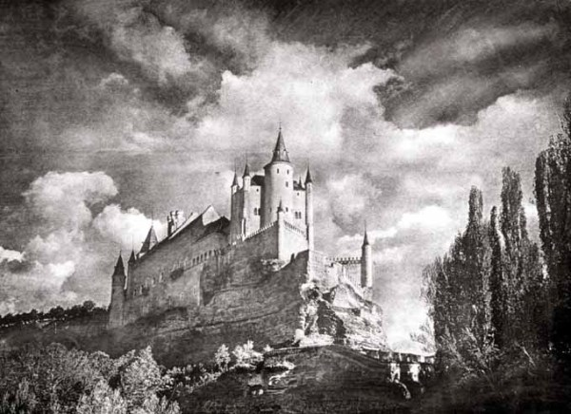
José Ortiz-Echagüe
Spanish Castle

Slide 14
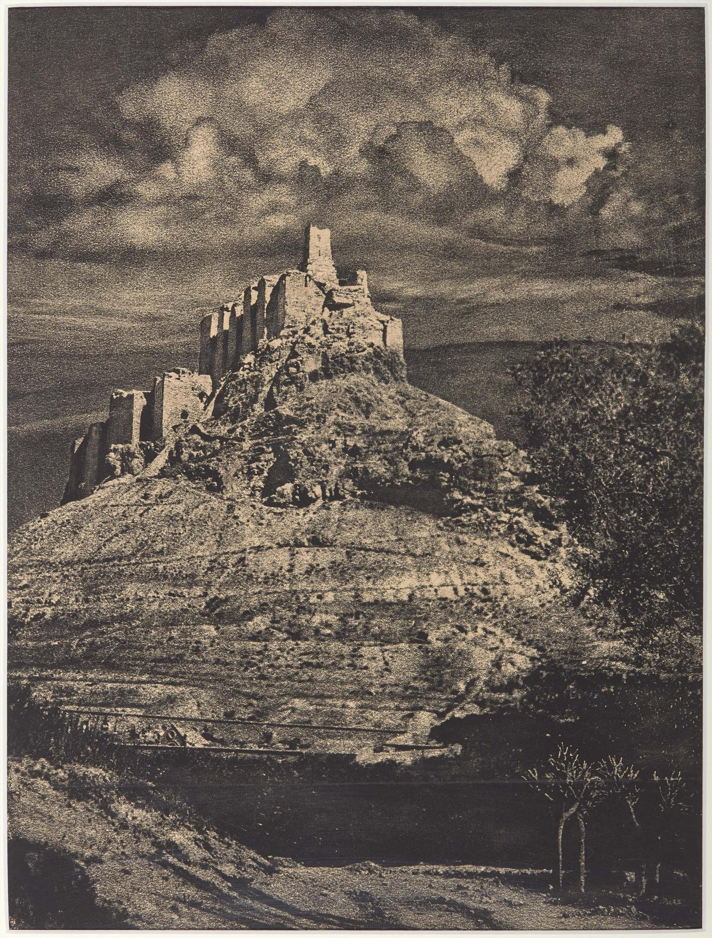
José Ortiz-Echagüe
Spanish Castle

Slide 15
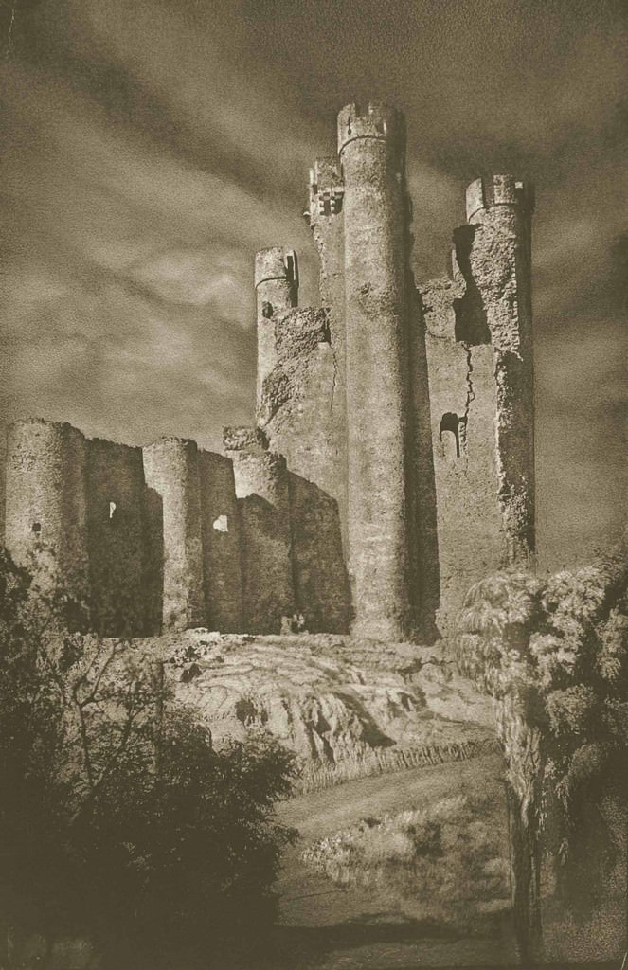
José Ortiz-Echagüe
Spanish Castle

Slide 16
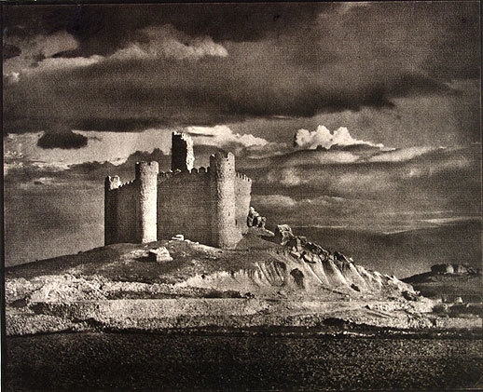
José Ortiz-Echagüe
Spanish Castle

Slide 17
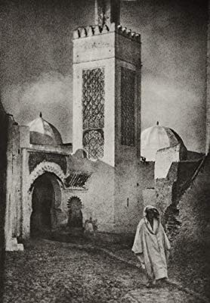
José Ortiz-Echagüe
North Africa

Slide 18
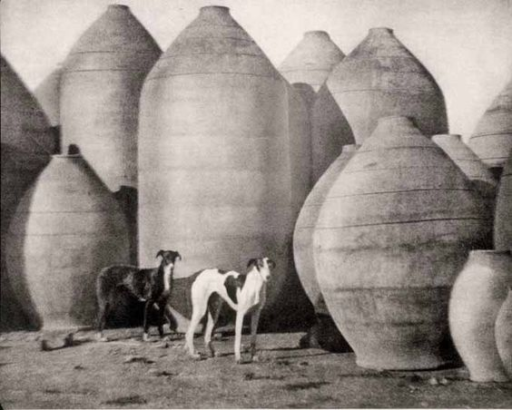
José Ortiz-Echagüe
Olive Jars and Hounds

Slide 19
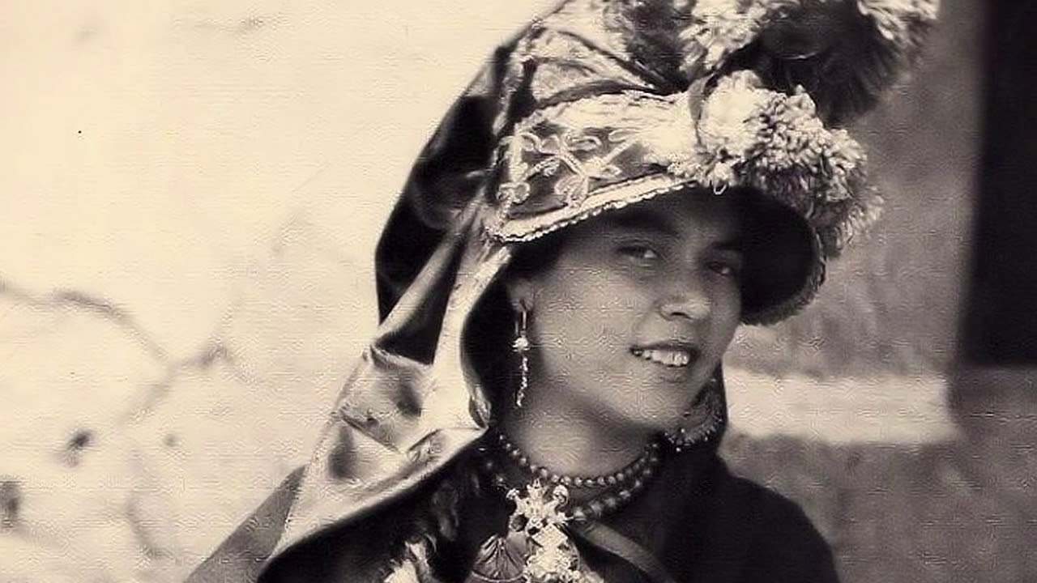
José Ortiz-Echagüe
Grupo Folk Pelujáncanu
El Pollu de Montehermoso

Slide 20
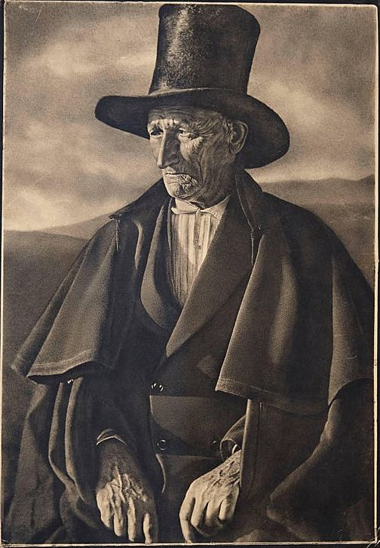
José Ortiz-Echagüe
Lino Dressed in Mourning

Slide 21
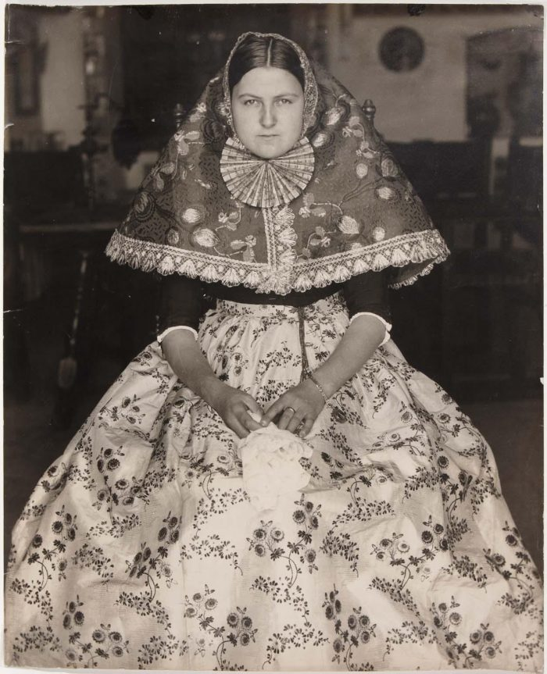
José Ortiz-Echagüe
Rural Spain

Slide 22
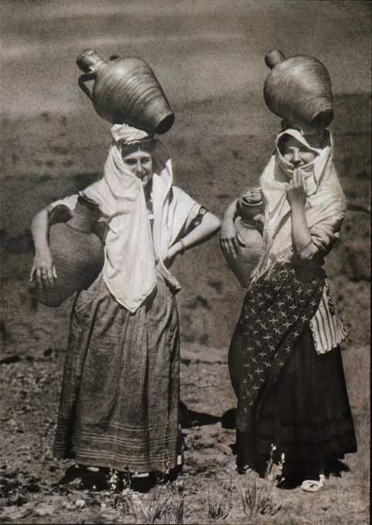
José Ortiz-Echagüe
Aquadoras
Water Carriers

Slide 23
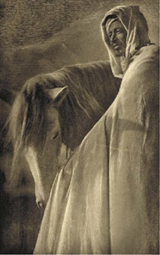
José Ortiz-Echagüe
Two Friends

Slide 24
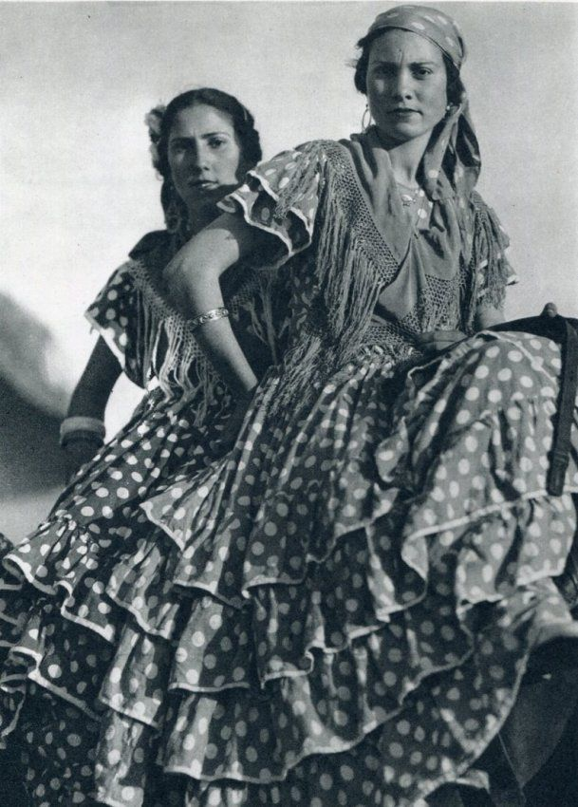
José Ortiz-Echagüe
Girls on a Horse

Slide 25
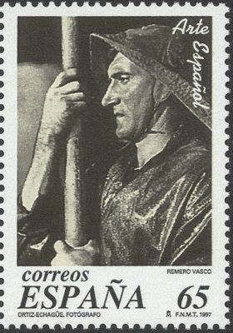
José Ortiz-Echagüe
Fisherman with Oar on a stamp
1997

Slide 26
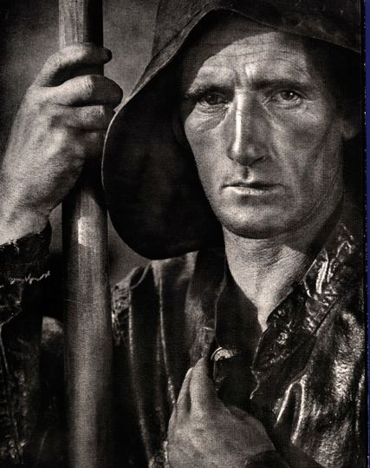
José Ortiz-Echagüe
Fisherman with Oar

Slide 27
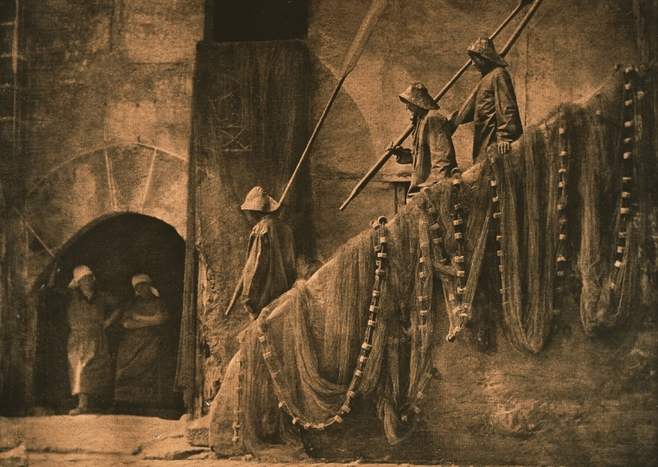
José Ortiz-Echagüe
Men with oars

Slide 28
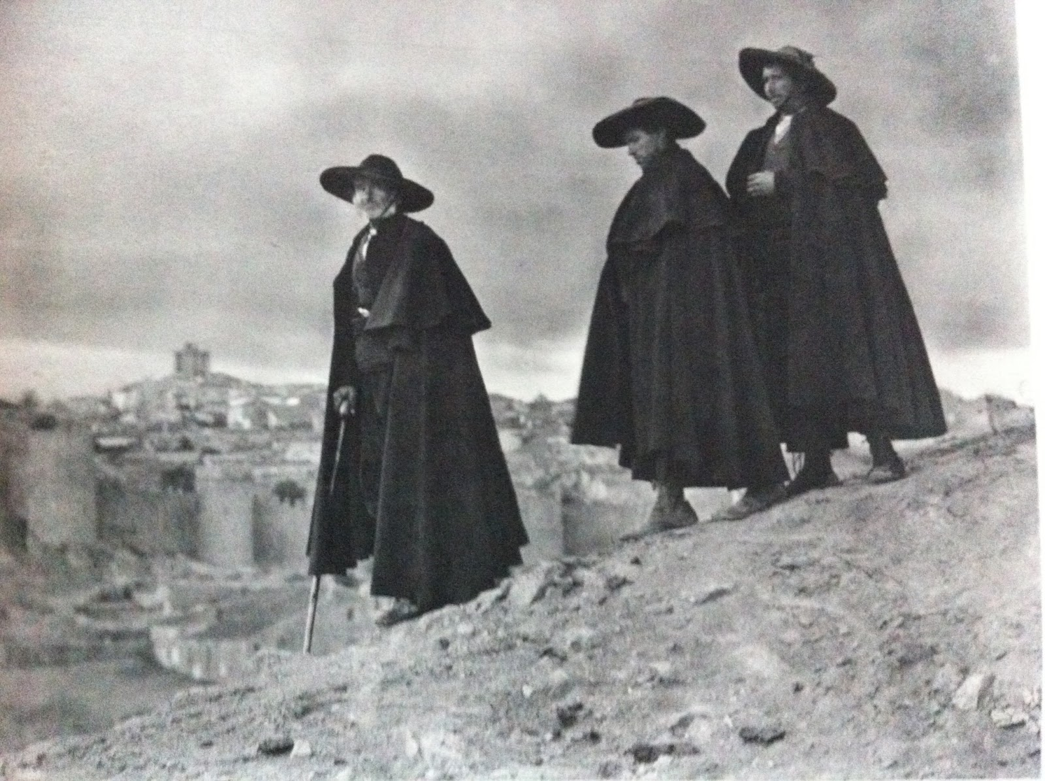
José Ortiz-Echagüe
The Dark Men

Slide 29
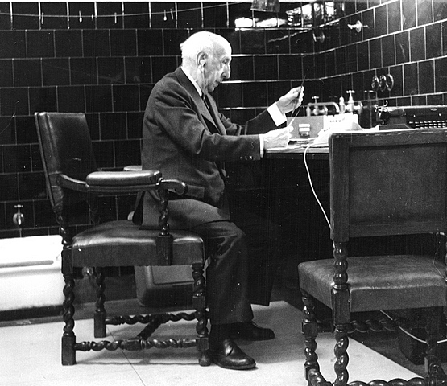
José Ortiz-Echagüe
The man himself in his laboratory

Slide 30
This work is licensed under
a Creative Commons Attribution-ShareAlike 3.0 Unported License.
It makes use of the works of
Kelly Loves Whales and Nick Merritt.

