Slide 1
Naturalism and Impressionism
Late Nineteenth & Early Twentieth Century Photography
The Royal Photographic Society,
The Linked Ring,
The Photo-Secession,
International Society of Pictorial Photographers
1

Slide 2
Naturalism and Impressionism
At some point in 19th Century photography was organised with the RPS setting the standards.
However, not all were happy and wanted more freedom and the recognition of Photography as a Fine Art.
So there arose the Linked Ring and Photo-Secessionists to make image aiming to be Art.
Emerson and Davison were the leaders. They set up the London Salon that became the model for Exhibitions ever since.
2

Slide 3
Naturalism and Impressionism
From the 1892 catalogue of RPS Exhibition
Of recent years it has become evident that the purely artistic is attainable by photographic means to a level not before suspected, and that whilst the RPS may be eminently useful in the development of chemical, optical and other scientific photographic enterprises by its very constitution it is wholly unsuited to support photography as a fine art, the interests of which are so distinct and have so little in common with the scientific element.
2

Slide 4
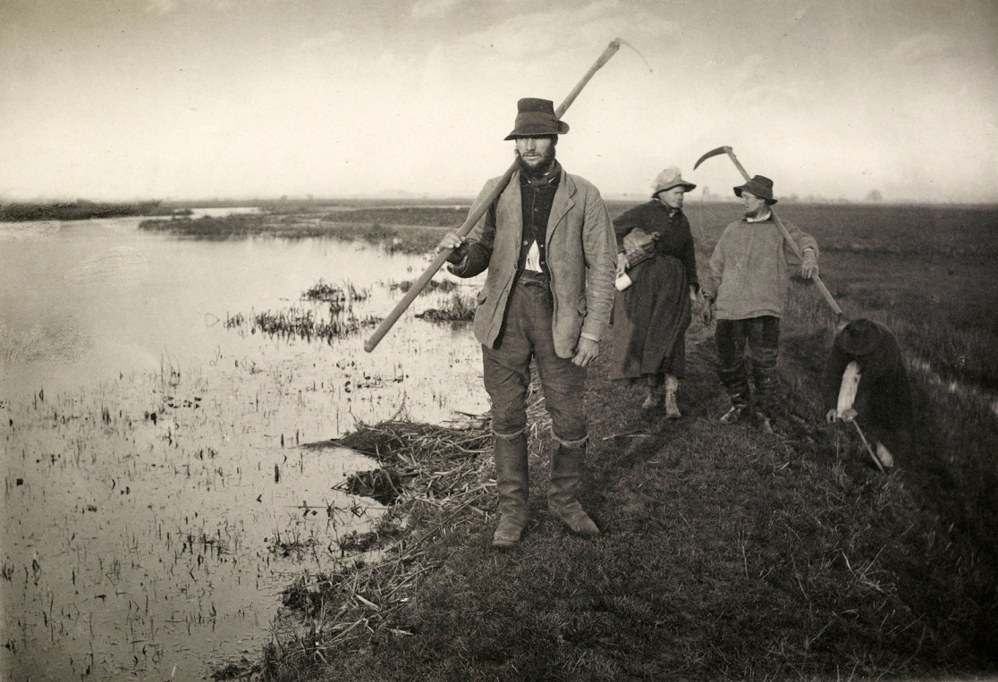
Naturalism
After the artificiality of Pictorial Photography at the end of the 19th Century Emerson urged a return to Nature for inspiration.
He photographed the Norfolk Broads for 10 years as shown on the previous photo and on the right.
His manifesto attracted George Davison,B Gay Wilkinson, Lyddell Sawyer & Frank M. Sutcliffe & more
Coming Home from the Marshes
2

Slide 5
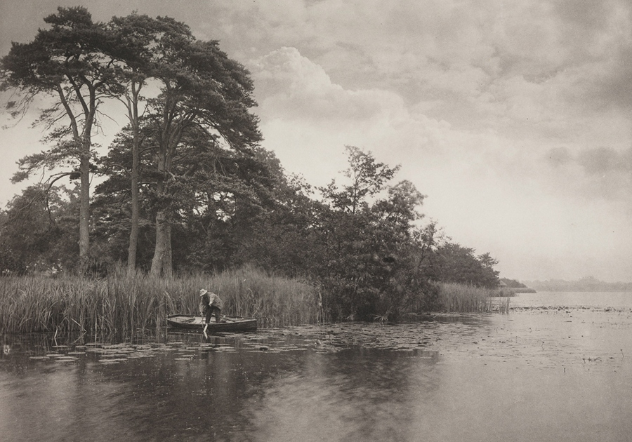
Peter henry Emerson 1889
2

Slide 6
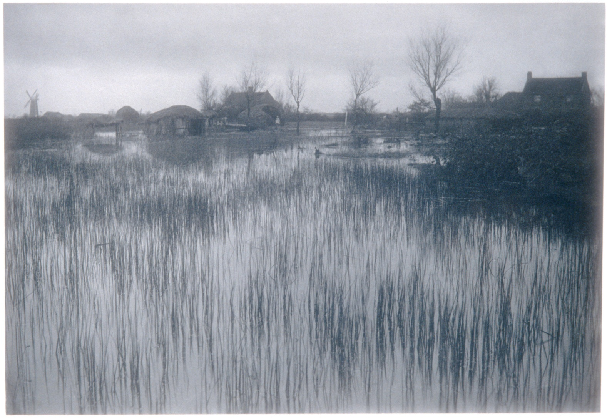
Peter henry Emerson
Rushy Shore
2

Slide 7
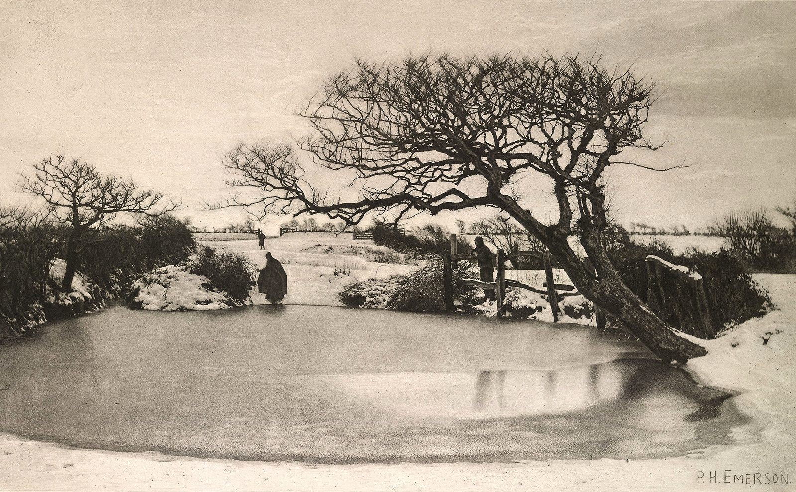
Peter henry Emerson
A Winters Morning
2

Slide 8
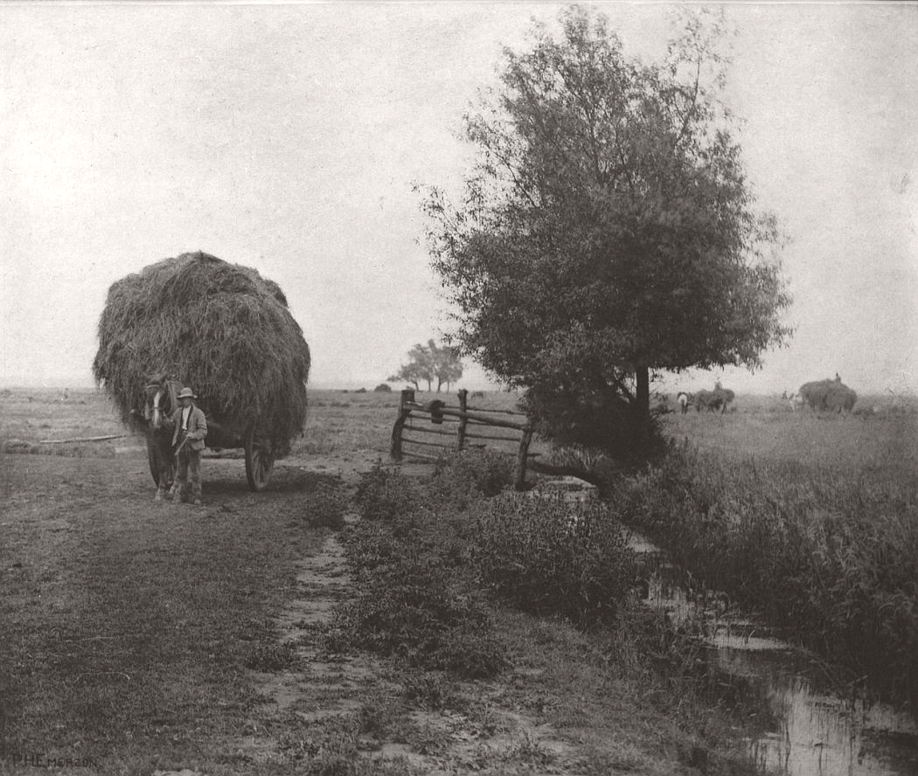
Peter henry Emerson
Rural Life
2

Slide 9
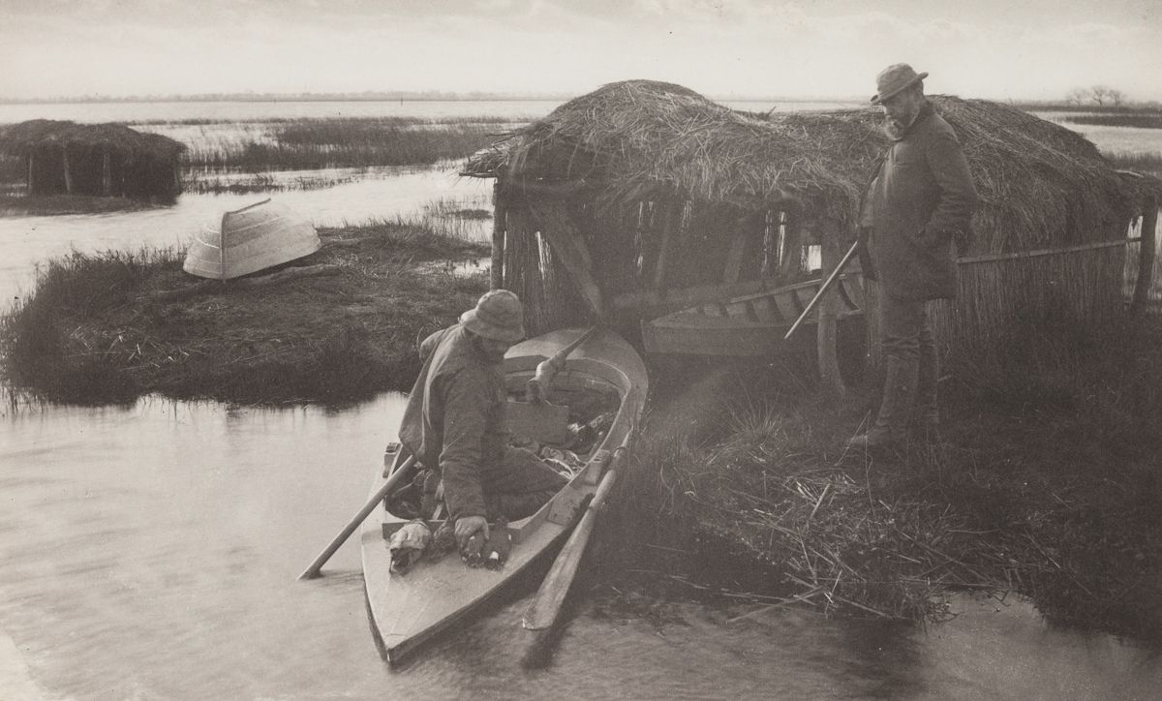
Peter henry Emerson
Punt Gun Boat
2

Slide 10
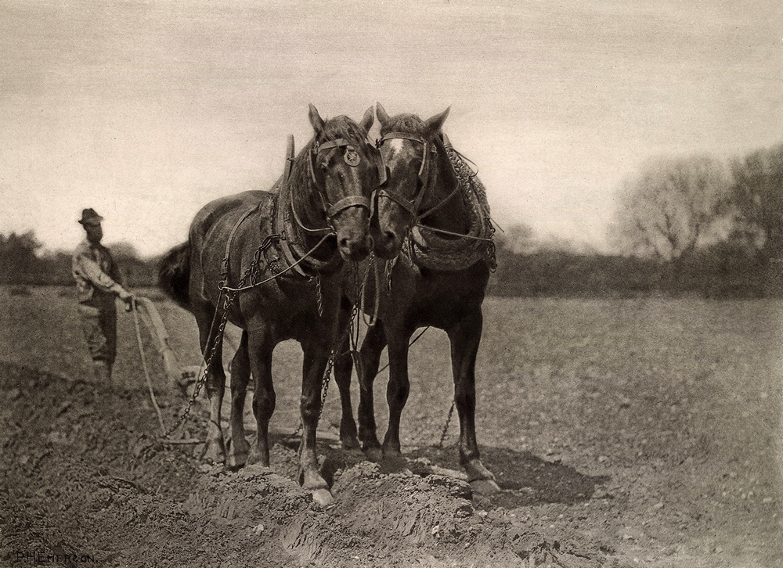
Peter henry Emerson
At Plough, The End of the Furrow
2

Slide 11
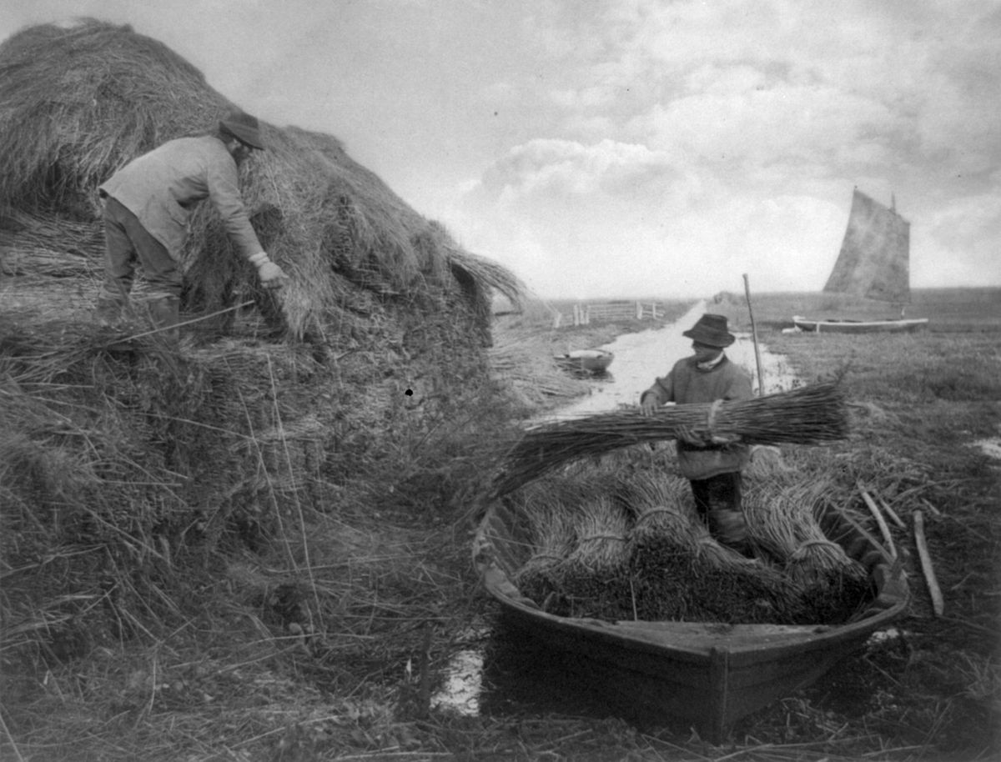
Peter henry Emerson
Ricking the Reeds
2

Slide 12
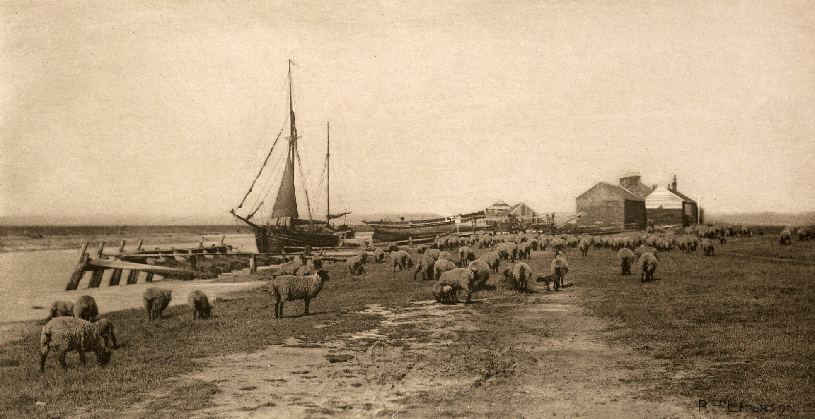
Peter henry Emerson
Blackshore, River Blythe, Suffolk 1888
2

Slide 13
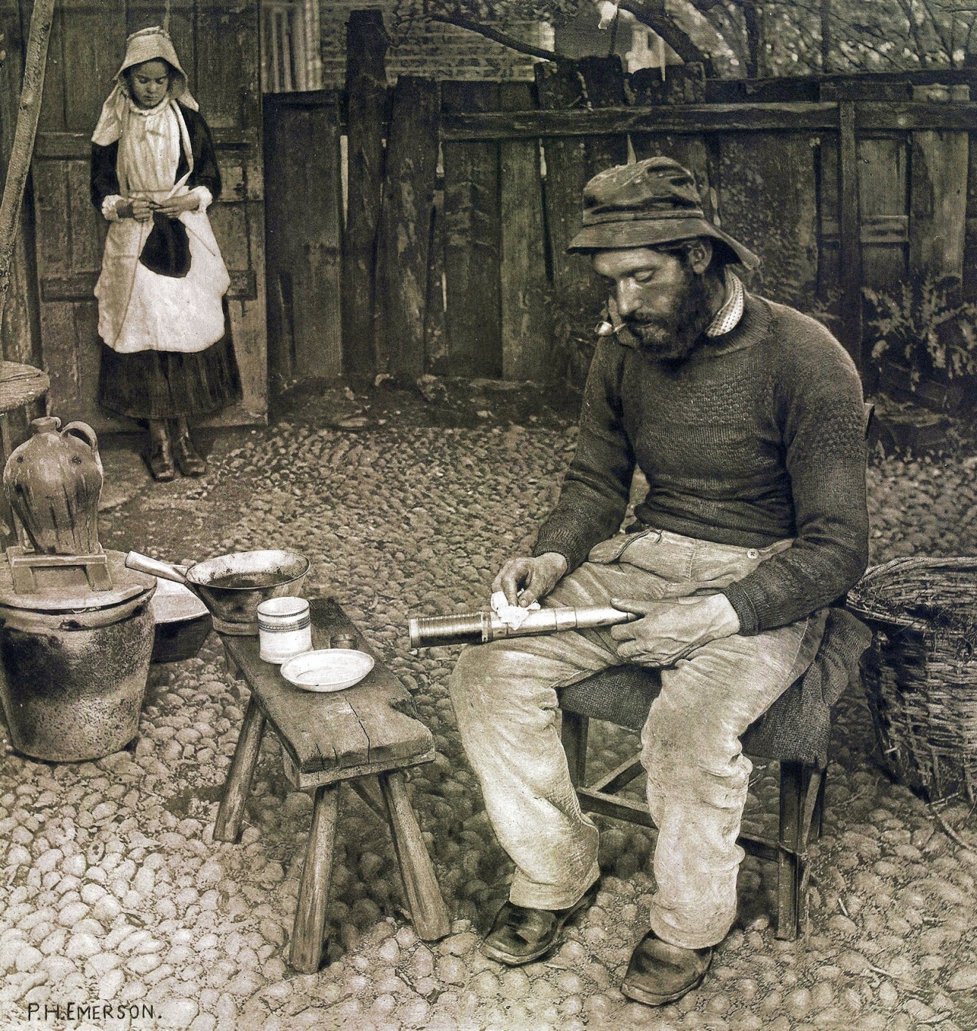
Peter henry Emerson
A Fisherman at Home
2

Slide 14
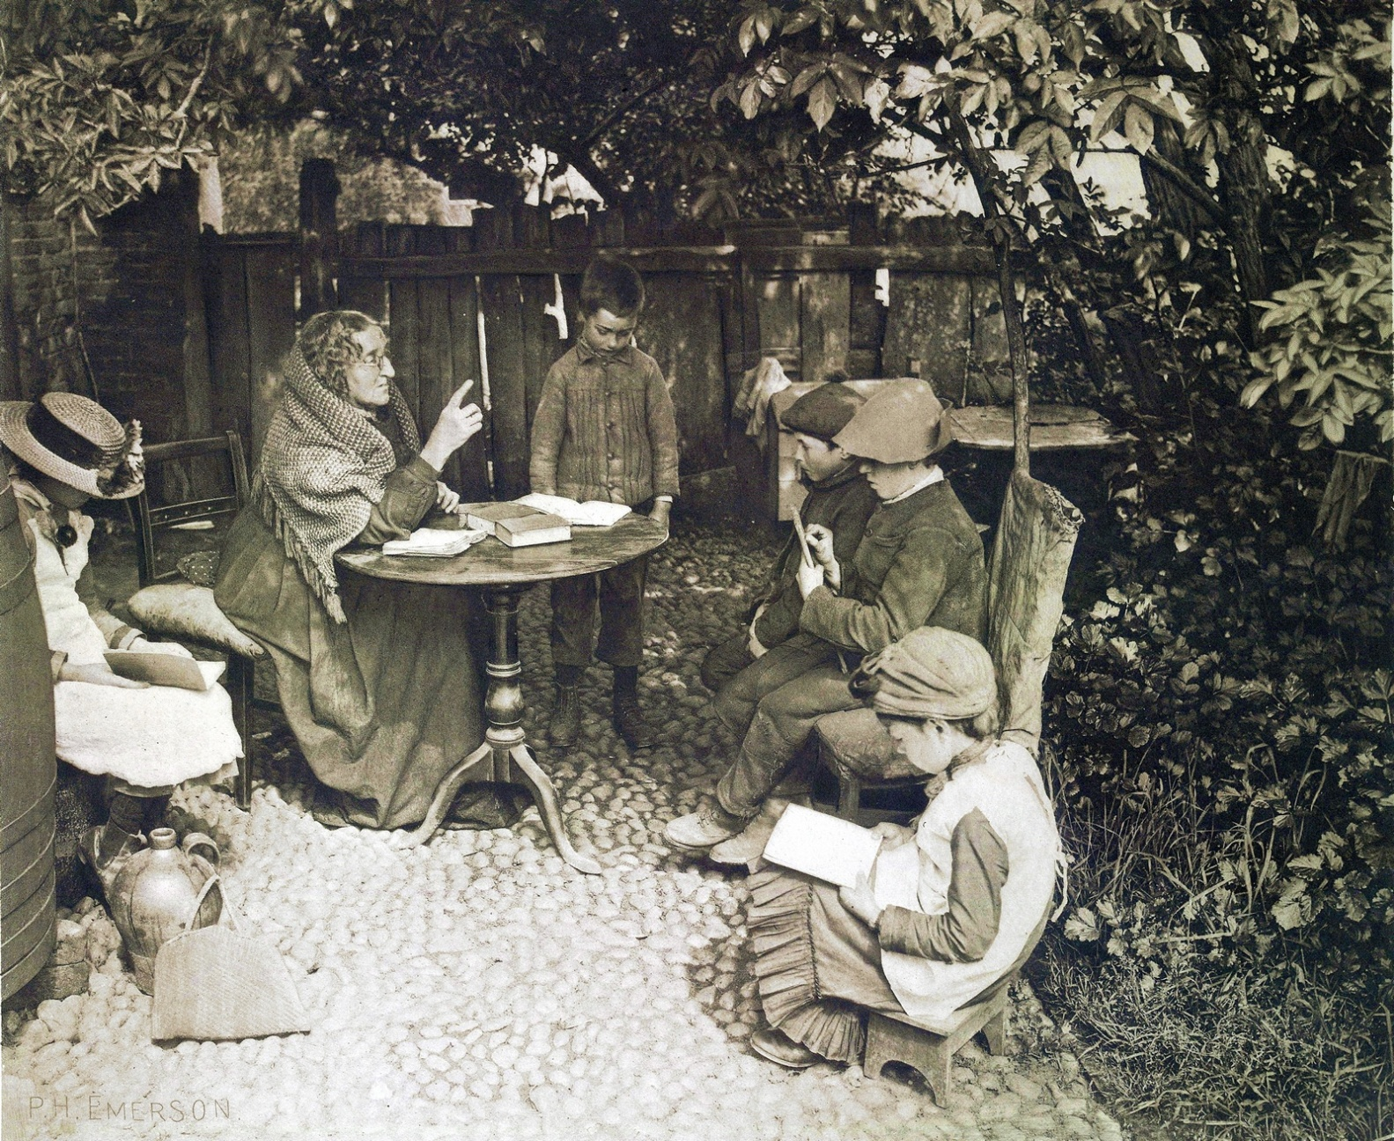
Peter henry Emerson
A Dame’s School
1887
2

Slide 15
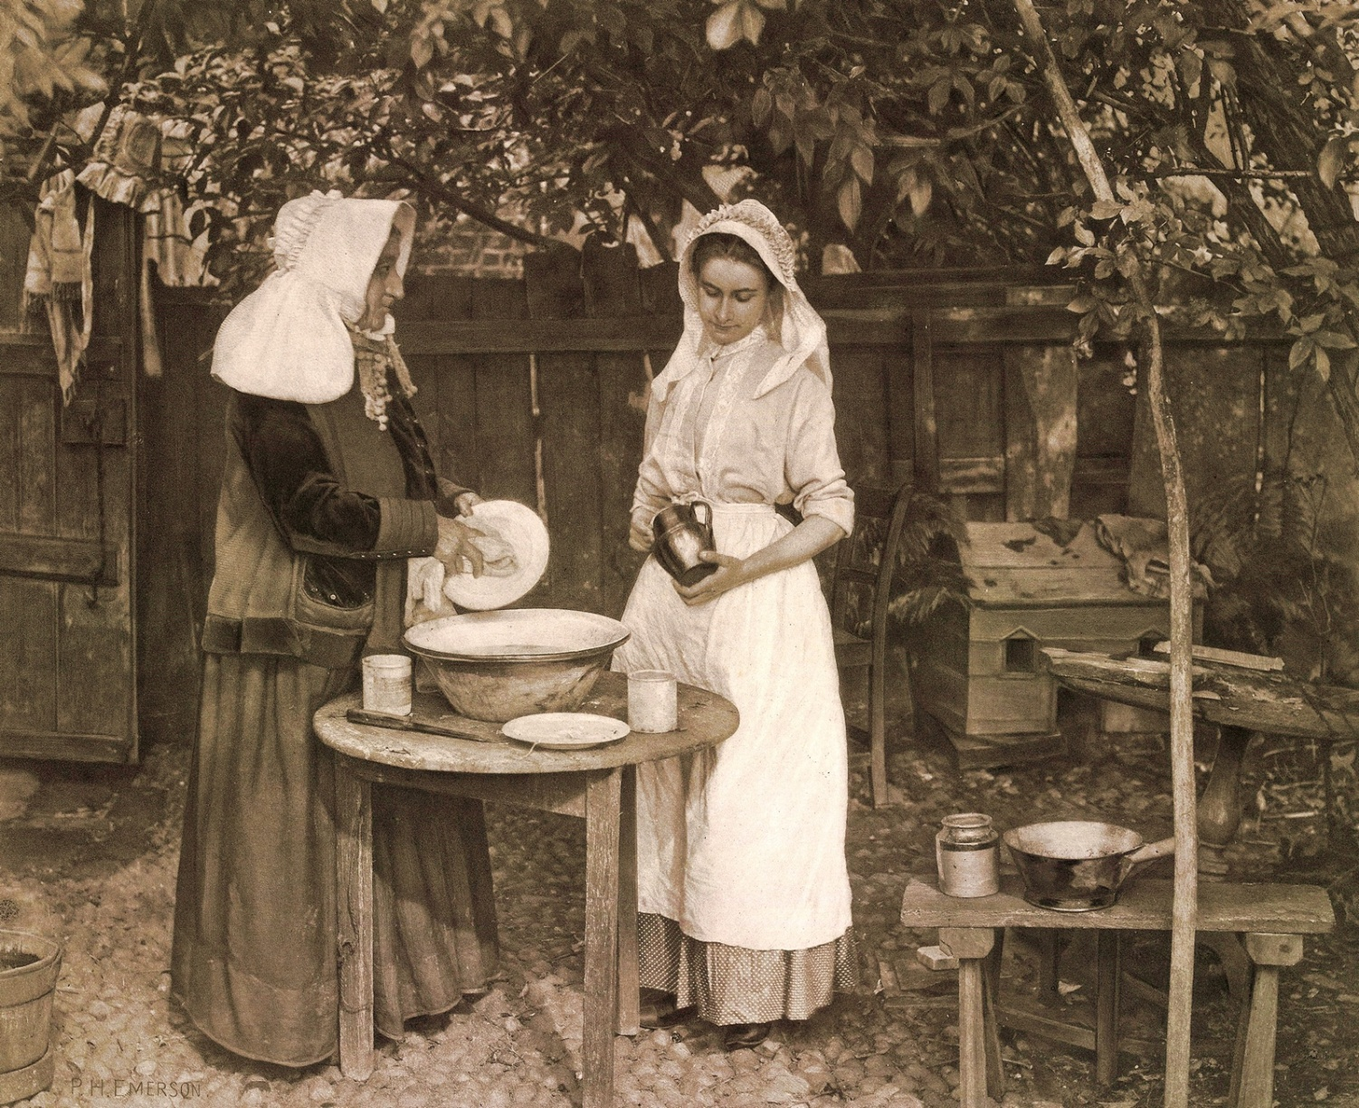
Peter henry Emerson
Confessions
2

Slide 16
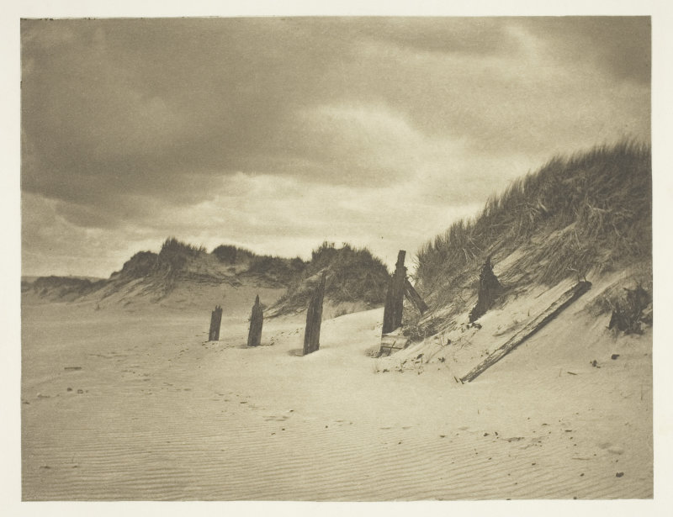
Benjamin gay wilkinson
Sand Dunes
2

Slide 17
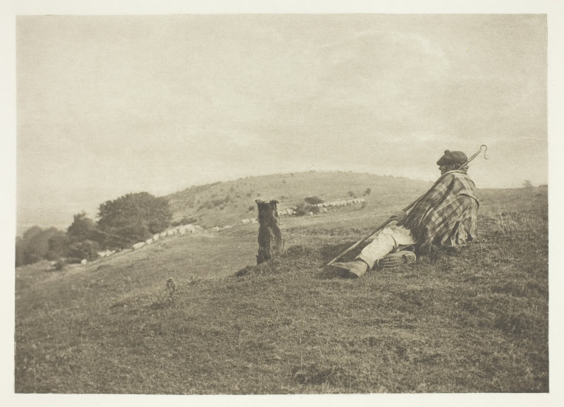
Benjamin gay wilkinson
Shepherd
2

Slide 18
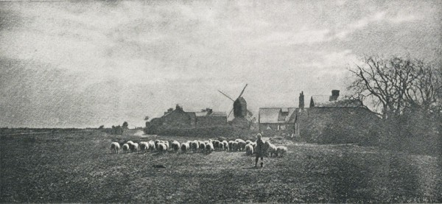
Benjamin gay wilkinson
Le Retour du Troupeau

Slide 19
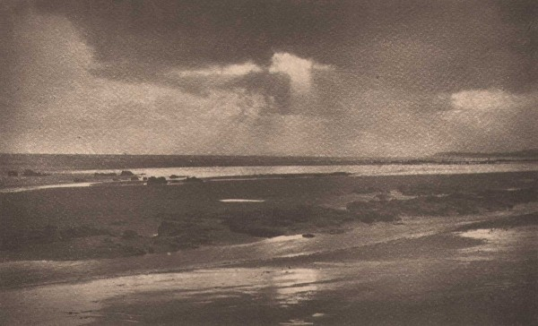
Benjamin gay wilkinson
Silver Strand
2

Slide 20
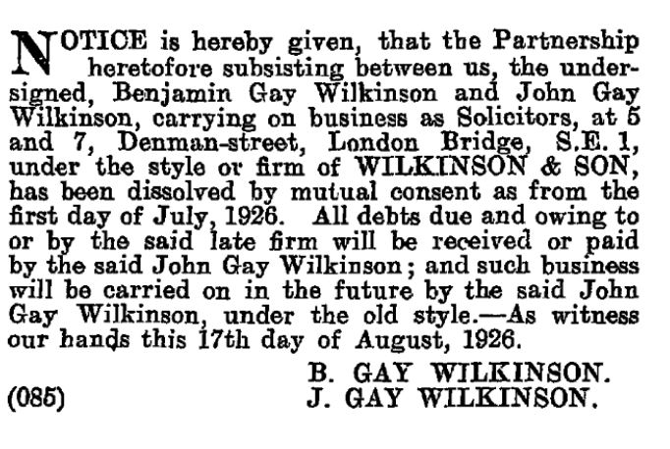
Benjamin gay wilkinson
Retirement:
He died the
following year
1927
2

Slide 21
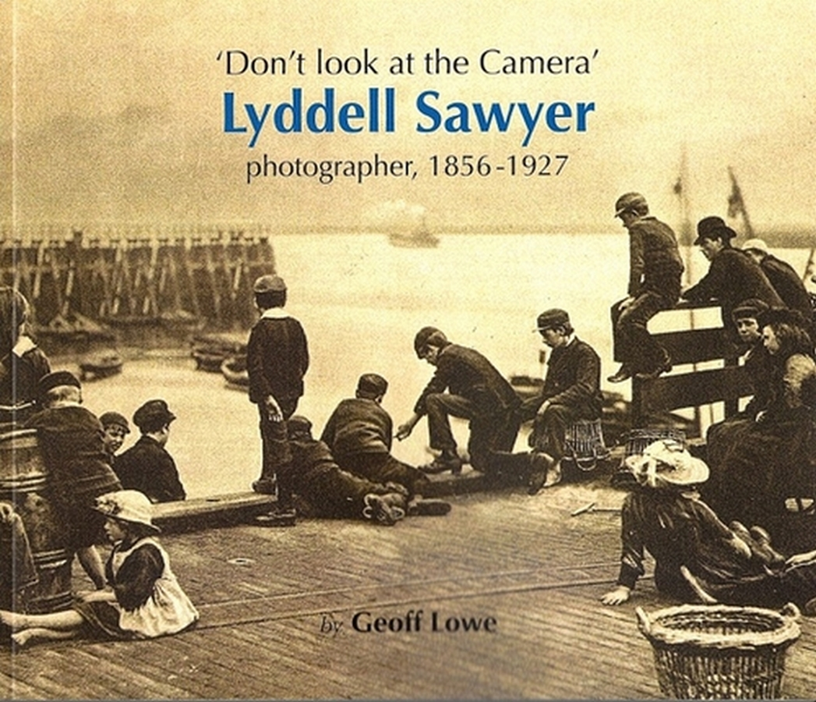
Lydell sawyer
1856 - 1927
Book Cover
Lyddell, or Lyd as he was later known, was a founder member of
'The Linked Ring', and although he showed almost 100 prints at what was later to become the Royal Photographic Society, only a handful of his images are well known.
2

Slide 22
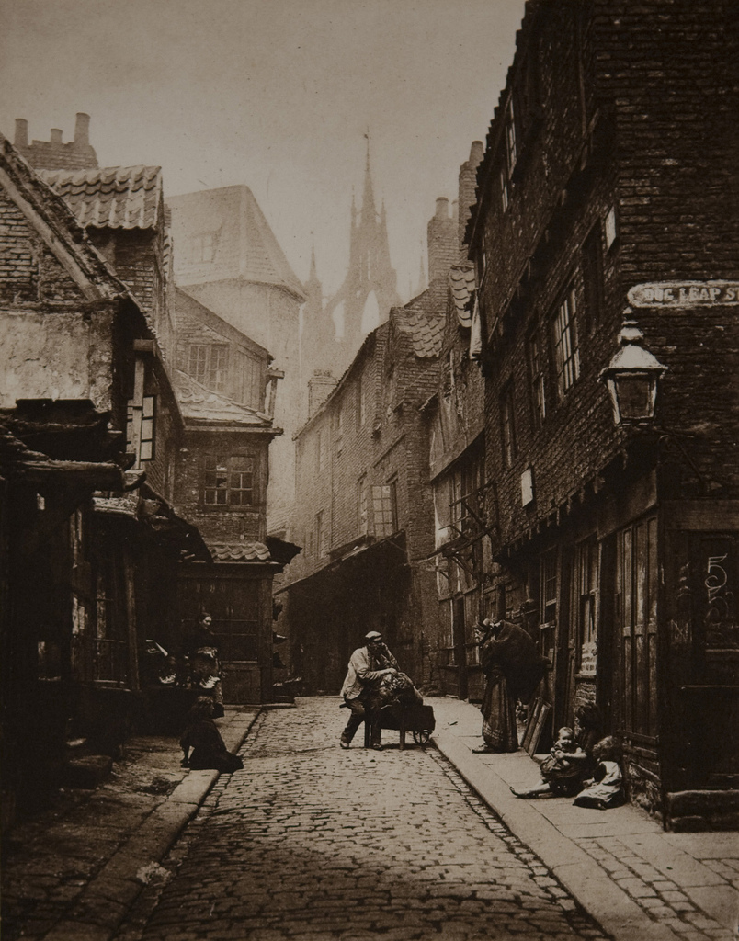
Lydell sawyer
The Castle Garth
Newcastle
1888
2

Slide 23
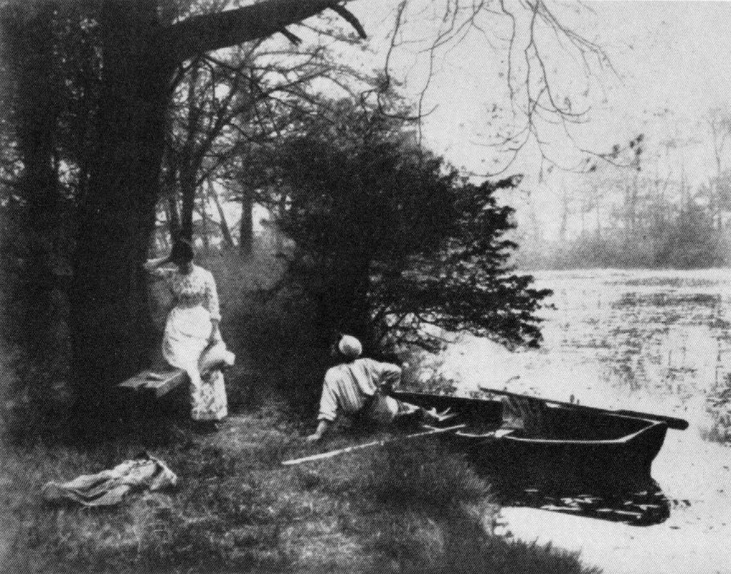
Lydell sawyer
In the Twilight
2

Slide 24
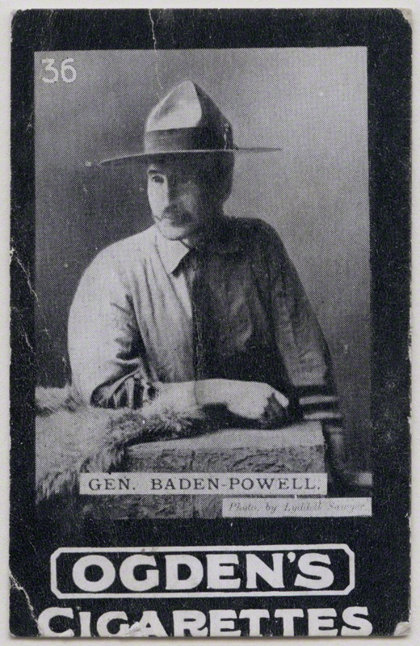
Lydell sawyer
Baden Powell
2

Slide 25
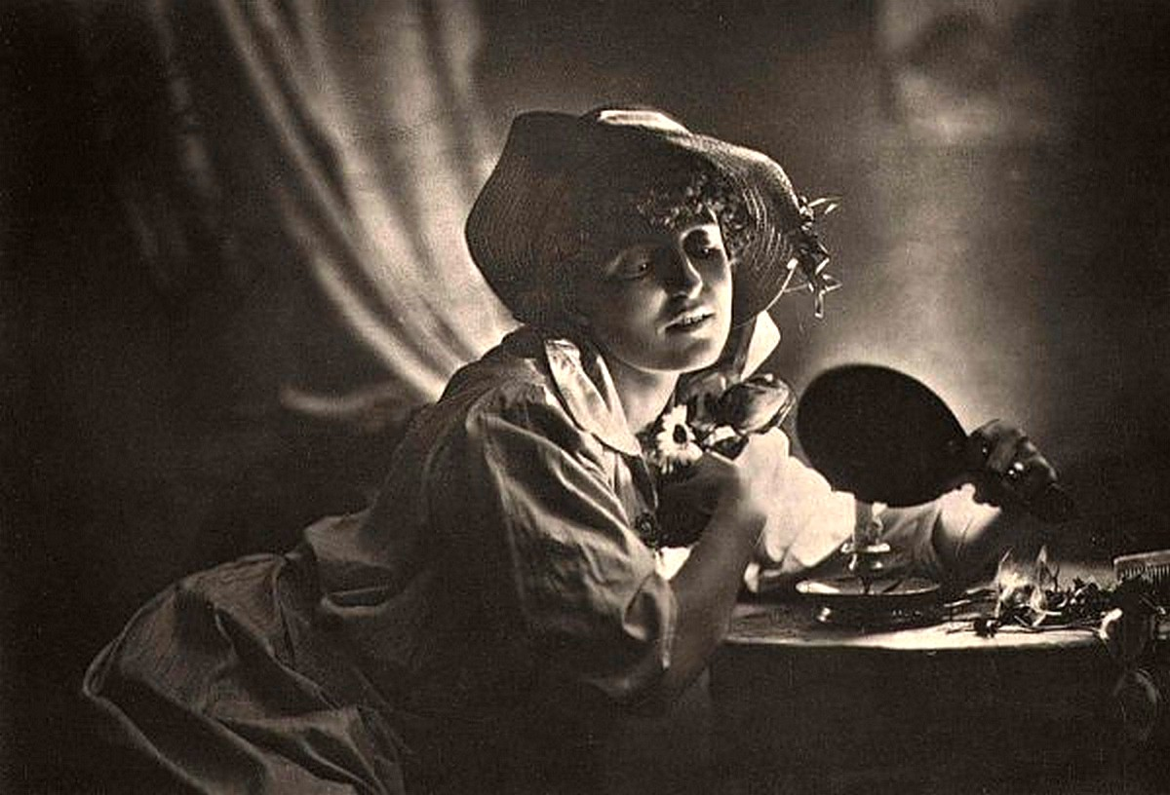
Lydell sawyer
Reflections
2

Slide 26
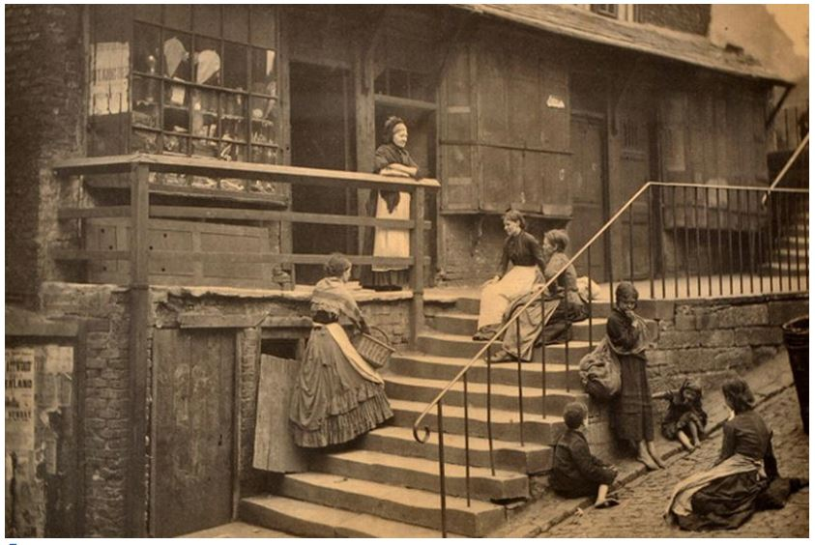
Lydell sawyer
Pilgrim Street Newcastle
2

Slide 27
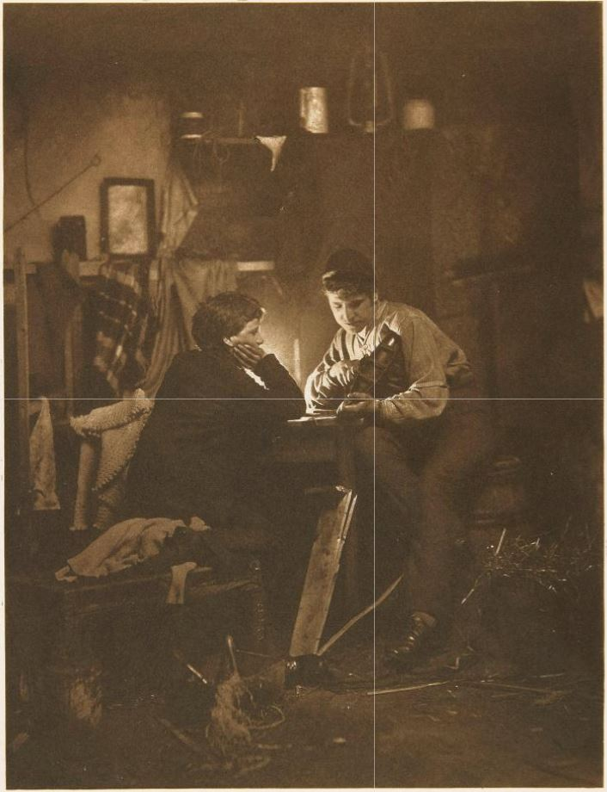
Lydell sawyer
The Boat Builders
2

Slide 28
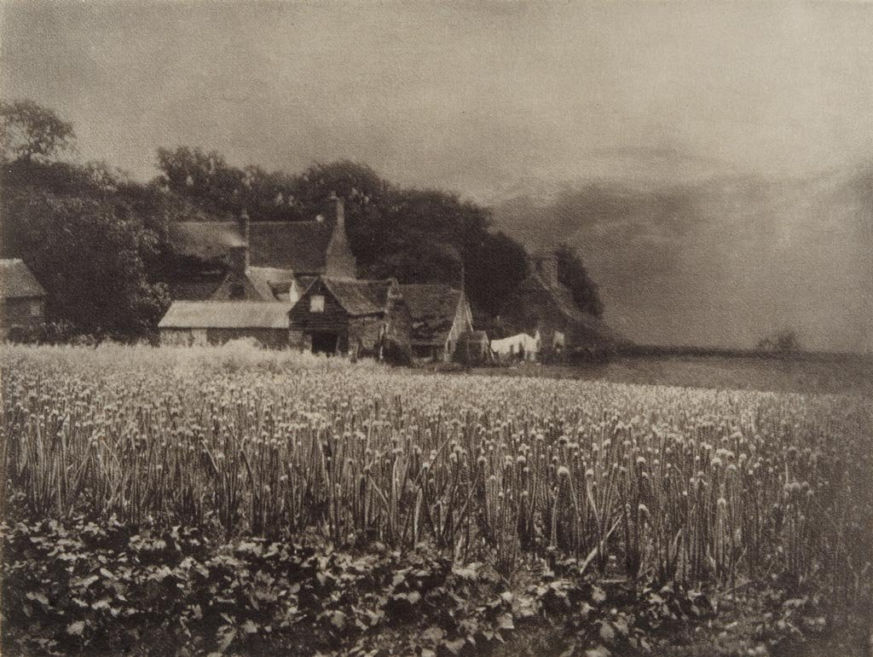
George davison
Davison was influenced by French impressionist paintings and he said that an image was more beautiful when it was soft as in his Onion Field photo in 1890
The Onion Field
The softness
was helped by
use of rough
paper &
soft focus
2

Slide 29
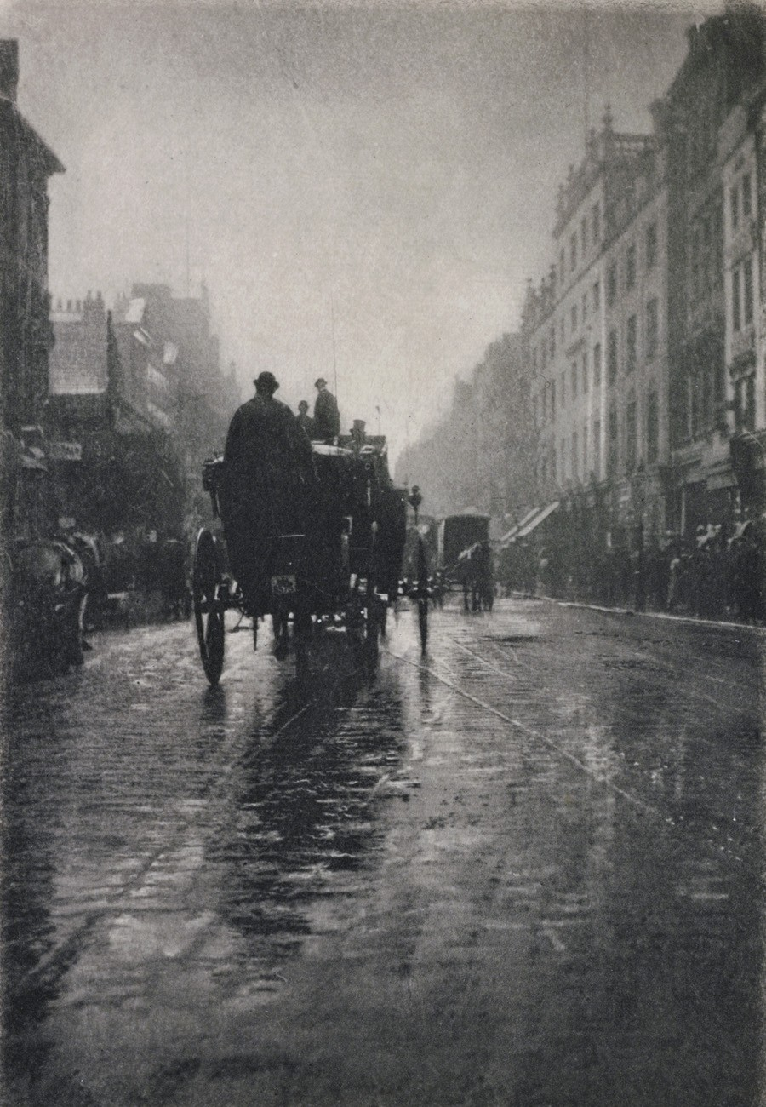
George davison
Oxford Street in the Wet
Director and founder of the English subsidiary of George Eastman.
2

Slide 30
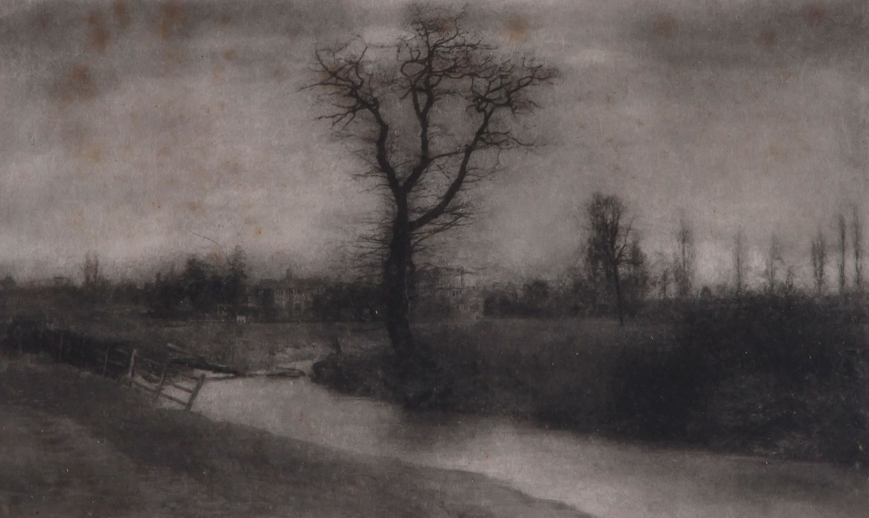
George davison
Landscape 1910
2

Slide 31
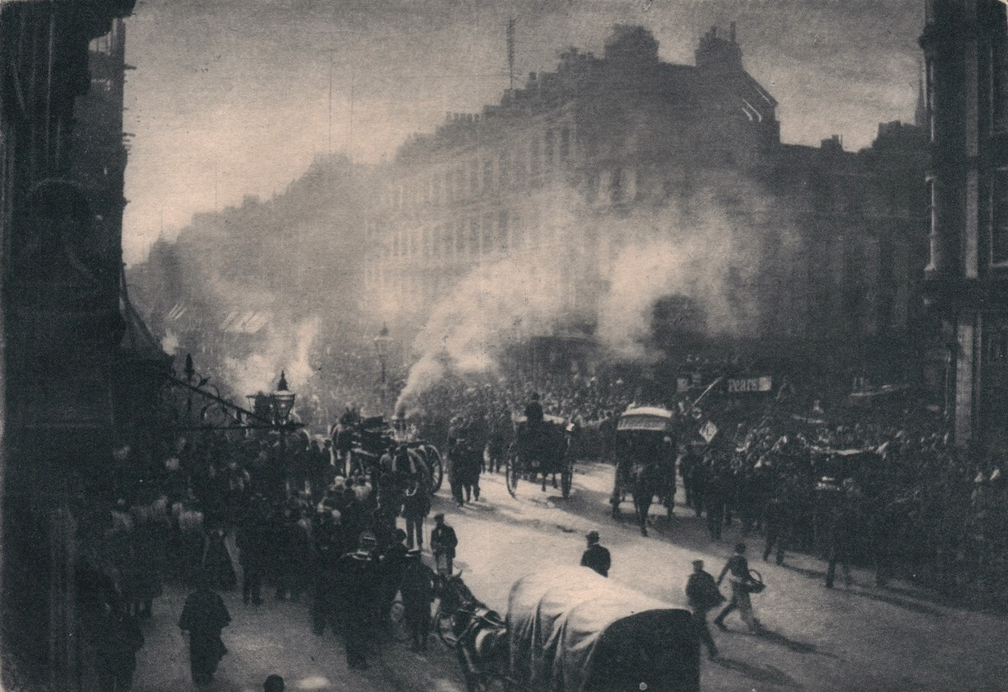
George davison
Fire in Oxford Street
2

Slide 32
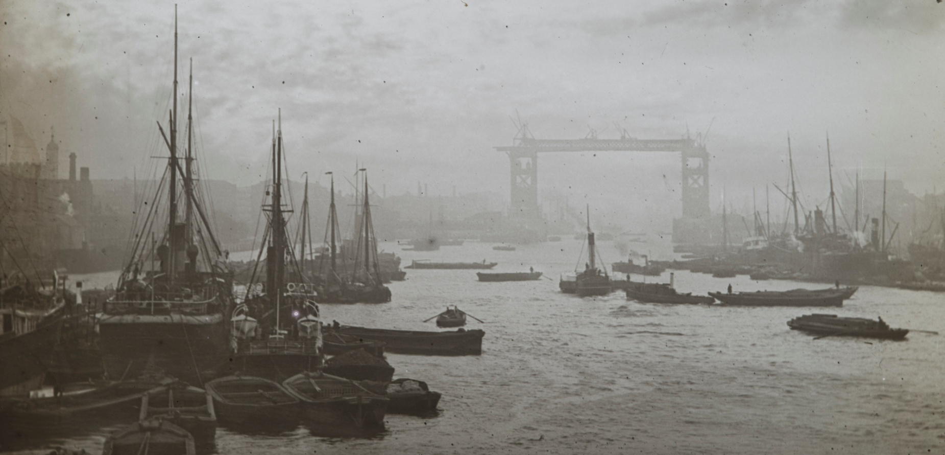
George davison
Under Construction –Tower Bridge
2

Slide 33
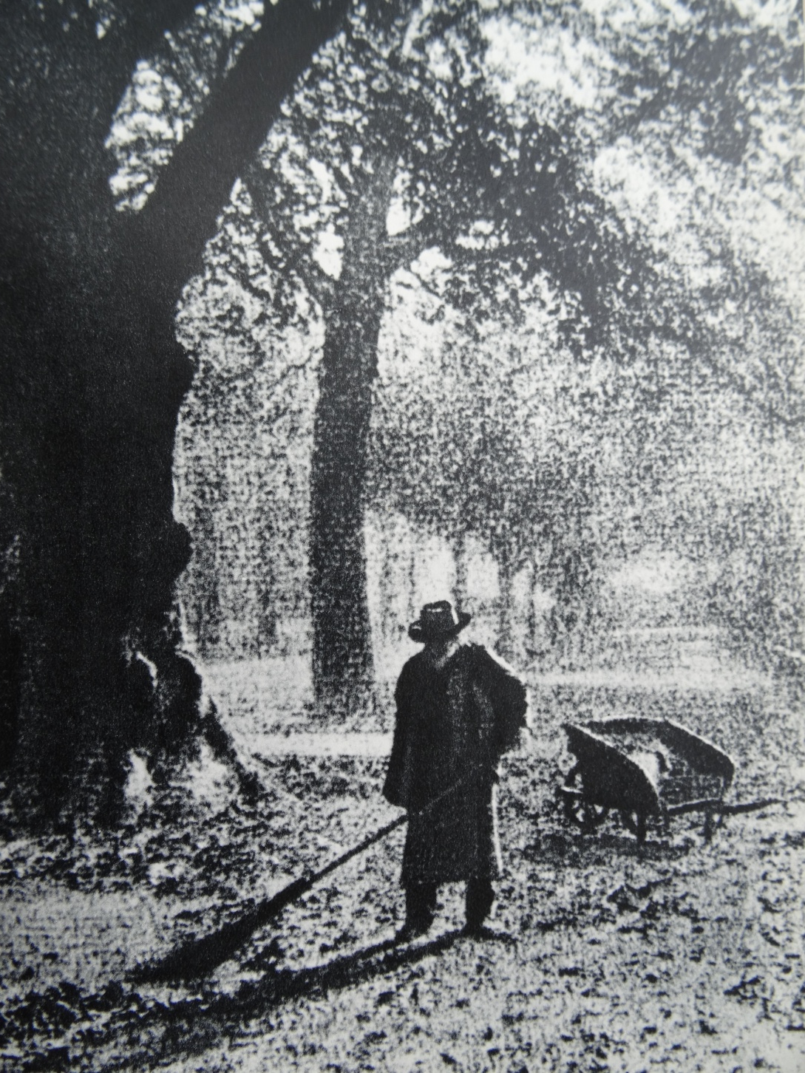
Lacroix
Marc Lacroix
(1927–2007)
was a French photographer.
Park Sweeper
Showing the
extremes of
Impressionism.
2

Slide 34
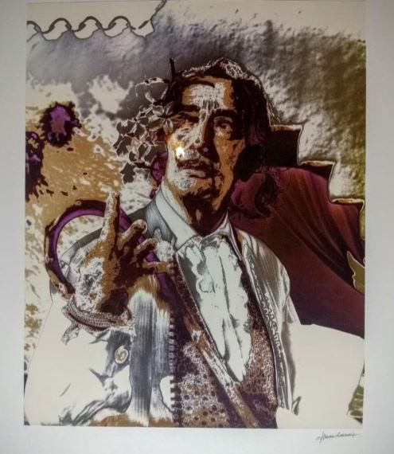
Lacroix
His friendship with Salvador Dali allowed him a glimpse into the Surrealist master's everyday life with his wife, and muse, Gala.
He began his photographic career while serving with the French army. When he returned to France in 1965, he worked with the premier artists and musicians of the time, such as Claude Luter, Sidney Bechet, Louis Armstrong, and Duke Ellington.
2

Slide 35
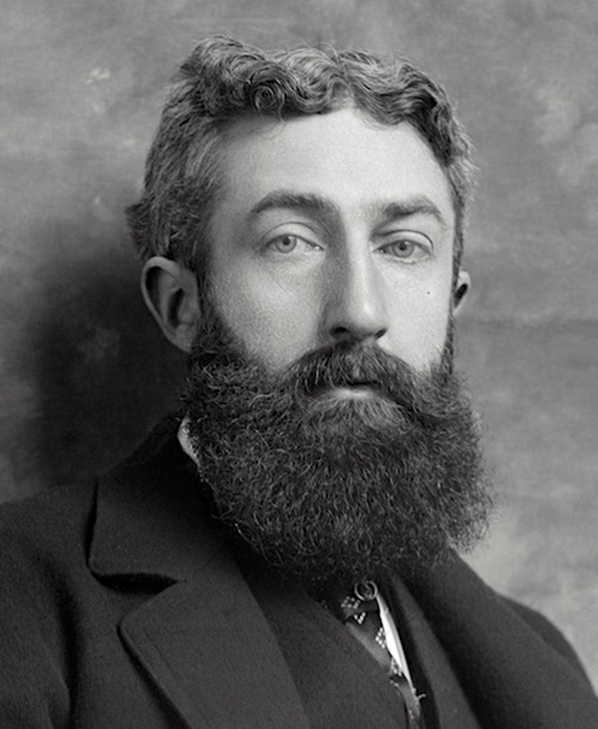
Robert demachy
Robert Demachy (1859–1936) was a prominent French Pictorial photographer of the late 19th and early 20th century. He is best known for his intensely manipulated prints that display a distinct painterly quality.
2

Slide 36
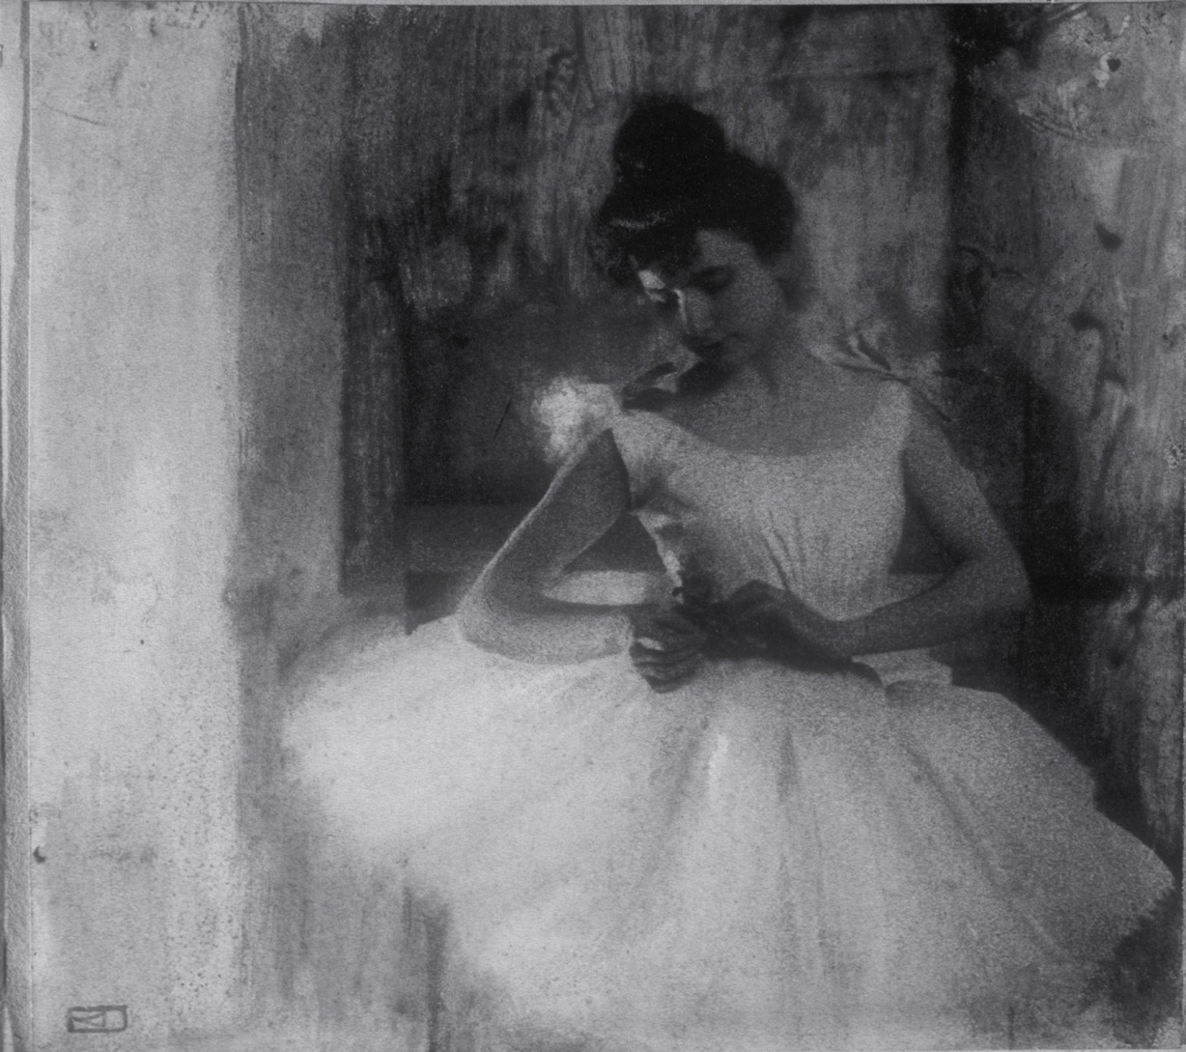
Robert demachy
Behind the Scenes
Almost a Degas painting
2

Slide 37
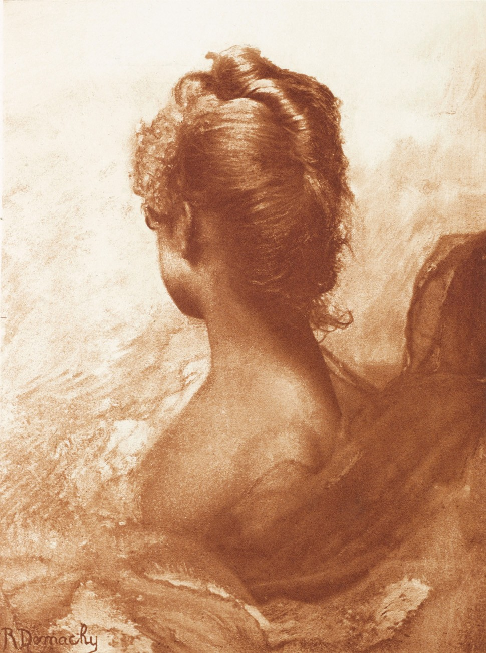
Robert demachy
Study of a Head
2

Slide 38
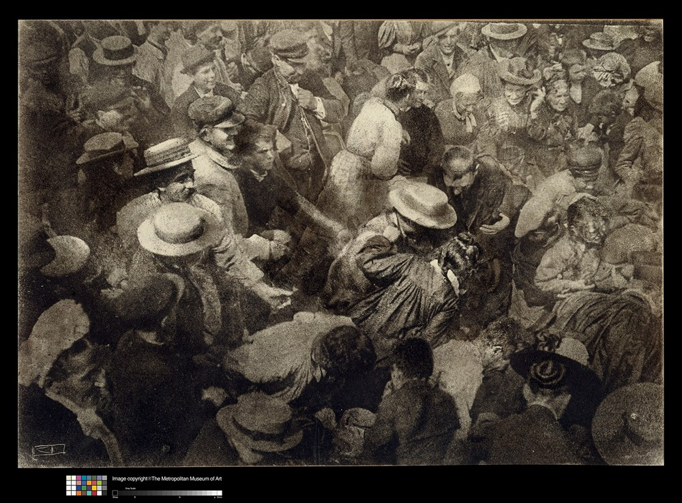
Robert demachy
Struggle
2

Slide 39
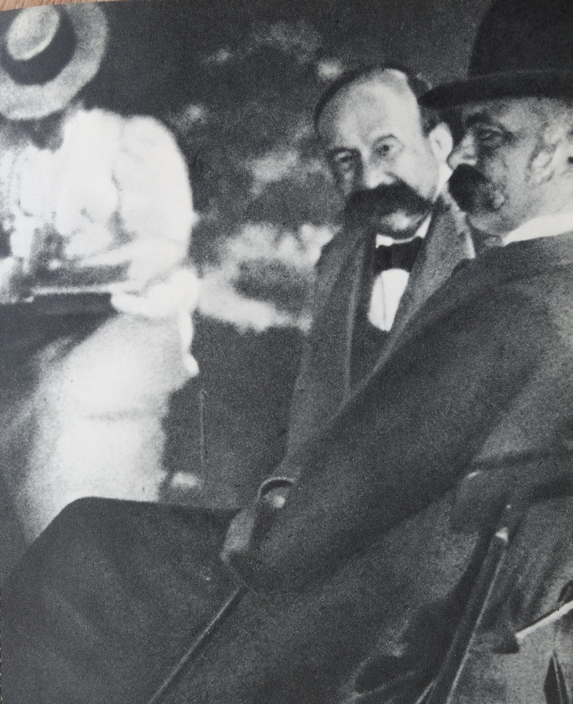
Frau E Nothmann
In the Garden
1897
Having the character
of a Renoir
2

Slide 40
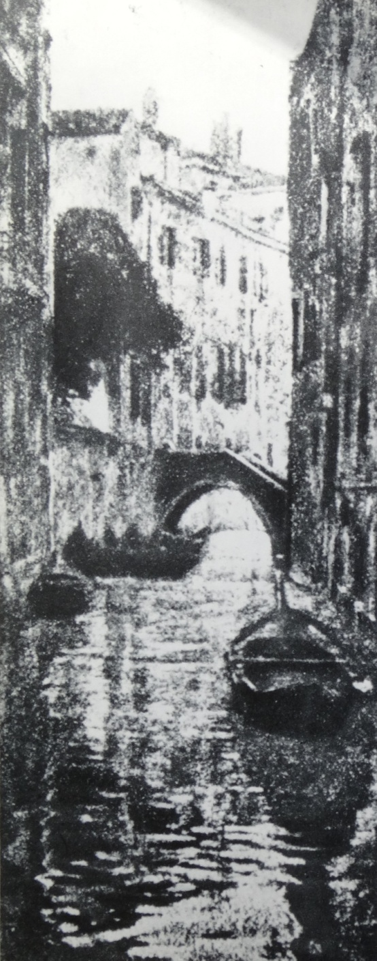
Heinrich kuhn
Venice
1897
2

Slide 41
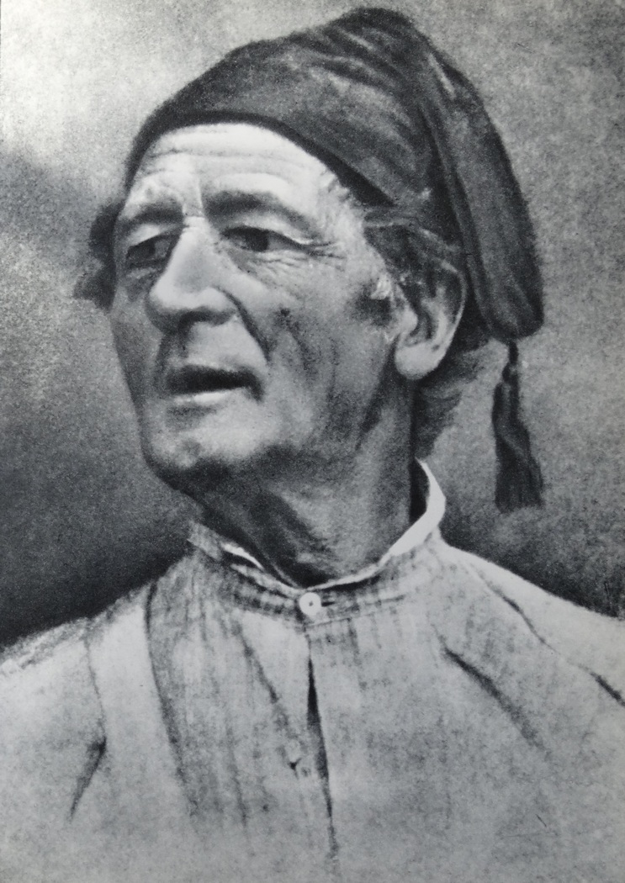
Hans watzek
A Peasant
1894
2

Slide 42
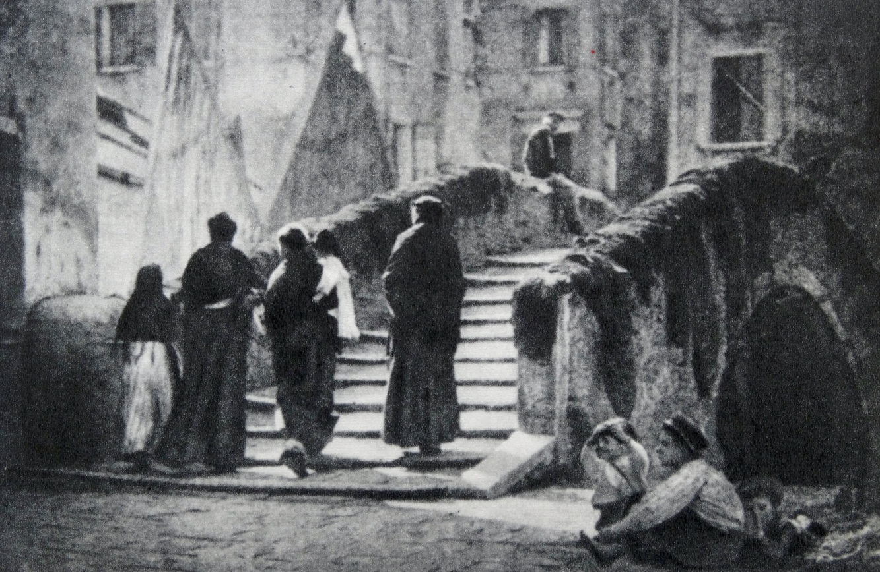
Alexander keighley
The Bridge - 1906
2

Slide 43
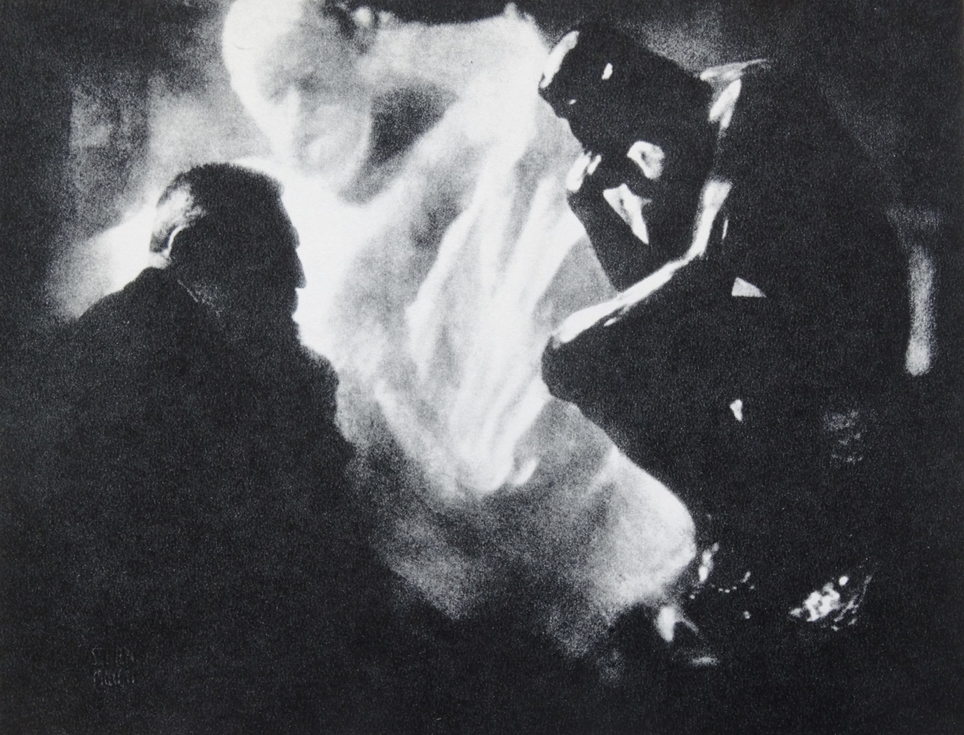
Edward steichen
Rodin,
Victor Hugo,
The Thinker
2

Slide 44
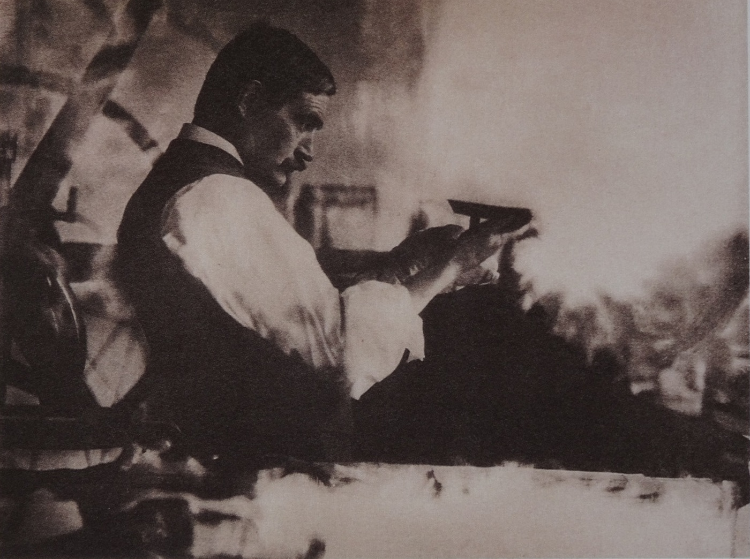
J craig annan
Sir William Strang
The Painter and
Etcher
2

Slide 45
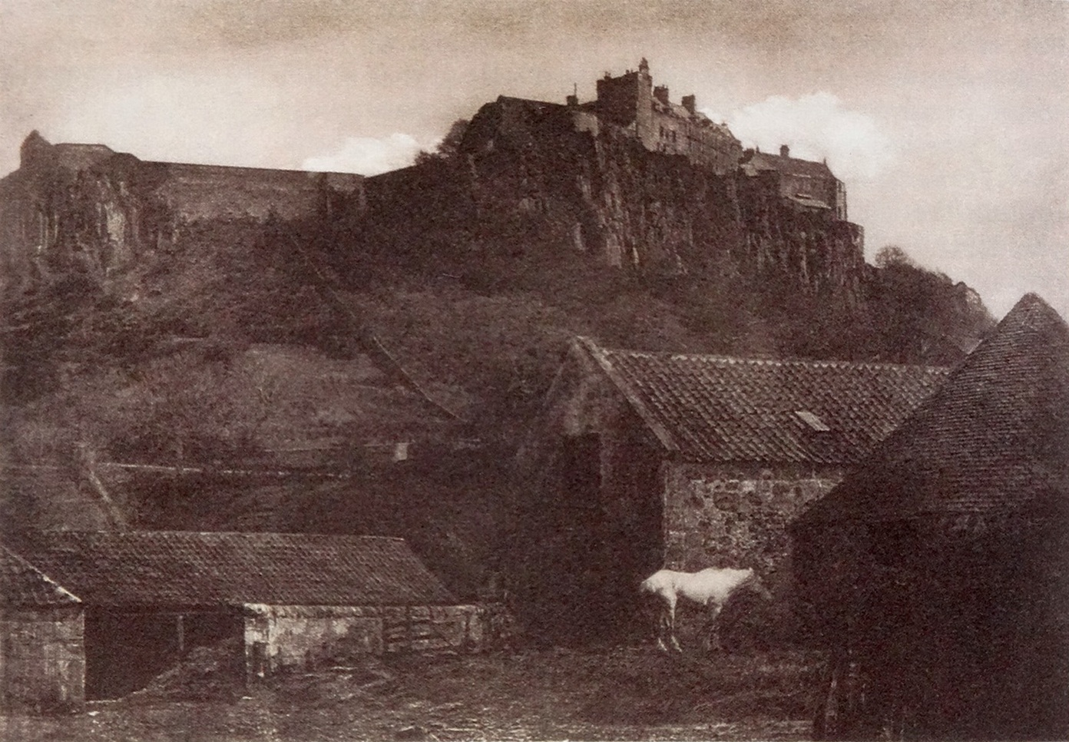
J craig annan
Stirling Castle
2

Slide 46
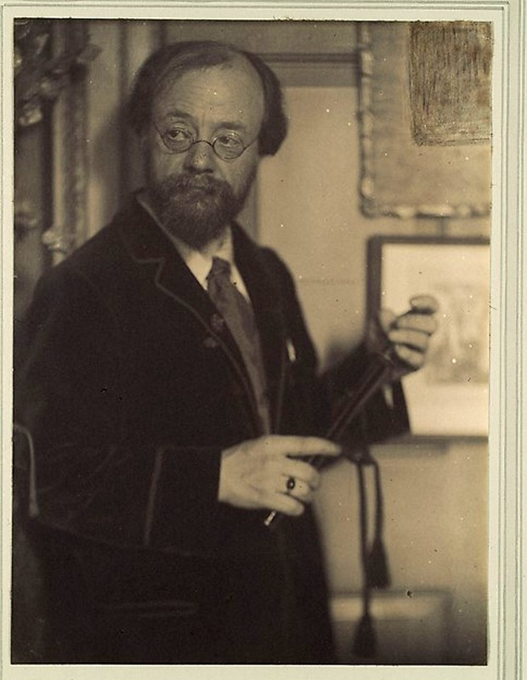
Frederick h evans
Frederick H. Evans
(26 June 1853 – 24 June 1943)
was a British photographer, best known for his images of architectural subjects, such as English and French cathedrals.
He made Platinum prints
for longevity.
2

Slide 47
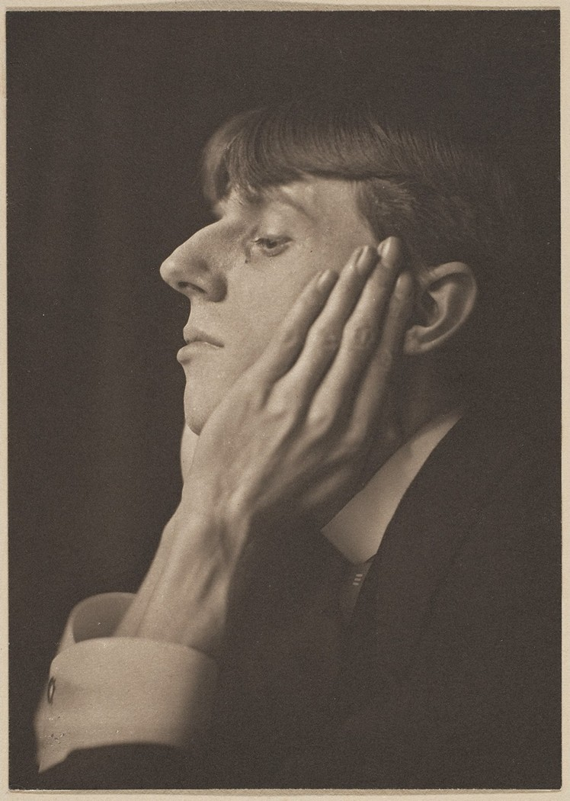
Frederick h evans
Aubrey Beardsley
1895
2

Slide 48
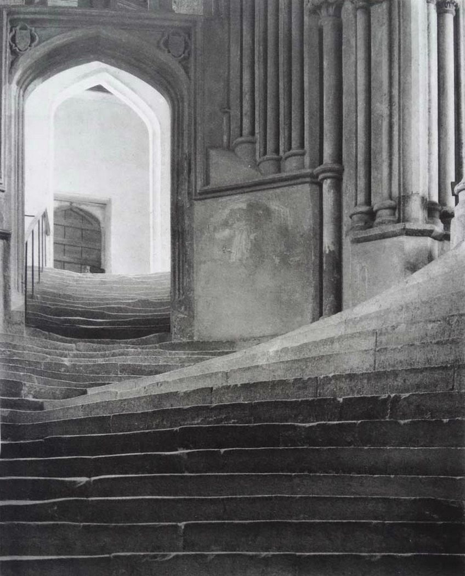
Frederick h evans
Sea of Steps
2

Slide 49
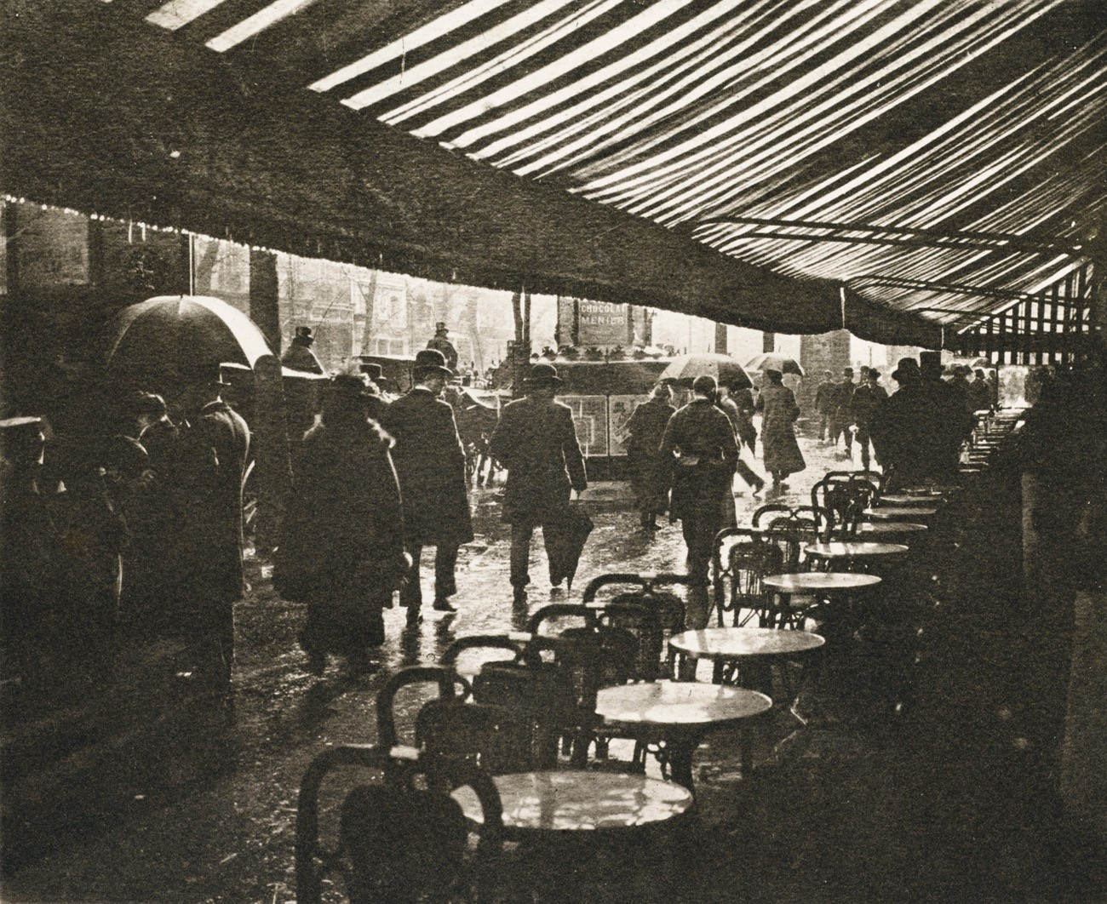
Maurice bucquet
Maurice Bucquet (c.1860–1921),
was President of
The Photo-Club de Paris which was
dedicated to the cultivation of photography as a fine art.
Effet de Pluie
2

Slide 50
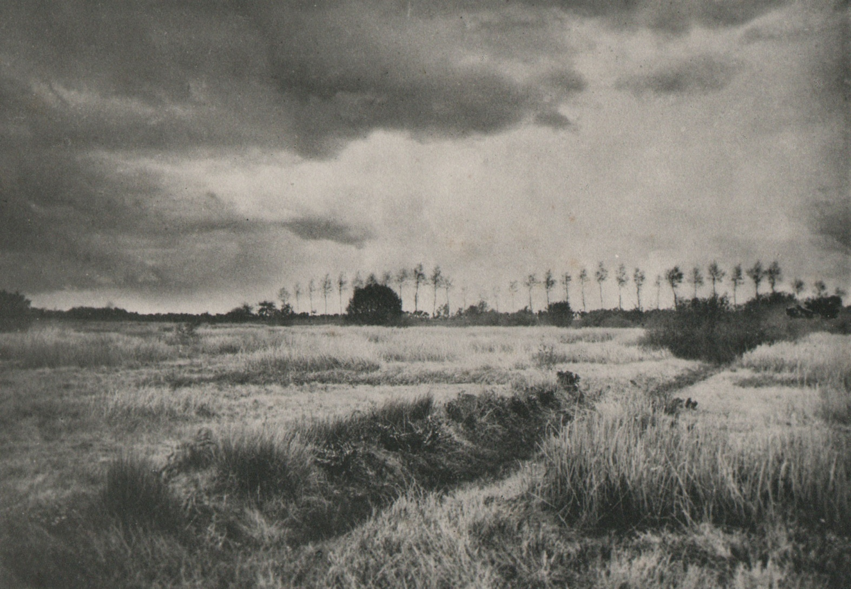
Maurice bucquet
Before the Grain
2

Slide 51
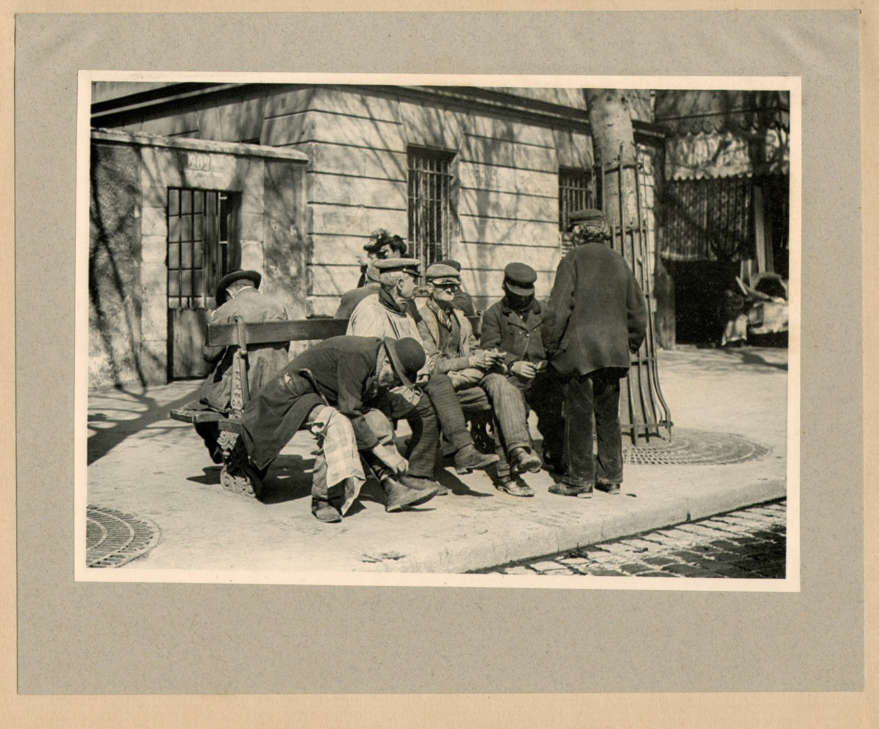
Maurice bucquet
Coin de Paris
2

Slide 52
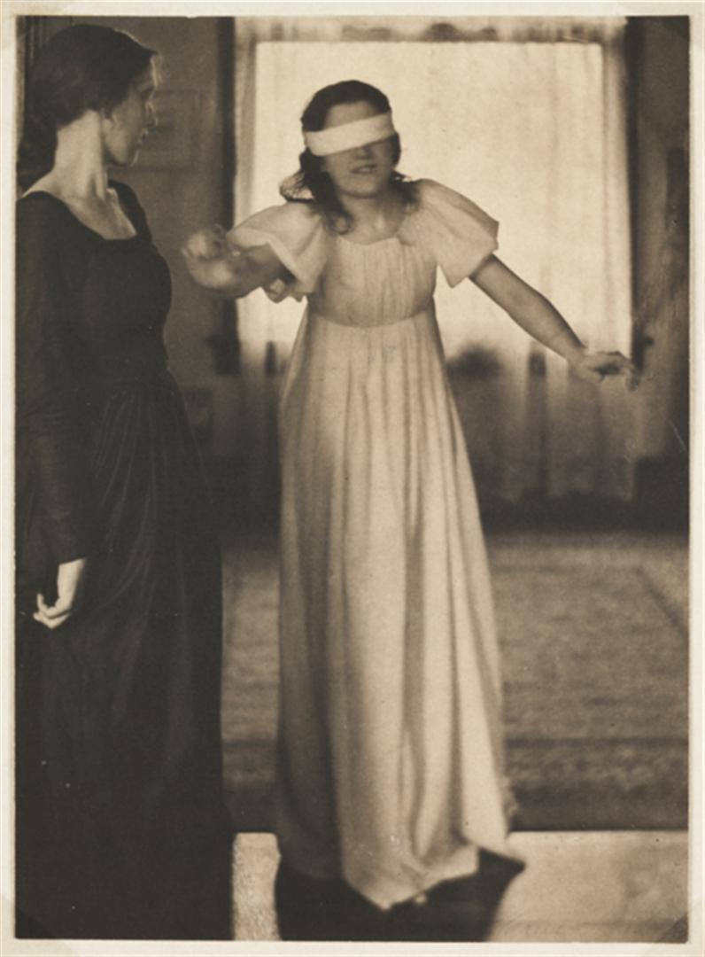
Clarence white
(April 8, 1871 – July 8, 1925)
Blindfold
2

Slide 53
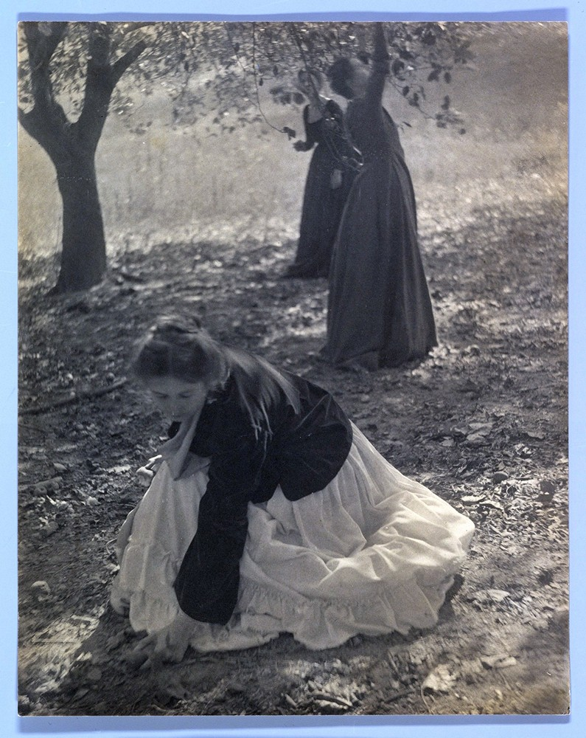
Clarence white
The Orchard
American photographer, teacher and a founding member of the Photo-Secession movement
2

Slide 54

Clarence white
2

Slide 55

Clarence white
Morning – The Bathroom
2

Slide 56

Alfred stieglitz
1864–1946
Fifth Avenue in April
2

Slide 57

Alfred stIeglitz
2

Slide 58

Alfred stieglitz
Steerage
2

Slide 59

Alfred stieglitz
Spiritual America
2

Slide 60

Harry c rubincam
Circus Rider
2

Slide 61

Tom Bright
Returning from Pasture, 1895
2

Slide 62

Charles berg
Art
2

Slide 63

Alfred clements
Eastwards at Sunset
2

Slide 64

Alfred clements
A Roadside in Surrey
2

Slide 65

Alvin langdon coburn
Hyde Park Corner
2

Slide 66

Alvin langdon coburn
The Tunnel Builders
2

Slide 67

Karl greger
London
2

Slide 68

Karl greger
<number>

Slide 69

Frederick hollyer
Ellen Terry
<number>

Slide 70

Frederick hollyer
Frances ca da Rimini
<number>

Slide 71

H K noyes
Shoeshine
<number>

Slide 72
The End
What came next?
Paul Strand, Cecil Beaton,
Man Ray, Angus Mcbean
X-Ray Photos, Colour Photos,
Digital imaging
Etc.
72

