Slide 1
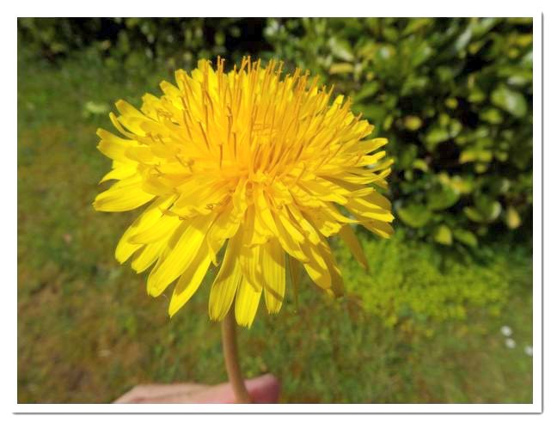
Photographing Dandelions Creatively

Slide 2
Photographing Dandelions Creatively
Dandelions might not be something Gardeners are fans of but they can make an interesting subject for photographers who can give them a creative twist when photographing them.

Slide 3
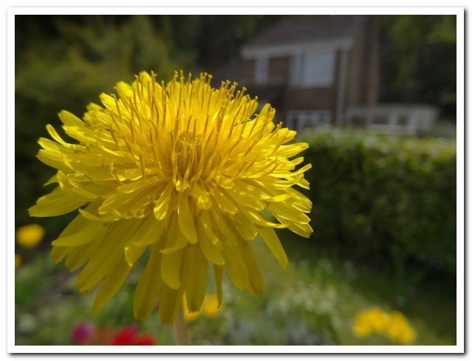
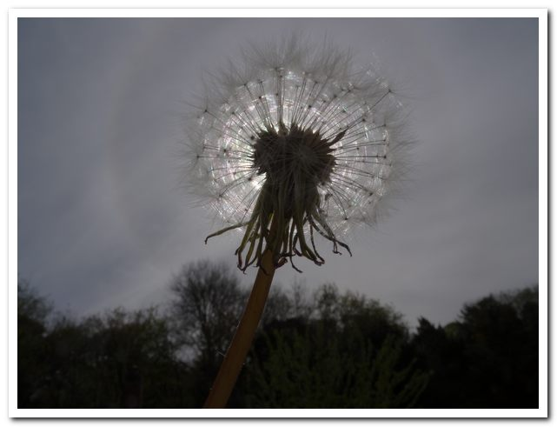
Photographing Dandelions Creatively
Before you dig up the humble dandelion, have you ever thought about photographing it? If you haven't, here's a straightforward guide on how you can capture a rather fun and creative image of one without too much effort on your part.

Slide 4
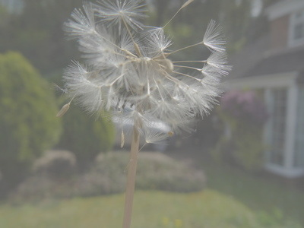
Photographing Dandelions Creatively
The Set-Up
Pick a dandelion that has a full seed head.
Hold it at arm's length in your non-camera hand with it positioned in front of grass (you can use a tripod as this will free both hands, making adjustments easier).

Slide 5
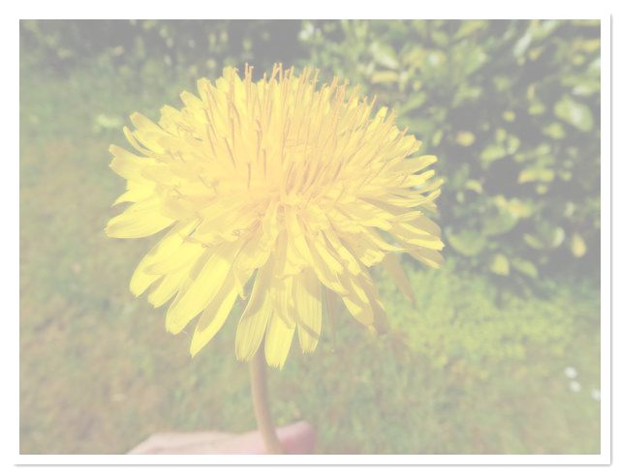
Photographing Dandelions Creatively
With your camera manually set to close focus and held to your eye, move the dandelion closer to the camera until it fills the frame and is in focus, then take a photo.
Adjust the exposure if the dandelion is too bright or too dark. If your camera is automatic take the photo when it's focused.

Slide 6
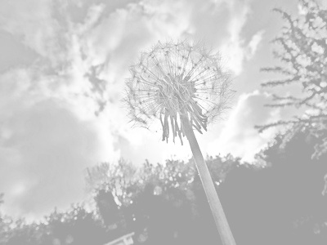
Photographing Dandelions Creatively
Experiment With Backgrounds
You can repeat the process but positioning the dandelion against different backgrounds.
Each shot will look different and no doubt one will be preferred.

Slide 7
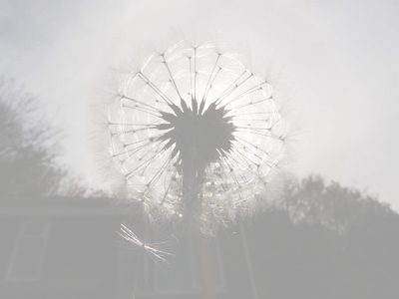
Photographing Dandelions Creatively
Here are just a few of the backgrounds you could use:
Trees
Blue sky
Cloudy sky
Coloured paper
Textured walls
Carpets
Silhouetted against the sun

Slide 8
Photographing Dandelions Creatively
Find a good specimen or two, out of the wind and you have a subject that is worth spending a little time on. You can shoot close-ups, backlit, from above, from below, with different backgrounds...the list goes on! Of course, being a weed you can just cut the head off to shoot indoors. By doing so you can, as many photographers have, spend ages simulating individual seeds being blown off the head.
If you want to shoot dandelion silhouettes, something we cover further down, please do NOT try this technique with a camera's optical viewfinder because you can cause irreparable eye damage. Always switch to LiveView when looking towards the sun. You have been warned!

Slide 9
Photographing Dandelions Creatively
Shot Type
With telephotos, explore viewpoints until you get one flower sharp against a lovely backdrop of blurred yellow flower-heads. Keep the aperture value wide for great selective focus.
Exposure
Exposure can be a challenge because brightly lit white seed heads can confuse the meter into thinking that there is more light around than there actually is and make them come out too grey, thus spoiling their look so do pay attention to this.

Slide 10
Photographing Dandelions Creatively
Silhouettes
You'll probably find it easier to set the focus and exposure manually. You'll also need to adjust focus by moving the subject back and forth.
It's not something that you are guaranteed to get right first time so do take the time to refine and reshoot, repositioning the dandelion, altering your focus or shooting at a different point during the day.
Remember that light is warmer around sunrise or sunset due to the level of the sun in the sky but it's not set in stone that you should shoot at this time.

Slide 11
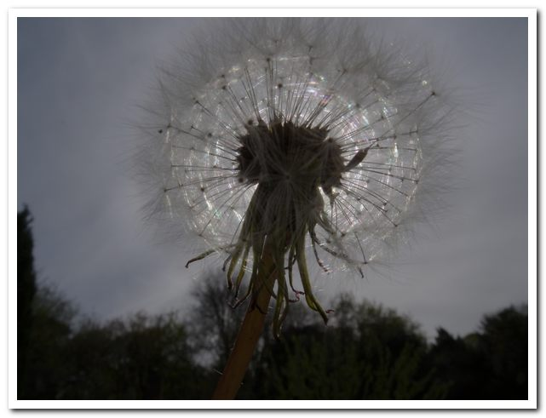
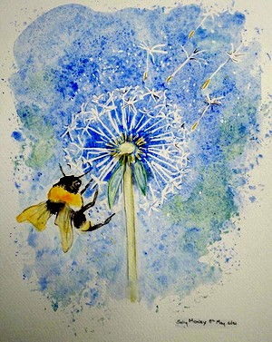
Photographing Dandelions Creatively

Slide 12
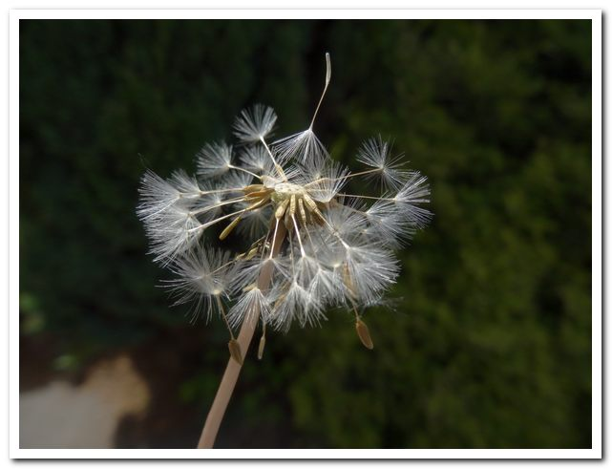
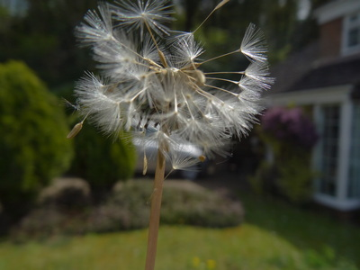
Photographing Dandelions Creatively

Slide 13
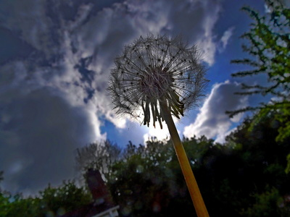
Photographing Dandelions Creatively

Slide 14
Photographing Dandelions Creatively
Try using In-Camera controls
to make your image different

Slide 15
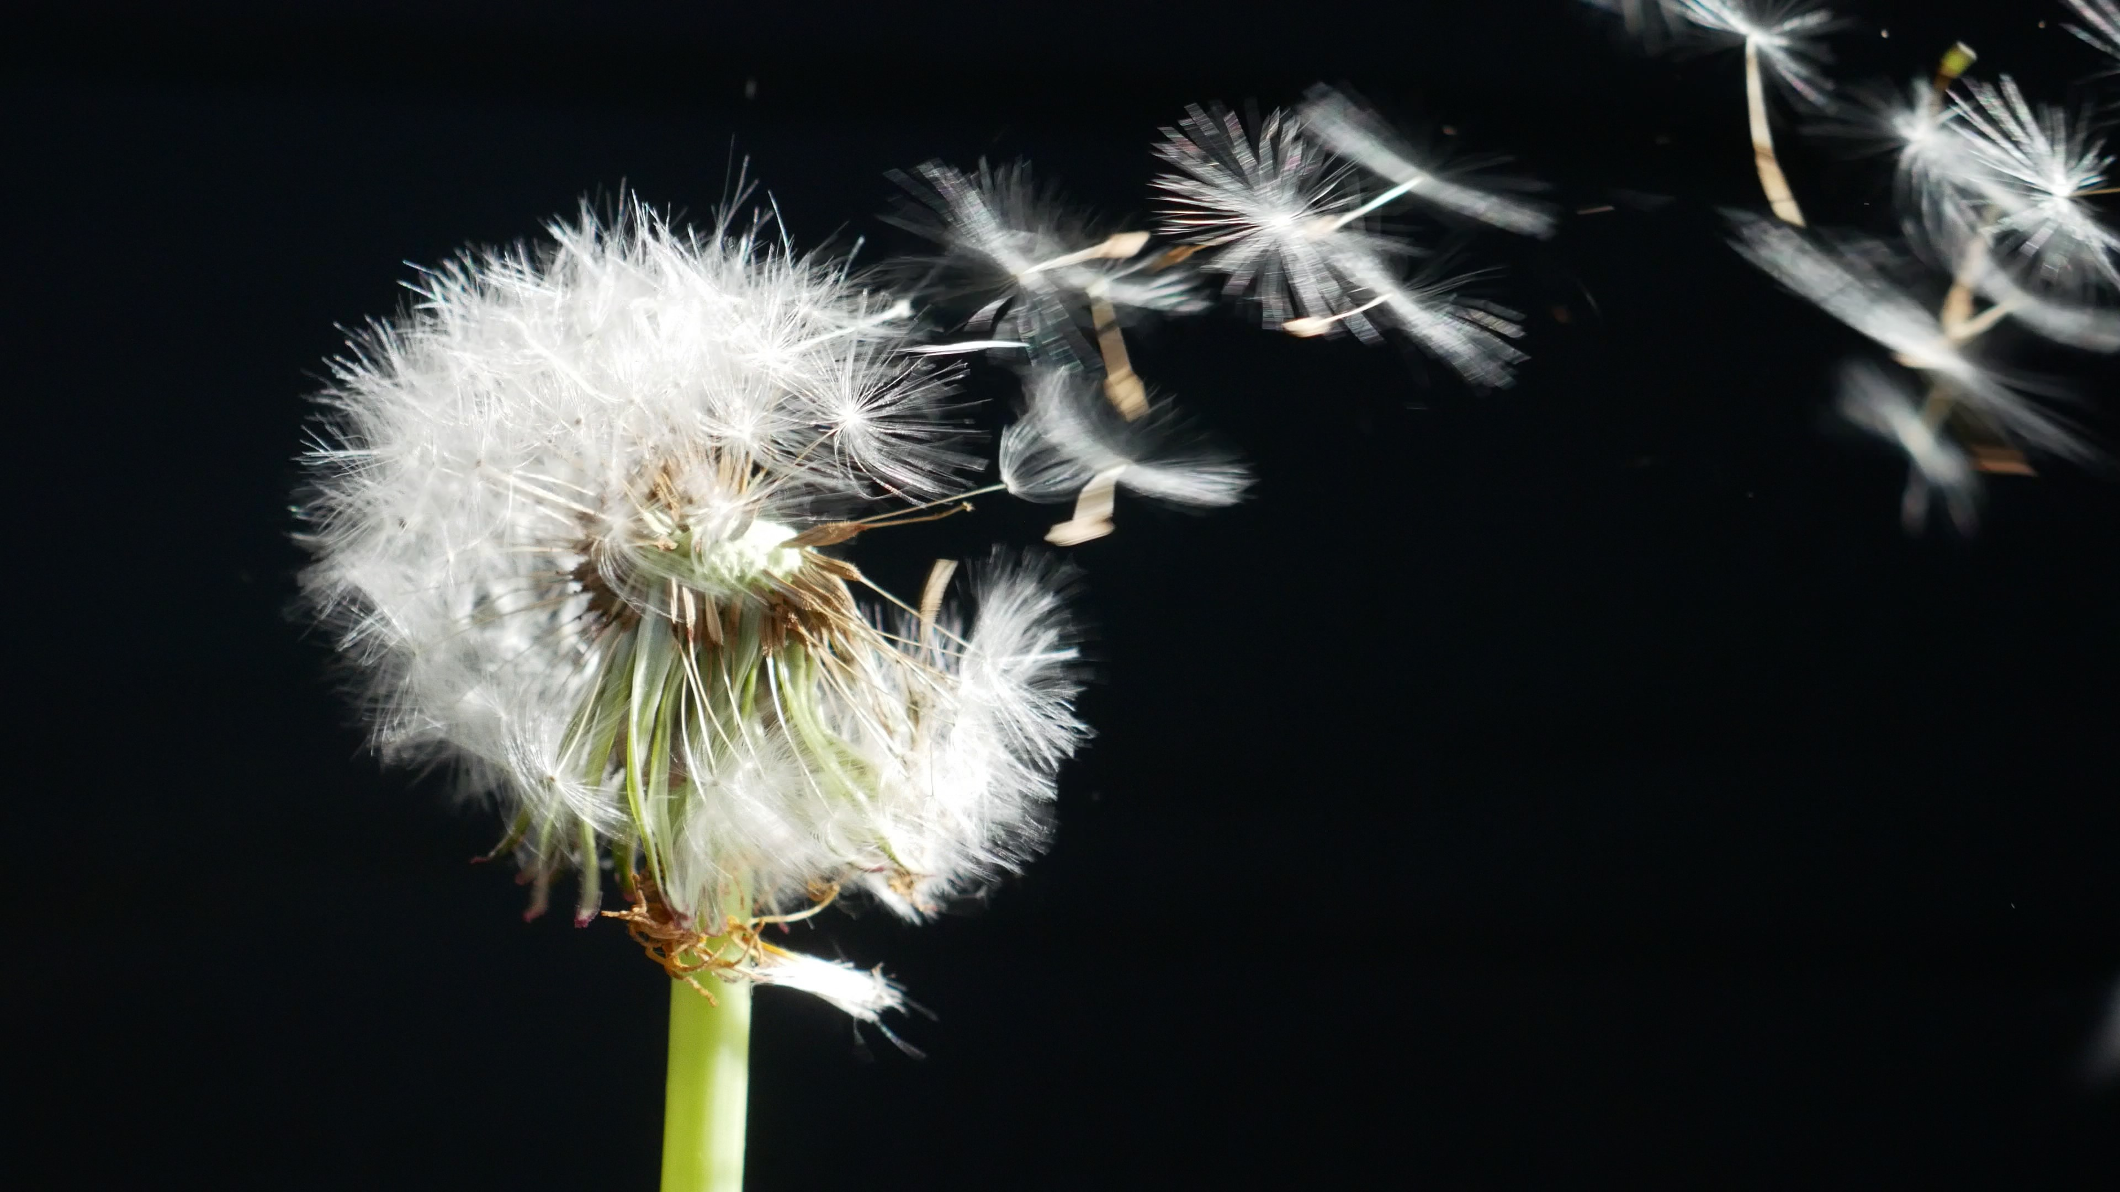
Photographing Dandelions Creatively
I want you to get really creative.
Try taking lots of heads in one shot.
And who says the image has to be SHARP?
Surprise me.

