Slide 1
Composing for Disharmony
Or
The Imperfect Composition

Slide 2
The Imperfect Composition
Our natural desire is to compose an image with a sense of harmony and equilibrium.
We are capable of achieving good composition intuitively with practice.
BUT do we always want to do this or could we aim at a different response.

Slide 3
The Imperfect Composition

Slide 4
The Imperfect Composition
It may be that if we are photographing a sad or problematic topic we may find that the conventional rules hardly look or feel right.
Now we could introduce DRAMA or a feeling of MENACE to illustrate intense human emotions.

Slide 5
The Imperfect Composition

Slide 6
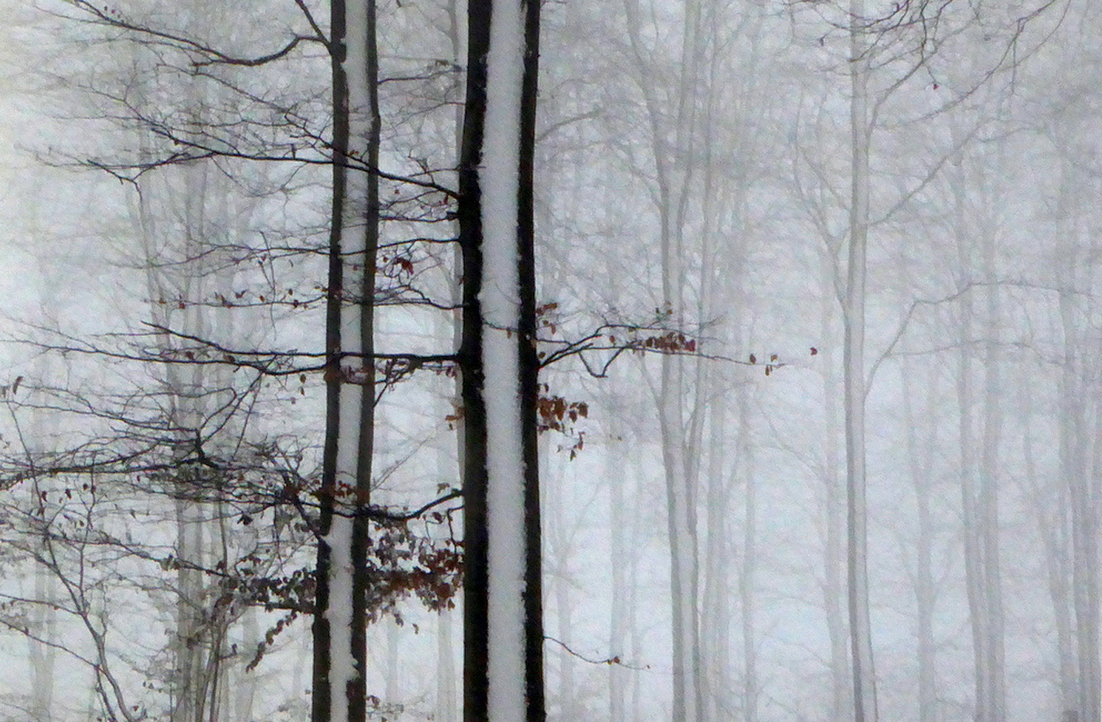
The Imperfect Composition
Normally we would not allow vertical elements to divide the image space.
Edgar Degas, however, used this concept in a number of his paintings.

Slide 7
The Imperfect Composition

Slide 8

The Imperfect Composition
This isolated building appears oddly distorted as a result of the viewpoint chosen.
Now this could be easily changed digitally but as it is this has an EDGY feel with the cropped lamp post and the building with no ground to sit on.

Slide 9
The Imperfect Composition

Slide 10
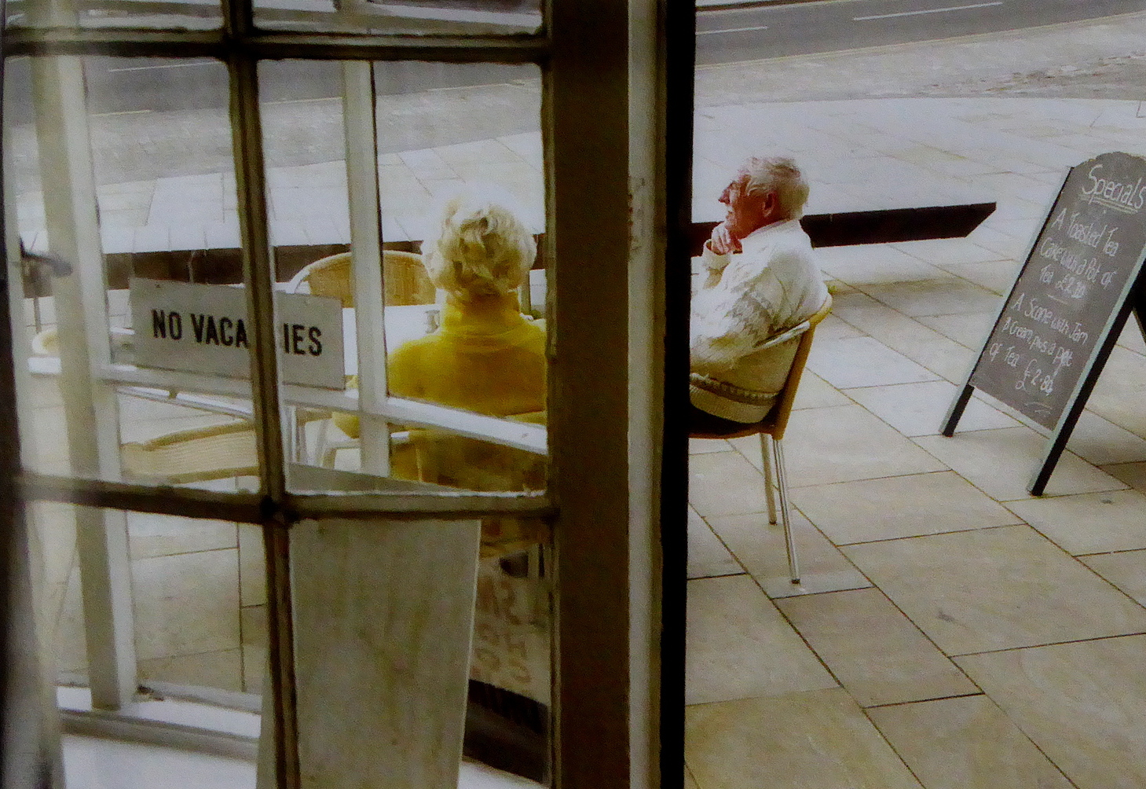
The Imperfect Composition
Roy King's picture is in the Degas genre dividing the image in two. One can assume that the two people are related, but because of the vertical line the man on the right is visually separated from the lady on the left. This splitting introduces tension and disharmony.
Is this a good thing?

Slide 11
The Imperfect Composition

Slide 12
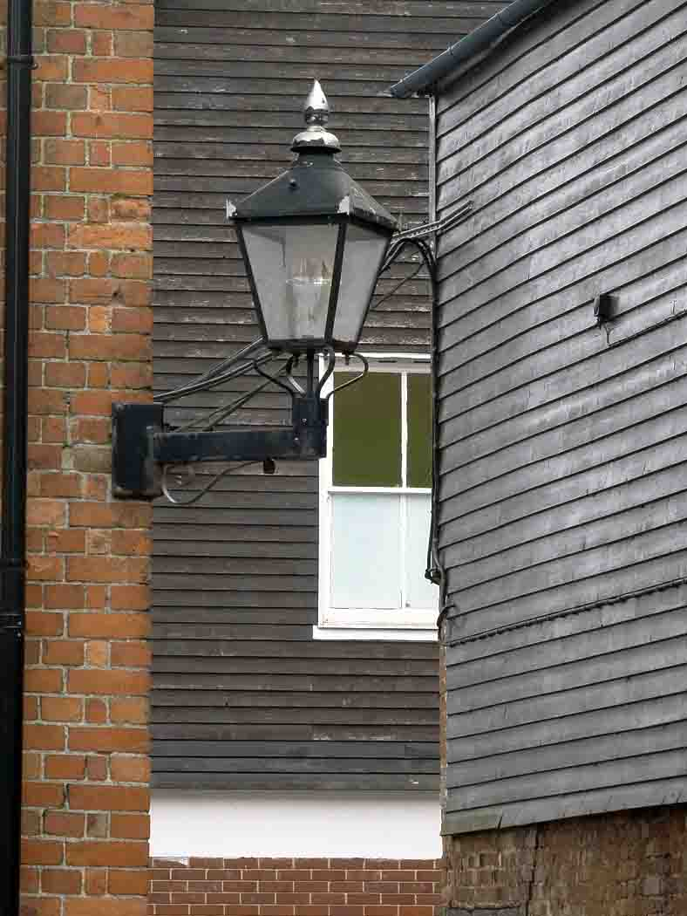
The Imperfect Composition
So how can we produce such images - by ignoring the composition 'rules'?
1]. Using a Right to Left Flow.
Normally we view images from left to right. Let us try to make the viewer got R to L instead.
2]. Inverted Counterbalance
That is instead of including elements to balance a photograph omit them. See my Video on Visual Weight

Slide 13
The Imperfect Composition

Slide 14
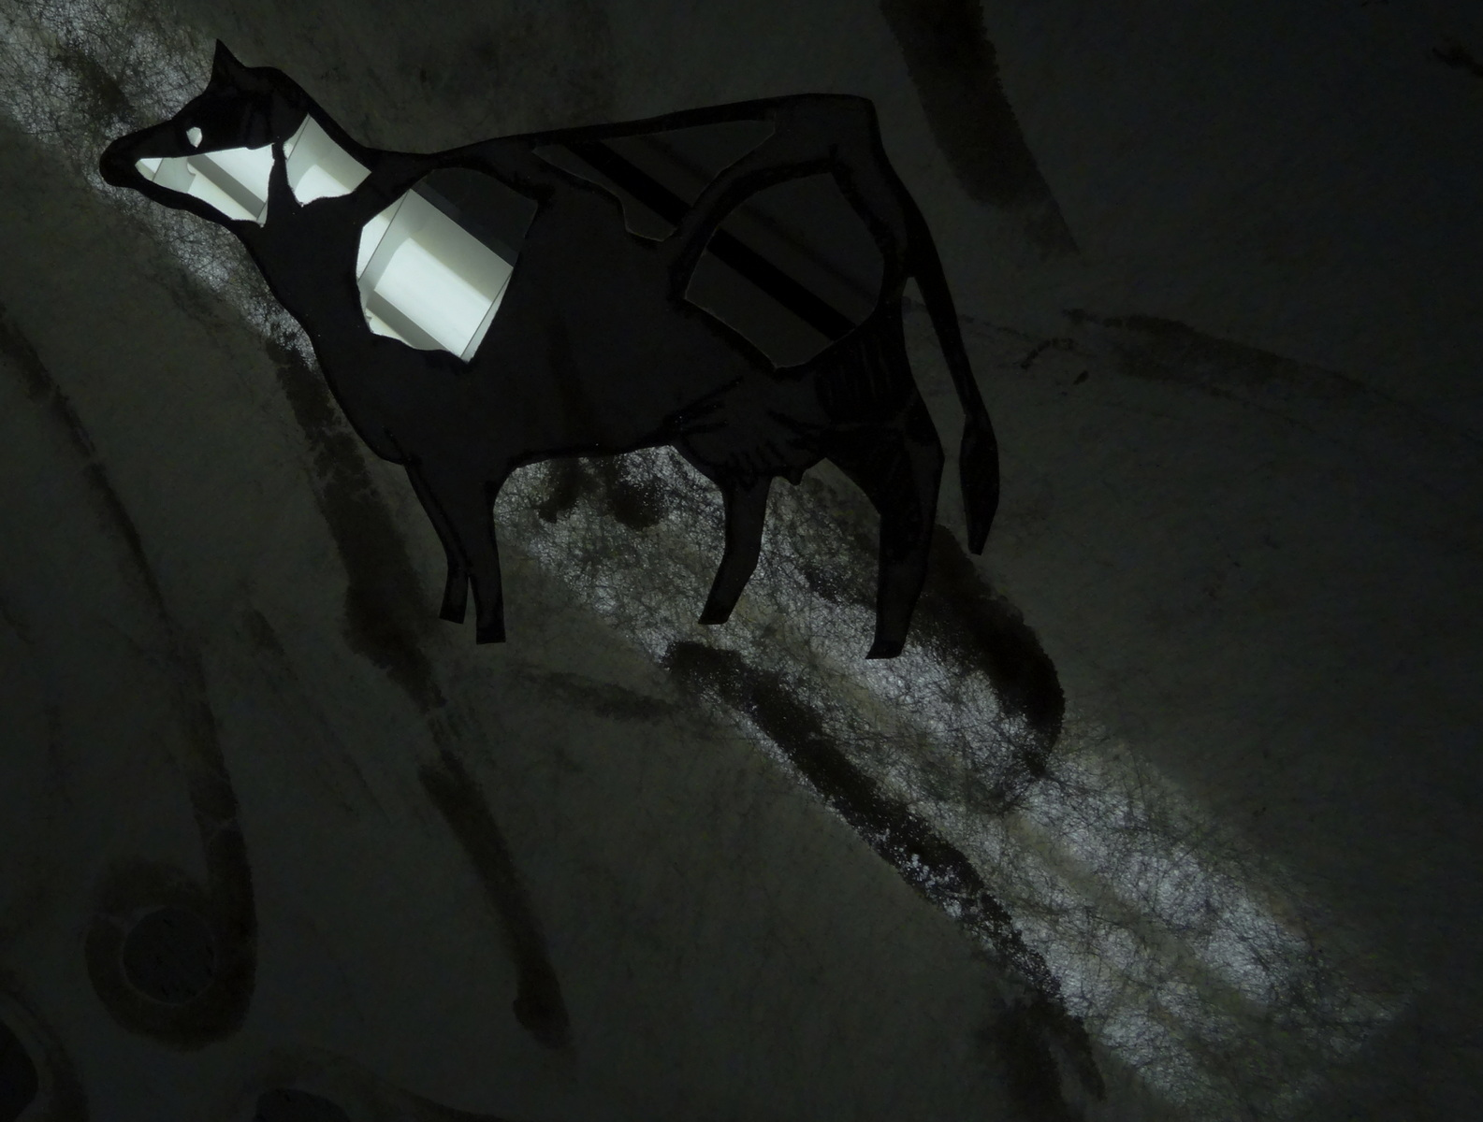
The Imperfect Composition
3]. Sloping the Horizon
Judges always complain when the horizon is slightly on the wonk [as it technically called]. So why not exaggerate this slope to, say, 45 degrees to make a more disturbing image.
4]. Use an Extremely Wide Angle Lens.
Such a lens will make images distorted easily. It can make a sky appear to be rushing madly towards you menacingly if they have a dark hue.

Slide 15
The Imperfect Composition

Slide 16
The Imperfect Composition
5.] Interrupting the Rhythm
Rows of things like cans of beans or a regular line of people or a line of fencing can be disrupted by just one of these is not conforming to the rest.
So the back view of lots of nuns with just one nun turned towards the camera. That will make an arresting photograph.

Slide 17
The Imperfect Composition

Slide 18
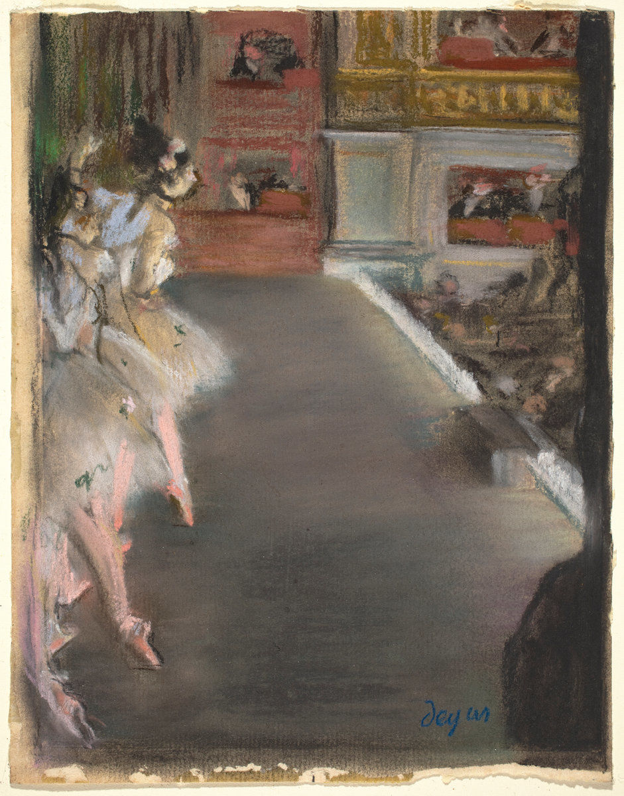
The Imperfect Composition
6]. Important Image Elements placed at the frame edge.
In other words ignore the Rule of Thirds. The elements of your picture could be placed at the very edge or even slightly beyond for maximum impact on a viewer. Degas has 2 images of ballerinas like that. The ballet dancers life was and still is hard. Degas tried to paint these trials.
I will leave you to find out how hard it was for junior ballerinas in the 19th Century.
Ballet Dancers Hide
a
Secret

Slide 19
The Imperfect Composition

Slide 20
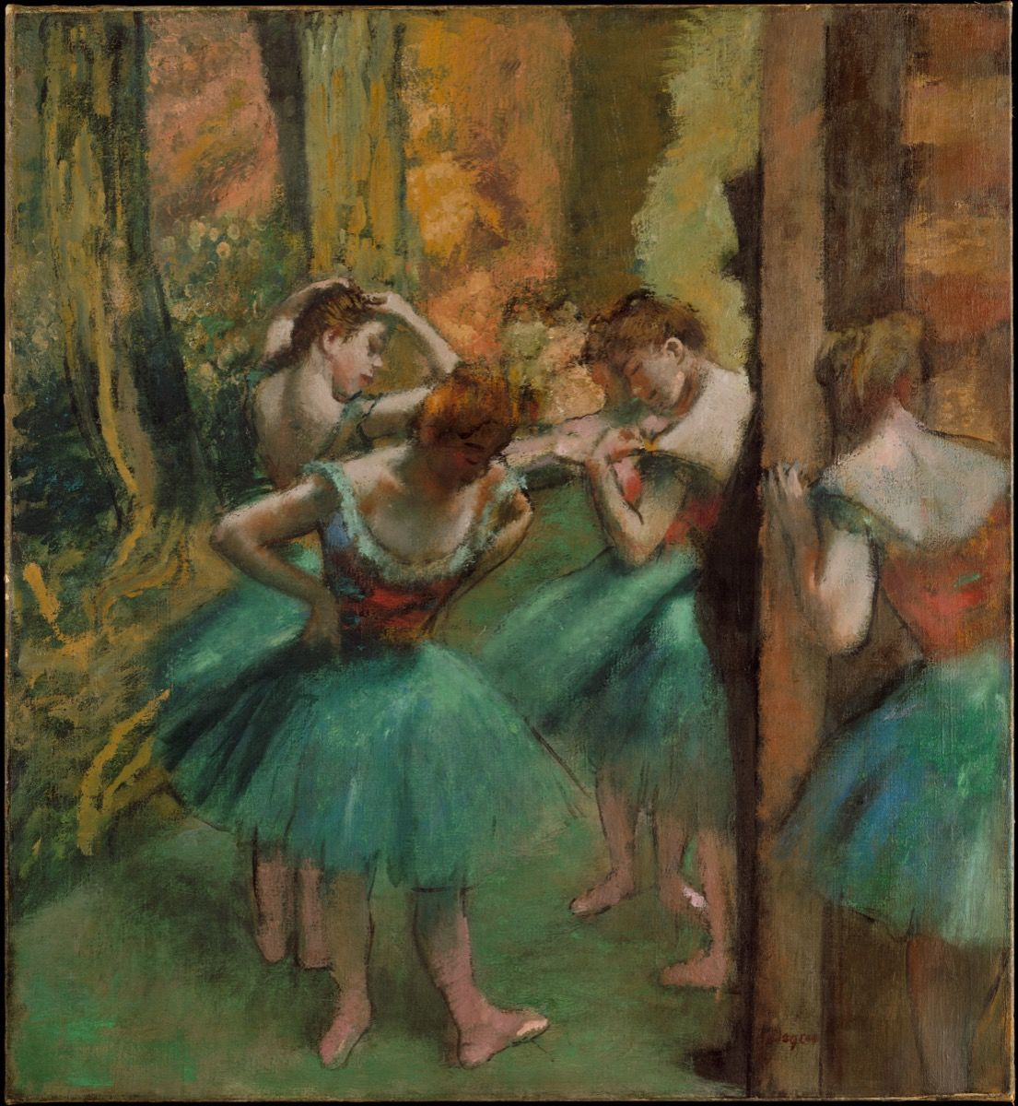
The Imperfect Composition
6]. Important Image Elements placed at the frame edge.

Slide 21
The Imperfect Composition

Slide 22
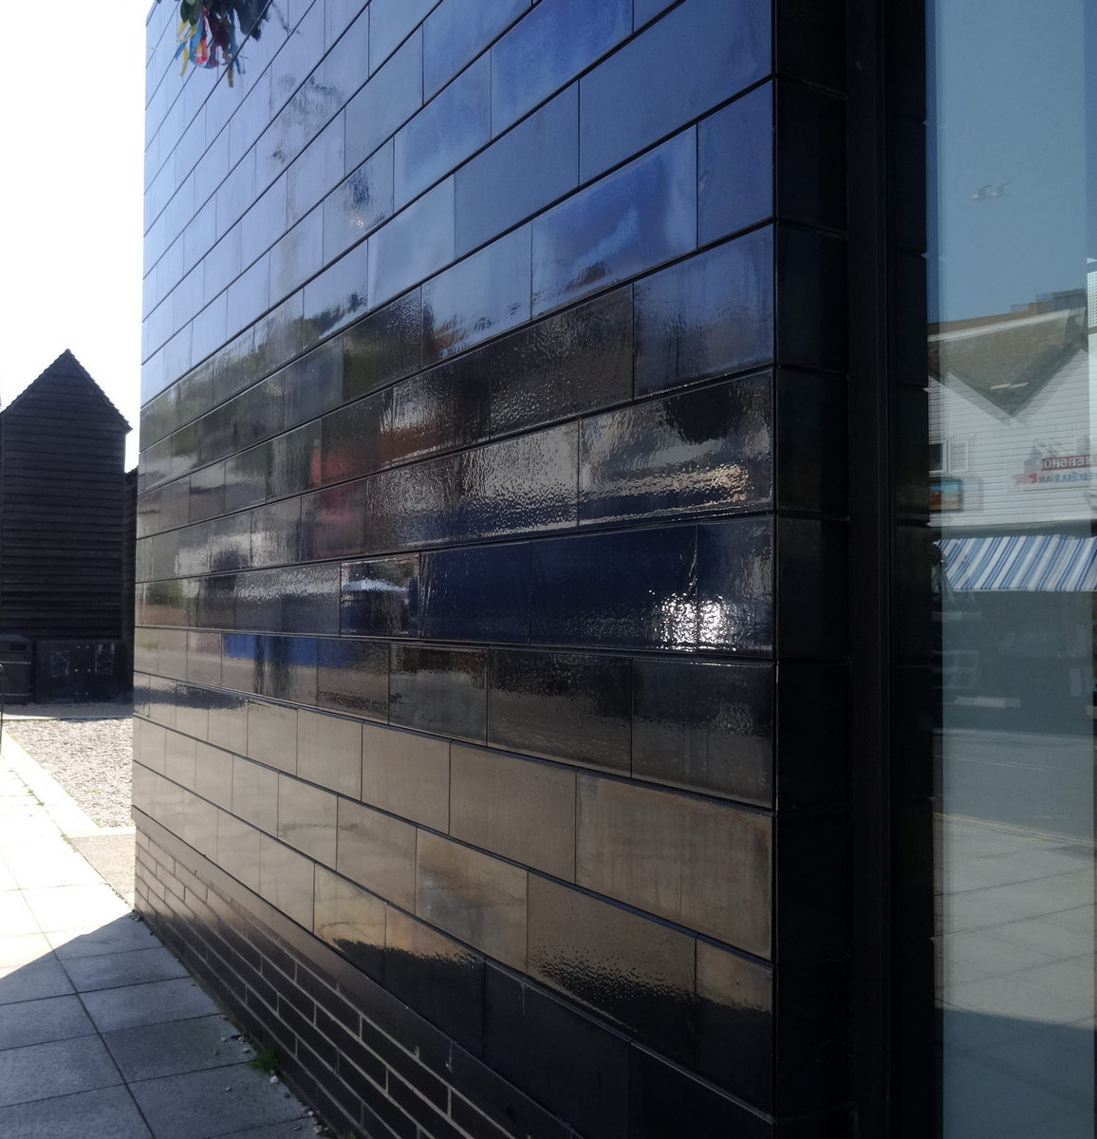
The Imperfect Composition
7]. Dividing the Photograph.
This is a terrible idea for the conventionalist photographer BUT interesting possibilities emerge. It also shows a characteristic of photography - that of its spontaneous nature.

Slide 23
The Imperfect Composition

Slide 24
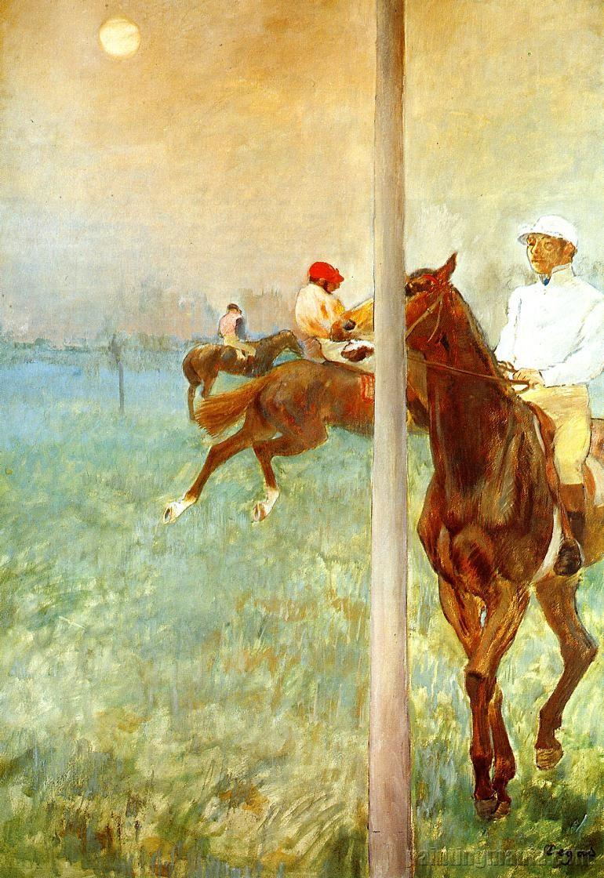
The Imperfect Composition
7]. Dividing the Photograph.
This is a terrible idea for the conventionalist photographer BUT interesting possibilities emerge. It also shows a characteristic of photography - that of its spontaneous nature.
Degas
Jockeys before race

Slide 25
The Imperfect Composition

Slide 26
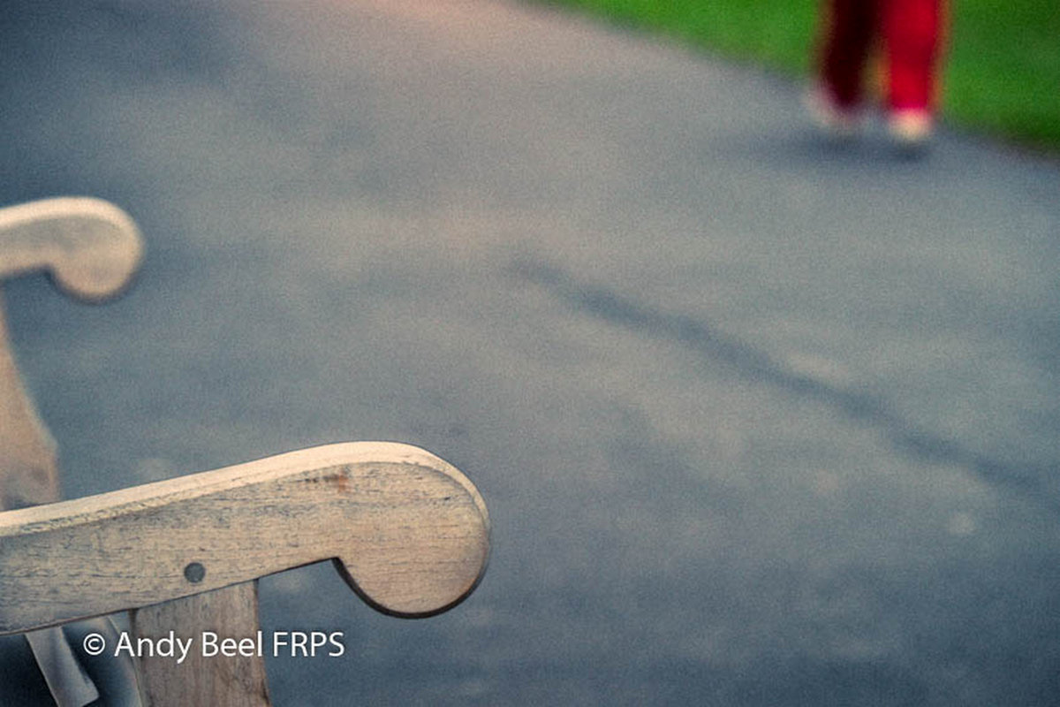
The Imperfect Composition
So here are further ideas in this category.

Slide 27
The Imperfect Composition

Slide 28
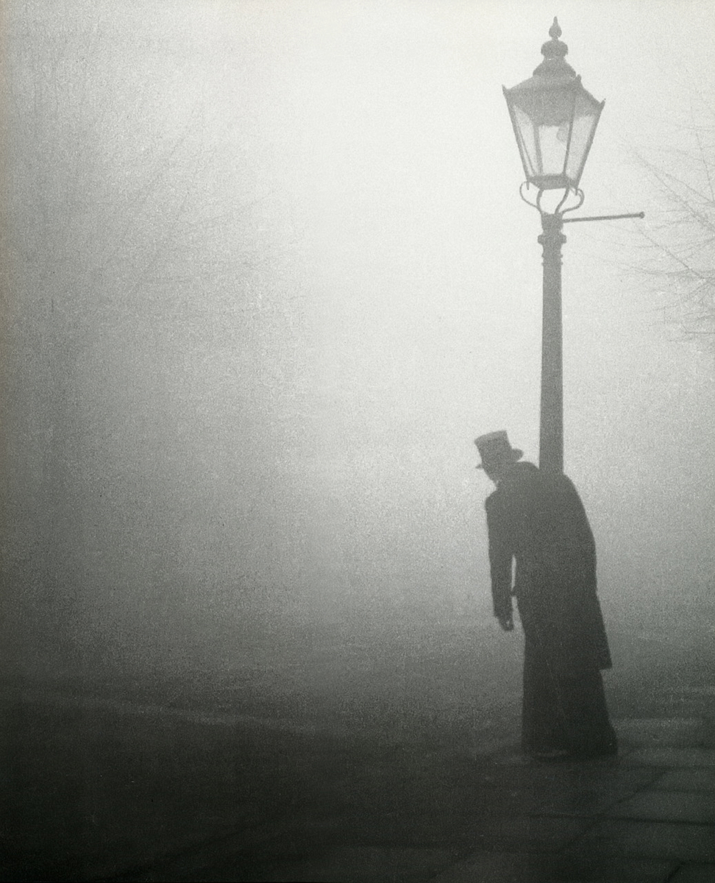
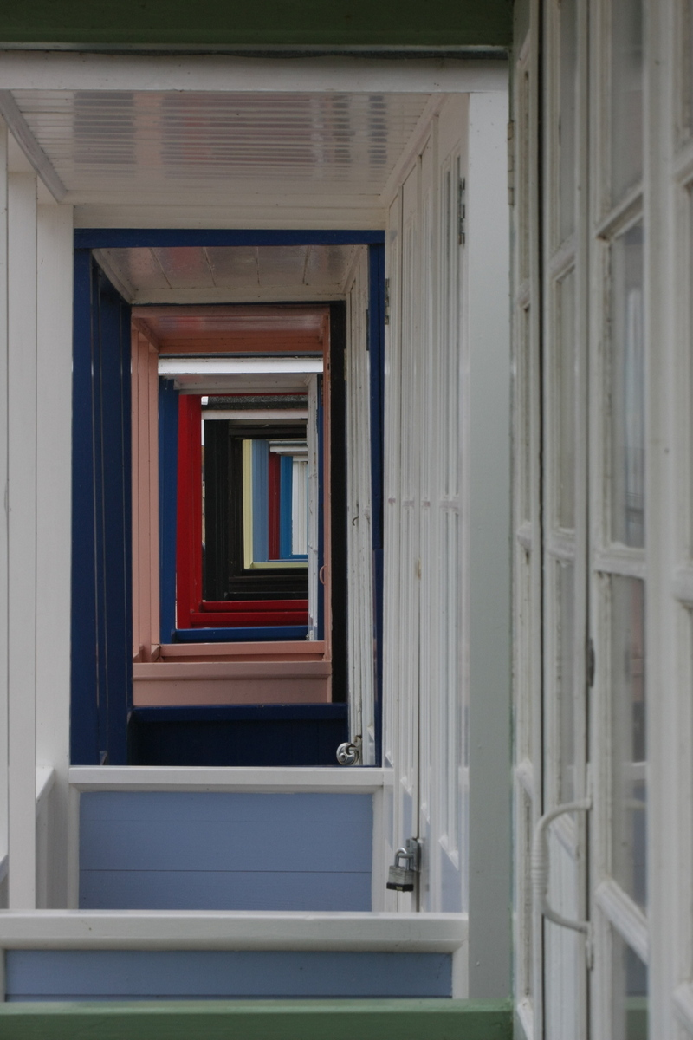
The Imperfect Composition
Beach
Bill Brandt London 1934
Southwold Beach Huts

Slide 29
The Imperfect Composition

Slide 30
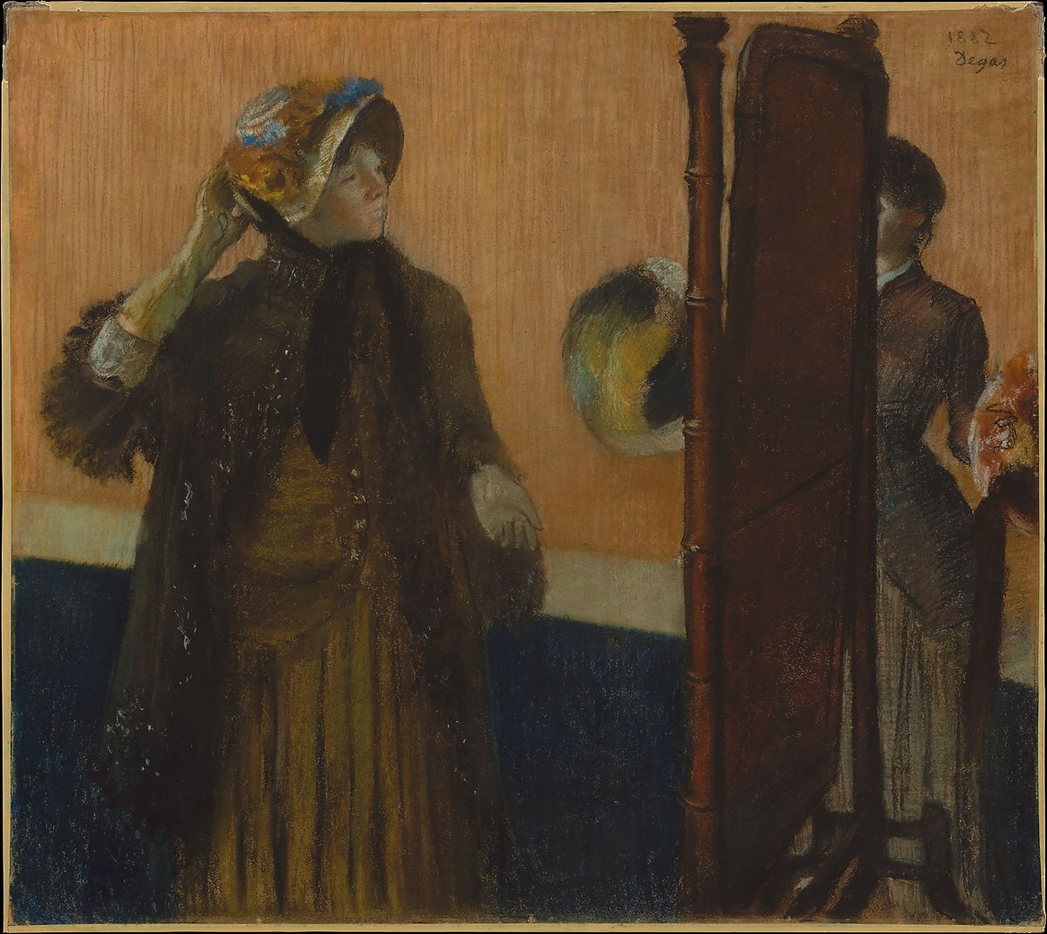
The Imperfect Composition
Painting and Drawing by Degas

Slide 31
The Imperfect Composition

Slide 32
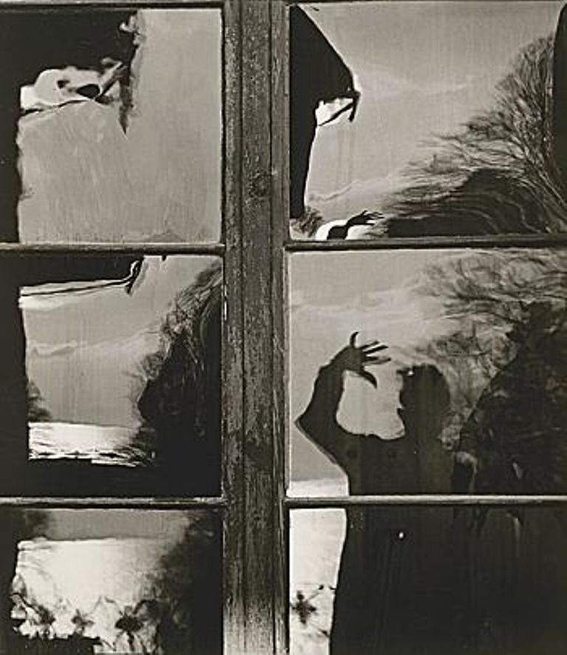
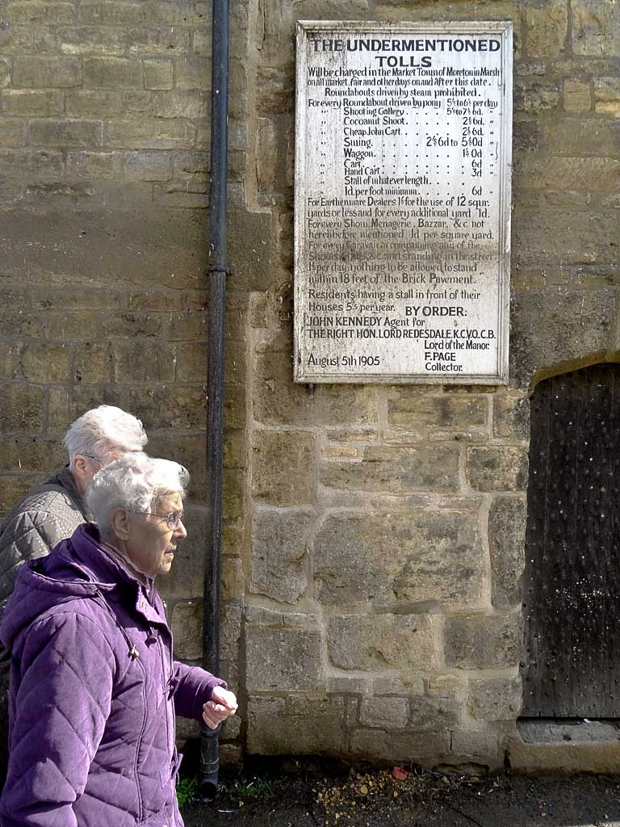
The Imperfect Composition
Toni Schneiders self portrait
Fotoform Style

Slide 33
The Imperfect Composition

Slide 34
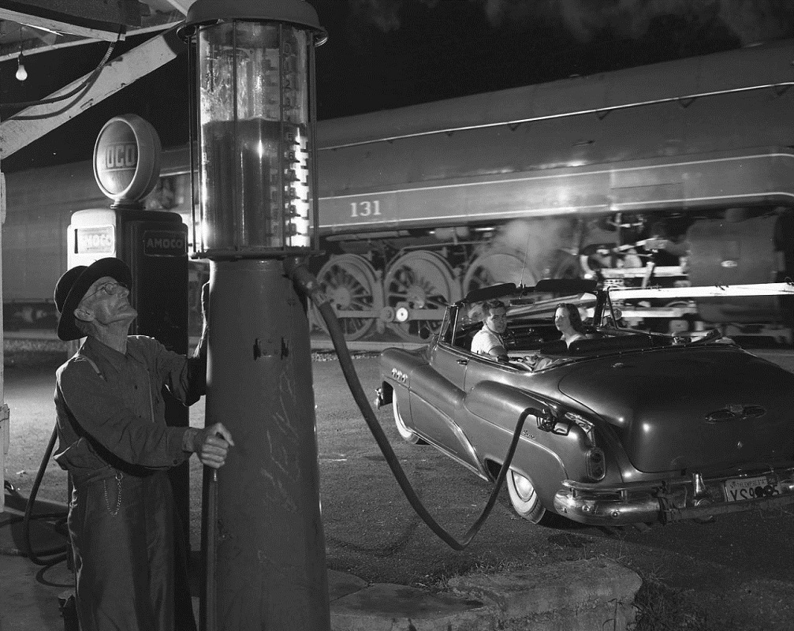
The Imperfect Composition
Winston Link’s amazing flash photography

Slide 35
The Imperfect Composition

Slide 36
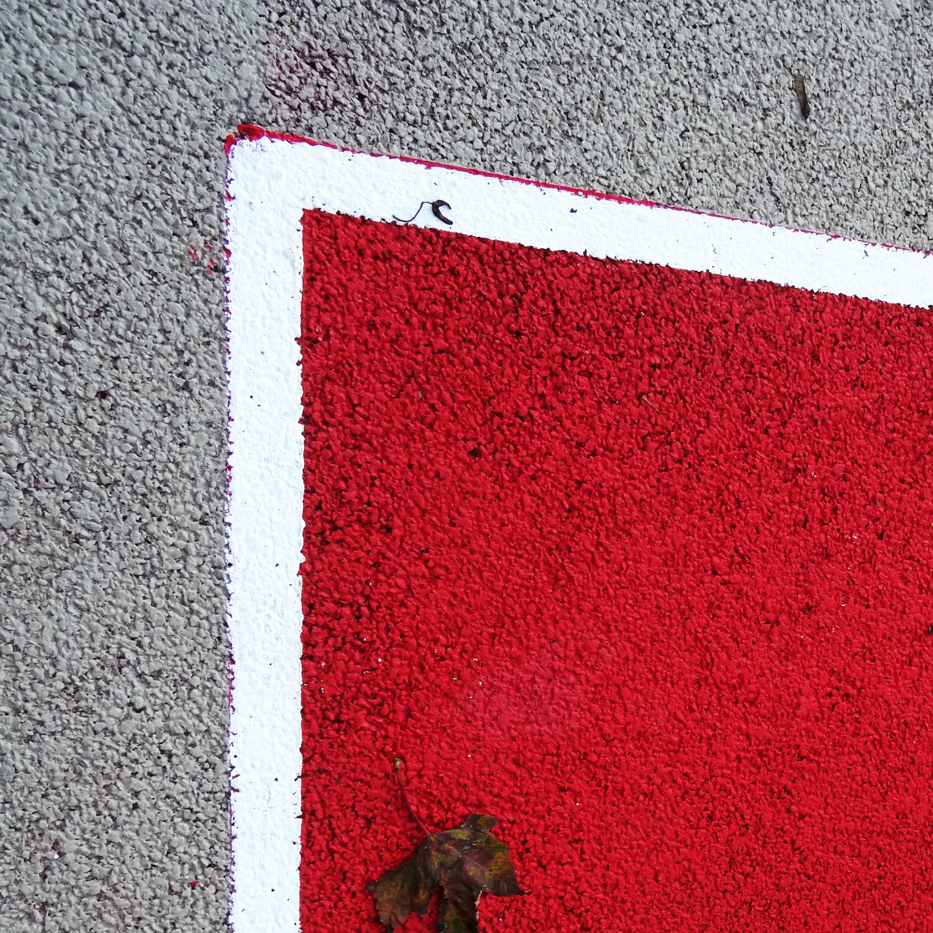
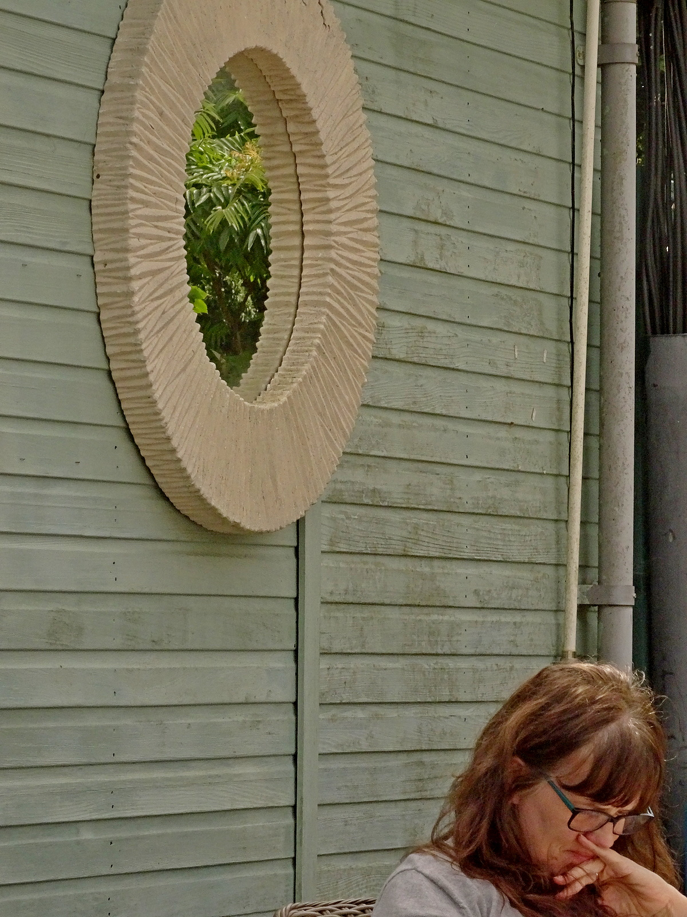
The Imperfect Composition
Tennis Court Markings
Wilton Garden Centre Cafe

Slide 37
The Imperfect Composition

Slide 38
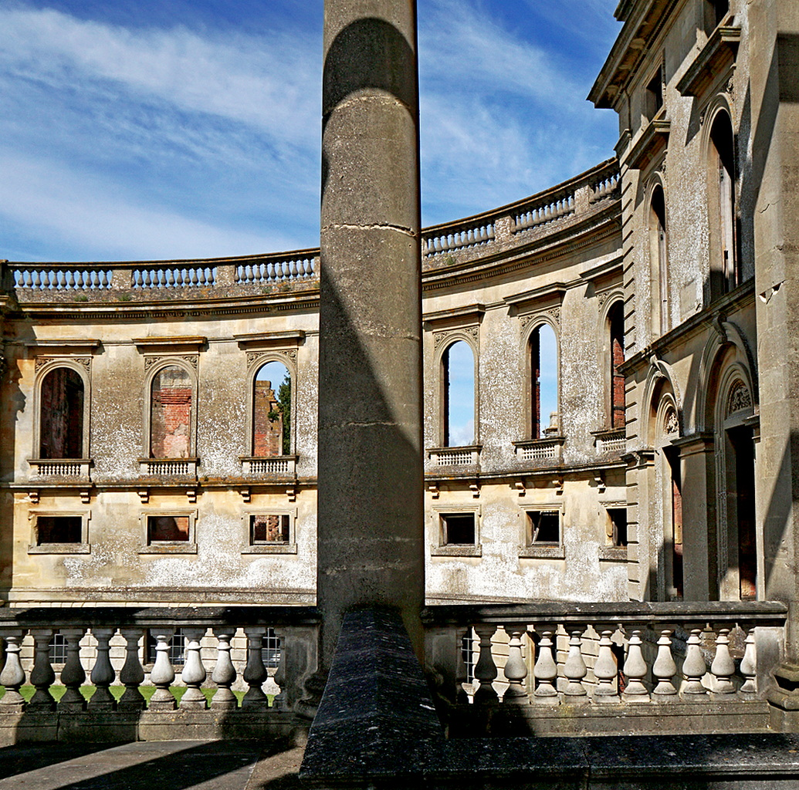
The Imperfect Composition
Witley Court, Glos.

Slide 39
The Imperfect Composition

Slide 40
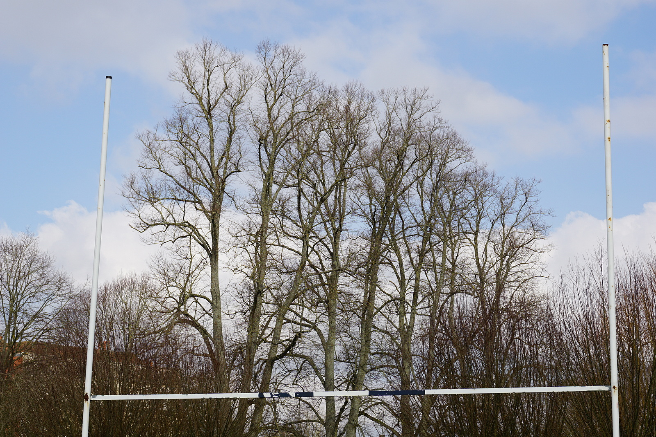
The Imperfect Composition
Rugby Football Goal
and Trees

Slide 41
The Imperfect Composition

Slide 42
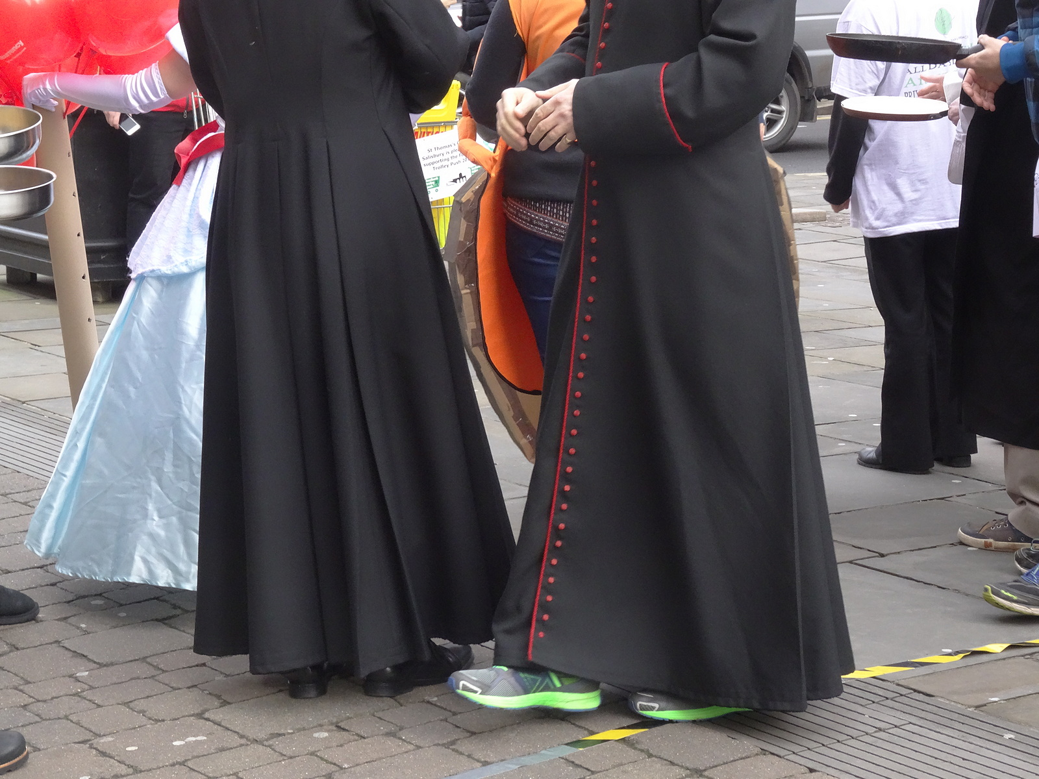
The Imperfect Composition
Pancake Day in Salisbury

Slide 43
The Imperfect Composition

Slide 44
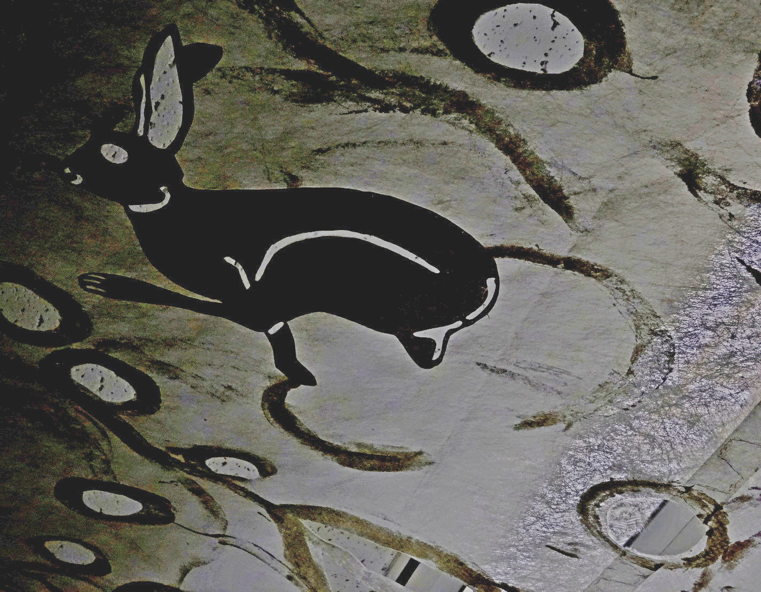
The Imperfect Composition
Things you can do with a sheet!

Slide 45
The Imperfect Composition

Slide 46
The Imperfect Composition
So for Homework see if you can take directly from your camera images that use some of these ideas.
It will stretch your mind to find images that fit but if you do then you will have achieved something new for you at least.
These may not win cups in competitions because the messages may be too obscure for untutored judges. But you know the messages and the worth of them.

Slide 47
The Imperfect Composition

Slide 48
The Imperfect Composition
So have fun with your picture capturing.
Take your time now to make a good job.
Peter Read 2021 April with a little help from Tony Worobiec

Slide 49
The Imperfect Composition

