Slide 1
Architectural Photography
Record
Spire U3A Group
3rd August 2018

Slide 2
Architectural Photography
Record
For this topic I define Record Architectural Photography as photographs taken square on to the subject with no attempt at pictorialism.
The image should convey information about the building but only from one view. Other views at right angles would reveal more information.
In practice these two views and maybe others too can be place or arranged on one sheet.

Slide 3
Architectural Photography
Record
The following pages show some of my Record Shots

Slide 4
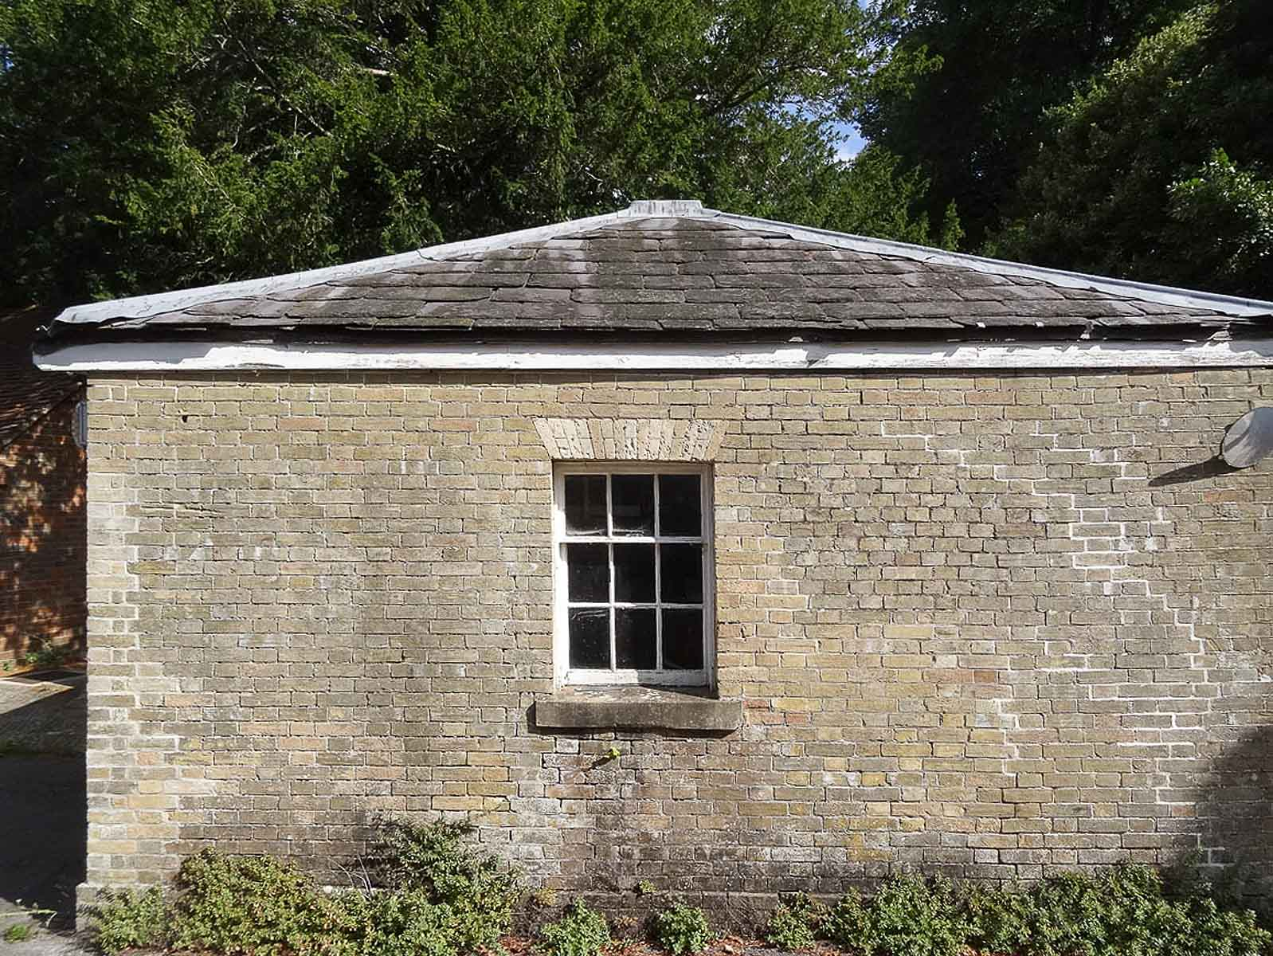
Architectural Photography
Record

Slide 5
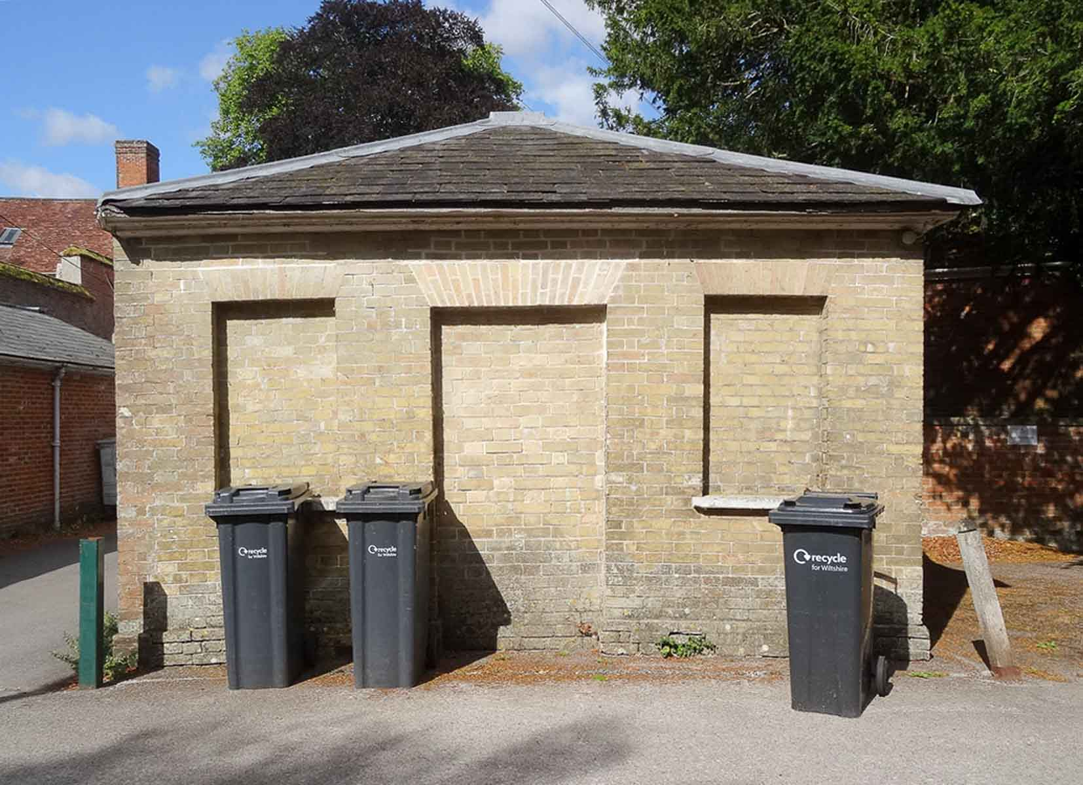
Architectural Photography
Record

Slide 6
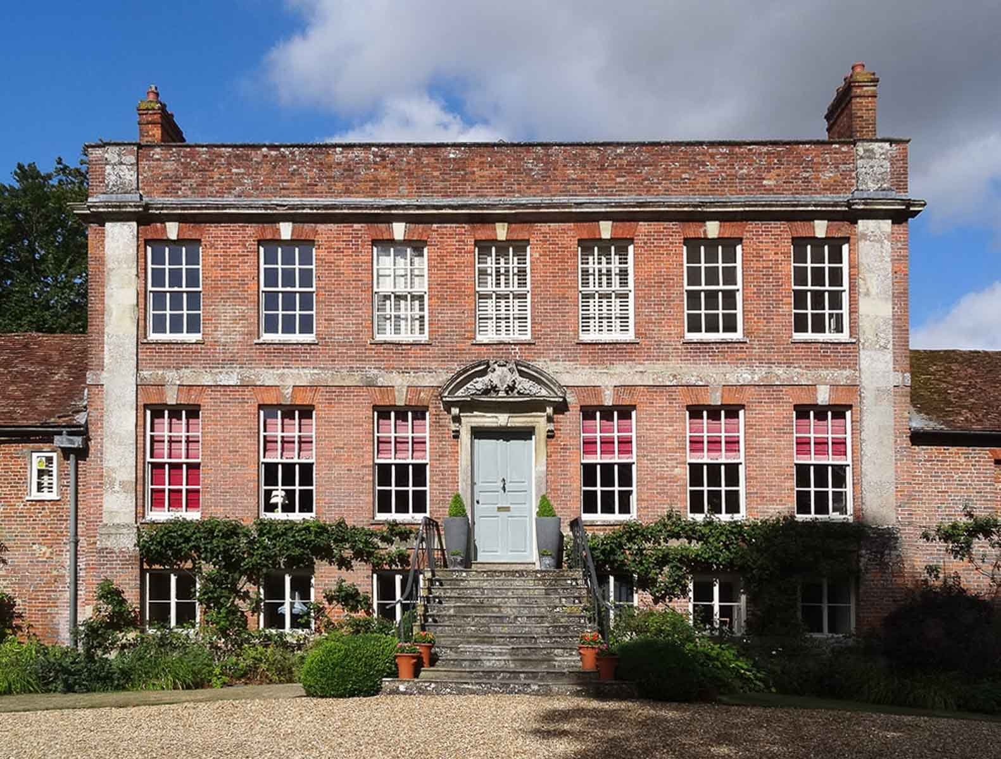
Architectural Photography
Record

Slide 7
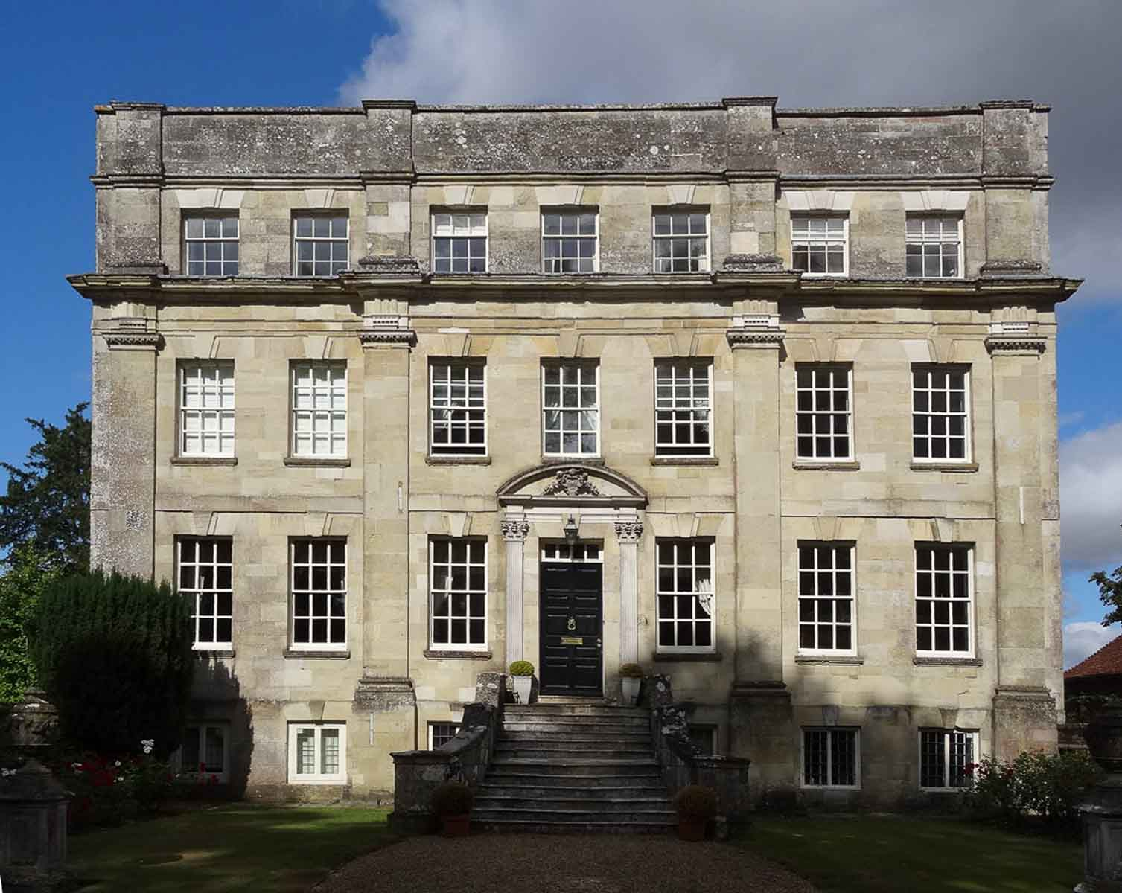
Architectural Photography
Record

Slide 8
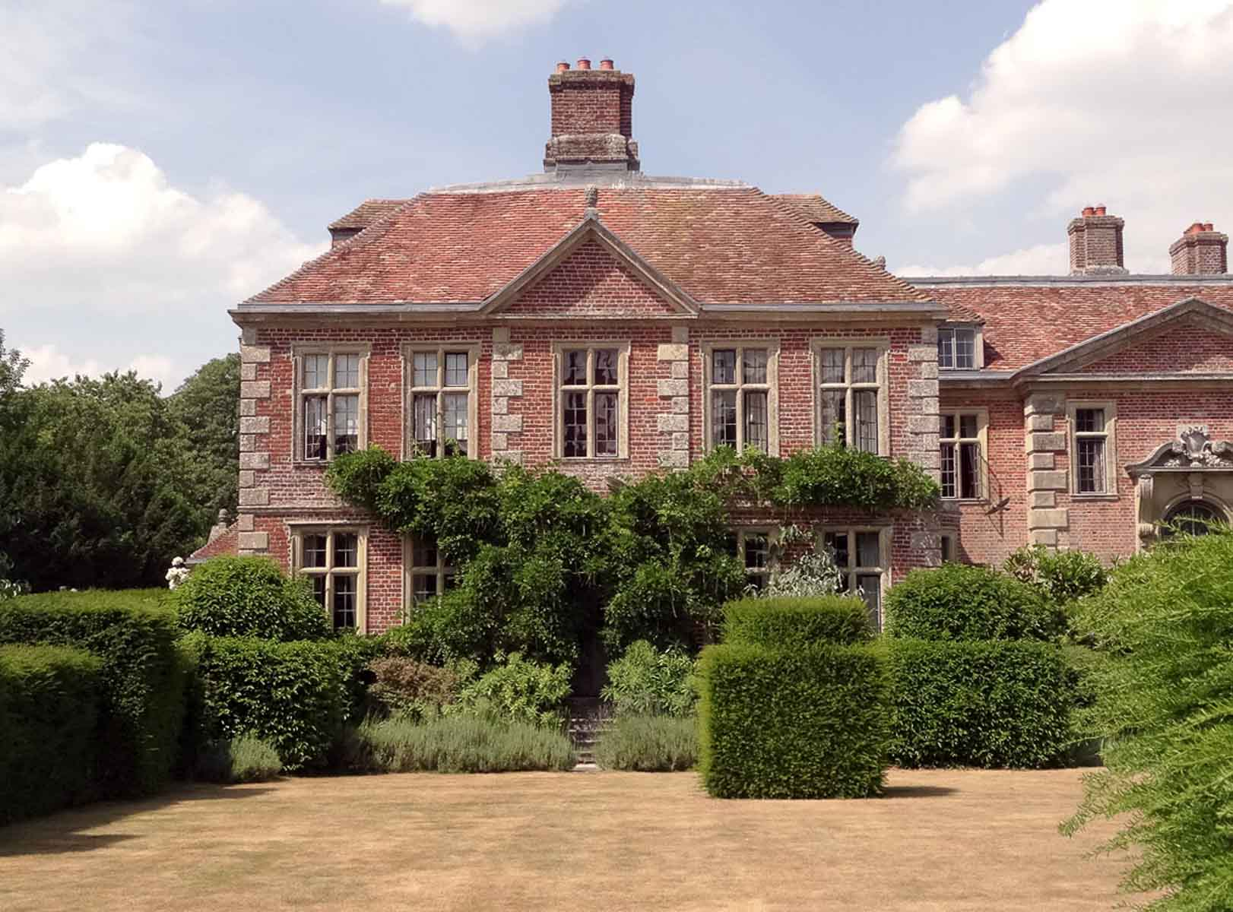
Architectural Photography
Record

Slide 9
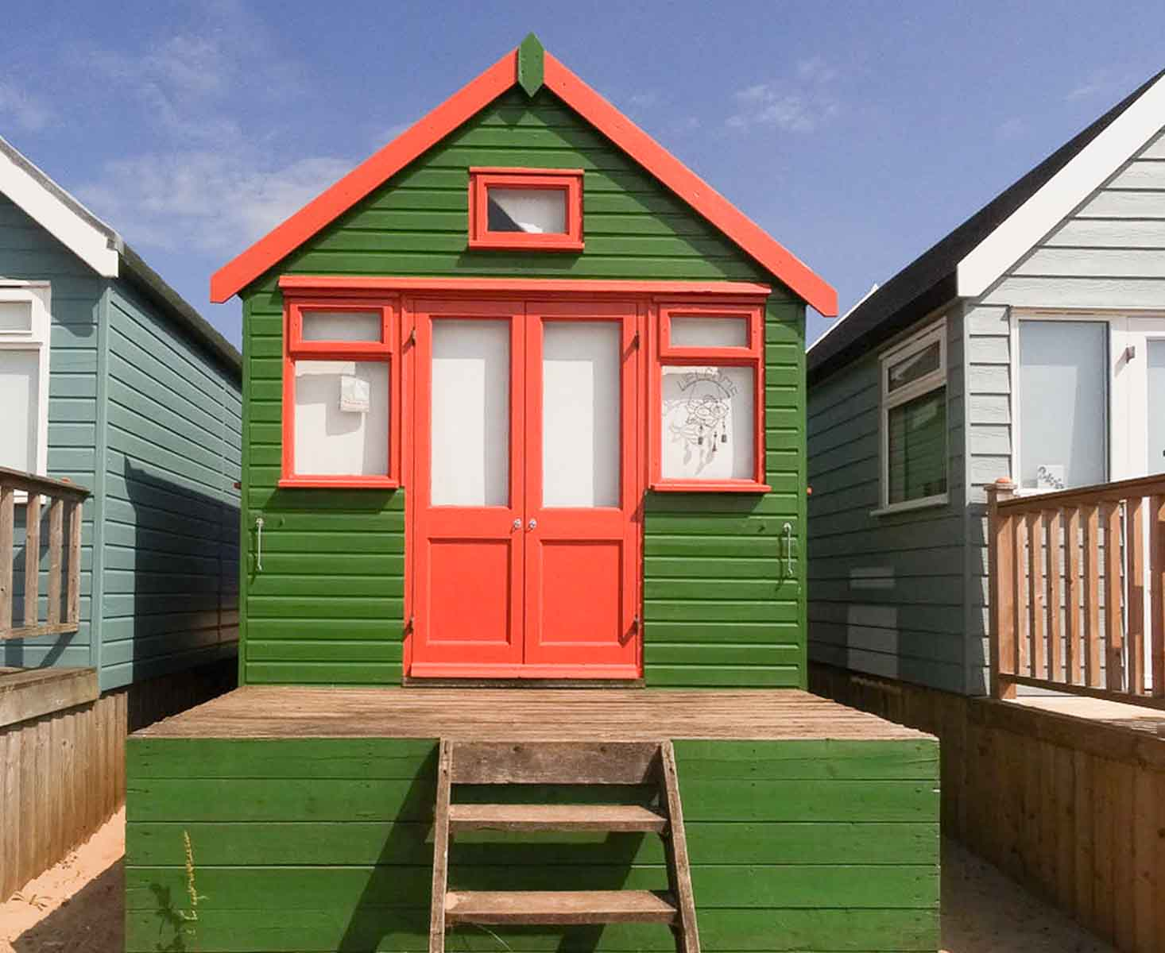
Architectural Photography
Record

Slide 10
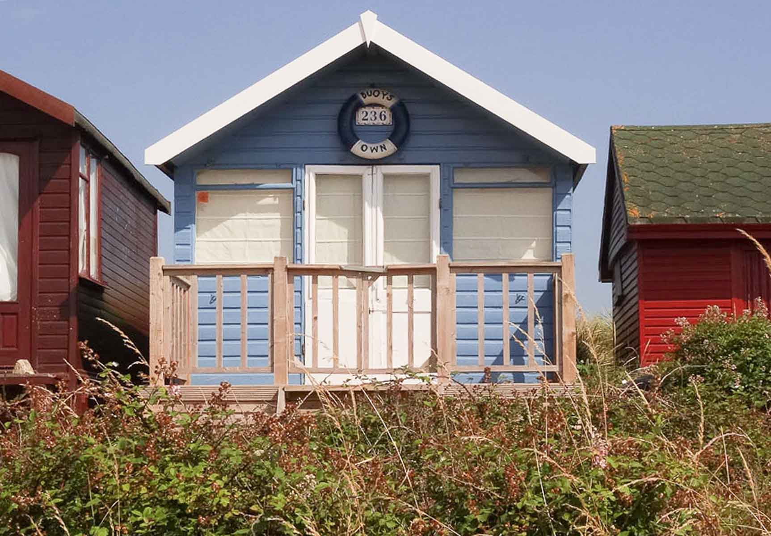
Architectural Photography
Record

Slide 11
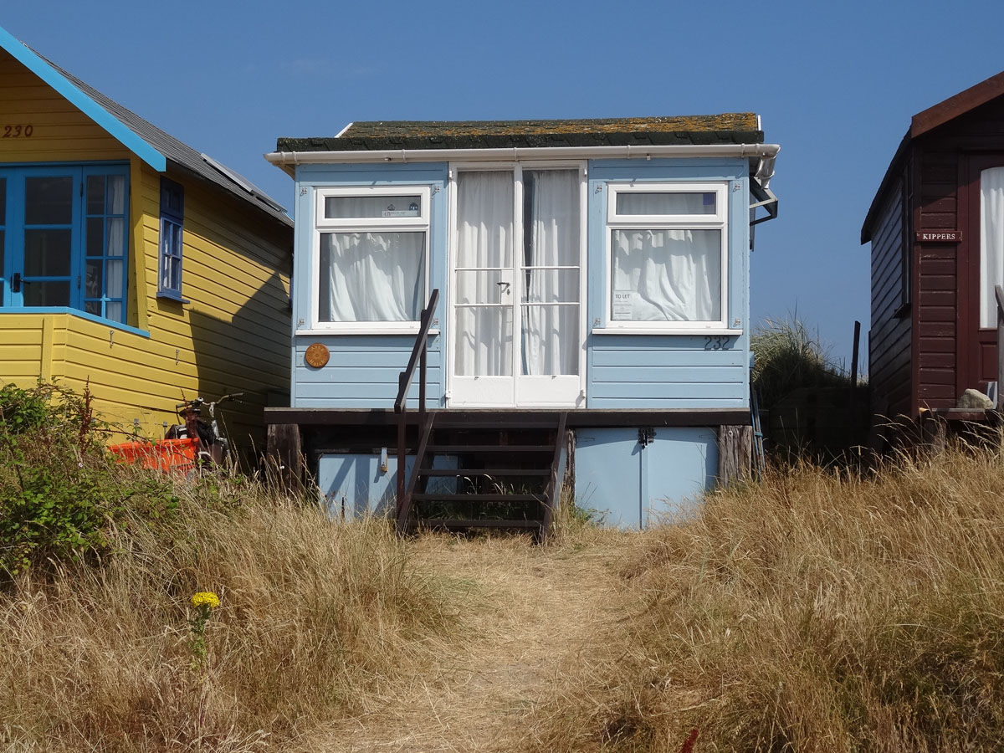
Architectural Photography
Record

Slide 12
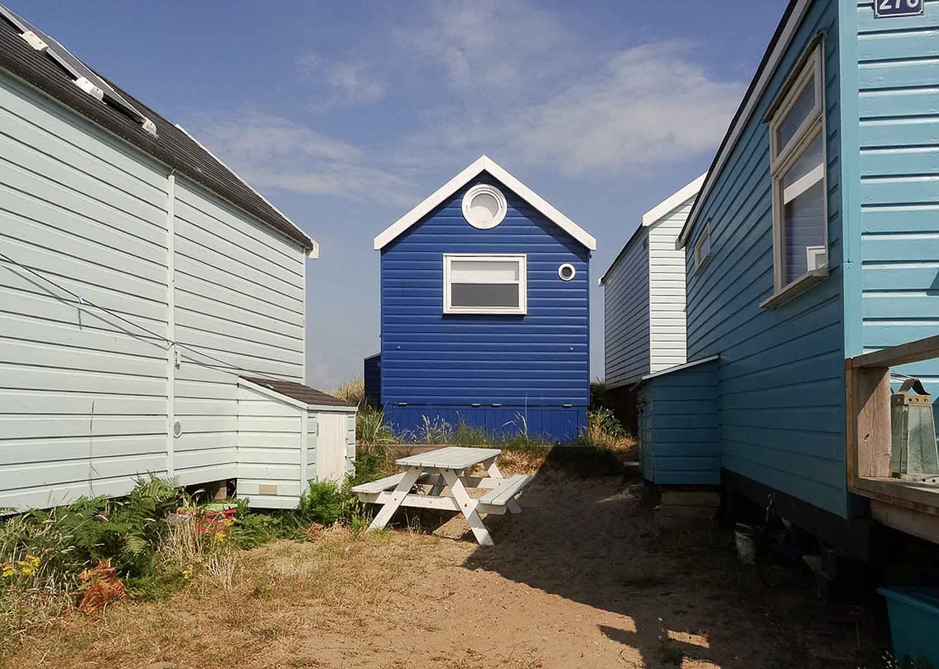
Architectural Photography
Record

Slide 13
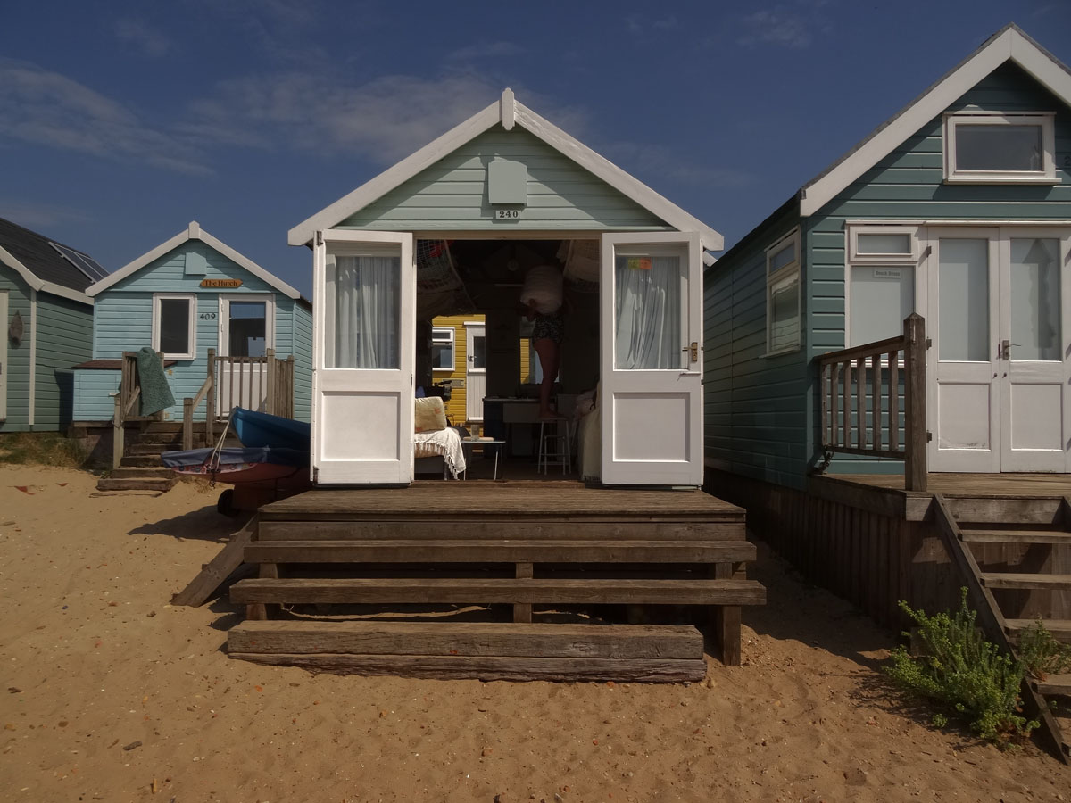
Architectural Photography
Record

Slide 14
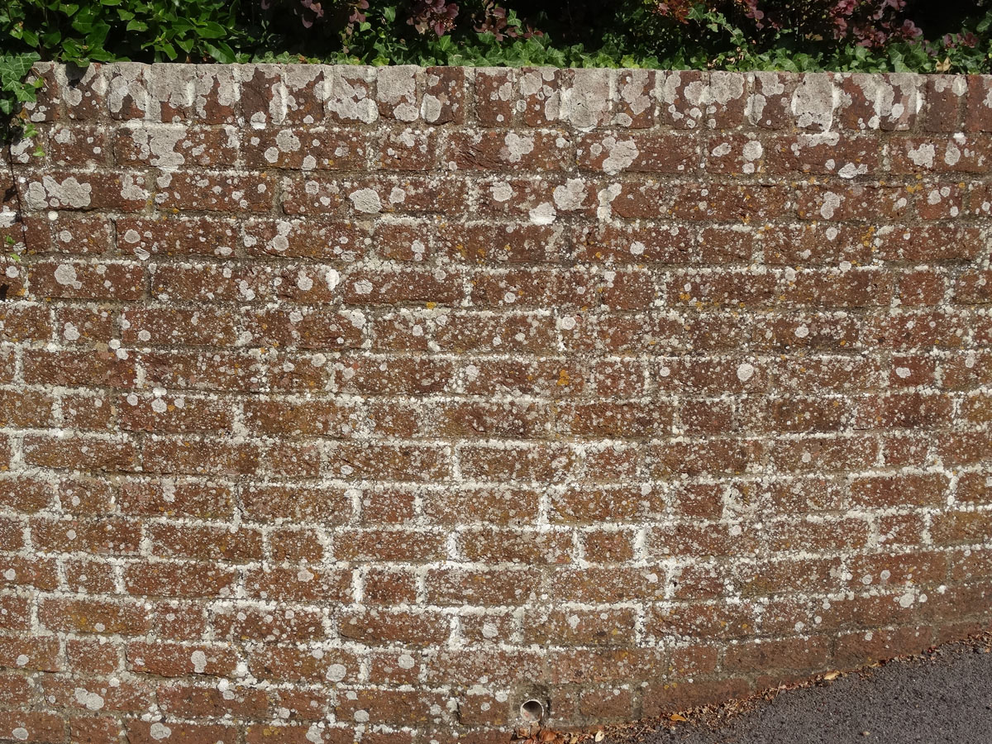
Architectural Photography
Record

Slide 15
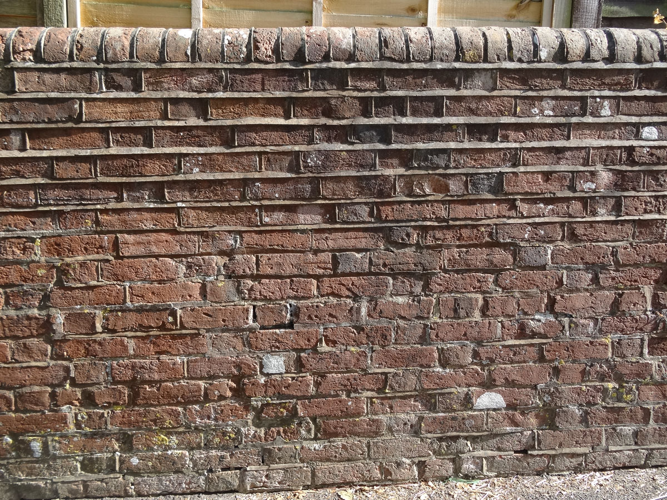
Architectural Photography
Record
Note the difference between these 2 shots of the same wall.
The glancing sunlight really shows up the textures

Slide 16
Architectural Photography
Record
I hope these images convey my meaning to you.

Slide 17
Architectural Photography
Record
The End

