Slide 1
Architectural Photography
For the Practical Photography Group
of Spire U3A

Slide 2
Architectural Photography
Three Kinds of Architectural Photography are:
Record
Illustration
Picture

Slide 3
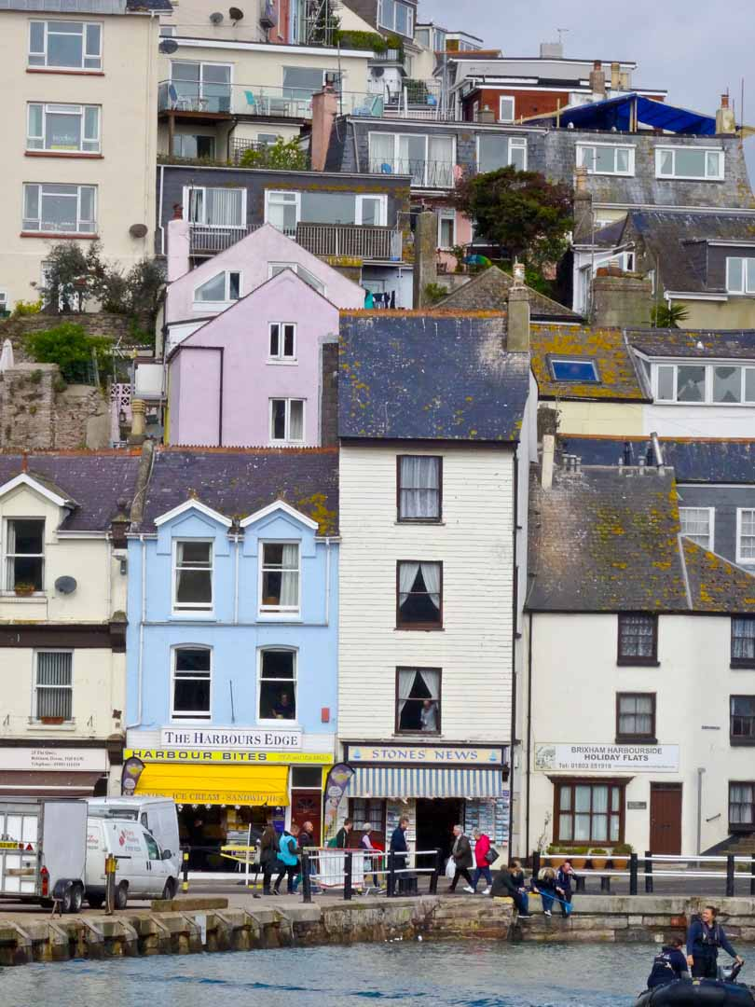
Architectural Photography
Record
Here is a photo of Brixham harbour.
A straight record shot.

Slide 4
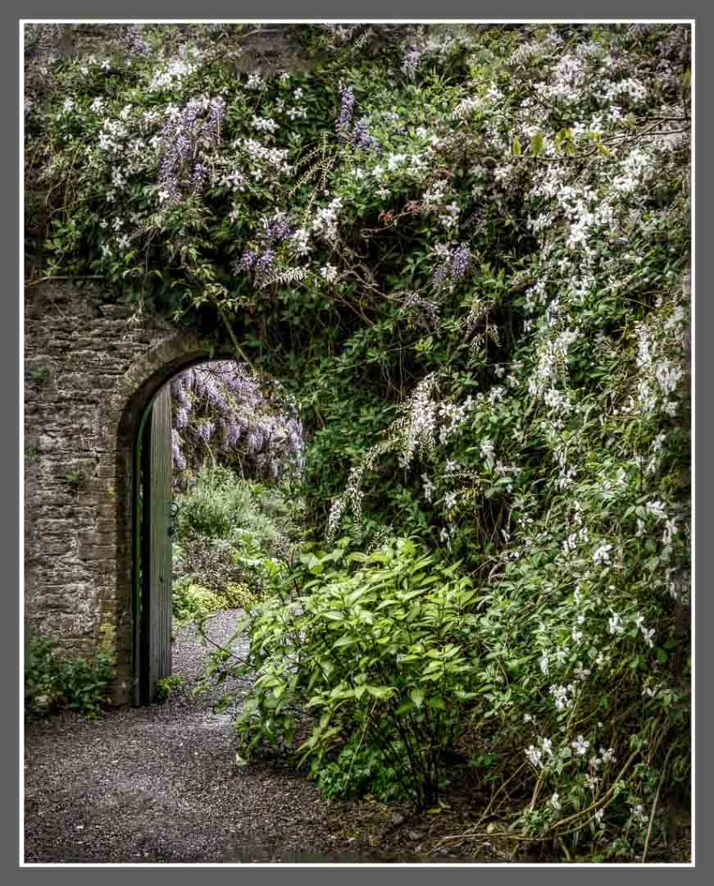
Architectural Photography
Illustration
Here is a photo a garden doorway.
A record shot but with pleasing foliage.

Slide 5
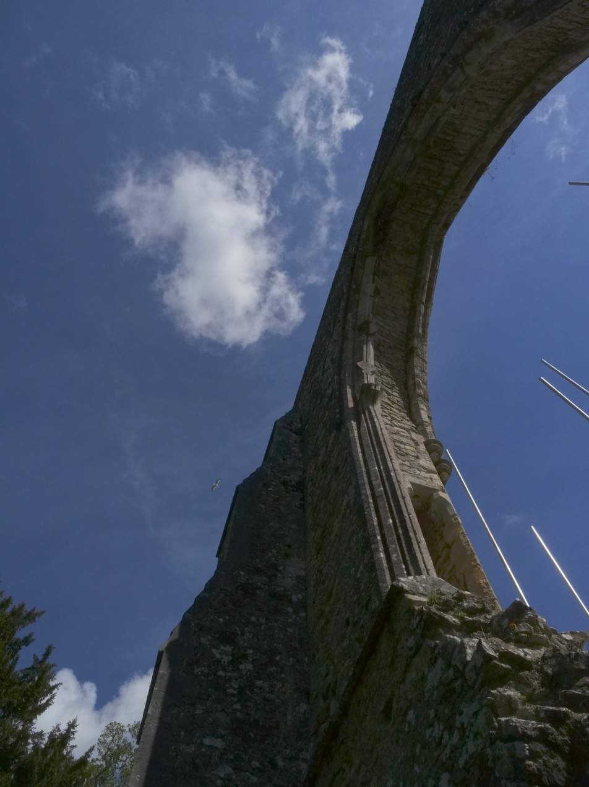
Architectural Photography
Picture
Netley Abbey from an interesting angle.
Not a record shot but with an unusual viewpoint

Slide 6
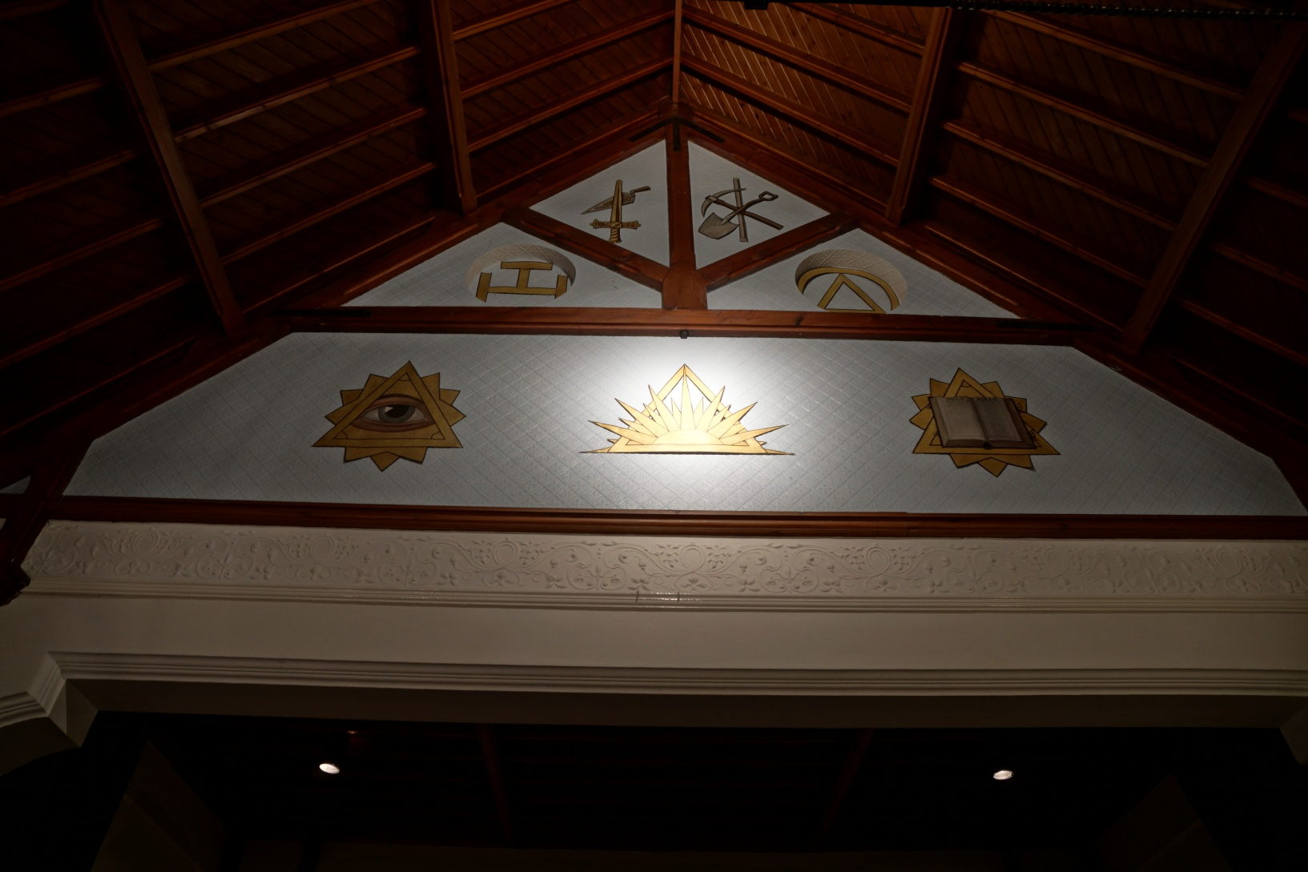
Architectural Photography
An Illustrative photograph?

Slide 7
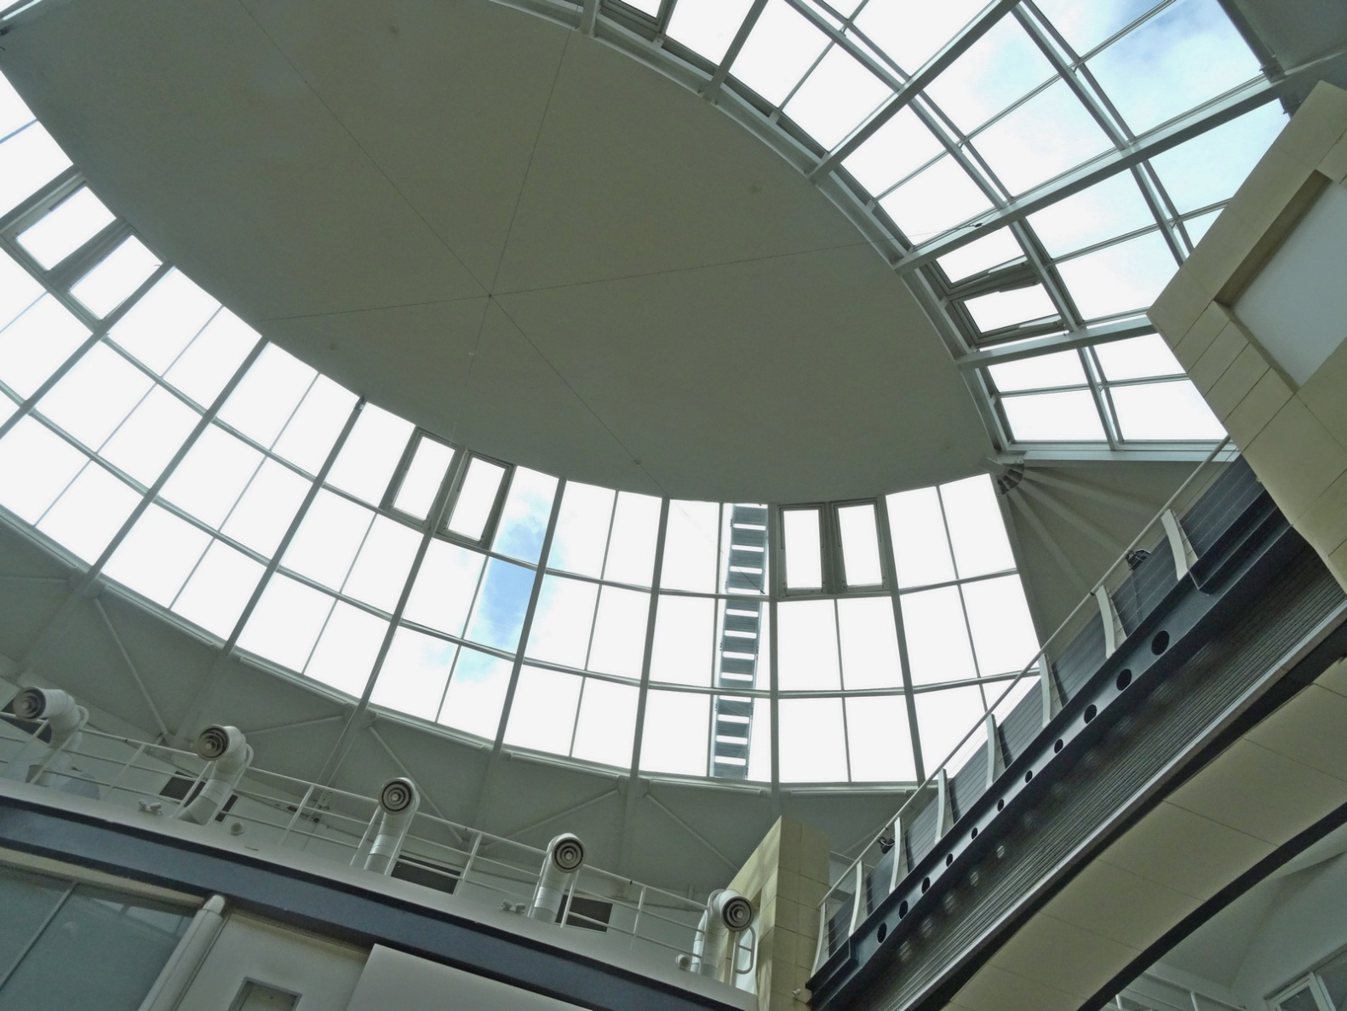
Architectural Photography
Mall Banbury. Is this a Record shot?

Slide 8
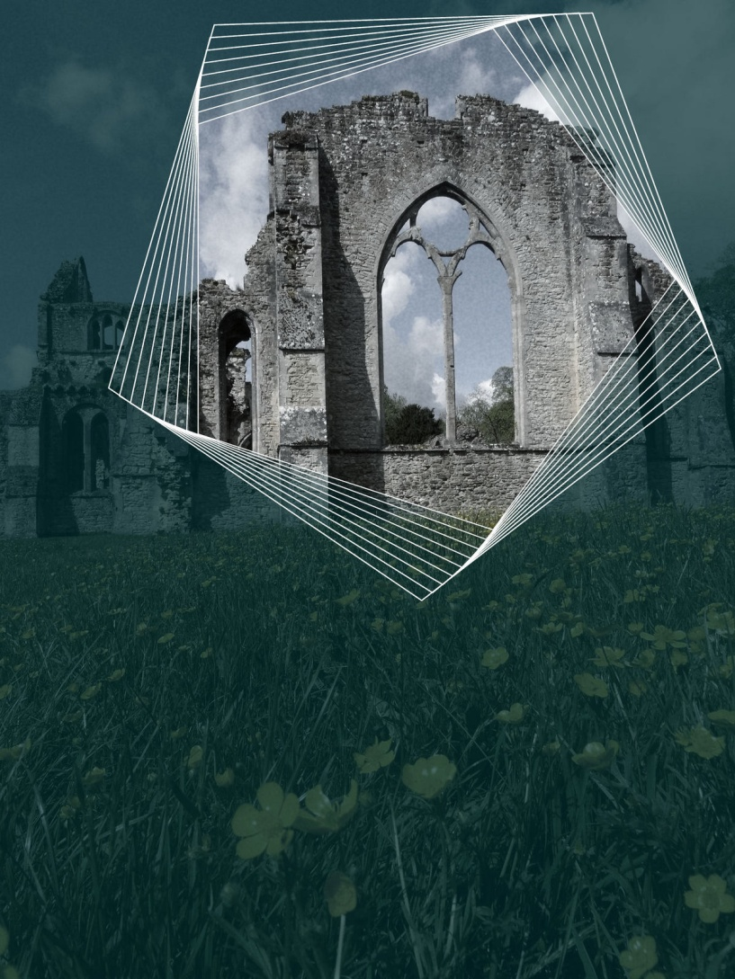
Architectural Photography
Surely an Illustrative image.

Slide 9
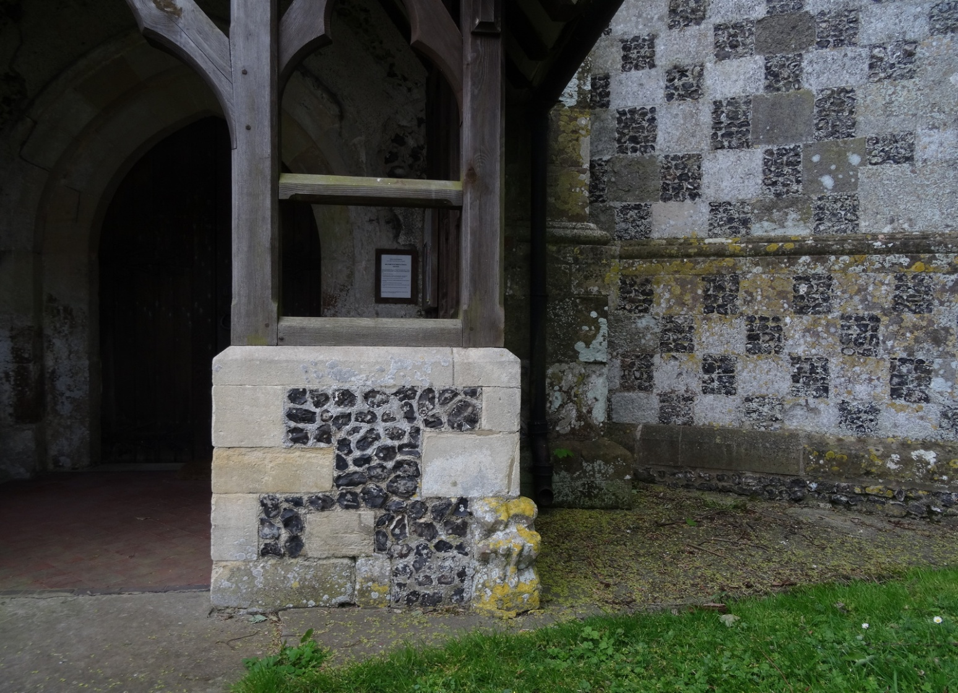
Architectural Photography
Is this a Record Photograph of the porch of Odstock Church?

Slide 10
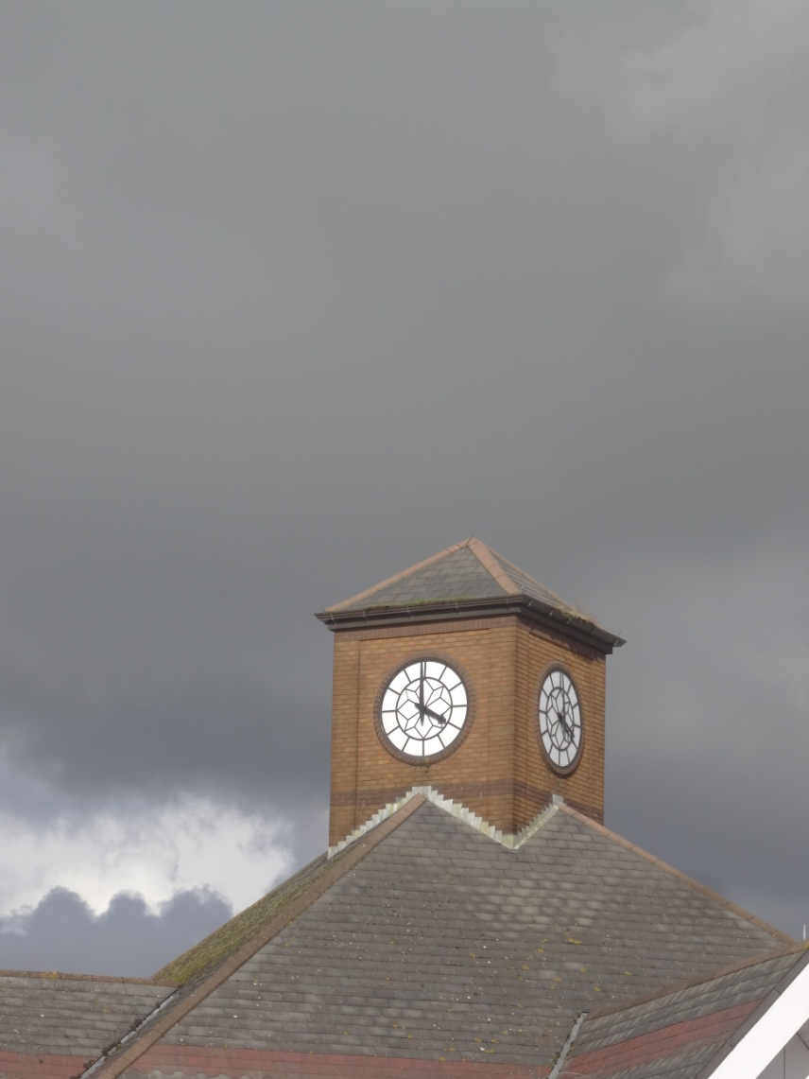
Architectural Photography
Not a Record but an Illustration of the Tesco Clock

Slide 11
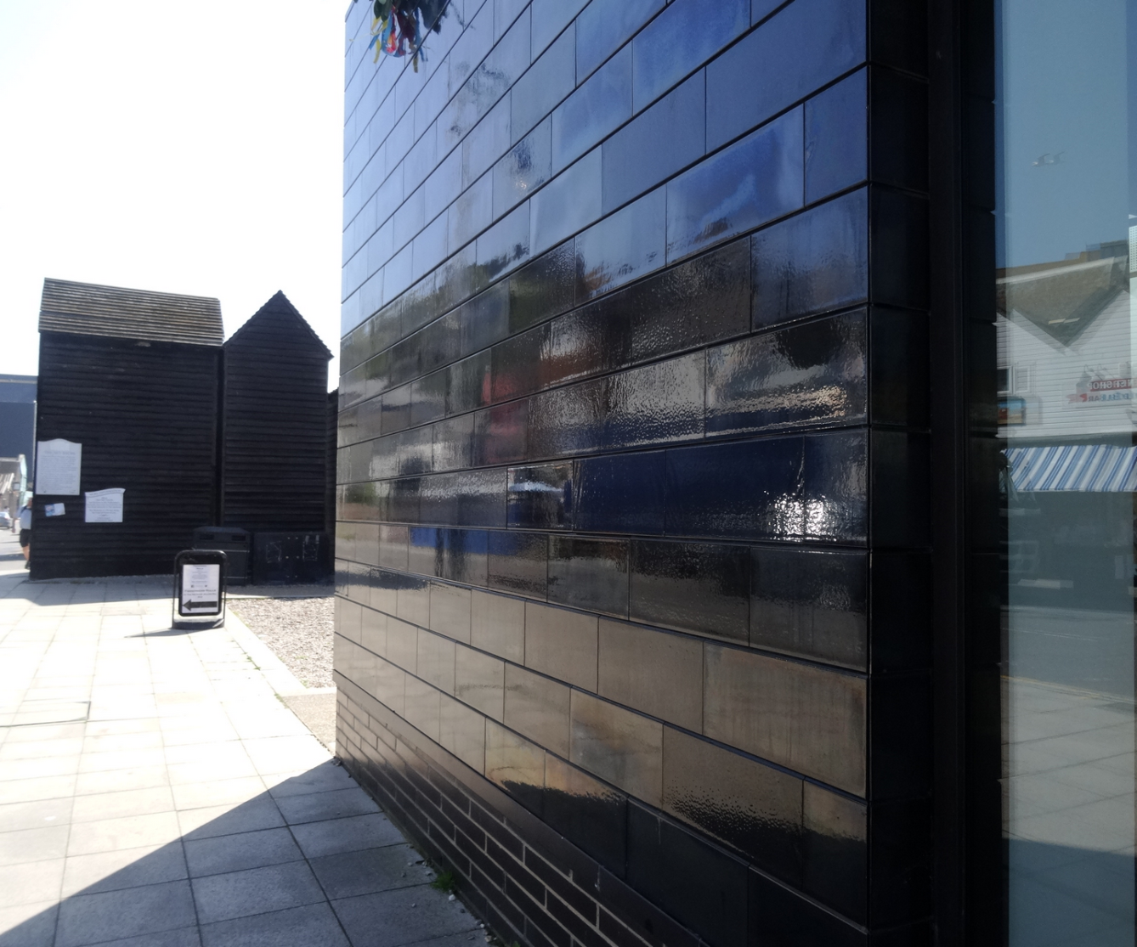
Architectural Photography
In the Picture category – It has Perspective and Reflections

Slide 12
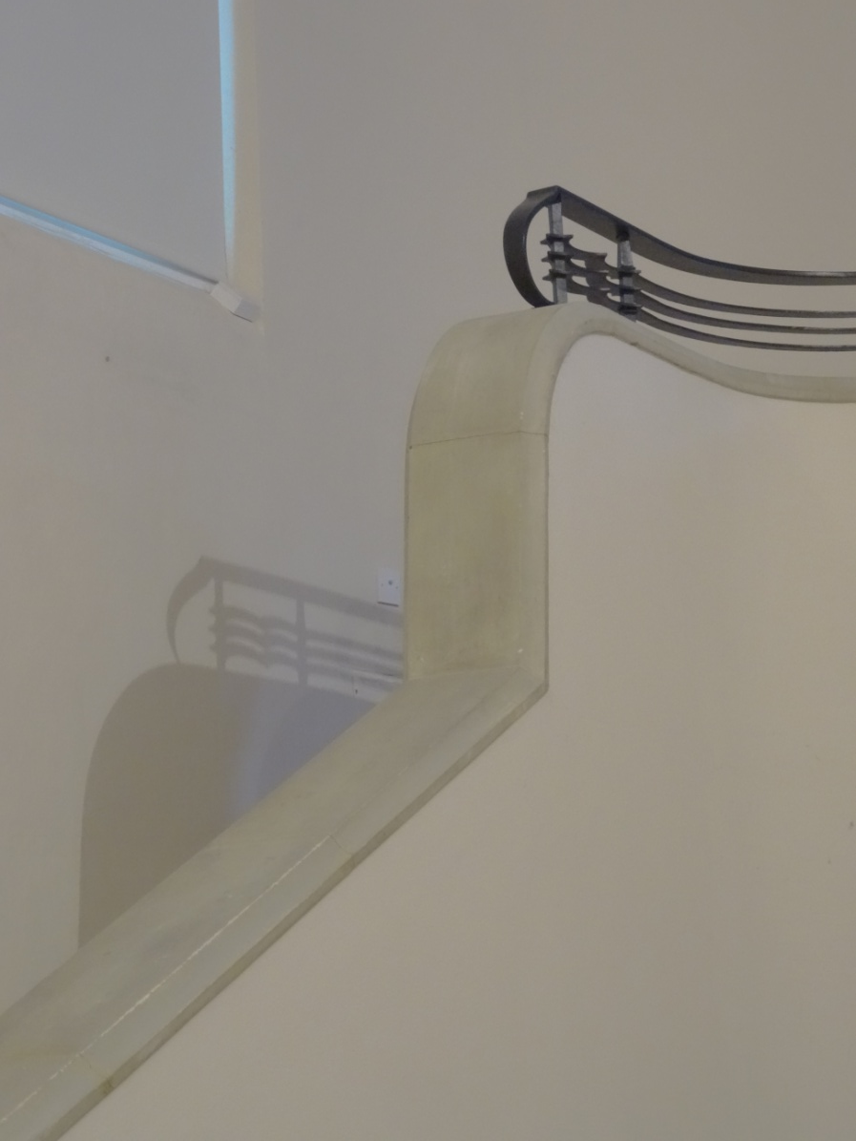
Architectural Photography
More than an Illustrative photograph with the subtle colouring and repeated shapes.

Slide 13
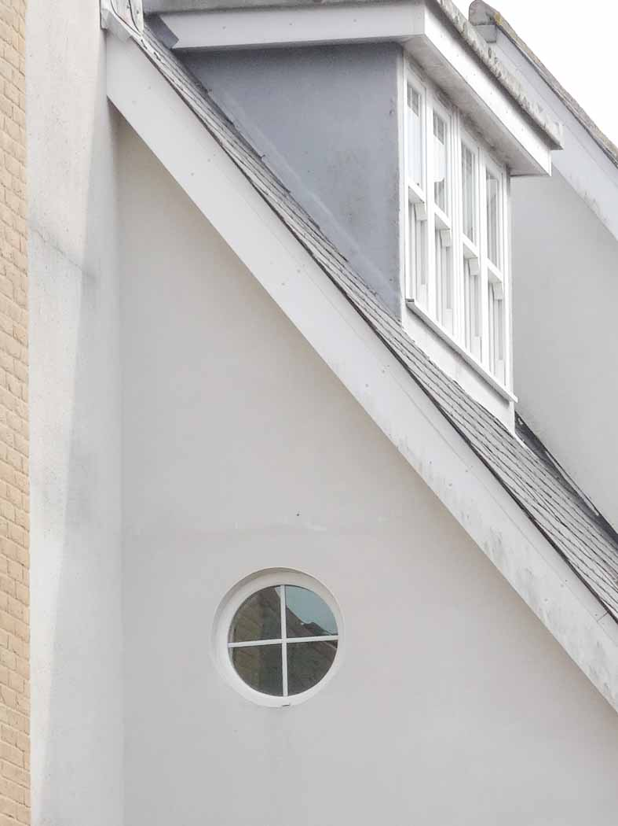
Architectural Photography
A detail that illustrates.
The round window attracts the eye.

Slide 14

Architectural Photography
A Picture detail photograph
of a Chinese roof timber

Slide 15
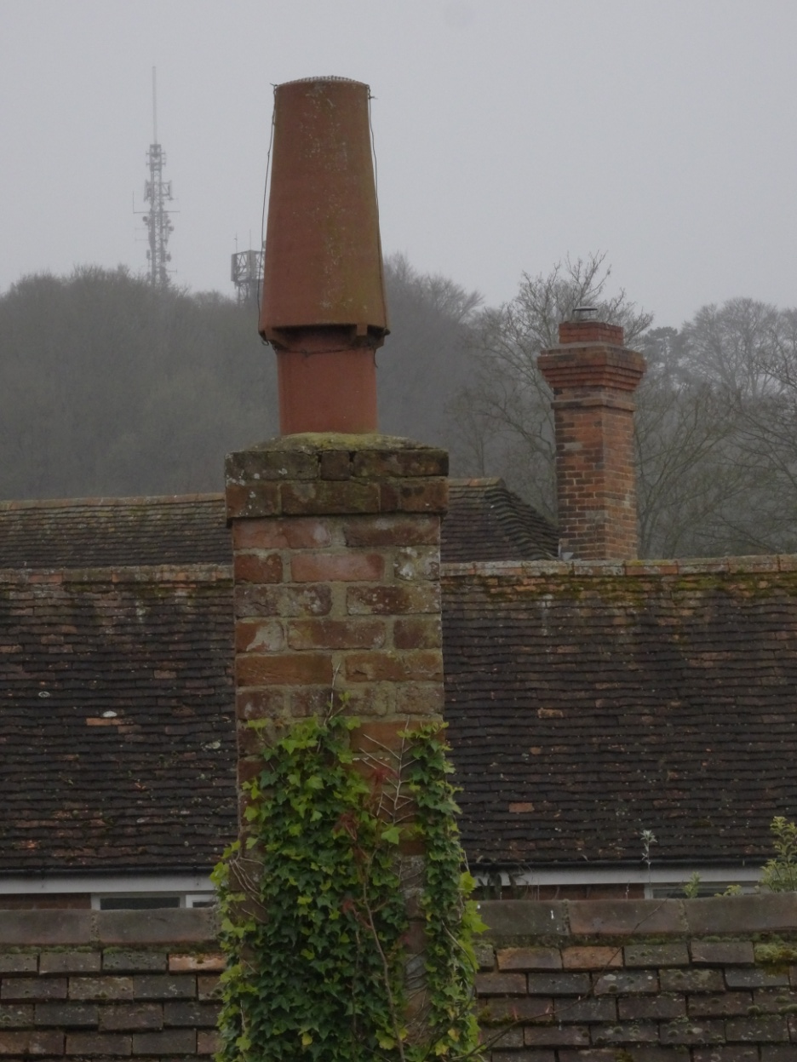
Architectural Photography
Another Illustrative shot of a
Chimney-scape showing repeated themes.

Slide 16
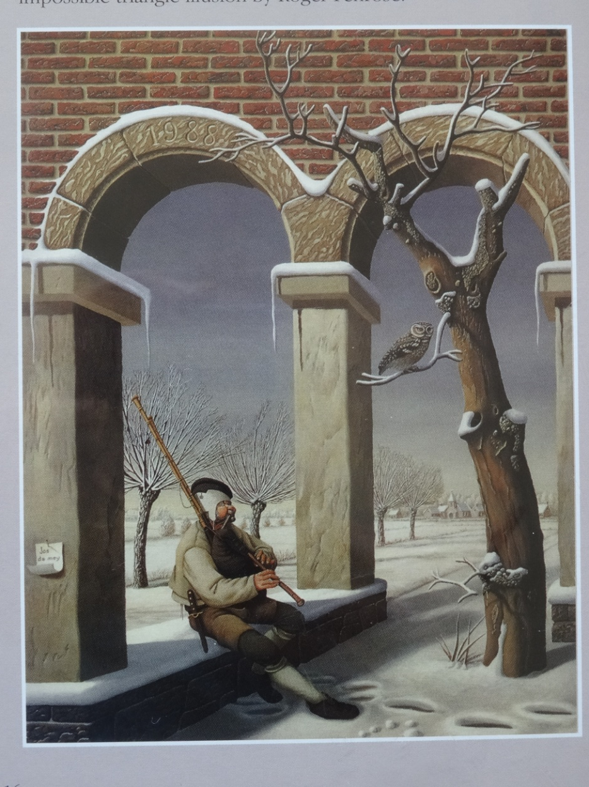
Architectural Photography
Some shots do not fit in the three Architectural categories such as this one!
It does Illustrate
an impossible
situation.

Slide 17
Architectural Photography
Architectural Photography covers a huge range of buildings inside and out. So you need to consider the purpose of your Photograph before pressing the shutter button
Try taking 3 photographs of a scene using the
3 categories.

Slide 18
Architectural Photography
The END
Written and Illustrated
by Peter Read LRPS, DPAGB

