Slide 1
Peg System for Remembering Lists
How to remember lists of information more clearly.

Slide 2
Background
The peg system is commonly used by Mental Athletes for memory competitions for events like card memorization as well as digit memorization.[4] The peg system has also been applied in a classroom with learning disabled students. The students that used the peg system performed significantly better than the control in both immediate and delayed tests.[7]
One complaint concerning the peg system is that it is often only applicable in mundane situations outside of the examples listed above. For example, the peg system can be used to remember grocery lists, key points in speeches, etc. However, this system can be used to remember a wide variety of objects or information. The peg system is a technique that can be applied in many different situations so as long as the information trying to be remembered is specific and tied to a unique retrieval cue, remembering can become more efficient.[8]
https://en.wikipedia.org/wiki/Mnemonic_peg_system

Slide 3
Different types of pegs
Number rhyme
Number shape

Slide 4
Example of number shape
0 is an orange
1 is a stick
1 pencil
1 Could be a sign
2. could be a snake
2 Two is swans neck
3 could be a hand cuffs or a w
3 Top of heart
4 sail boat shape
5 a coat hanger
5 hook
6 is a golf club
7 is a boomerang
7 Cliff edge
8 is an infinity symbol
9 balloon on stick
10 fork and plate

Slide 5
The problem in memorising just numbers is because they are an abstract system. It is better to remember physical objects that we use in our daily lives.

Slide 6
Rhymes of numbers
1 = sun
2 = shoe
3 = tree
4 = door
5 = hive
6 = sticks
7 = heaven
8 = gate

Slide 7
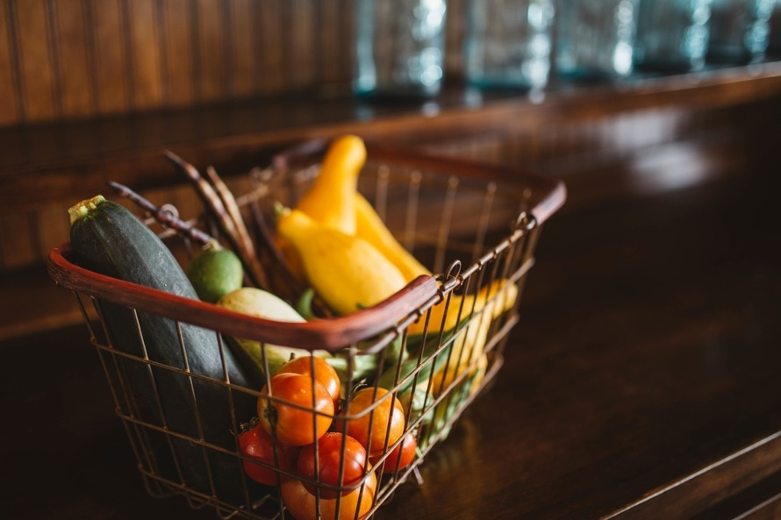
Here is our shopping list
Strawberry
Lemon
Milk
Apple
Washing powder
Carrot
Oranges

Slide 8
Remembering objects for the first time
Lets start off with a strawberry.
Using our first peg 1 is sun.
Think of a strawberry sunning itself on a beach.
Use your imagination you can use your other senses to reinforce the memory. The more senses that you apply the more concrete the memory will be.

Slide 9
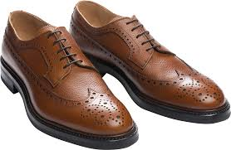

Examples
Lets imagine our shoes coated in thick lemon juice.
The image could be funny
Imagine the tree has buds on it and each bud is a
Milk bottle

Slide 10
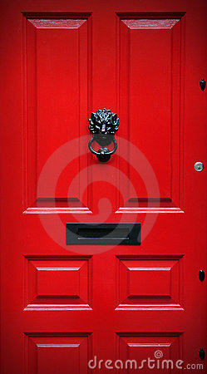
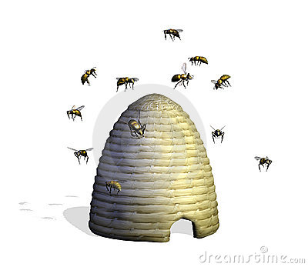
Examples
Imagine a door with lots of apples hanging on the front.
Or imagine a Door with an apple door knocker.
Imagine a hive with the bees going to flowers made up of
washing powder

Slide 11
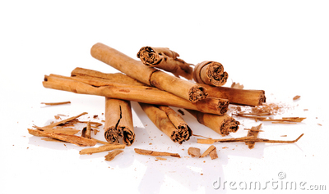

Examples
A house made out of carrot sticks to
to remember carrots.
Imaging heaven , angles stacked with lovely
Brightly coloured oranges

Slide 12
Homework
Memorise these number sequences.
Explain how you remembered these numbers.
1456
34356
3.4576
23467
PI to 10 places
Golden ratio to 5 places
Fibonacci sequence to 6 places

