Slide 1
Cassini Spacecraft
2004 to 2017
An incredible adventure

Slide 2
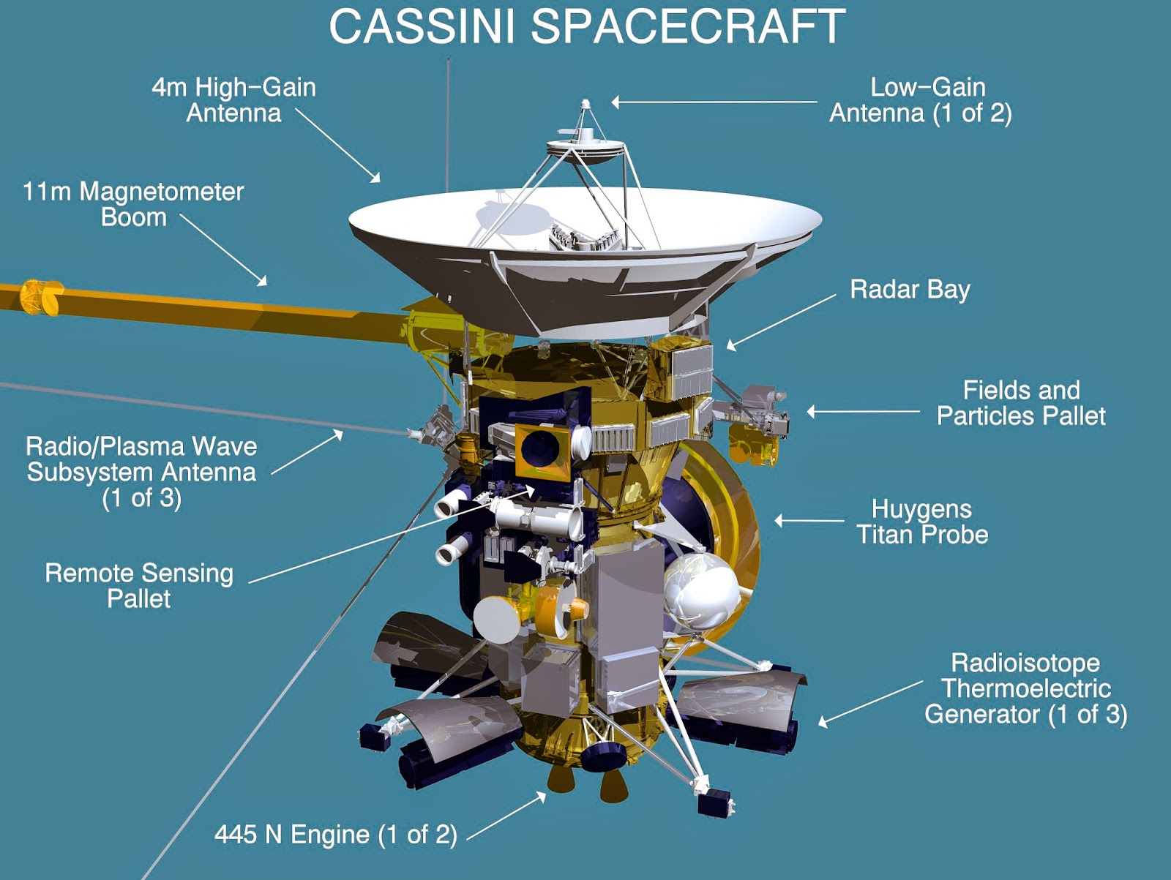

Slide 3
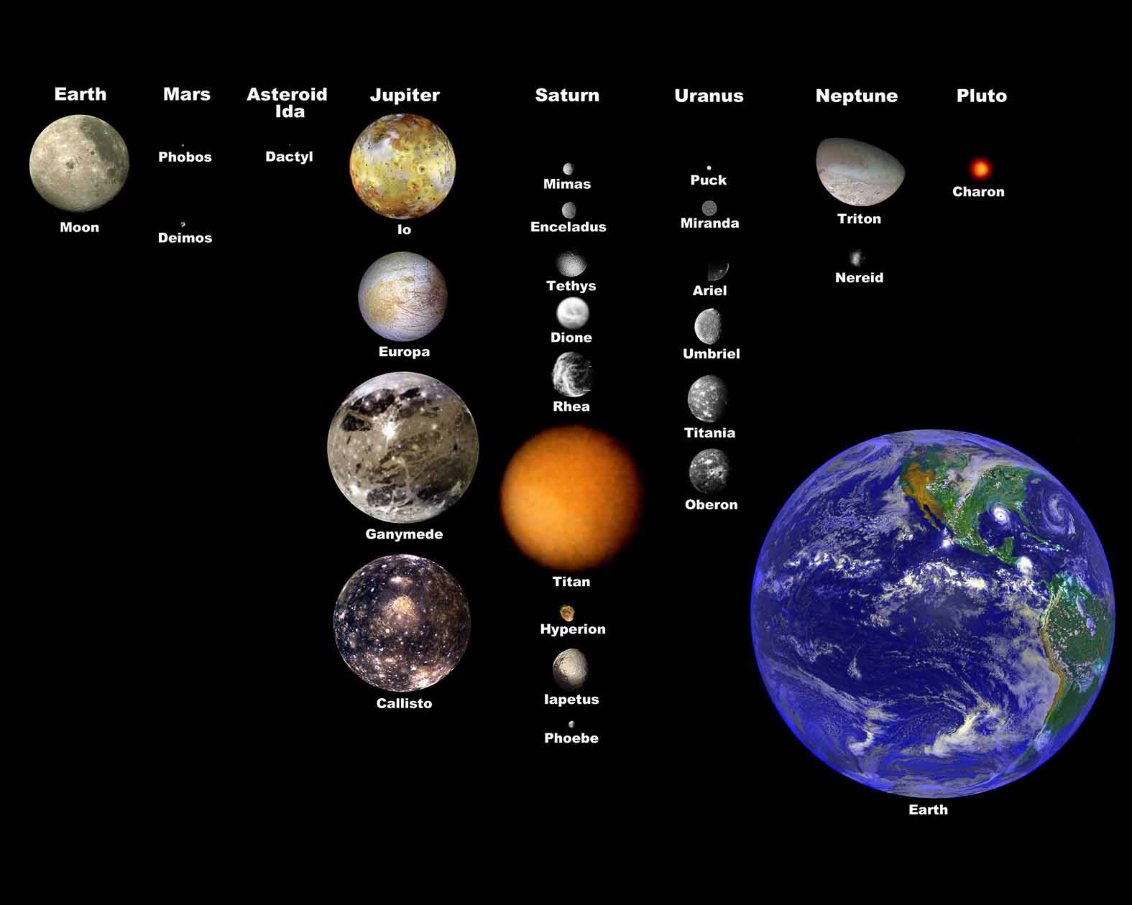
Comparison of Moons of the Solar System and Earth

Slide 4
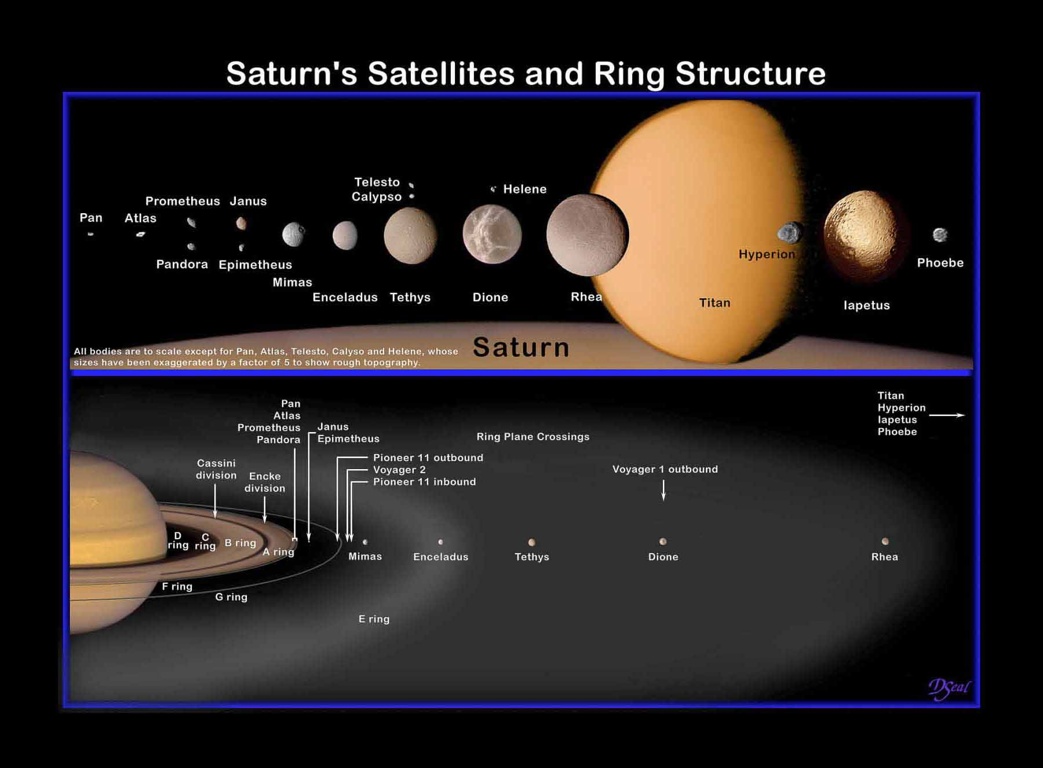

Slide 5
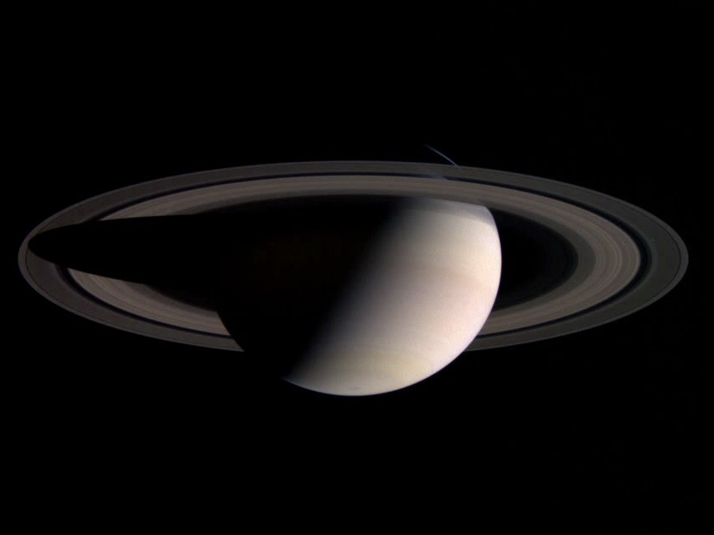

Slide 6
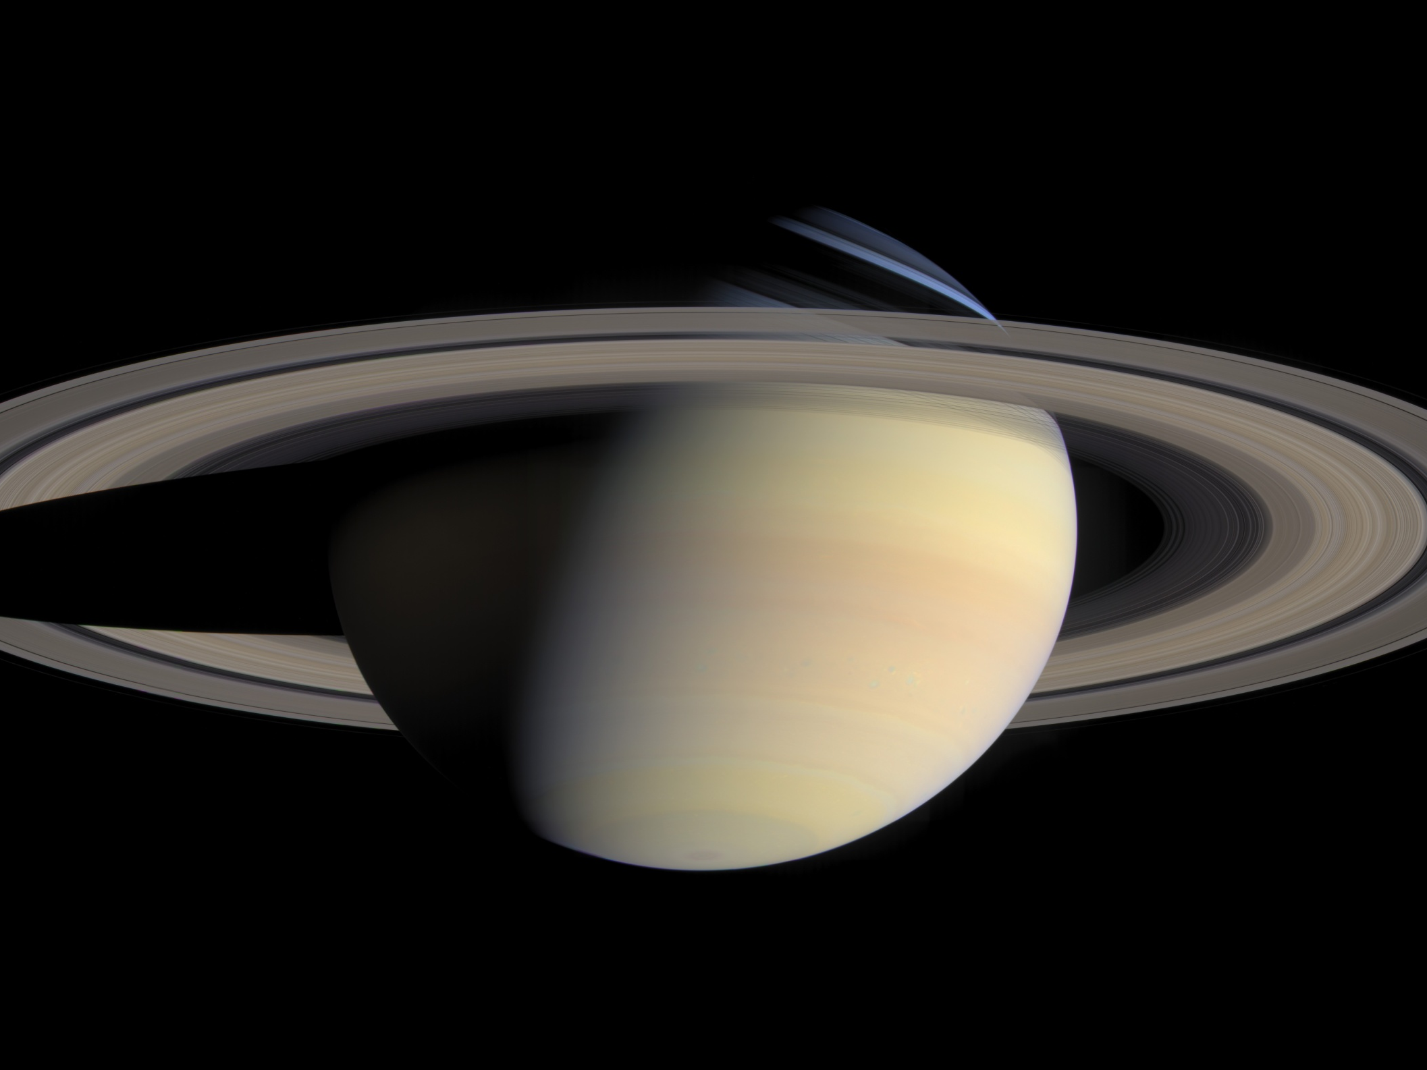

Slide 7
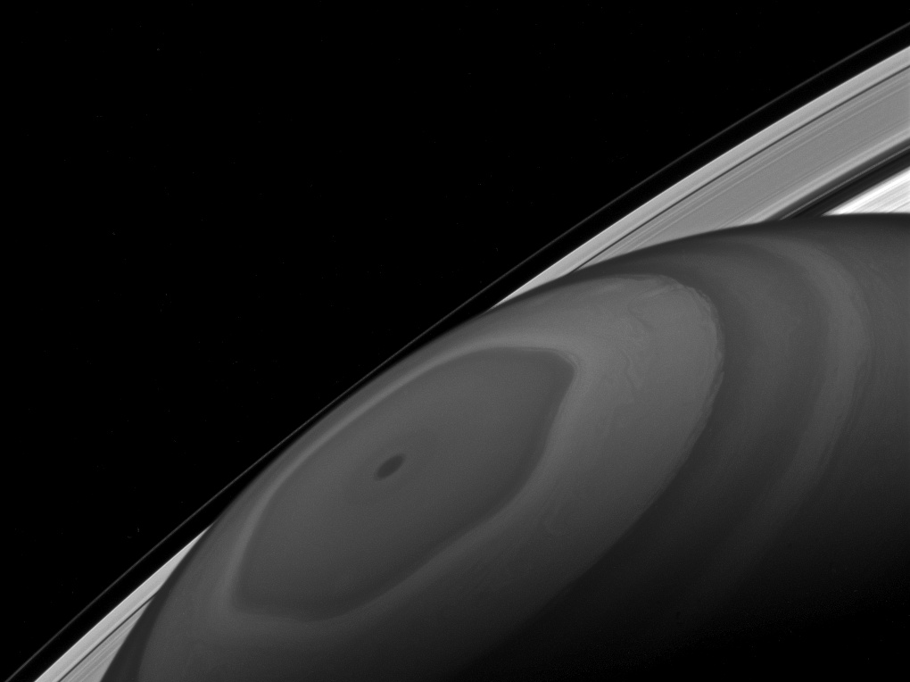
Notes:
The north pole of Saturn sits at the center of its own domain. Around it swirl the clouds, driven by the fast winds of Saturn. Beyond that orbits Saturn's retinue of moons and the countless small particles that form the ring.
Although the poles of Saturn are at the center of all of this motion, not everything travels around them in circles. Some of the jet-stream patterns, such as the hexagon-shaped pattern seen here, have wavy, uneven shapes. The moons as well have orbits that are elliptical, some quite far from circular.
This view looks toward the sunlit side of the rings from about 26 degrees above the ring plane. The image was taken with the Cassini spacecraft wide-angle camera on Dec. 2, 2016 using a spectral filter which preferentially admits wavelengths of near-infrared light centered at 890 nanometers.
The view was acquired at a distance of approximately 619,000 miles (996,000 kilometers) from Saturn. Image scale is 37 miles (60 kilometers) per pixel.
The Cassini Solstice Mission is a joint United States and European endeavor. The Jet Propulsion Laboratory, a division of the California Institute of Technology in Pasadena, manages the mission for NASA's Science Mission Directorate, Washington, D.C. The Cassini orbiter was designed, developed and assembled at JPL. The imaging team consists of scientists from the US, England, France, and Germany. The imaging operations center and team lead (Dr. C. Porco) are based at the Space Science Institute in Boulder, Colo.
For more information about the Cassini Solstice Mission visit http://ciclops.org, http://www.nasa.gov/cassini and http://saturn.jpl.nasa.gov.

Slide 8
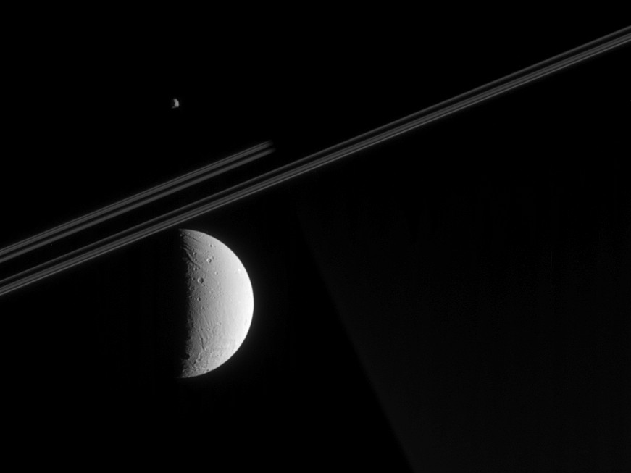
Notes:
Cassini looks toward Saturn's night side in this view, capturing a glimpse of Dione's tortured surface in the foreground and a far-off view of Epimetheus beyond the planet. The spacecraft was just a tenth of a degree above the ringplane when this image was taken.
Parts of Dione's (1,123 kilometers, 698 miles across) surface have been stretched and ripped apart by tectonic forces. Some of these faults are visible here, as is a large impact basin (not seen in Voyager images) near the moon's south pole. Although this crater's diameter has not yet been measured by imaging scientists, it appears to be wider than 250 kilometers (155 miles), which would make it the largest impact structure yet identified on this moon.
Epimetheus (113 kilometers, 70 miles across) presents a similar face here to that revealed in a spectacular false-color view from March, 2005 (see PIA06226).
The image was taken in visible light with the narrow angle camera on May 5, 2005, from a distance of approximately 910,000 kilometers (570,000 miles) from Dione, 1.4 million kilometers (900,000 miles) from Epimetheus and 1.3 million kilometers (800,000 miles) from Saturn. The image scale is 5 kilometers (3 miles) per pixel on Dione and 1,123 kilometers (698 miles) per pixel on Epimetheus.
[Caption updated on October 5, 2005.]
The Cassini-Huygens mission is a cooperative project of NASA, the European Space Agency and the Italian Space Agency. The Jet Propulsion Laboratory, a division of the California Institute of Technology in Pasadena, manages the Cassini-Huygens mission for NASA's Science Mission Directorate, Washington, D.C. The imaging team consists of scientists from the US, England, France, and Germany. The imaging operations center and team lead (Dr. C. Porco) are based at the Space Science Institute in Boulder, Colo.
For more information about the Cassini-Huygens mission, visit http://saturn.jpl.nasa.gov and the Cassini imaging team home page, http://ciclops.org.
Credit: NASA/JPL/Space Science Institute
Released: June 21, 2005 (PIA 07525)

Slide 9
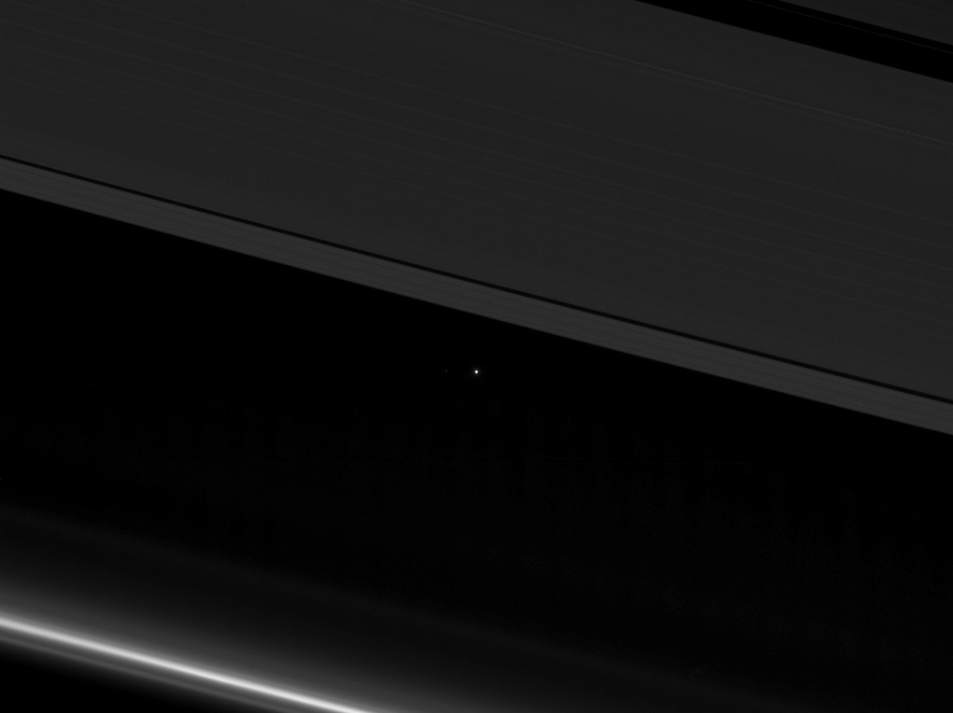
This view from NASA's Cassini spacecraft shows planet Earth as a point of light between the icy rings of Saturn.

Slide 10
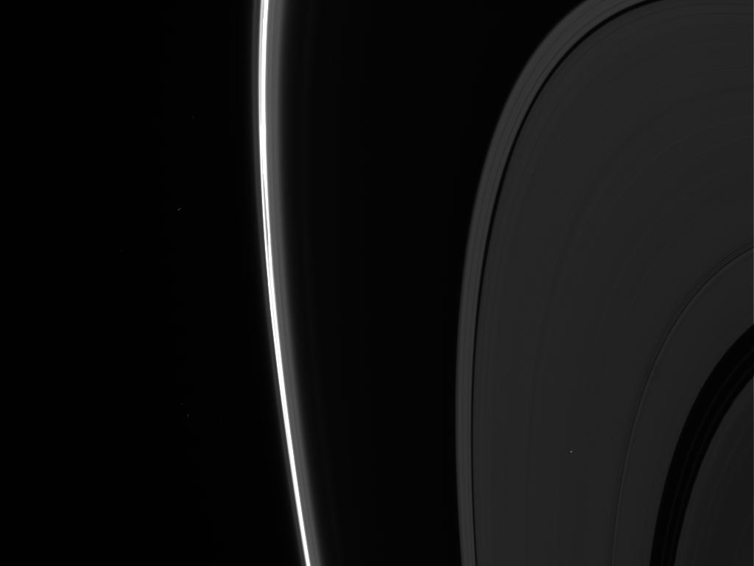

Slide 11
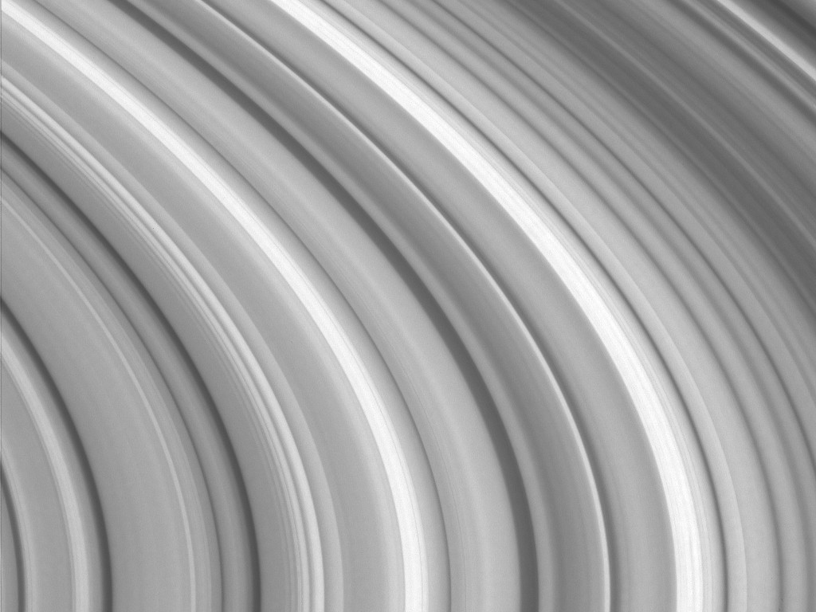
Variations in ring particle concentration give Saturn's brilliant rings the appearance of ripples in a pond in this close-up Cassini view. Many of the gaps and wavelike patterns elsewhere in the rings are due to the gravitational influence of Saturn's moons, but the origin of much of the structure in the B ring seen here is still unexplained.
Notes:
Variations in ring particle concentration give Saturn's brilliant rings the appearance of ripples in a pond in this close-up Cassini view. Many of the gaps and wavelike patterns elsewhere in the rings are due to the gravitational influence of Saturn's moons, but the origin of much of the structure in the B ring seen here is still unexplained.
The image was taken with the narrow angle camera on October 29, 2004, from a distance of approximately 824,000 kilometers (512,000 miles) from Saturn. The image scale is 4.5 kilometers (2.8 miles) per pixel. The image has been slightly contrast-enhanced to aid visibility.
The Cassini-Huygens mission is a cooperative project of NASA, the European Space Agency and the Italian Space Agency. The Jet Propulsion Laboratory, a division of the California Institute of Technology in Pasadena, manages the Cassini-Huygens mission for NASA's Science Mission Directorate, Washington, D.C. The imaging team consists of scientists from the US, England, France, and Germany. The imaging operations center and team lead (Dr. C. Porco) are based at the Space Science Institute in Boulder, Colo.
For more information about the Cassini-Huygens mission, visit http://saturn.jpl.nasa.gov and the Cassini imaging team home page, http://ciclops.org.
Credit: NASA/JPL/Space Science Institute
Released: December 21, 2004 (PIA 06543)

Slide 12
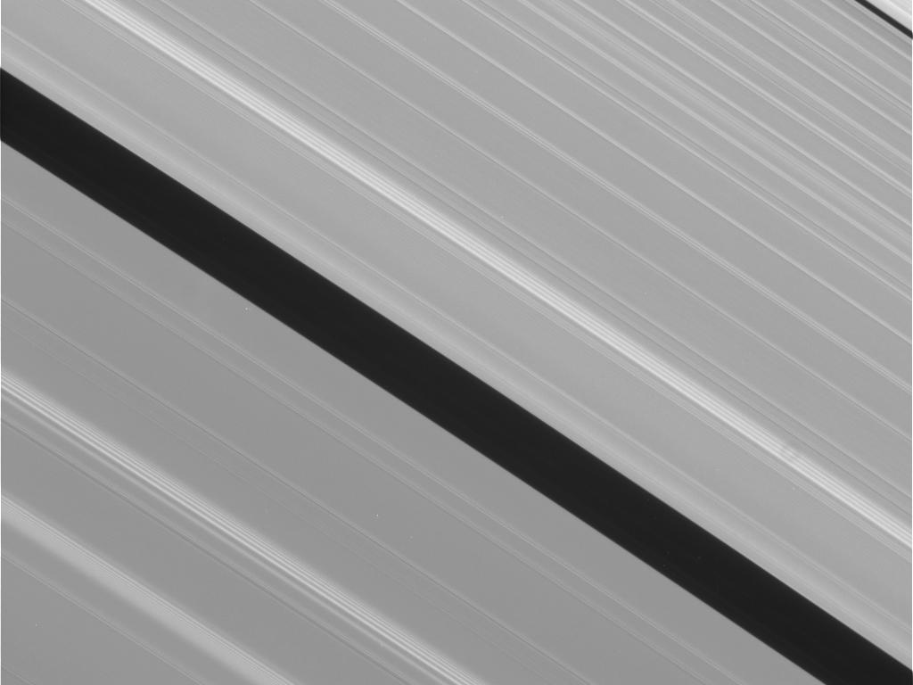
Notes:
N00281676.jpg was taken on 2017-05-14 18:59 (PDT) and received on Earth 2017-05-15 05:24 (PDT). The camera was pointing toward Saturn-rings, and the image was taken using the CL1 and CL2 filters

Slide 13
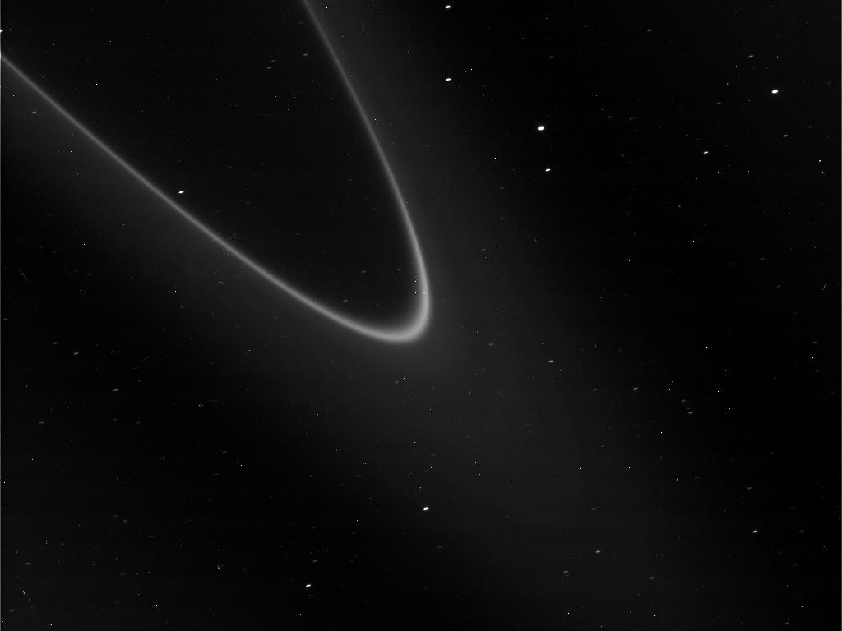
Notes:
Image of Saturn Rings
File name: N00281731.jpg
Taken: May 18, 2017 8:04 AM
Received: May 18, 2017 6:37 PM
The camera was pointing toward SATURN-RINGS, and the image was taken using the CL1 and CL2 filters. This image has not been validated or calibrated. A validated/calibrated image will be archived with the NASA Planetary Data System.
Image Credit: NASA/JPL-Caltech/Space Science Institute

Slide 14
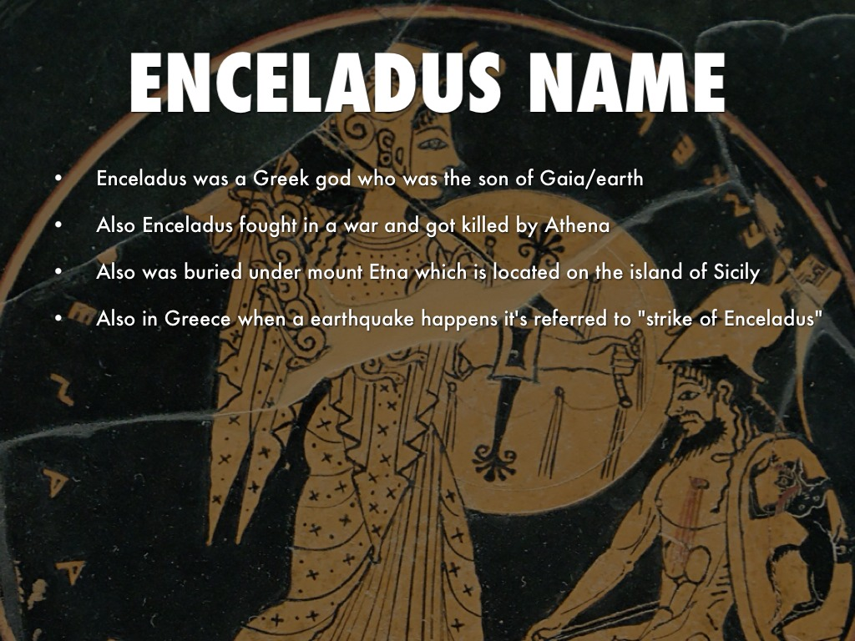

Slide 15
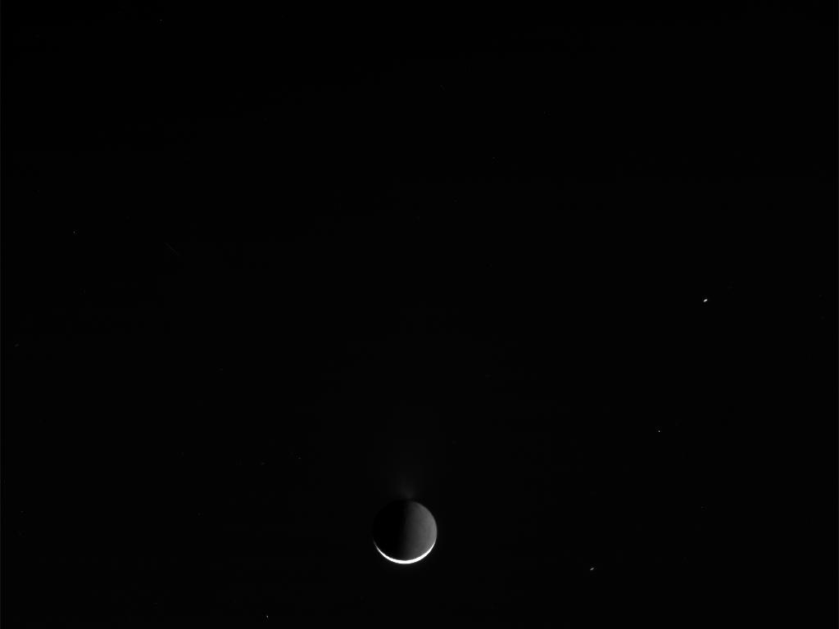
Enceladus

Slide 16
Enceladus is only
504 kilometers (313 miles)
across, small enough to fit
within the length
of the United Kingdom,
as illustrated here.

Slide 17
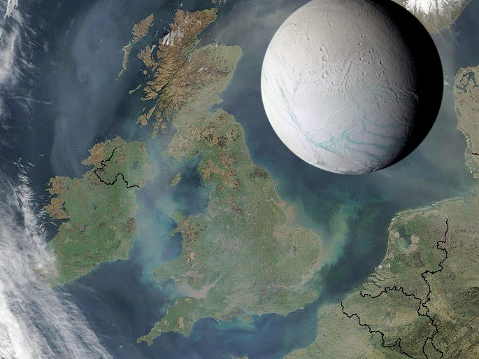

Slide 18
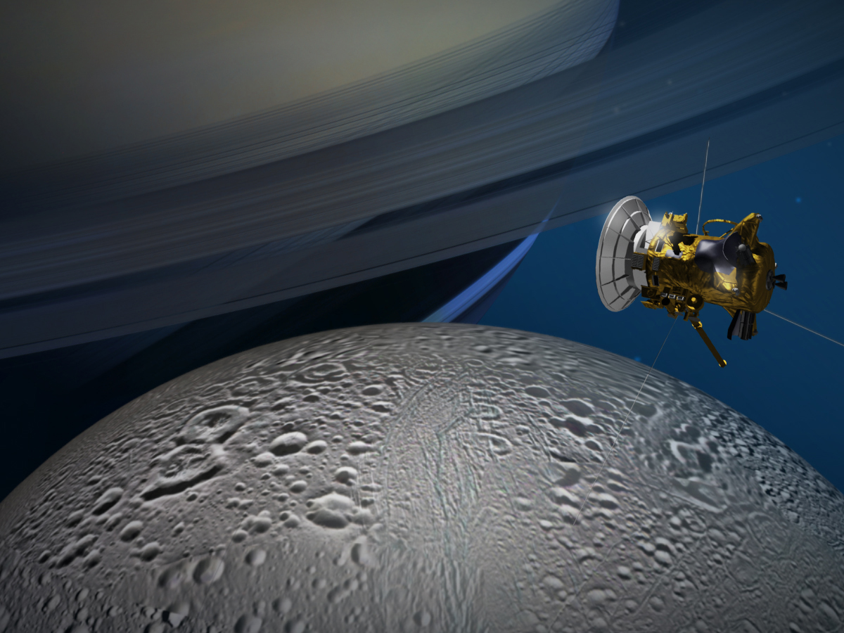
Enceladus flyby

Slide 19
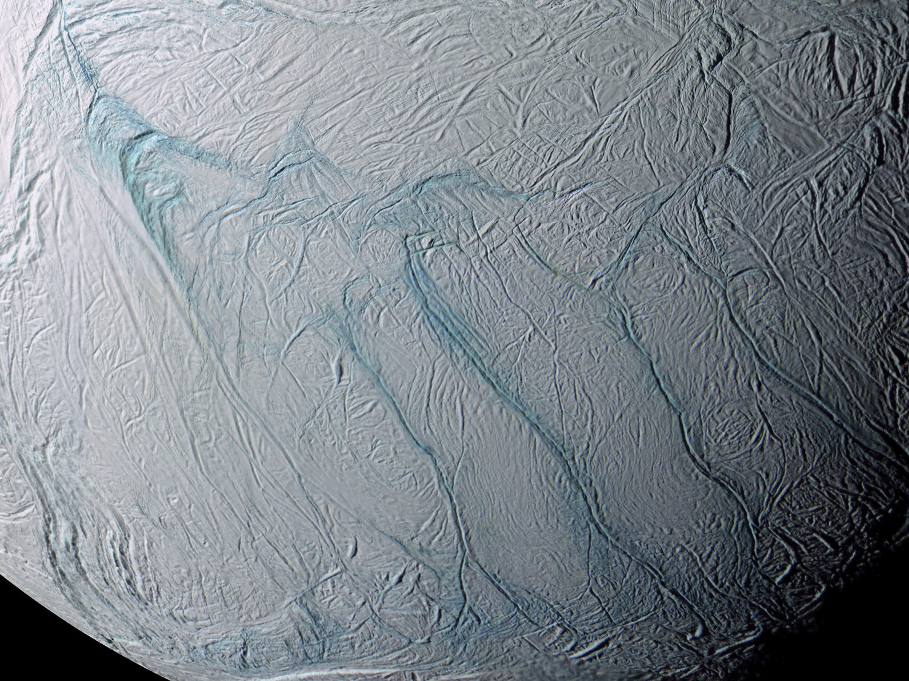

Slide 20
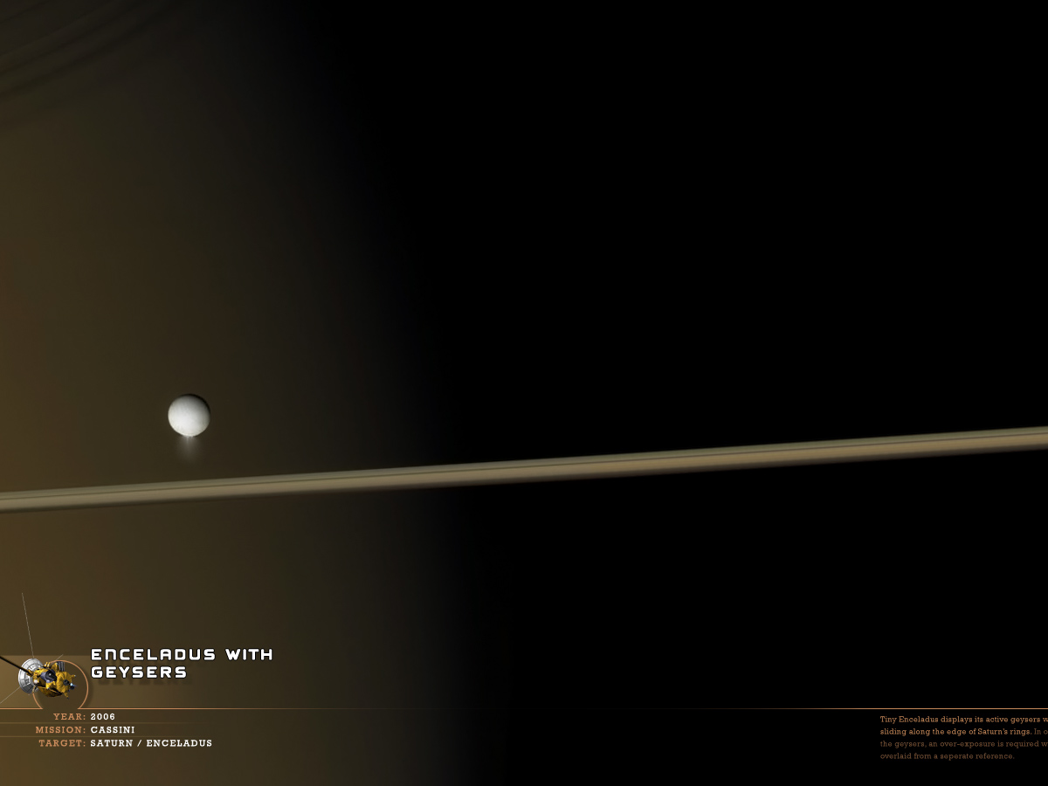

Slide 21


Slide 22
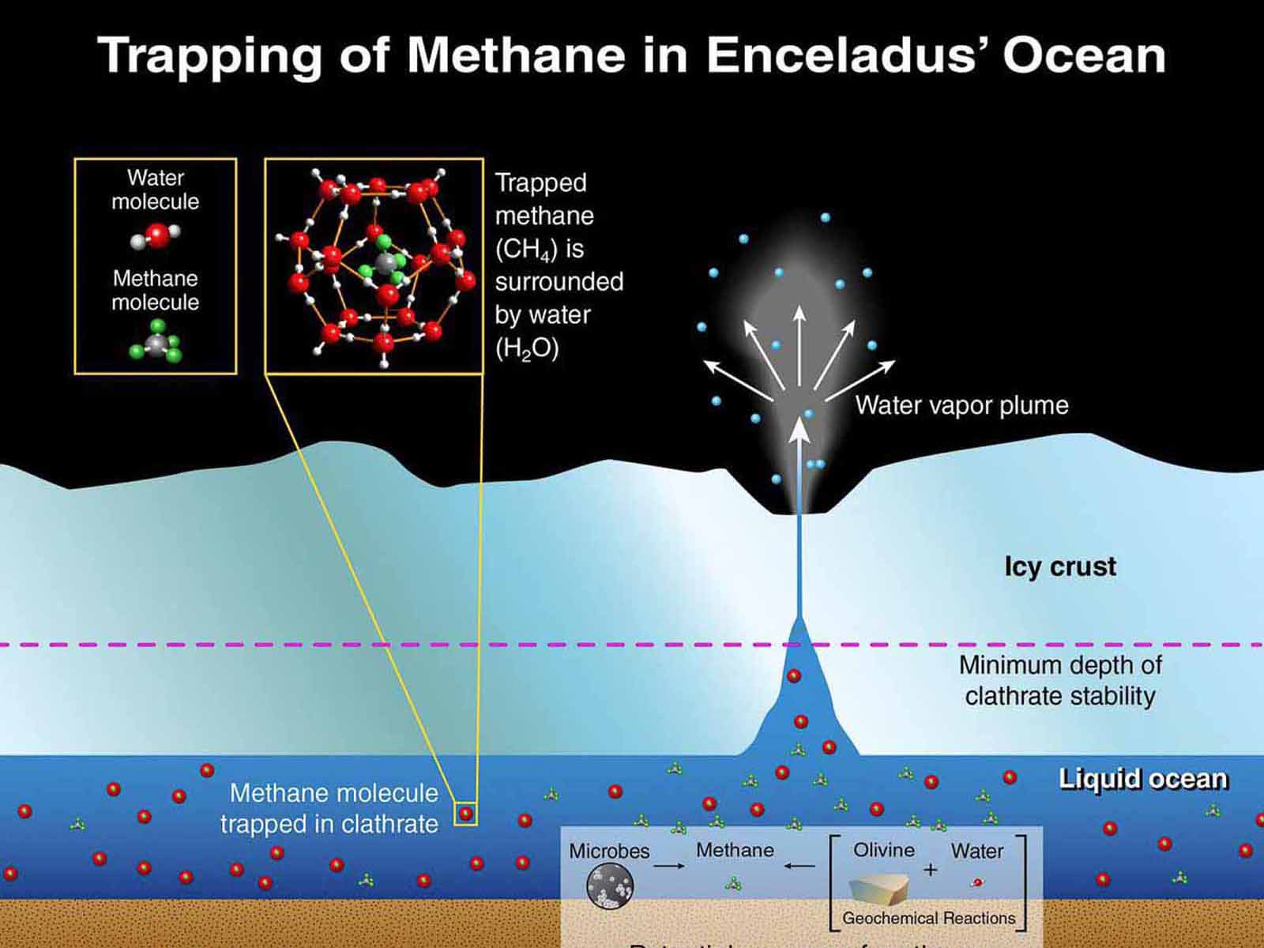

Slide 23
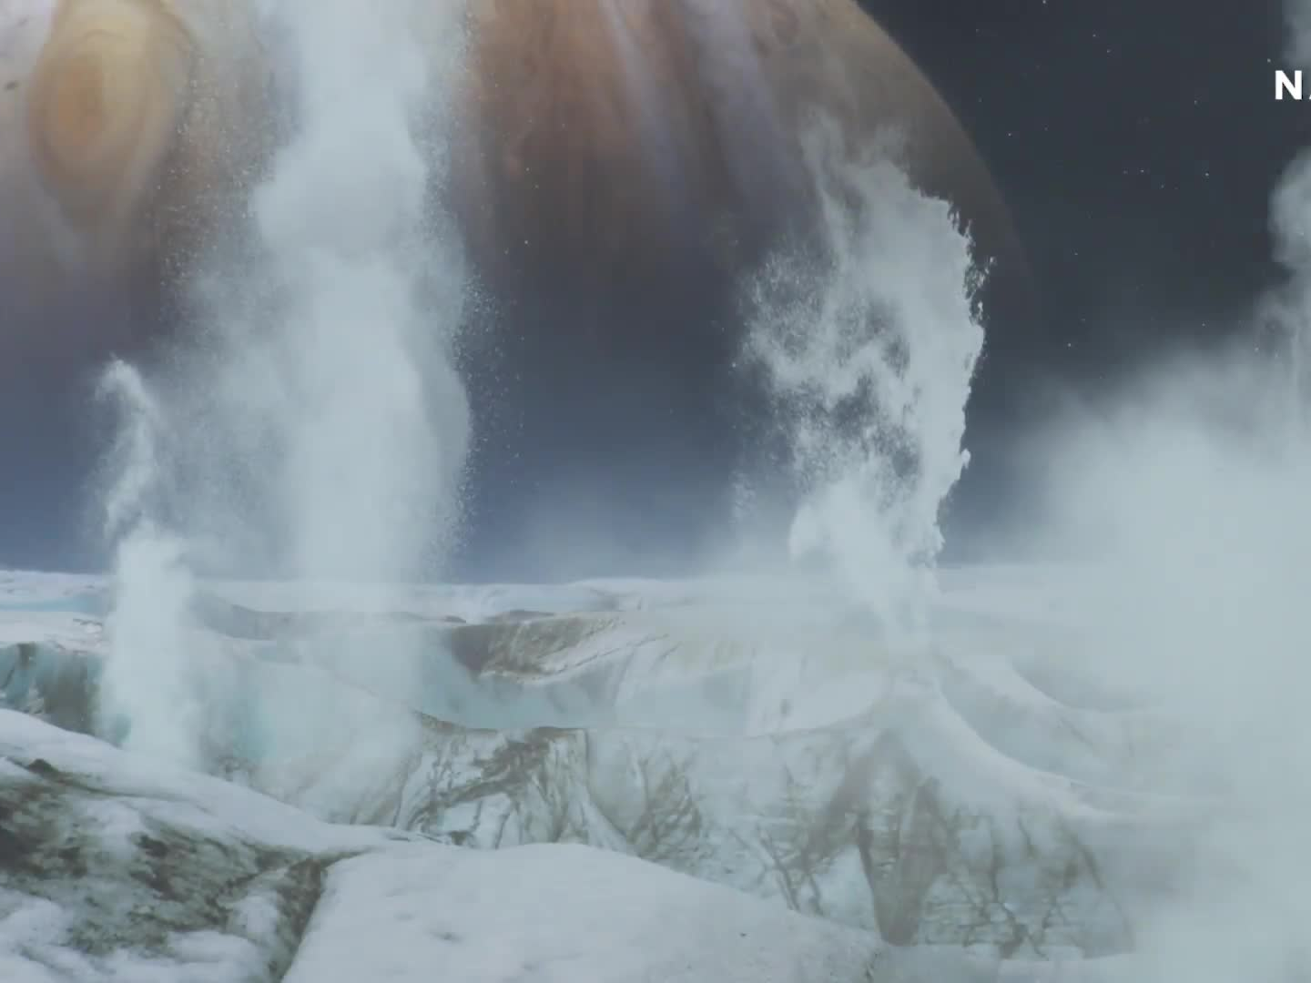
Enceledus Plumes

Slide 24
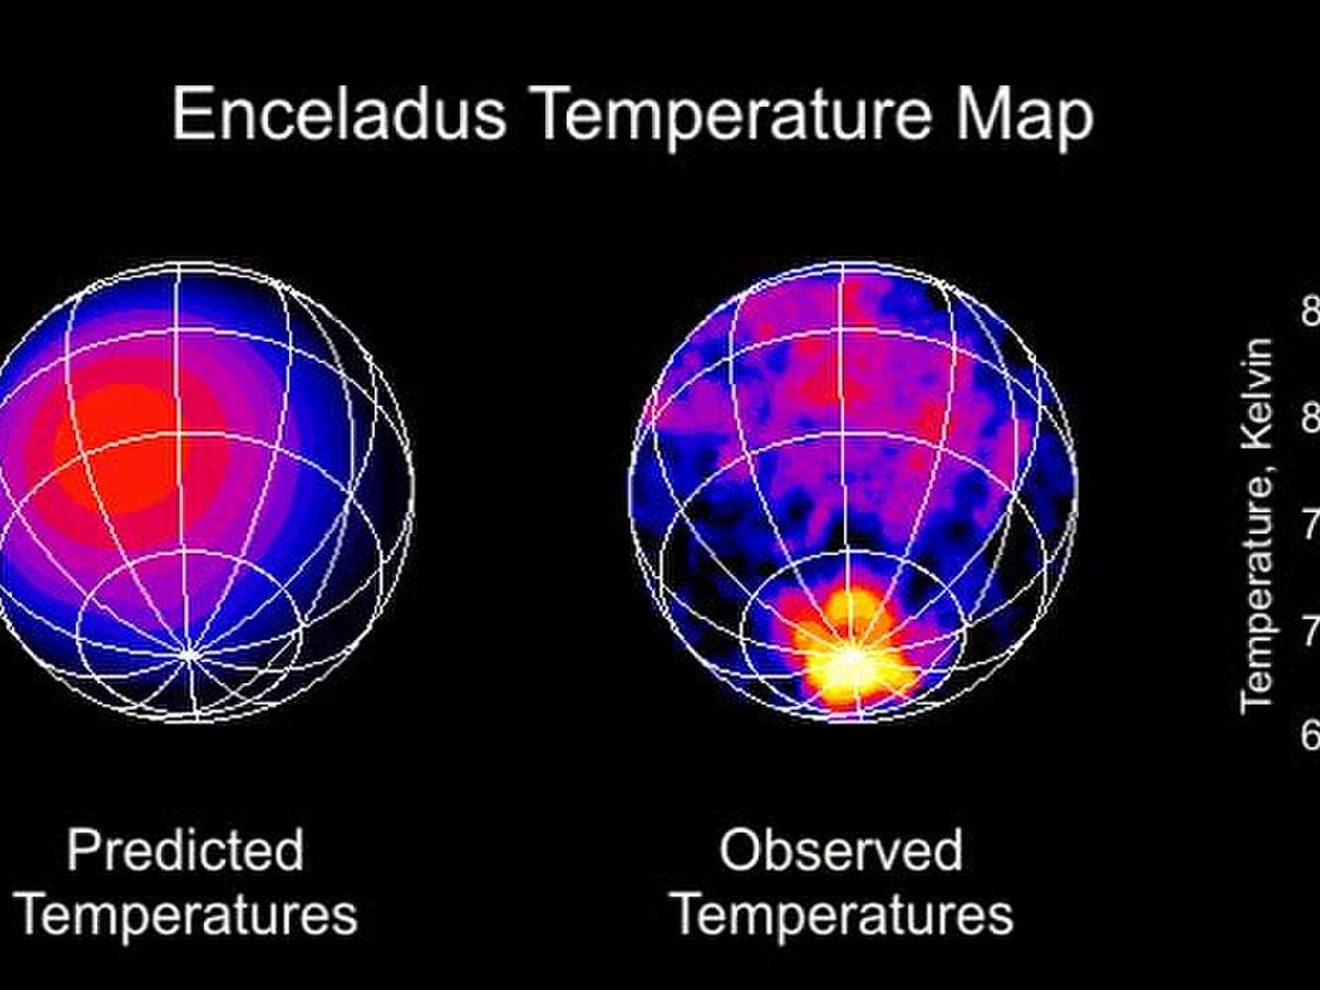

Slide 25
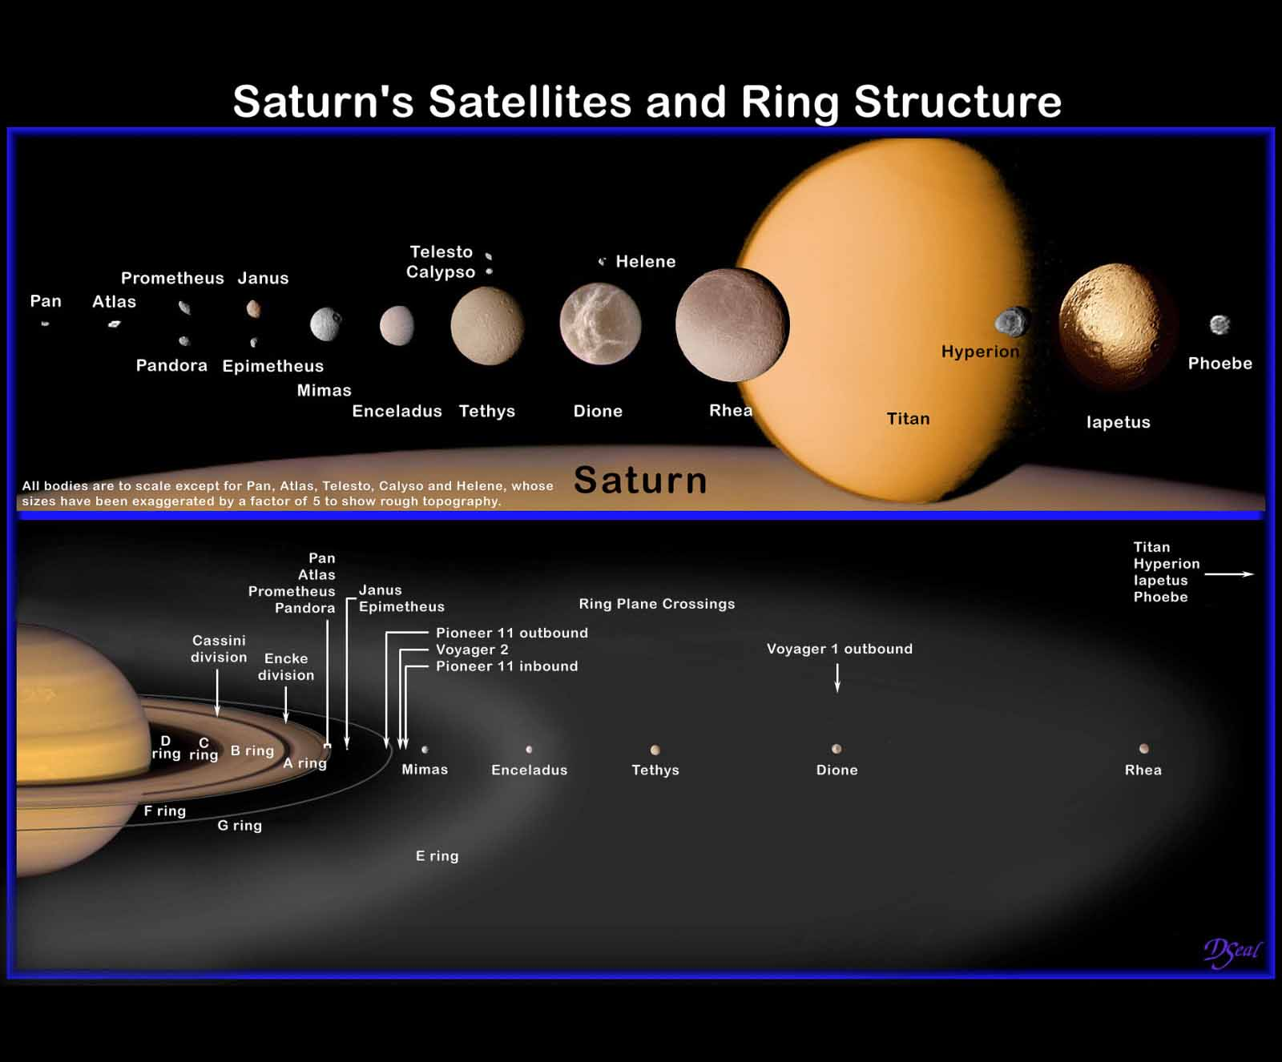

Slide 26
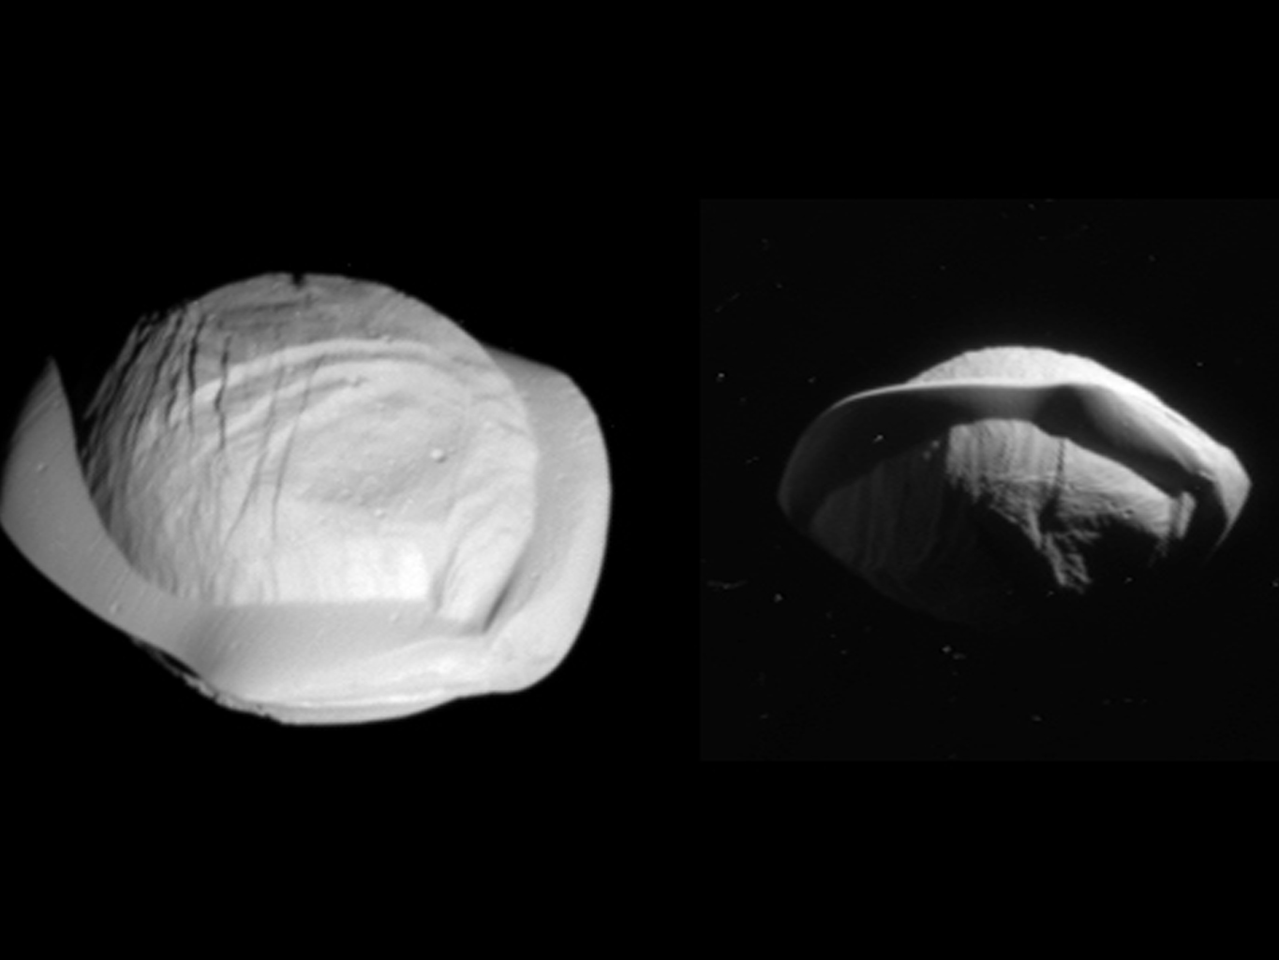
Pan
Pan
Pan
Notes:
The views show the northern and southern hemispheres of Pan, at left and right, respectively. Both views look toward Pan's trailing side, which is the side opposite the moon's direction of motion as it orbits Saturn.
Cassini imaging scientists think that Pan formed within Saturn's rings, with ring material accreting onto it and forming the rounded shape of its central mass, when the outer part of the ring system was quite young and the ring system was vertically thicker. Thus, Pan probably has a core of icy material that is denser than the softer mantle around it.
The distinctive, thin ridge around Pan's equator is thought to have come after the moon formed and had cleared the gap in the rings in which it resides today. At that point the ring was as thin as it is today, yet there was still ring material accreting onto Pan.

Slide 27
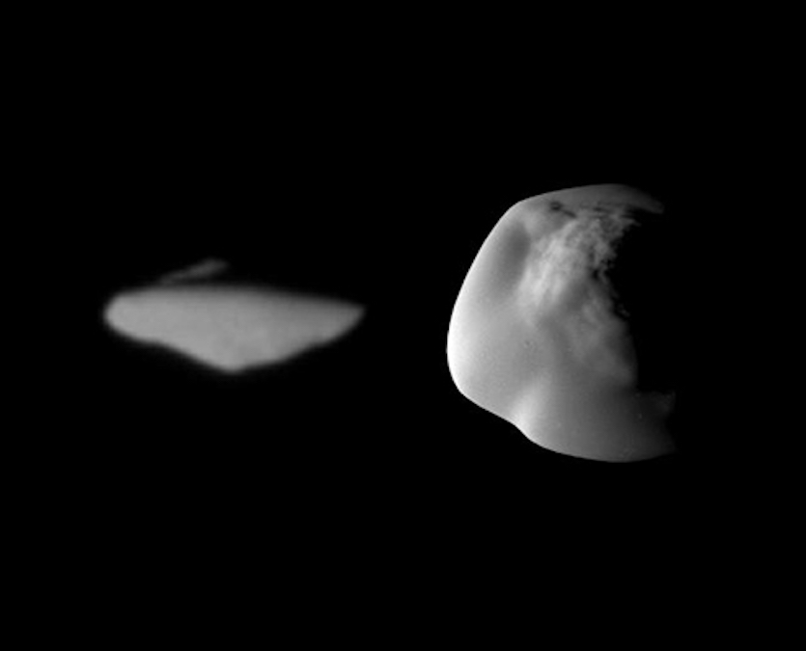
Atlas
Atlas
Notes:
Atlas is an inner moon of Saturn, orbiting around the outer edge of Saturn's A Ring. Like Pan, Atlas has a distinctive flying saucer shape created by a prominent equatorial ridge not seen on the other small moons of Saturn. Cassini images revealed in 2004 that a temporary faint ring of material with the orbit of Atlas.
The small, pointy moon has a mean radius of 9.4 miles (15.1 km). It orbits 85,544 miles (137,670 km) away from, taking 14.4 hours to complete its trip around the planet.

Slide 28
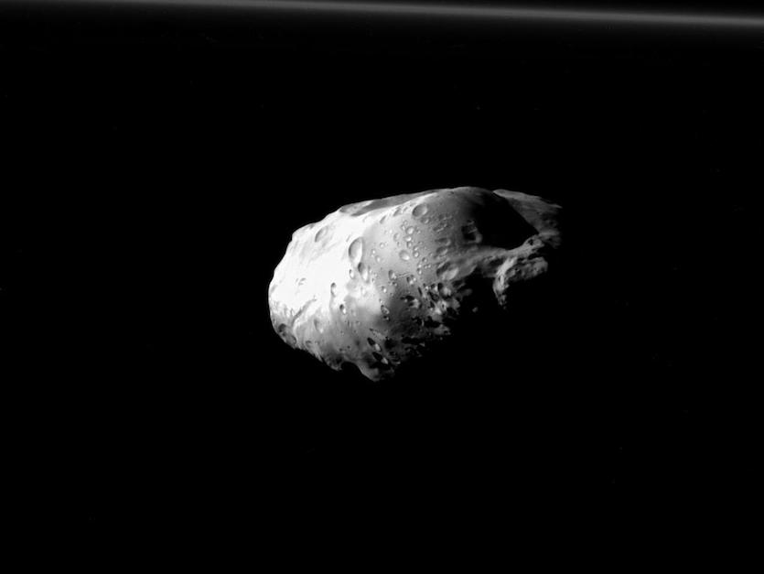
Prometheus
Prometheus
Notes:
Prometheus acts as a shepherding moon, constraining the extent of the inner edge of Saturn's F Ring. Prometheus is extremely irregular and has visible craters -- some up to 12.4 miles (20 km) in diameter. However, it is much less cratered than its nearby neighbors Pandora, Janus and Epimetheus. The density of Prometheus has been estimated to be low; it is probably a porous, icy body.
The potato-shaped moon is about 26.8 miles (43.1 km) in mean radius, orbiting Saturn at a distance of 87,000 miles (139,000 km), taking 14.7 hours to go around the planet.

Slide 29
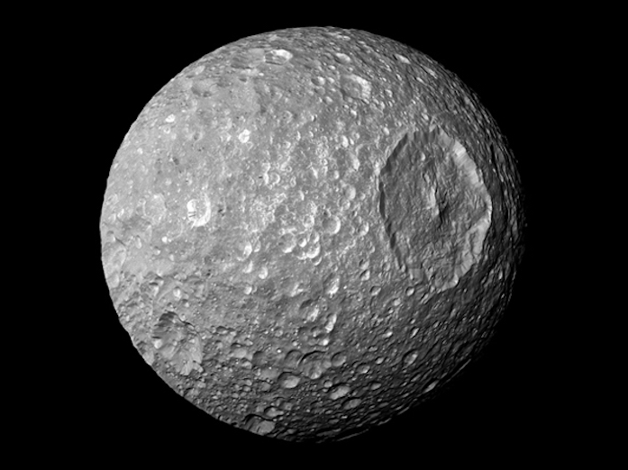
Mimas - The Death Star

Slide 30
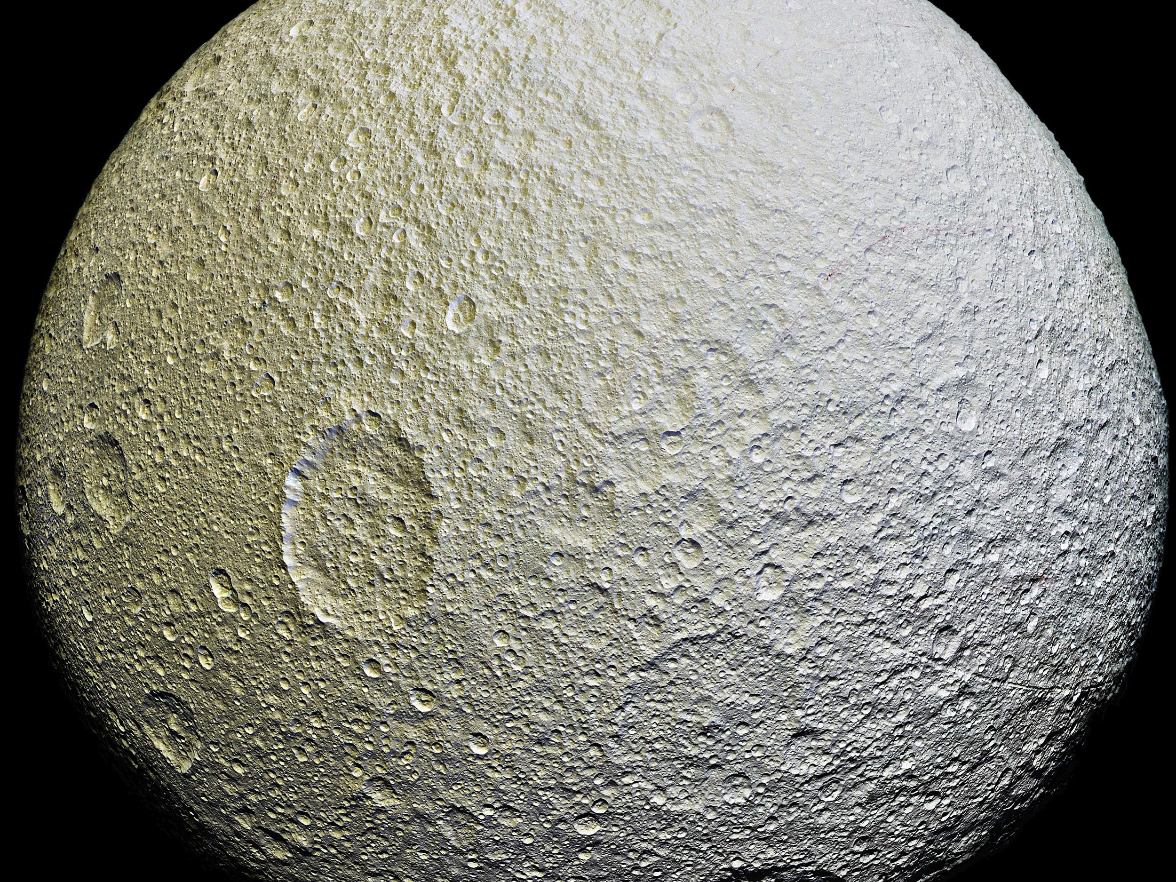
Tethys

Slide 31
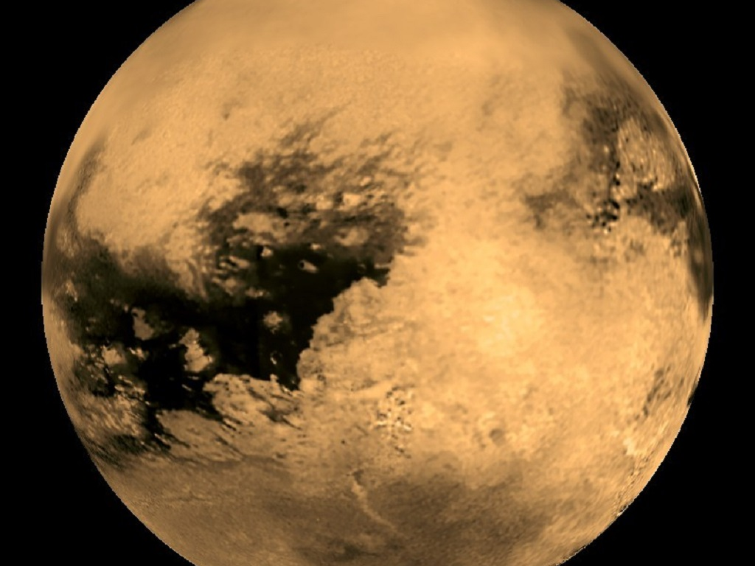
Titan
Notes:
Titan is, with a diameter of 5,150 kilometers (3,200 miles), Saturn’s largest moon and the second largest moon in our Solar System (only Jupiter’s moon Ganymede is larger), roughly 50% larger than our own Moon and 80% more massive. Titan orbits Saturn at a distance of about 1.2 million km (745,000 mi), taking almost 16 days to complete a full orbit. It is tidally locked with Saturn, what means that Titan always orbits with one and the same side to Saturn.
The moon receives just about 1 % of the amount of sunlight Earth gets. This cold world — the temperature at Titan’s surface is about -178 degrees Celsius (-289 degrees Fahrenheit) — is the only moon known to have clouds and a dense hazy, planet-like atmosphere, impenetrable by telescopes and cameras. Its atmospheric pressure is about 60 percent greater than the Earth’s.
Titan’s climate, including wind and rain, creates surface features similar to those of Earth, such as sand dunes, rivers, lakes, seas and deltas, and is dominated by seasonal weather patterns as on Earth. With its liquids (both surface and subsurface) and robust nitrogen atmosphere, Titan’s methane cycle is viewed as an analog to Earth’s water cycle, although at a much lower temperature.
The moon is primarily composed of water ice and rocky material. Although mountains and several possible ice volcanoes have been discovered, Titan is rather smooth with just few impact craters. Its surface is geologically young, between 100 million and 1 billion years old. Geological processes like volcanism and wind may have reshaped its surface.

Slide 32
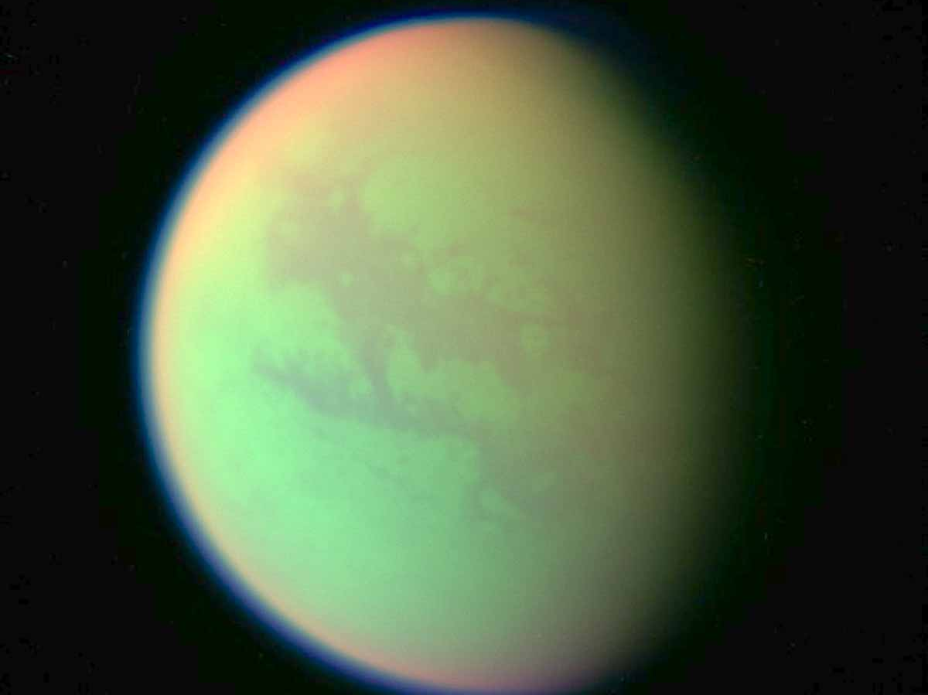

Slide 33
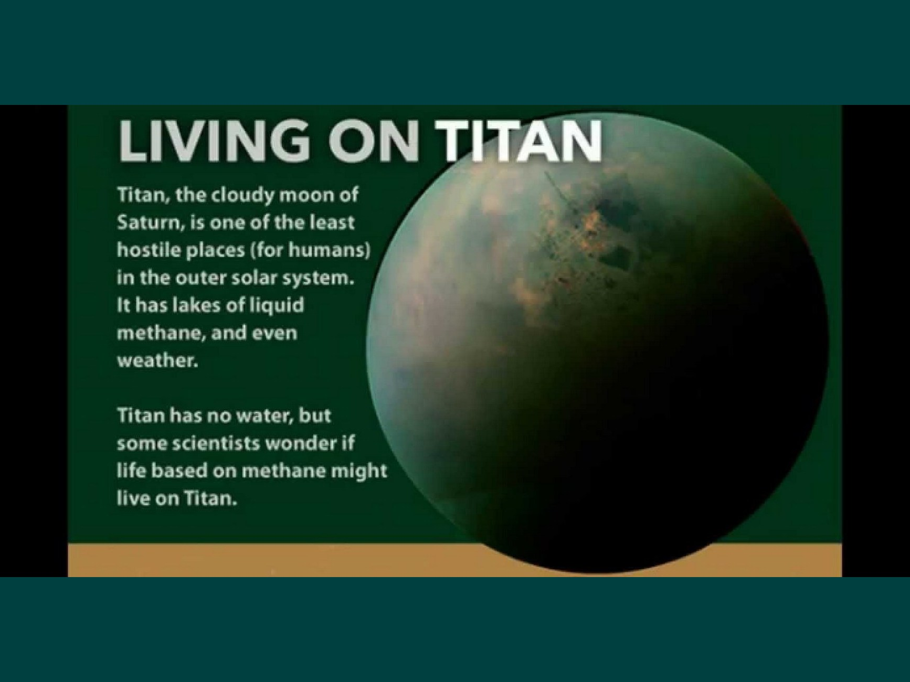

Slide 34
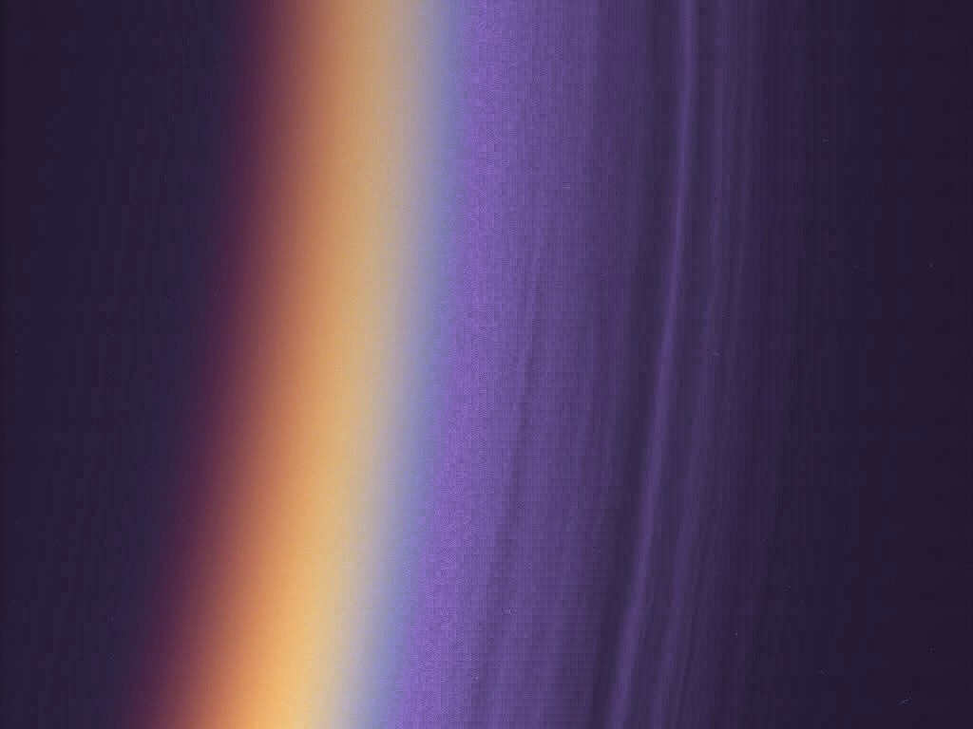
Titan’s many layers
Notes:
Cassini has found Titan's upper atmosphere to consist of a surprising number of layers of haze as is shown in this ultraviolet image of Titan's nightside limb, colorized to look like true color. The many fine haze layers extend several hundred kilometers above the surface. Although this is a nightside view, with only a thin crescent receiving direct sunlight, the haze layers are bright from light scattered through the atmosphere. About 12 distinct haze layers can be seen in this image, with a scale of 0.7 kilometers (.43 miles) per pixel. The limb shown here is at about 10 degrees S. latitude, in the equatorial region.
The Cassini-Huygens mission is a cooperative project of NASA, the European Space Agency and the Italian Space Agency. The Jet Propulsion Laboratory, a division of the California Institute of Technology in Pasadena, manages the Cassini-Huygens mission for NASA's Science Mission Directorate, Washington, D.C. The imaging team consists of scientists from the US, England, France, and Germany. The imaging operations center and team lead (Dr. C. Porco) are based at the Space Science Institute in Boulder, Colo.
For more information about the Cassini-Huygens mission, visit http://saturn.jpl.nasa.gov and the Cassini imaging team home page, http://ciclops.org.
Credit: NASA/JPL/Space Science Institute
Released: December 16, 2004 (PIA 06160, 06161)

Slide 36
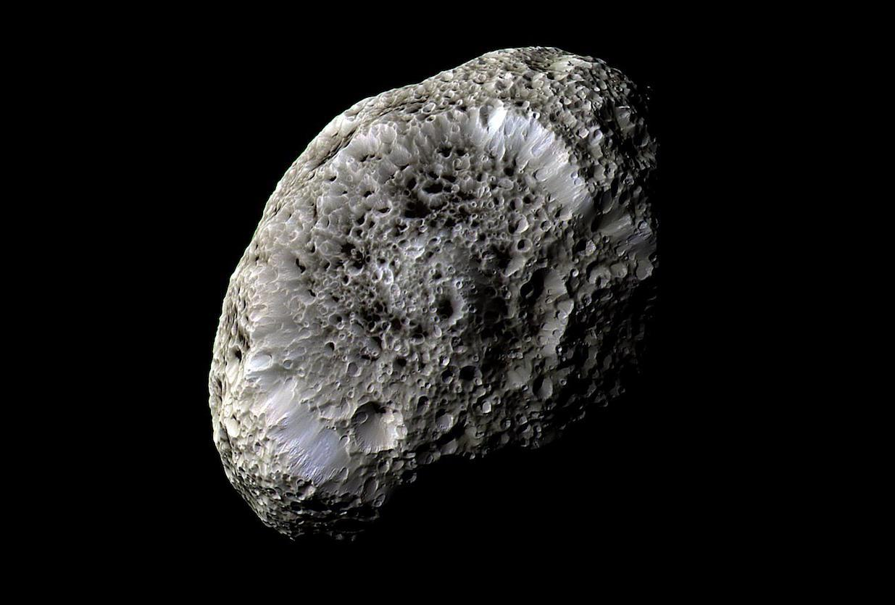
Hyperion
Notes:
Hyperion is the largest of Saturn's irregular, nonspherical moons. Hyperion's mean radius is 83.9 miles (135 km), but since Hyperion is rather potato-shaped, its shape can be described in terms of its diameter along its three axes: 255 x 163 x 137 miles (410 x 260 x 220 km, respectively). Considering its odd shape, Hyperion is probably a remnant of a larger moon that was destroyed by a major impact.
Hyperion's density is slightly more than half that of water. This could be due to water ice with gaps (porosity) of more than 40 percent. Also, lighter materials, such as frozen methane or carbon dioxide, could make up part of Hyperion. This is consistent with the concept of Hyperion accreting from a number of smaller ice and rock bodies, but not having enough gravity to compact them. Thus, Hyperion might be similar to a large rubble pile.

Slide 37
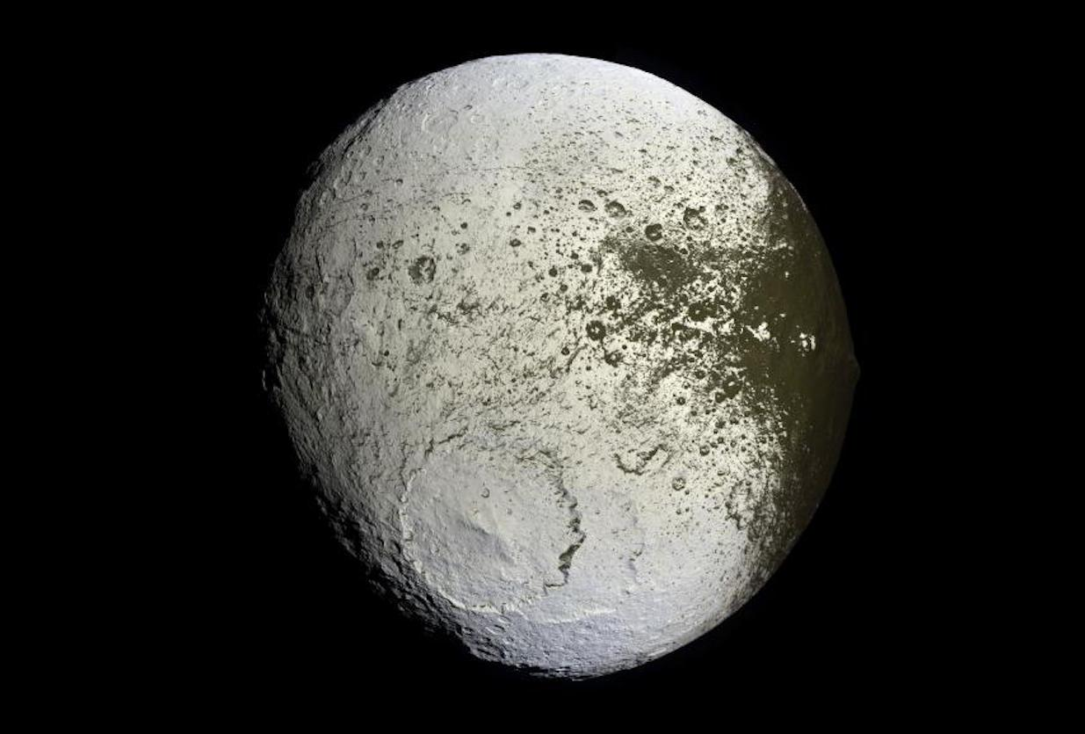
Iapetus
Notes:
Iapetus has been called the yin and yang of the Saturn moons because its leading hemisphere has a reflectivity (or albedo) as dark as coal (albedo 0.03-0.05 with a slight reddish tinge) and its trailing hemisphere is much brighter at 0.5-0.6.
Saturn's third largest moon, Iapetus has a mean radius of 457 miles (736 km) and a density only 1.2 times that of liquid water. It has been suggested that Iapetus (like Rhea) is three quarters ice and one quarter rock.
Iapetus orbits at 2,213,000 miles (3,561,000 km) from Saturn. The great distance from Saturn's tidal forces and from most of the other moons and ring particles has probably allowed the Iapetus surface to be largely unaffected by any melting episodes that could have caused some smoothing or "resurfacing" as on some of the moons closer to Saturn.
However, despite the great distance, Saturn has tidally locked Iapetus. The moon always presents the same face toward Saturn. With its distant, inclined orbit, Iapetus is the only large moon from which there is a nice view of the rings of Saturn.
As with some other Saturnian moons, Iapetus is in resonance with Saturn's largest moon, Titan, which orbits at 759,200 miles (1,221,850 km). That means that the two objects speed up and slow down as they pass each other in a complex set of variations. However, Iapetus has a diameter less than a third of Titan's diameter, so Titan's rotation and orbit are affected much less than those of Iapetus.

Slide 38
These two montages
of images of Phoebe
taken by Cassini in
June 2004 show the names
provisionally assigned to
twenty-four craters on this
Saturnian satellite by the
International Astronomical Union.

Slide 39
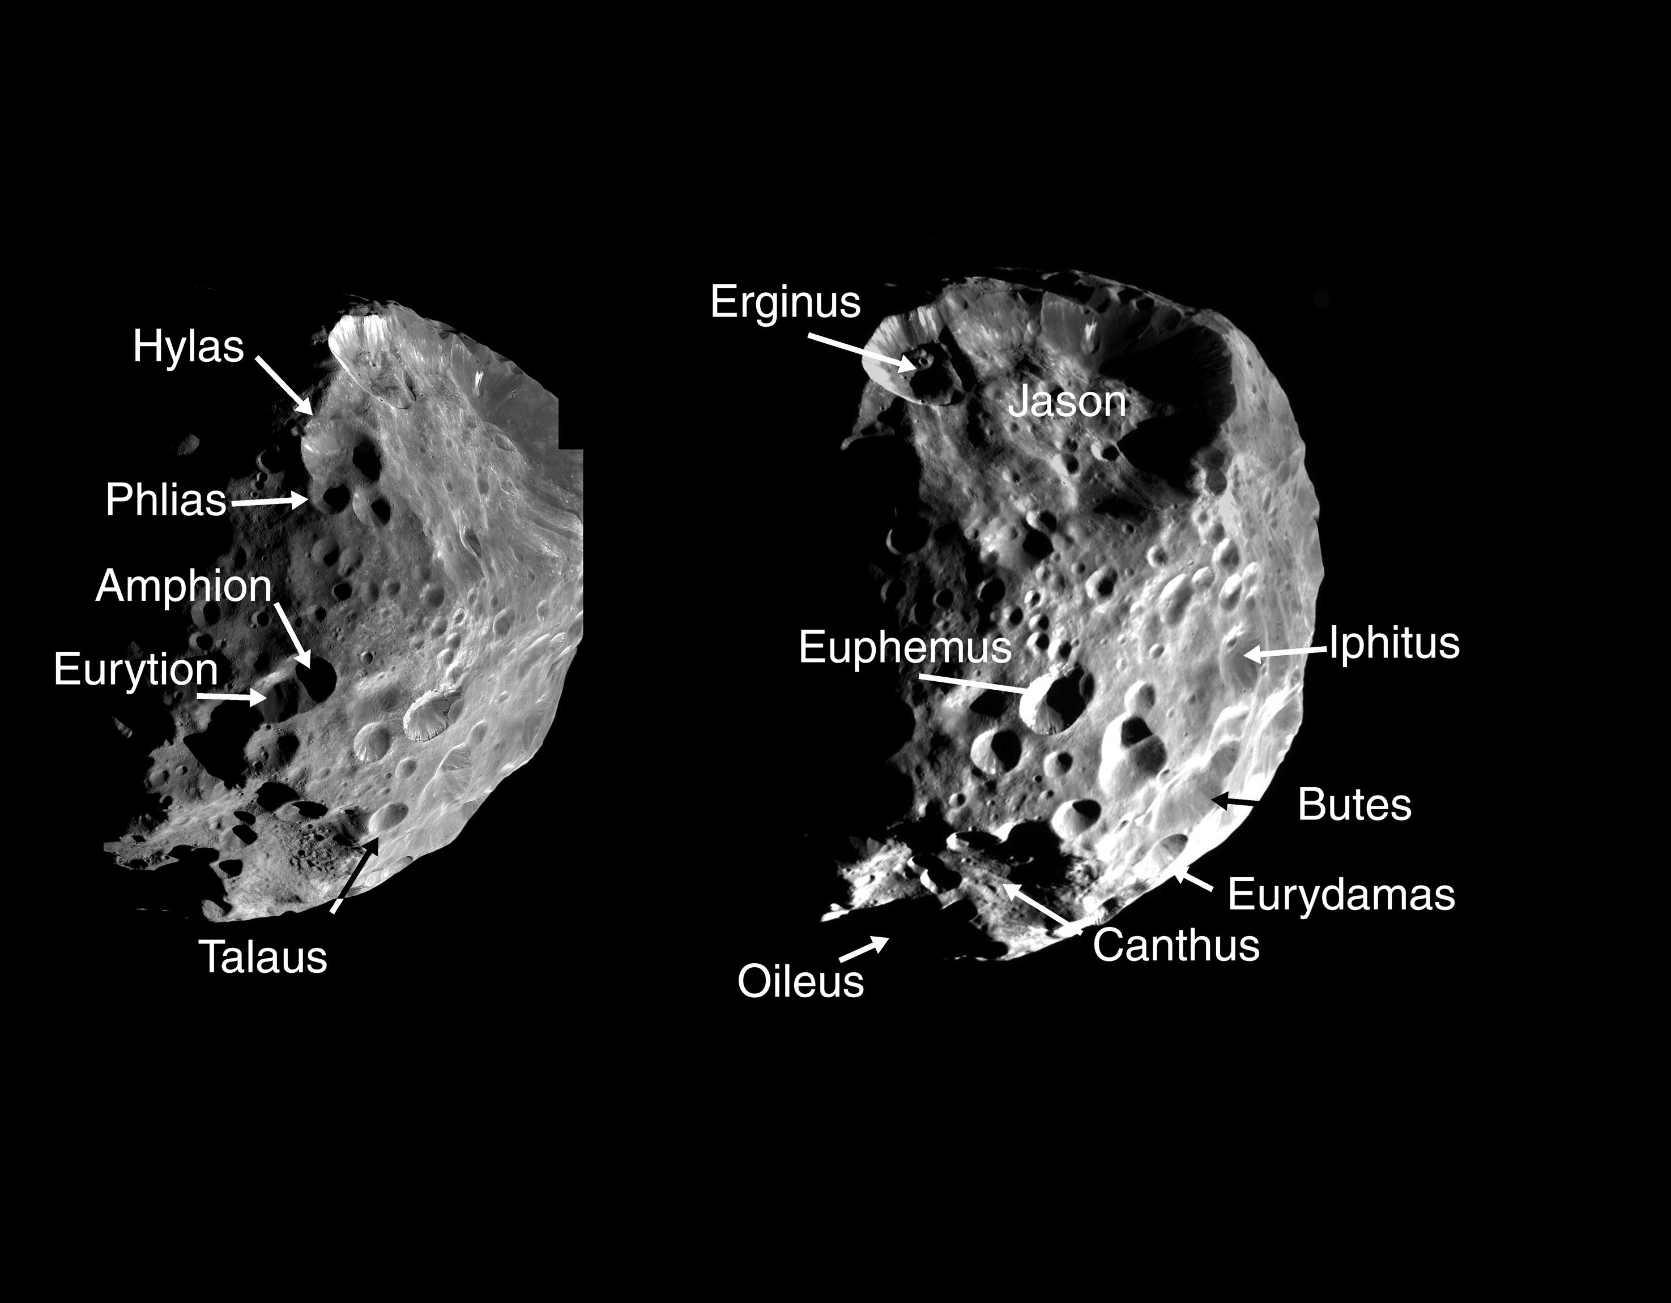
Phoebe
Phoebe
Phoebe

Slide 40
The Grand Finale

Slide 41
The spacecraft will make 22 orbits around Saturn that carry the spacecraft over the planet's north before diving between Saturn and its rings. At the conclusion of this final set of daring orbits, the spacecraft will plunge into Saturn's atmosphere, ending its mission on Sept. 15, 2017.

Slide 42
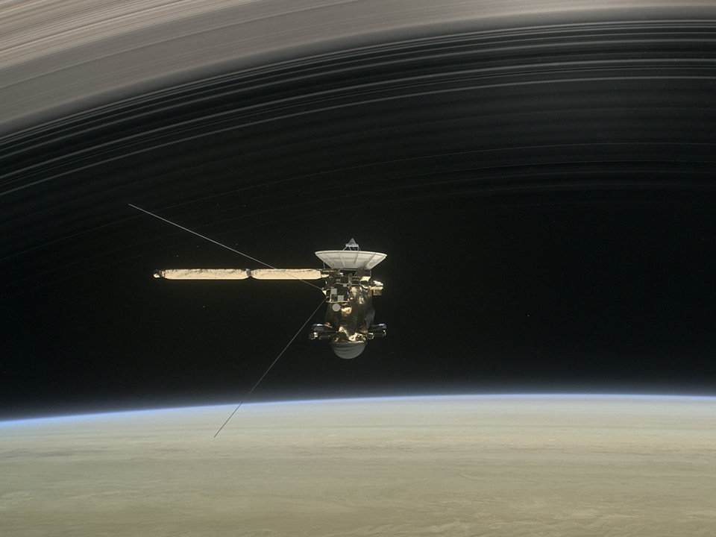

Slide 43
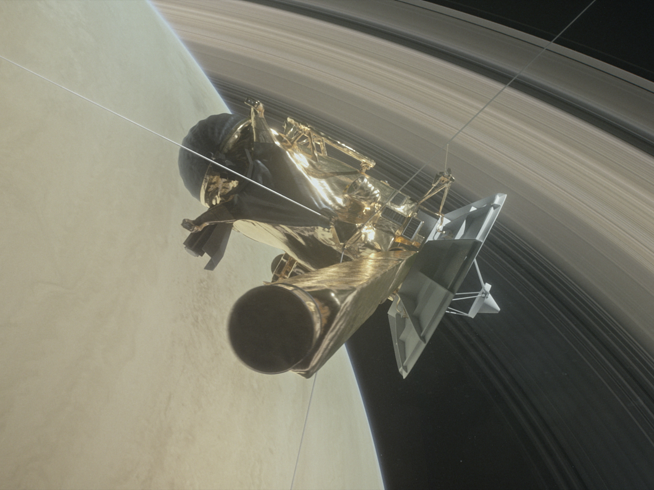

Slide 44
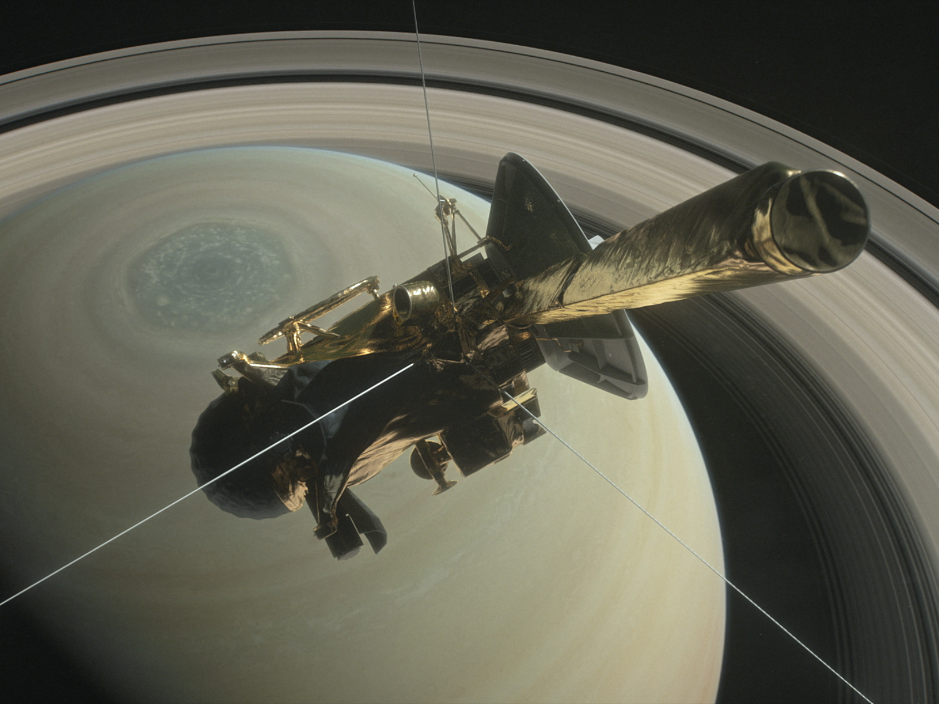

Slide 45
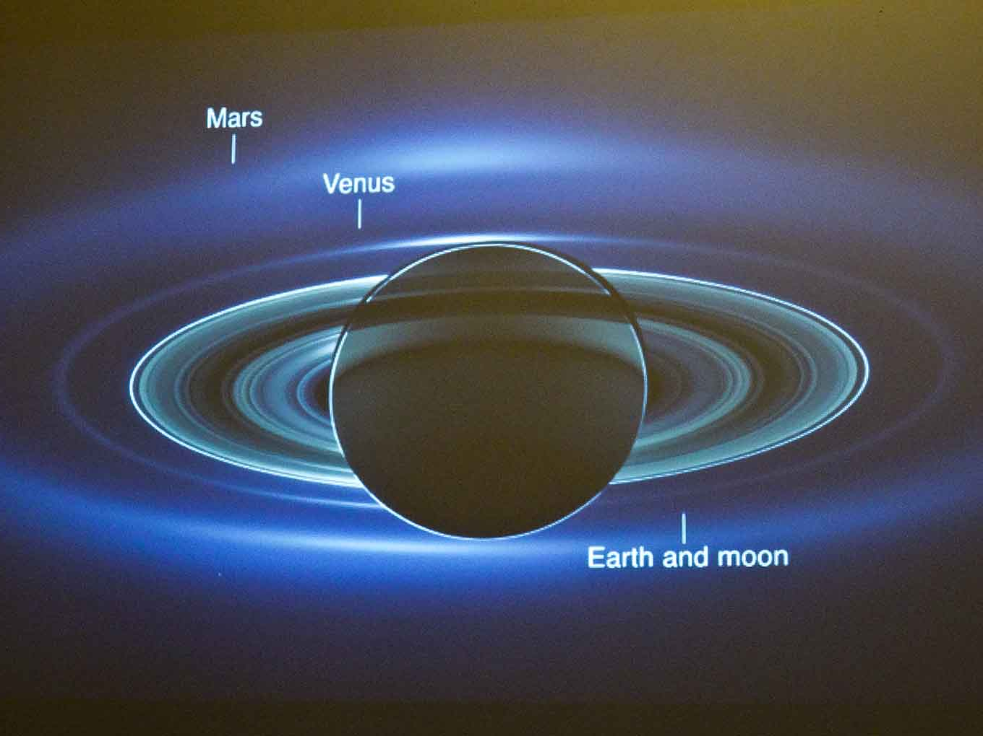
View from Cassini looking towards the Sun. Saturn is backlit. The Earth is one pixel

Slide 46
The End
Peter Read
22/5/2017

